Slide 1
The following Bible presentation includes references to dates from
THE ANNALS THE WORLD By James Ussher, Archbishop of Armagh
Printed in 1658
The picture of the Tabernacle is taken from the CANDLE BOOKS – ‘Essential Bible Reference Series’ – ‘The Tabernacle’ by Tim Dowley - permission applied for.
Maps are taken from
Nelsons Complete Book of Bible Maps & Charts
Presentation Compiled by
Mark Stapleton
©Mark Stapleton 2024
1

Slide 2
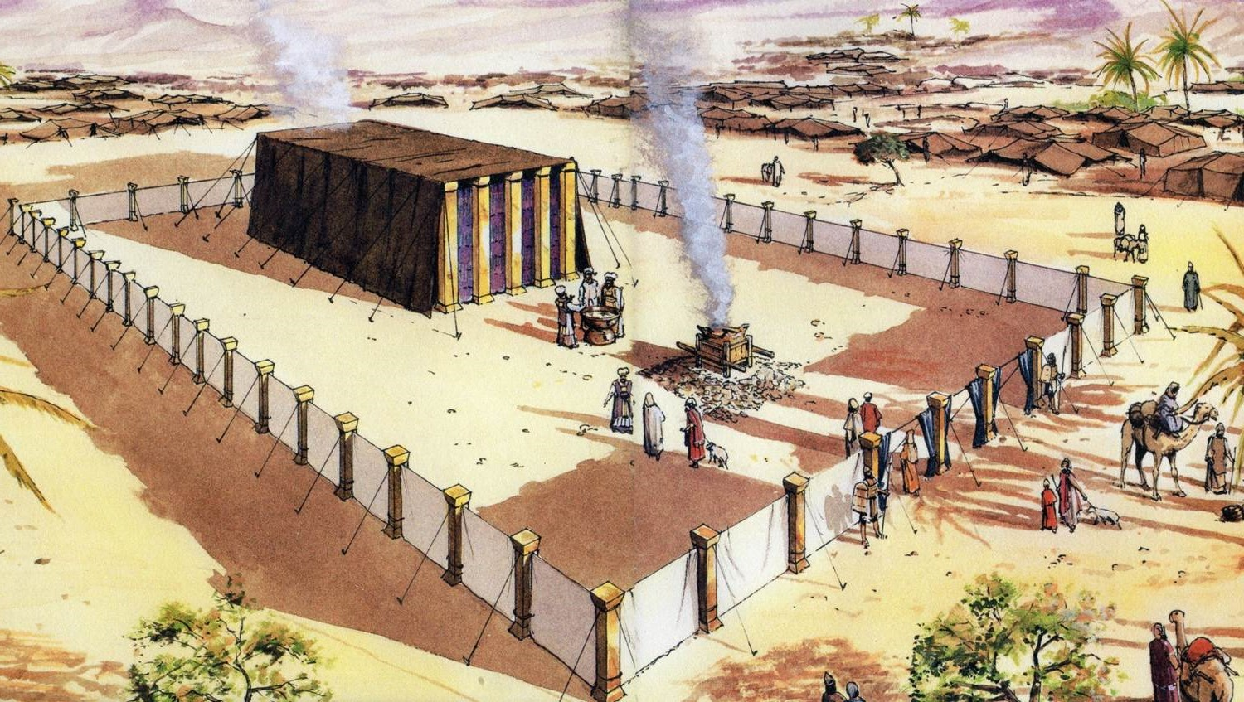
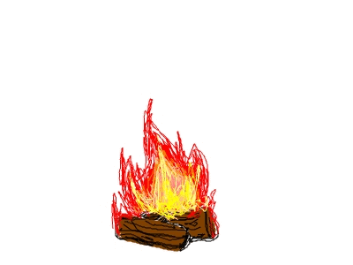
THE TABERNACLE
Part 8
What happened next?
2

Slide 3
The End of the Wilderness Journey
c1451BC
Instructions given by God to Moses about the division of Canaan, the Promised Land
Numbers 33: 50-56, chapters 34-35
Moses dies on Mount Nebo, in Moab, aged 120 years. Buried by God in a valley in Moab opposite Beth Peor
Deuteronomy 32: 48-52, 34: 1 - 12
God confirms Joshua as the new leader
Joshua 1: 1-9
After the crossing of the River Jordan, the people and the Tabernacle made camp at Gilgal
Joshua 5: 10
The day that they celebrated Passover at Gilgal, the Manna ceased
Joshua 5: 12
3

Slide 4
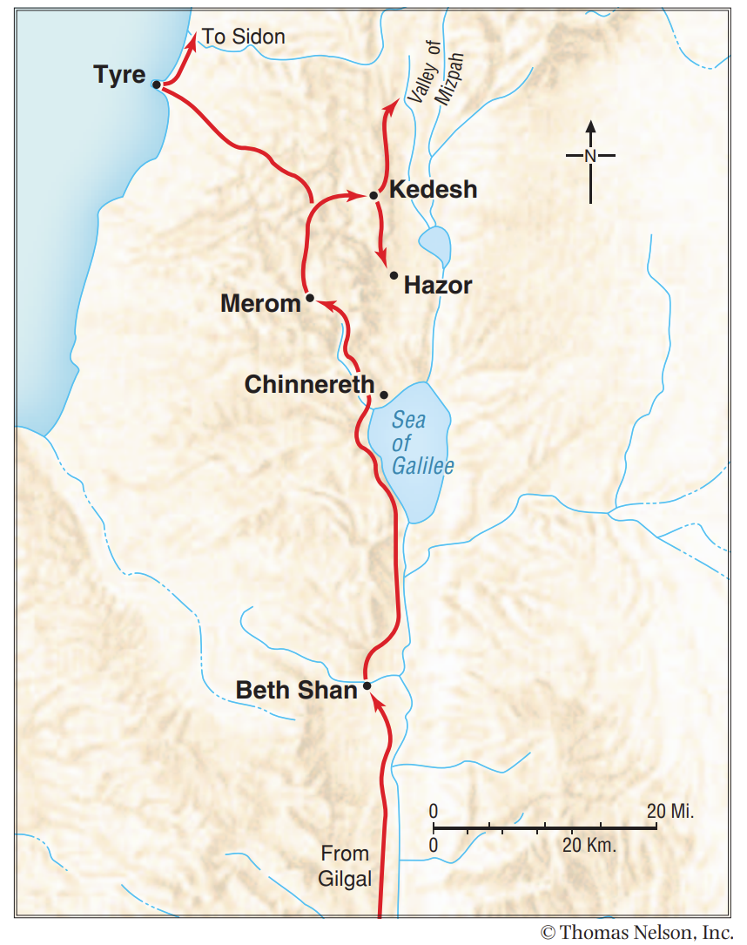
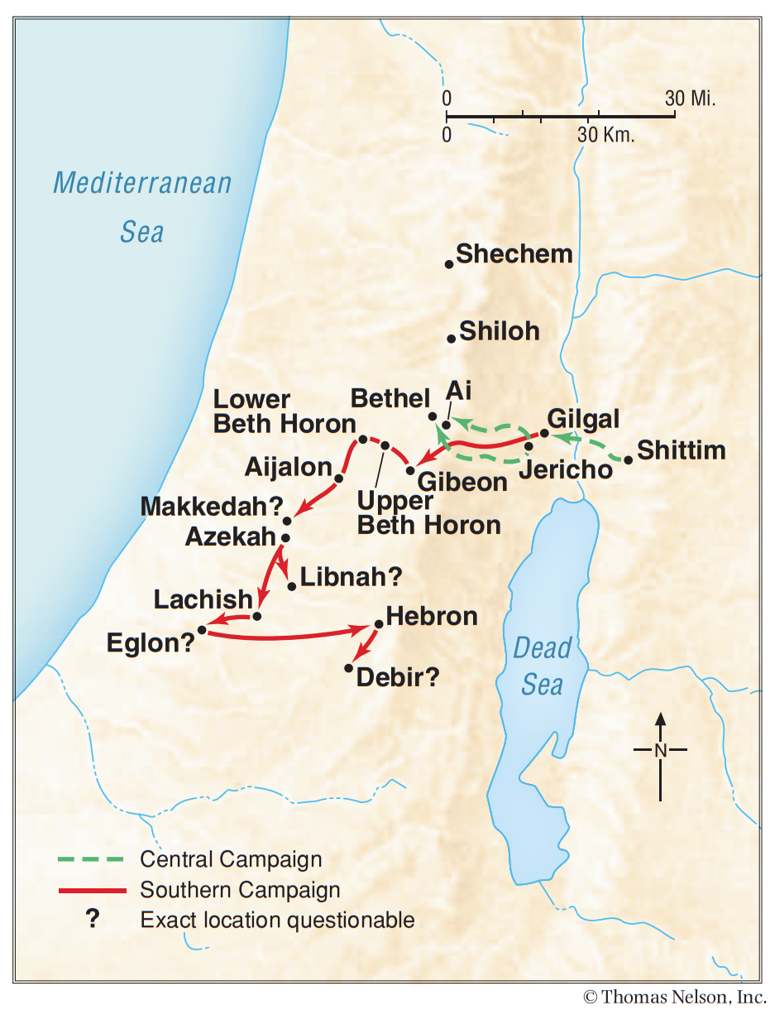
The Conquest of Canaan
c1451-1445BC
CENTRAL & SOUTHERN
CAMPAIGNS
NORTHERN CAMPAIGN
4

Slide 5
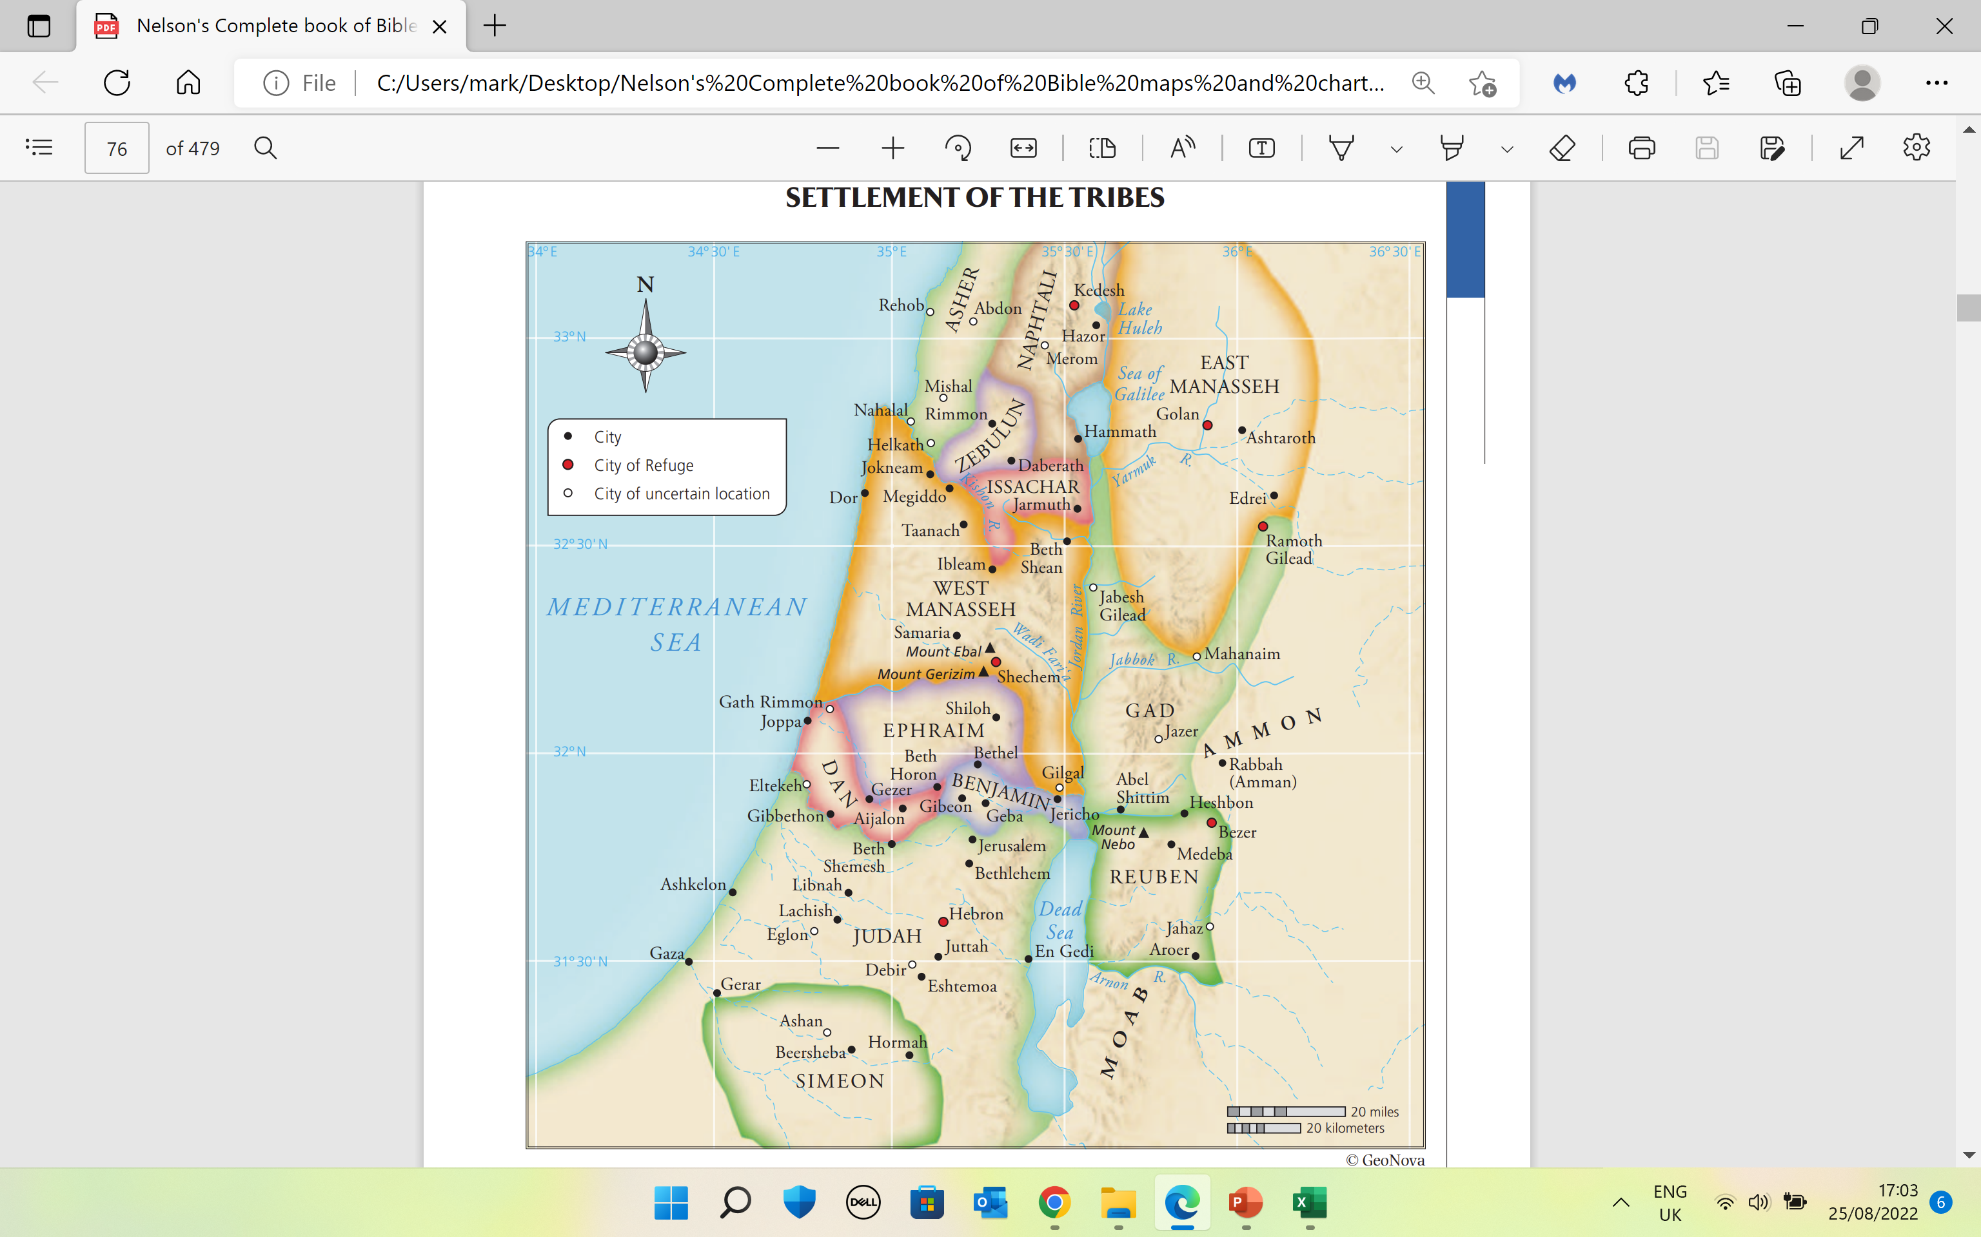
Settlement of the Tribes
c1445BC
Tribes – 2½ tribes on the east of the Jordan River, and 9 ½ tribes on the west.
God tells Joshua to appoint 6 cities of refuge – 3 on the west of the River Jordan, and 3 on the east
Joshua chapter 20
The Tabernacle was moved from Gilgal to Shiloh, about 8 miles north of Bethel in the land of Ephraim, where it remained for 328 years
Joshua 18:1 Judges 18: 31
Psalm 78: 60
5

Slide 6
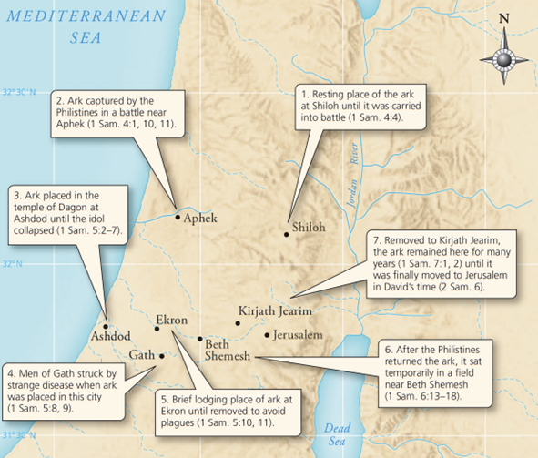
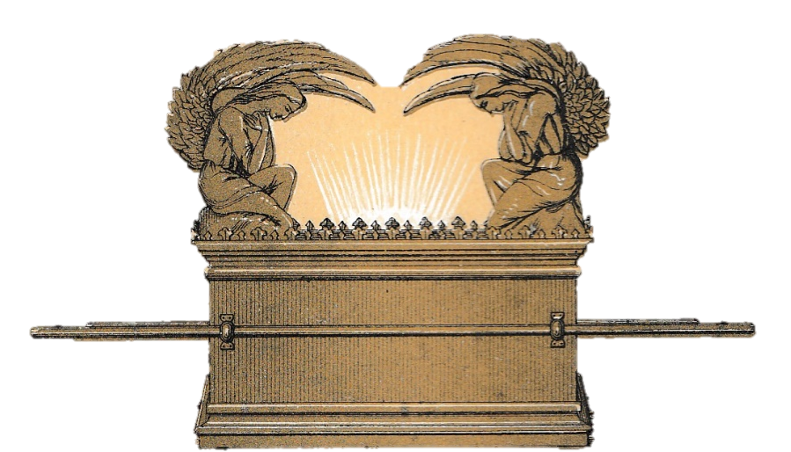
THE ARK CAPTURED
c1116BC
After 7 months of capture by the Philistines, the Ark was brought to the house of Abinadab, which was on a hill in Kirjath-Jearim.
1 Samuel chapters 1-3,
1 Samuel 7: 1
Abinadab’s son, Eleazar was consecrated to look after the Ark.
1 Samuel 7: 1
It remained there for 20 years.
1 Samuel 7: 2
6

Slide 7
SAMUEL’s REBUKE
c1096BC
At the end of the 20 years, Samuel gathers the children of Israel at Mizpah (5 miles NW of Jerusalem), and tells them to turn away from foreign gods – the Baals and Ashtoreths - and serve the one true God.
The people confess that they had sinned against God.
1 Samuel 7: 3-6
A reminder
1 John 1: 9 –
If we confess our sins, He (the Lord Jesus Christ) is faithful and just to forgive us our sins and to cleanse us from all unrighteousness
7

Slide 8
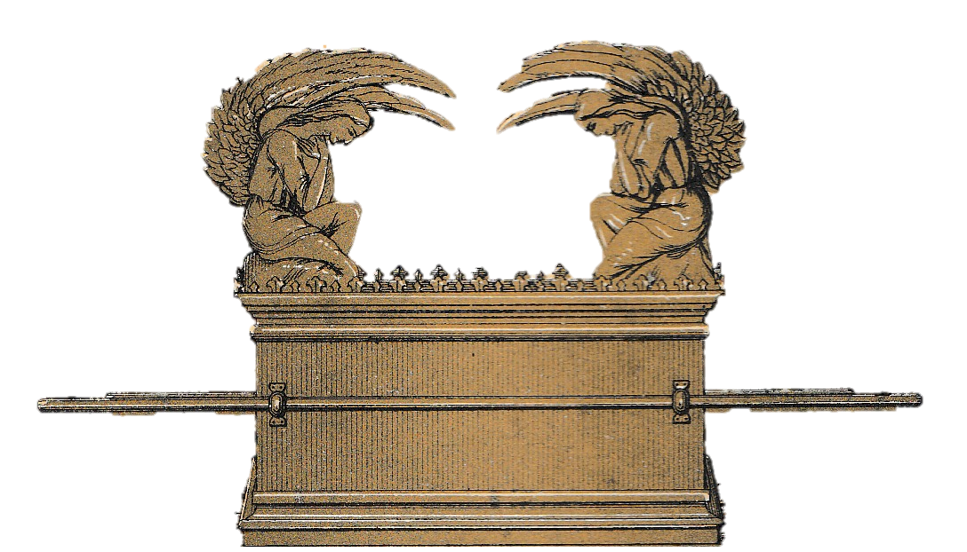
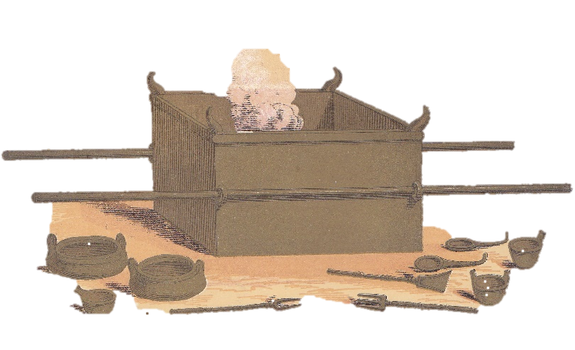
King David’s Reign
King David moves the Ark from the house of Abinadab at Kirjath-Jearim, to the house of Obed Edom in Jerusalem, where it remained for 3 months
2 Samuel
chapter 6
1 Chronicles chapter 13
c1045BC
After 3 months, King David moved the Ark to a Tabernacle (Tent) which he had prepared in Jerusalem
2 Samuel 6:17
Sacrifices were offered at the Tabernacle in Gibeon
1 Chronicles 16: 39-40
8

Slide 9
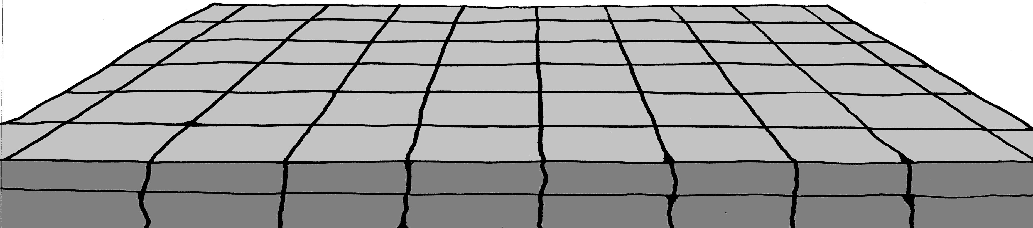
King Solomon’s Reign
c1012BC
God had given David the plans for the building of the Temple at Jerusalem
2 Samuel 7: 1 - 9
1 Chronicles 28: 11-12
David gathers materials for the building of the Temple
1 Chronicles 29: 1- 9
Solomon starts to lay the foundations of the Temple on Mount Moriah
2 Chronicles 3: 1 - 3
Christian work must be based on the foundation of the Lord Jesus Christ
1 Corinthians 3: 11
9

Slide 10
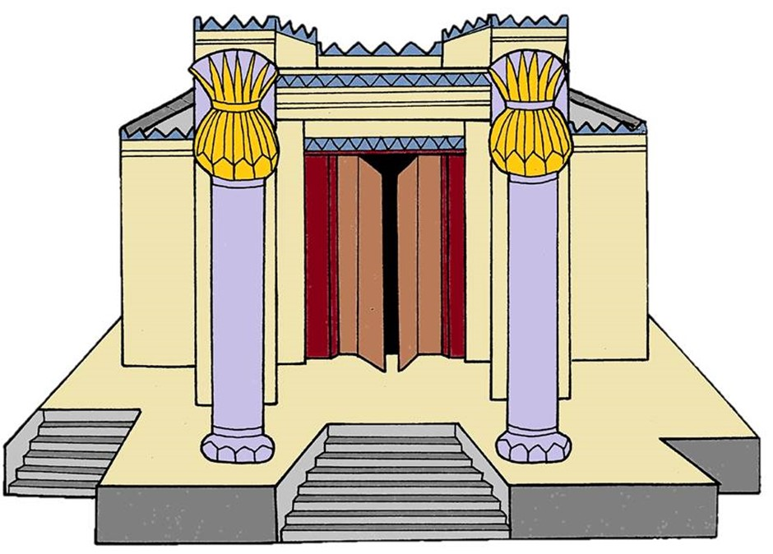
King Solomon’s Reign
c1004BC
The Ark is brought from the temporary tabernacle in the City of David, and is
placed in the Most Holy Place in the Temple
The Tabernacle and all the holy furnishings were brought up from Gibeon.
1 Kings 8: 4
(NB. Probably placed in
the Temple Treasury)
The Temple is completed after 7½ years in building
1 Kings 6:1, 38
10

Slide 11
Jerusalem Plundered by Nebuchadnezzar (8th year of his reign)
c599BC
Treasures of the House of the LORD taken
Treasures of the King’s house taken
Temple items of Gold cut in pieces
2 Kings 24: 12-13; Jeremiah 20: 5
11

Slide 12
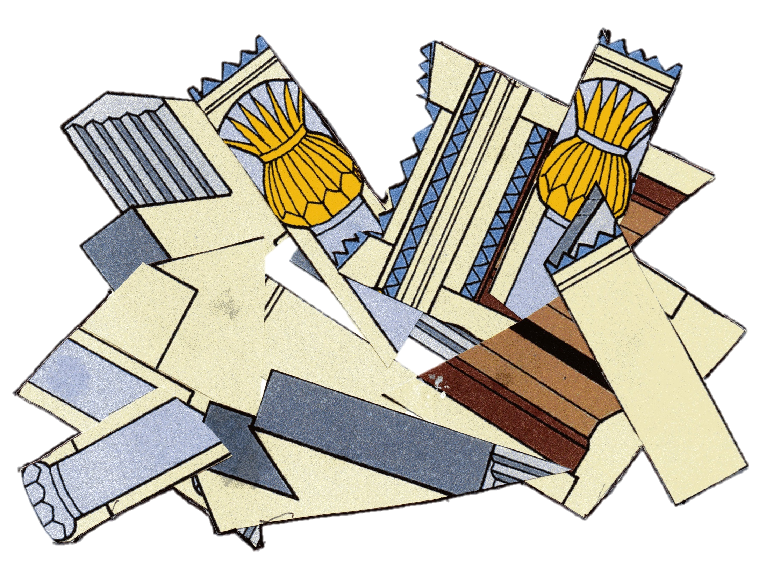

Jerusalem burned by Nebuchadnezzar (19th year of his reign)
c588BC
Bronze items, together with more gold and silver taken by Nebuchadnezzar’s army
The rest of the Temple and the city destroyed by fire. Some people were captured and taken to Babylon
2 Kings 25: 9; Jeremiah 39: 8; 52: 12-14
12

Slide 13

What happened to the Ark of the Covenant?
1.
It has been suggested that the Ark was probably destroyed in the destruction of Jerusalem and the temple by Nebuchadnezzar.
3.
There is no mention of an Ark in the Most Holy Place in Ezekiel’s Temple, described in Ezekiel chapters 40 - 47
2.
On the return from Captivity, the people set about to re-build the Temple. The Altar was re-built and some items of silver and gold were brought back to Jerusalem by King Cyrus of Persia (Ezra chapters 1-6) – no mention of the Ark
4.
The prophet Jeremiah declared that the Ark - “… shall not come to mind, nor shall they remember it, nor shall they visit it, nor shall it be made anymore (Jeremiah 3: 16).
5.
The Ark was a sign of God’s presence with His people – no longer necessary, as God’s Holy Spirit now dwells in the lives of individuals and in the local Church.
13

Slide 14
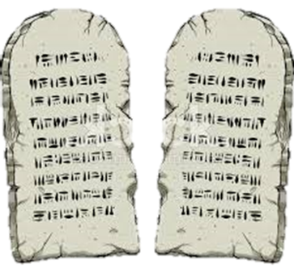
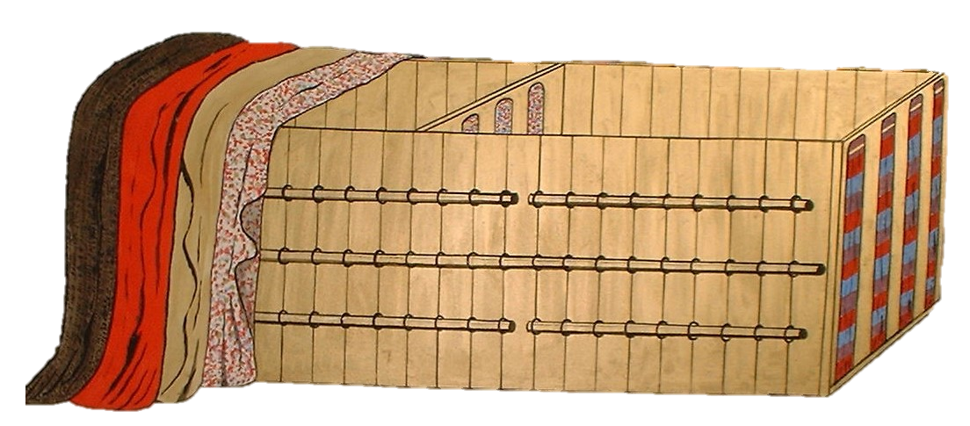

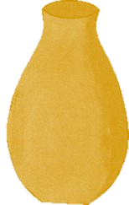

TODAY
Christ is the head of the church - Ephesians 5: 23
God will bring His people to their heavenly home
John 14: 2
One way into God’s presence – John 14: 6
God’s laws are to be obeyed– John 14: 15
How to worship God – John 4: 23
God’s provision of a sacrifice – Hebrews 9: 22
God’s presence with His people – Matthew 28: 20
God’s provision for His people – Philippians 4: 19
14

Slide 15
The letter to the Hebrews
Described as a commentary on the Old Testament books
about the Tabernacle
EXODUS
LEVITICUS
NUMBERS
DEUTERONOMY
15
The Old Testament laws and instructions given to Israel are now shown in God’s plan of Redemption for everyone who believes in the finished and complete work of the Lord Jesus Christ, as revealed in the New Testament

Slide 16
The letter to the Hebrews
Described as a commentary on the Old Testament books
about the Tabernacle
ONLY POSSIBLE THROUGH THE
LORD JESUS CHRIST
†
BETTER – things – Hebrews 6: 9
BETTER – priesthood – Hebrews 7: 5-7
BETTER – hope – Hebrews 7: 19
BETTER – covenant – Hebrews 7: 22
BETTER – promises – Hebrews 8: 6
BETTER – sacrifice – Hebrews 9: 23
BETTER – possessions – Hebrews 10: 34
BETTER – country – Hebrews 11: 16
BETTER – resurrection – Hebrews 11: 35
BETTER – provision – Hebrews 11: 40
16

