Slide 1
The following Bible presentation has used notes by the
Rev L G Stapleton
The picture of the Tabernacle is taken from the CANDLE BOOKS – ‘Essential Bible Reference Series’ – ‘The Tabernacle’ by Tim Dowley - permission applied for.
Compiled by
Mark Stapleton
©Mark Stapleton 2024
1

Slide 2
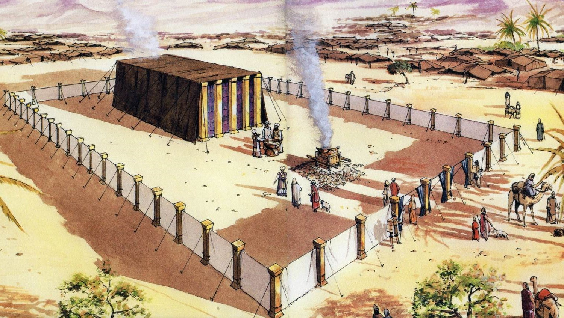
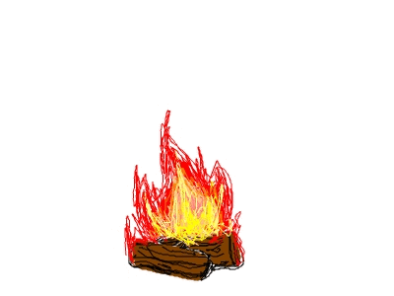
THE TABERNACLE
Part 7
The Wilderness Journey
2

Slide 3
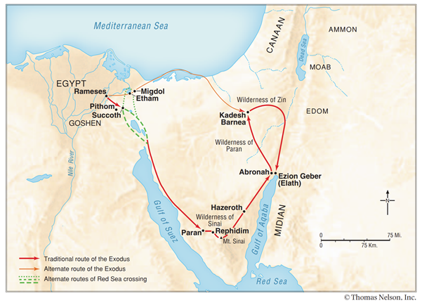
THE WILDERNESS JOURNEY
Note – God did not allow Israel to travel by the alternate route by way of the land of the Philistines, although that was near; for God said, “Lest perhaps the people change their minds when they see war… Exodus 13: 17-18
It took about 2-3 months for Israel to reach Mount Sinai.
The route of wanderings of around Kadesh Barnea for 38 + years is not clear. They eventually arrived on the East of the River Jordan, having passed the Dead Sea.
3

Slide 4
CLOUD BY DAY
Numbers 9: 16
4

Slide 5
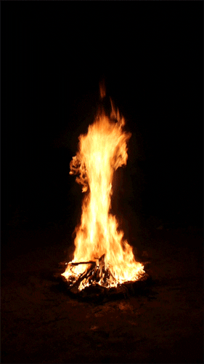
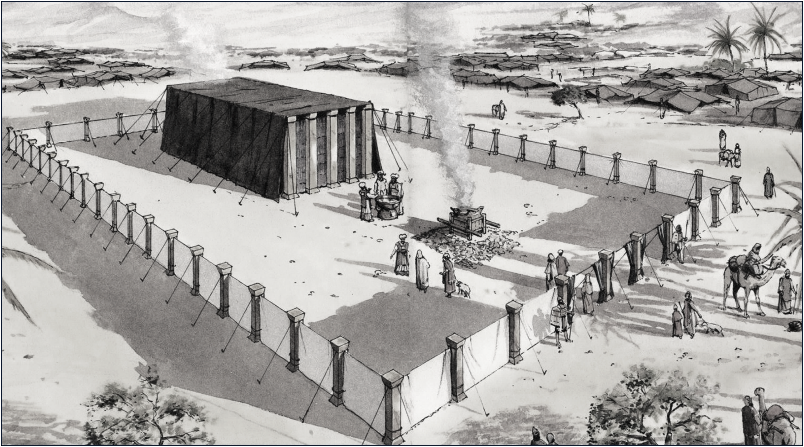
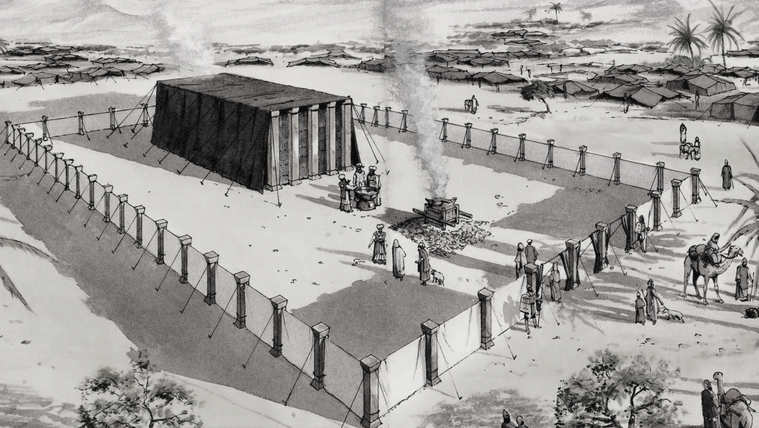
FIRE BY NIGHT
Numbers 9: 16
5

Slide 6
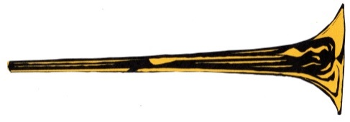
Two Silver Trumpets
Numbers chapter 10: 1-10
Used for –
Calling the congregation together (vs. 1-2)
Directing the movement of the camp (v. 2)
When both trumpets are blown – all the congregation gather before the door of the Tabernacle of meeting (vs. 3, 7)
If only 1 trumpet is sounded, then the heads of the divisions gather before Moses (vs. 4)
When the advance (i.e. move forward) is sounded, then the tribes that lie on the East, begin their journey (vs. 5)
When the advance is sounded the second time, the tribes that lie on the South, begin their journey (vs. 6). These would have been followed by the tribes on the West and North
The priests, the sons of Aaron blow the trumpets (vs. 8)
When they went to war, an alarm is sounded with both trumpets (vs. 9)
At times of gladness – appointed feasts and the beginning of the month, trumpets were to be blown over the sacrifices (vs. 10)
6

Slide 7
The layout of the Camp (Numbers chapter 2)
The Order of the march
NORTH
TRIBES OF -
MANASSEH EPHRAIM BENJAMIN
TRIBES OF -
ISSACHAR JUDAH ZEBULUN
TRIBES OF -
ASHER DAN NAPHTALI
MOSES
AARON PRIESTS
GERSHONITES
MERARITES
WEST
TABERNACLE
EAST
KOHATHITES
TRIBES OF -
SIMEON REUBEN GAD
4
SOUTH
7

Slide 8
The duties of the sons of Levi
The Kohathites
(Numbers 4: 4-16)
To Cover and then carry -
- the Ark of the Covenant (or Testimony) – covered with badger skins and then a blue cloth
- the Table of Shewbread– covered with a blue cloth, the utensils covered with a scarlet cloth and then badger skins overall
- the Lampstand and its utensils – covered with a blue cloth, then badger skins overall
- the Golden Altar of incense – covered with a blue cloth, and badger skins
- the Bronze Altar and its instruments – covered with a blue cloth
The above pieces of furniture had poles inserted through the rings on the sides, so that they could be carried
Note – The Kohathites were not given carts on which to put the above items
They were all to be carried Numbers 7: 9
8

Slide 9
The duties of the sons of Levi
The Gershonites
(Numbers 4: 21-28)
To transport -
- the curtains of the Tabernacle (including the badger skins)
- the screen for the door of the Tabernacle
- the screen for the gate of the Court and their cords
- the hangings of the Court
Note – The Gershonites were given 2 carts and 4 oxen to transport the above items – given by the leaders of the children of Israel - Numbers 7: 7
9

Slide 10
The duties of the sons of Levi
The Merarites
(Numbers 4: 29-33)
To transport -
- the boards of the Tabernacle, its bars, its pillars and its sockets
- the pillars around the Court, with their sockets, pegs and cords
Note – The Merarites were given 4 carts and 8 oxen to transport the above items, given by the leaders of the people of Israel - Numbers 7: 8
10

Slide 11
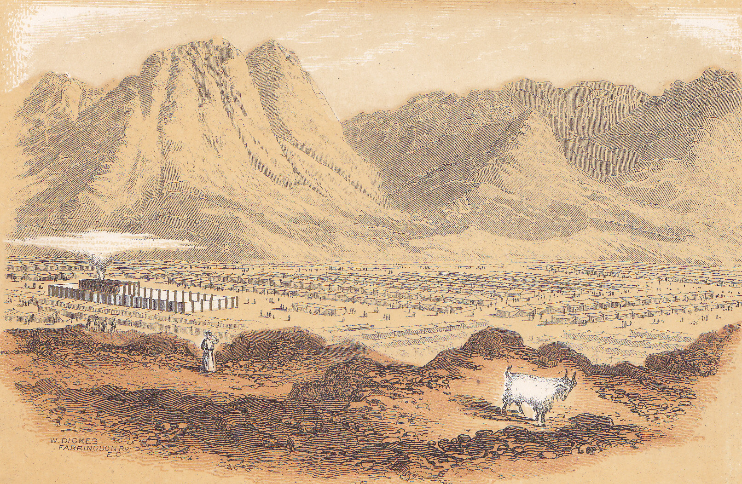
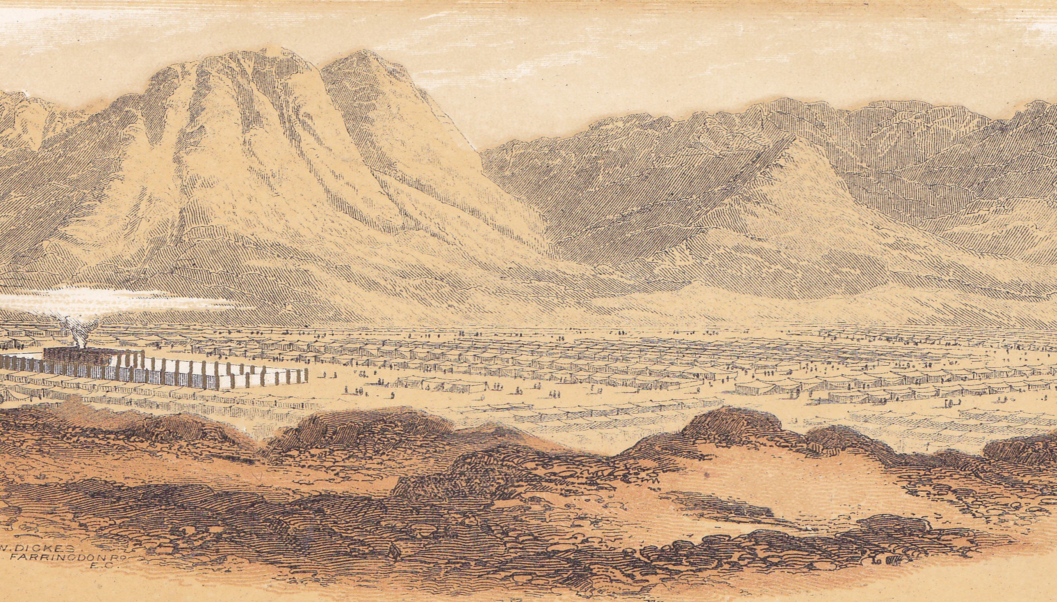
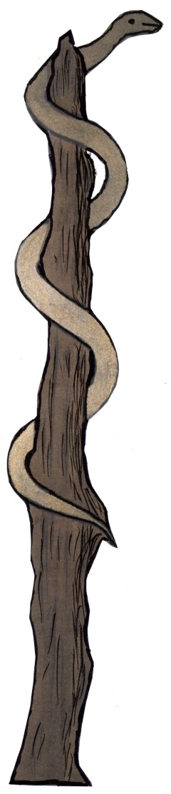
THE SERPENT ON THE POLE
Because of the people’s complaint against God and Moses, they were bitten by fiery snakes. God instructed Moses to make a bronze serpent and put it on a pole, for all to see. All those who were bitten by the fiery snakes, were made whole - if they looked towards the pole (Numbers 21: 4-9). This happened near Mount Hor, on the edge of the land of Edom,south of the Dead Sea.
The use of Bronze reminds us that sin has to be judged.
Isaiah 53: 6; John 1: 29; John 3: 14 reminds us that all our sin was laid upon the Lord Jesus Christ at Calvary’s cross
11

Slide 12
THE WILDERNESS YEARS
God provided His people with their daily bread (manna) and water
God protected His people
God provided the people with a way for their sin to be dealt with
God guided His people through their wilderness journey
God provided His people with the Ten Commandments to instruct them in His ways
God brought His people to the Promised Land
12

Slide 13
TODAY
†
God is mindful of the daily needs of His people
God watches over His people
God provides Atonement for His people through the subsitutionary sacrifice of the Lord Jesus Christ
God guides us in our earthly pilgrimage
God gives us His word, the Bible, to guide and teach us in our daily living
God brings us to His promised destination - Heaven
All this is possible through the work and life of the Lord Jesus Christ
This should result in greater praise and adoration -
2 Corinthians 9: 15 - Thanks be to God for His indescribable gift!
Are we waiting for the great trumpet call, when Christ gathers His people together ? (1 Corinthians 15: 51-52)
13

