Slide 1
The following Bible presentations is based on notes by the
Rev L G Stapleton
The picture of the Tabernacle is taken from the CANDLE BOOKS – ‘Essential Bible Reference Series’ – ‘The Tabernacle’ by Tim Dowley - permission applied for.
Compiled by
Mark Stapleton
©Mark Stapleton 2024
1

Slide 2
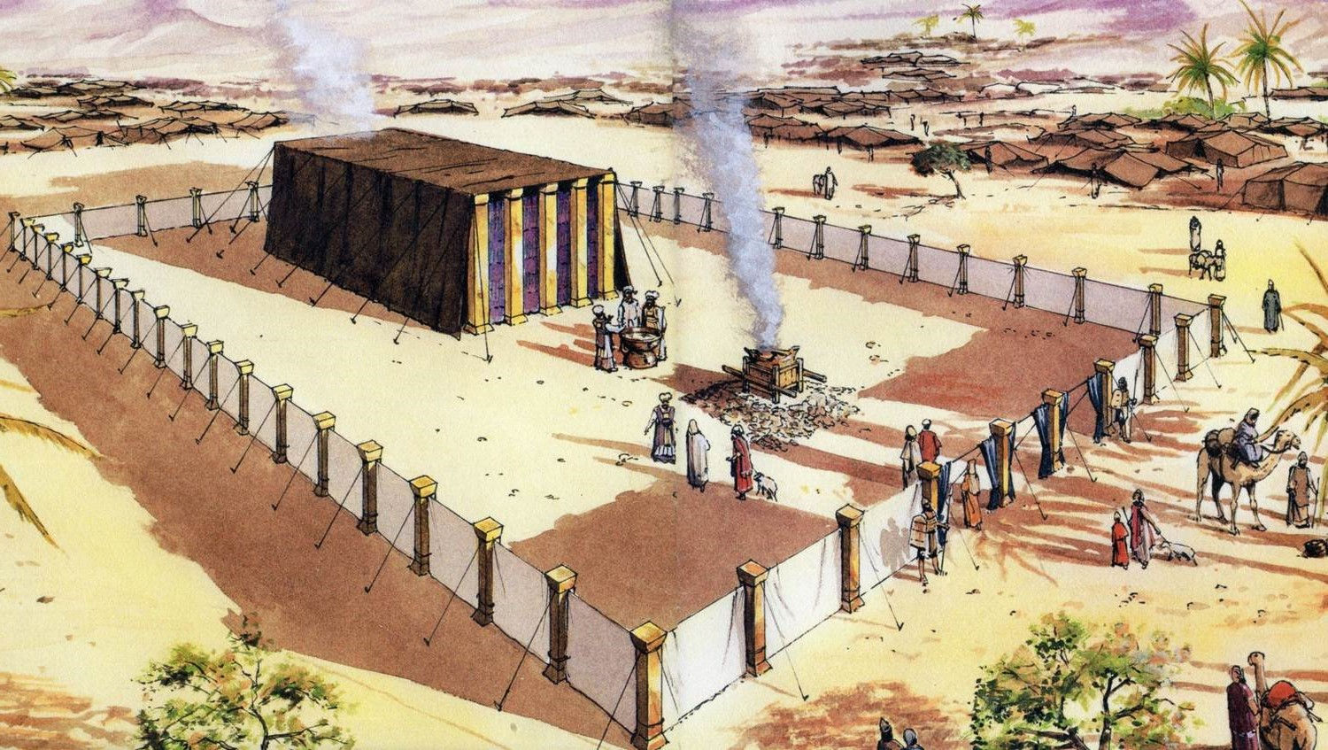
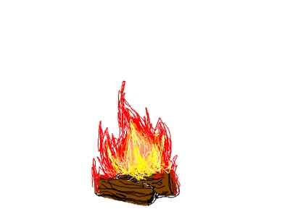
THE TABERNACLE
Part 6
Offerings and Sacrifices
2

Slide 3
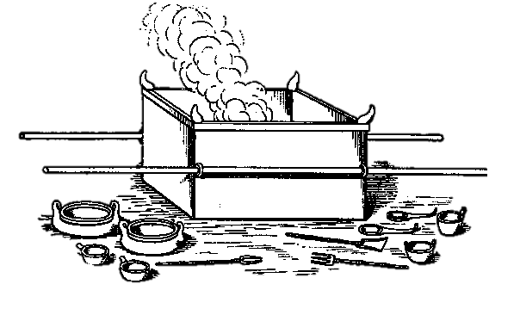
OLD TESTAMENT OFFERINGS and SACRIFICES
INTRODUCTION
These fall into roughly three classes -
3
1
Sacred Offerings for the endowment of the Sanctuary
(i.e. particularly for the Tabernacle)
2
Payments for the maintenance of the priests and Levites
3
Altar Sacrifices for the Lord’s personal appropriation and pleasure –
Levitical Offerings
Applicable to all three classes –
It must be the PROPERTY of the Offerer (2 Samuel 24: 24).
It was to be WHOLLY DEDICATED to GOD – Acknowledging man’s dependence; acknowledging God’s Sovereignty; seeking His favour, but, of course, God really wanted the GIVER HIMSELF.
It was to be REPRESENTATIVE – of the class of goods, animals etc. of the PERSON making the offering.

Slide 4
1
Sacred Offerings for the endowment of the Sanctuary
(i.e. particularly for the Tabernacle)
These comprised anything in the nature of PROPERTY and included such things as HOUSES, VINEYARDS, GOLD, SILVER etc.
Note: Gold and Silver were never used as an offering for sin – forgiveness cannot be BOUGHT.
The people brought a wide variety of materials for the construction of the Tabernacle (Exodus 35: 5-9). These are spoken of as OFFERINGS (verse 5). They were given WILLINGLY. They were to be given not primarily to the project, not to Moses, but to the LORD.
The Princes, representing the Twelve tribes, offered WAGONS, OXEN, SILVER DISHES, SILVER BOWLS and GOLDEN SPOONS. (Numbers 7: 3).
The army officers brought a THANKOFFERING after the defeat of Midianites.
(Numbers 31: 48-54)
4

Slide 5
2
Payments for the maintenance of the Priests and Levites
The HOUSE of AARON (the priests) were to receive the FIRST FRUITS of the harvests (Numbers 18: 12).
The MALE FIRSTBORN of man or beast was the property of the Lord (Exodus 13: 13-15). These, apart from the CLEAN animals were to be REDEEMED and the money given to the priests (Numbers 18: 8-14).
The clean beasts would be used for sacrifices and the priests ate certain parts of those offerings (Numbers 18: 8-14).
The LEVITES (those in the tribe of Levi apart from the household of Aaron) were to receive the TITHE (or tenth) of the produce of the land (Numbers 18: 20). Note- This was because the Levites had no inheritance in the land of Canaan.
Even the Levites had to give a tithe of their tithe to the priests (Numbers 18: 26).
Apart from the first emphasis that they were to God, the system was also God’s way of providing for the needs of His full-time workers (1 Corinthians 9: 9-14).
5

Slide 6
3
Altar sacrifices for the Lord’s personal appropriation and pleasure
The Levitical Offerings and Sacrifices – Leviticus chapters 1 - 6
Group 1
THREE SWEET AROMA OFFERINGS
Chapters 1 - 3
THE WHOLE BURNT OFFERING
b. THE GRAIN OFFERING
c. THE PEACE OFFERING
Note – Sweet Savour means something pleasing to God. These offerings are so called because they do not have in view the dealing with sin.
Group 2
TWO NON SWEET AROMA OFFERINGS
Chapters 4 - 6
THE SIN OFFERING
b. THE TRESPASS OFFERING
Note - The Sinner and the Sin are dealt with in these offerings.
1. The Order of the offerings in Leviticus is given from God outwards (The Whole burnt offering in Leviticus 1).
2. We look at the offerings in the reverse order (The Trespass Offering in Leviticus 5).
3. The offerings were all offered, in whole or in part, on the bronze altar = the Cross  .
4. The one offering of Christ – Hebrews 10: 12 – is seen to be a composite offering. Its full significance is only progressively understood by the believer, being revealed by the Holy Spirit as Spiritual progress is made.
5. From different angles, the Lord Jesus Christ may be thought of as A. - The Offering or B. - The Offerer or C. - The Priest.
6

Slide 7



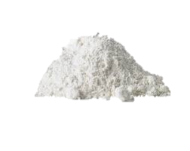
THE TRESPASS OFFERING
Leviticus 5: 1-19; 6; 1-7; 7: 1-10
A
The Offering itself
A Female Lamb or Kid or 2 young pigeons; or 2 turtle doves or 1 tenth deal of flour.
All fat burnt = Inward perfection
(Burnt in all the offerings).
Blood poured out around the altar.
The rest eaten by the priests (Differs from the Burnt Offering).
B
The Aim of the Offering
To deal with specific sins (no mention of the person).
These include –
Sins by the offender against himself (Leviticus 5: 1-5).
Sins by the offerer against God (Leviticus 5: 15, 19).
Sins against others (Leviticus 6: 1-7).
KEY WORD
GUILTY
C.
THE OFFERING DEMANDS –
RESTITUTION (the proof of repentance) to God after the Offering (Malachi 3: 8).
RESTITUTION to others before the offering (Leviticus 6: 5; Numbers 5: 8; c/f Luke 19: 8)
AN IMPORTANT QUESTION
Can a person steal an article, keep that article and yet be forgiven for stealing that article?
7

Slide 8
THE SIN OFFERING
(Non-sweet-aroma)
Leviticus 4; 6: 25-30
The Offering itself
A young bullock, female kid or lamb – all without blemish. The animal varied with the category of the offerer. All fat was burnt. Categories 3 & 4 – the rest of the animal was eaten by the Priests (Leviticus 6:29). Categories 1 & 2 the rest was carried outside the camp. (Leviticus 4:11-12, 20-21; Hebrews 13: 10-13)
The Offering itself
- continued
The hand of the Offerer was laid on the head of the animal, SIGNIFYING –
Acknowledging the need of a substitute.
Acceptance of the animal as that substitute
Acceptance with the animal in its death as substitute
CATEGORIES OF PEOPLE
The Anointed Priest- Leviticus 4:3
The whole Congregation – Leviticus 4:13
A Ruler – Leviticus 4:22
A Common Person – Leviticus 4:27
In the SCAPEGOAT OFFERING, made on the Day of Atonement (Leviticus 16) two goats are presented – one, as a sin offering, when both hands are laid on the animal’s head, with the idea of sin being transferred; the other is let go to wander in the wilderness (Leviticus 16: 7-10, 21; John 1: 29)
8

Slide 9
THE SIN OFFERING
(Non-sweet-aroma)
Leviticus 4; 6: 25-30
CHARACTERISTIC FEATURES
The Sprinkling of the blood
Categories 1 & 2 , the blood is sprinkled before the veil
7 times and put on the horns of the altar of incense (Leviticus 4: 6,7,17,18) = Restoration to worship & intercession.
Categories 3 & 4 – blood is put on the horns of the brazen altar (Leviticus 4: 25, 34) = ability to offer other offerings.
In all cases the surplus blood was poured out at the base of the brazen altar = Foundation of all acceptance by God).
OCCASIONS FOR USE OF THE OFFERING
At the consecration of the Priests (Exodus 29: 10-14) and Levites (Numbers 8: 8).
On the Day of Atonement (Leviticus 16: 3).
As soon as sin is known (Leviticus 4: 14, 23, 28). NB. Not in the case of the Priest.
CATEGORIES OF PEOPLE
The Anointed Priest- Leviticus 4:3
The whole Congregation – Leviticus 4:13
A Ruler – Leviticus 4:22
A Common Person – Leviticus 4:27
9

Slide 10
THE SIN OFFERING
(Non-sweet-aroma)
Leviticus 4; 6: 25-30
THE MEANING OF THE OFFERING
Not the putting away of sins (Trespass Offering) but the acceptance of the sinner.
In laying on the hand, the offerer is saying that this life is to forfeited instead of mind
Christ was made sin (counted as a sinner) for us (Galatians 3: 13; 2 Corinthians 5: 21)
NOTE
It is still possible for a believer to sin – he/she need not.
Sin is progressively more serious in Christian experience (The animals are more costly from categories 4 to 1).
When convicted of the Holy Spirit, bring the sin offering at once. No long penance required. (1 John 1: 9) assures our immediate acceptance anew)
In the Trespass Offering, Christ took our sins
In the Sin Offering – Christ took our place as sinners
CATEGORIES OF PEOPLE
The Anointed Priest- Leviticus 4:3
The whole Congregation –
Leviticus 4:13
A Ruler – Leviticus 4:22
A Common Person – Leviticus 4:27
My faith would lay her hand
On that dear head of Thine
While like a penitent I stand,
And there confess my sin.
10

Slide 11
THE PEACE OFFERING
Leviticus 3; 7: 11-21, 29-38
THE OFFERING ITSELF (SWEET AROMA)
Male/Female animal from the herd/flock – without blemish
The blood is sprinkled on the bronze altar (Leviticus 3: 8, 13). The fat is burnt – as in all offerings.
The hand of the offerer is placed on the head of the animal (Leviticus 3: 2)
The Priests eat A. the wave breast (Leviticus 7: 30), B, the right thigh (Leviticus 7: 32)
CHARACTERISTIC FEATURES
The Offerer eats some of the flesh (Leviticus 7: 15, 18, 20 etc.)
Not so in any other offerings.
WHY & WHEN WAS IT OFFERED
No Compulsion & no need as in Trespass & Sin Offerings
As an act of the freewill (Leviticus 19: 5)
As an act of thanksgiving (Leviticus 7: 12)
As a vow (Leviticus 7: 16)
At a time of rejoicing (Deuteronomy 27: 7; 1 Samuel 11: 15)
11

Slide 12
THE PEACE OFFERING
Leviticus 3; 7: 11-21, 29-38
THE MEANING OF THE OFFERING
In the order of man’ experience, it follows the trespass and sin offering.
Peace with God is the result of justification (Romans 5: 1). i.e. rebellion is finished (Ephesians 2: 17; Colossians 1: 20; Isaiah 53: 5).
This means restored fellowship and communion with God. Celebrated in the fellowship meal of the offering.
All three parties are physicaslly satisfied by the offering: God has the fat; the Priests have their portions; the offerer has his part.
Spiritually, God the Father is satisfied, Christ as Priest is satisfied, the believer as offerer is satisfied. The meeting point is Christ.
This is linked with thanksgiving (Philippians 4: 6-7).
THE WARNINGS OF THE PEACE OFFERING
The peace offering cannot be offered before the trespass and sin offerings. (Leviticus 7: 20-21)
Experience of this fellowship must be kept up-to-date (Leviticus 7: 18)
12

Slide 13
THE GRAIN OFFERING
(AV = MEAT or MEAL OFFERING)
Leviticus 2; 6: 14-23
THE CHARACTERISTIC FEATURE OF THE OFFERING
No animal is involved – the word ‘meat’, is used in the sense of a ‘sweetmeat’.
Therefore, no blood is shed.
THE OFFERING ITSELF - SWEET AROMA (AV = SAVOR)
Fine Flour, + oil, + Frankincense (Leviticus 2: 2)
Sometimes baked in the oven. or in the pan, or in the frying pan
Leviticus 6: 4,5,7
Apparently prepared at home by the offerer
Part burnt on the bronze altar – Leviticus 2: 9
The rest eaten by the priests – Leviticus 2: 3, 10
Described as Most Holy – Leviticus 2: 3, 10 ; 6: 17
THE SIGNIFICANCE OF THE OFFERING
The offering has to do, not with the death of Christ primarily,
but with His life (Romans 5: 10). It therefore portrays the nature of His life:-
Fine flour = purity and even consistency of character
No leaven = a type of sin – Leviticus 2:11, Hebrews 4: 15
No honey = natural sweetness – Leviticus 2: 11
Entirely edible = all profiitble to God
Offered on the bronze altar = the Cross – shows the life laid down or offered
13

Slide 14
THE GRAIN OFFERING
(AV = MEAT or MEAL OFFERING)
Leviticus 2; 6: 14-23
THE PREPARATION FOR
THE OFFERING
1.Flour is made by bruising and crushing grain
2. Mingled with oil (Divine Humanity) or anointed with oil (Leviticus 2:1, 4, 15; Matthew 3:16)
3. Exposed to fire = suffering (Hebrews 2:10) – sometimes as in a pan; sometimes hidden as in an oven
4. God’s portion burnt – Leviticus 2: 2 – (a life lived to God but also for the benefit of His people (priests)
5. All frankincense burnt – Leviticus 2: 2. Fragrance was for God
THE MEANING OF THE OFFERING
The Offering of a perfect life before God (Hebrews 5: 8-9)
This portrays Christ our righteousness (Romans 5: 19) We offer His sinless life to God as our substitute
THE GUARANTEE OF
THE OFFERING
Salt was offered with it (Leviticus 2: 13; Numbers 18: 19; 2 Chronicles 13: 5)
Signifies a ratified covenant of agreement
God’s eternal covenant with us – He accepts the sinless one’s life, in fact he credits that life to us
See in this something of the meaning of the bread in the Communion service
14

Slide 15
THE BURNT OFFERING
Leviticus 1; 6: 8-13
THE OFFERING ITSELF
(Sweet Aroma – Leviticus 1: 9, 13, 17)
From the herd/flock – male, without blemish (1: 3, 10) or turtle doves/young pigeons (1/14)
Offerer brings it to the door of the Tabernacle (1: 3)
Offerer puts his hand on the head (1:4)
Offerer kills it, skins it and dissects it (1: 5-6)
Offerer washes the inwards and legs in water (1: 9)
Priests sprinkle the blood around the bronze altar (1: 5)
Priests arrange the pieces on the bronze altar (1:7-8)
THE CHARACTERISTIC FEATURES
The washing of the inwards and legs (Leviticus 1: 9)
The offering wholly burnt (except the skin
This gave the name to the bronze altar – Altar of Burnt Offering
WHEN THE OFFERING WAS USED
Daily - morning & evening, for general purposes (Numbers 28: 3)
Continually kept on the altar
When the offerer wishes to offer personally (Leviticus 1: 2)
On special occasions (Exodus 40:29; 2 Chronicles 7: 1, 7)
15

Slide 16

THE BURNT OFFERING
Leviticus 1; 6: 8-13
THE SIGNIFICANCE OF THE OFFERING
Found in its characteristic feature – whole burnt = the whole given to God
Compare with Christ, who voluntarily offering Himself to the complete will of God – this is something wholly well pleasing to God (Hebrews 10: 5 – 9, 9: 14; Philippians 2: 8; Luke 22: 42)
This was not just a crisis – but a continuing experience throughout His life (Leviticus 6: 12-13)
When I survey the wondrous Cross
On which the Prince of glory died
My richest gain I count but loss
And pour contempt on all my pride
†
THE LESSONS OF THE OFFERING
Since it is last in God’s order of the offerings, we, of necessity only come to it after the previous offerings.
We are ‘Accepted in the Beloved’ (Ephesians 1: 6) – The perfection of Christ’s offering for us cannot be questioned. Our position in Him cannot be questioned either.
The outworking, however, needs to come to us in daily experience (1 Peter 2: 21)
We need to be given over entirely to the will of God (Romans 12: 1)
Maintenance of this devotion is a daily requirement (Leviticus 6: 13)
16

Slide 17
OLD TESTAMENT
Many Sacrifices
Many Priests (Hebrews 7:23)
The Tabernacle furniture – no seating .
The Priest’s work was never finished. (Hebrews 5: 1, 3; 10: 11)
Moses was faithful in God’s house. (Hebrews 3: 2)
NEW TESTAMENT
One Sacrifice for sin – for ever. (Hebrews 1:3; 10:12)
One Priest only – the Lord Jesus Christ . (Hebrews 3: 1)
After Christ had offered up Himself, He sat down at the right hand of God. (Hebrews 1: 3; 8: 1; 10: 12)
Christ’s work was completed at the Cross. (John 19: 30)
Christ was faithful. (Hebrews 3:1-2)
†
The Blood of Jesus Christ… cleanses us from all sin (1 John 1: 7)
17

