Slide 1
The following PowerPoint presentation includes illustrations
from the book ‘Christ in the Tabernacle’ (1877) by Frank H White
The picture of the Tabernacle is taken from the CANDLE BOOKS – ‘Essential Bible Reference Series’ – ‘The Tabernacle’ by Tim Dowley - permission applied for.
Compiled by
Mark Stapleton
©Mark Stapleton 2024
1

Slide 2
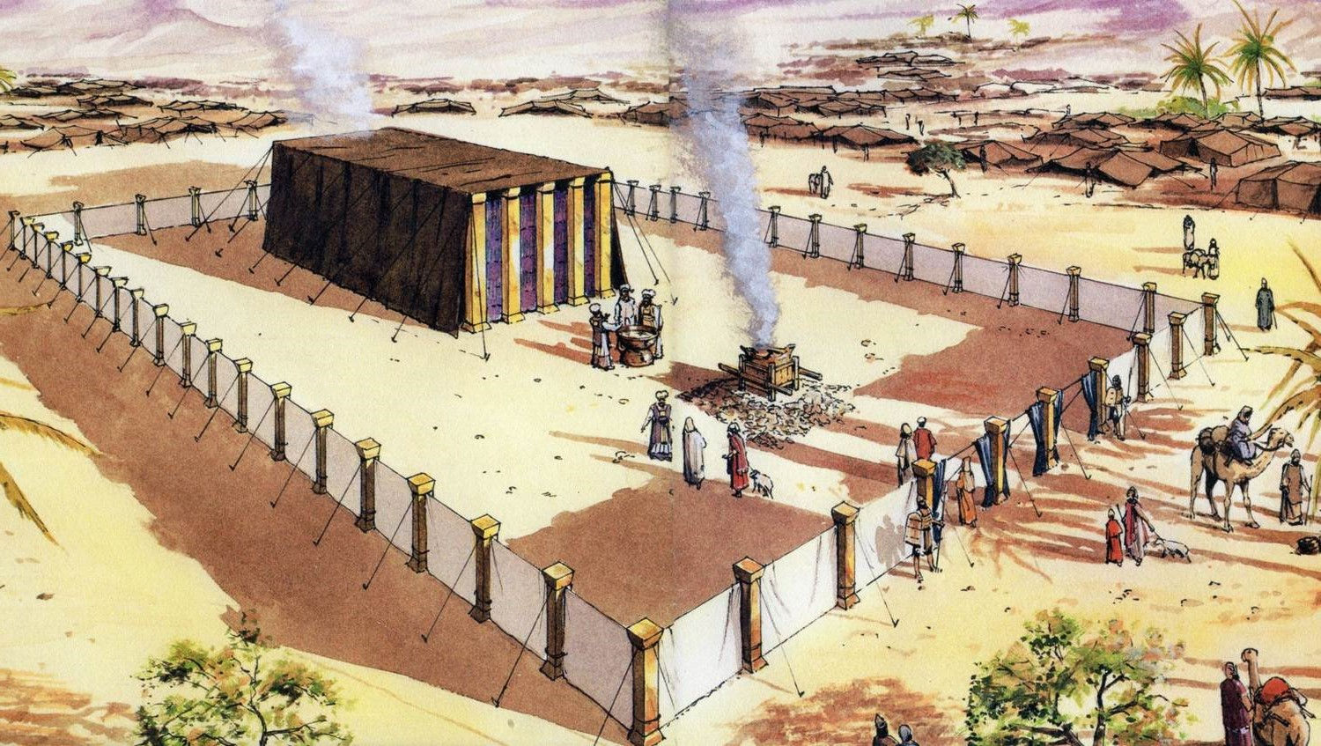
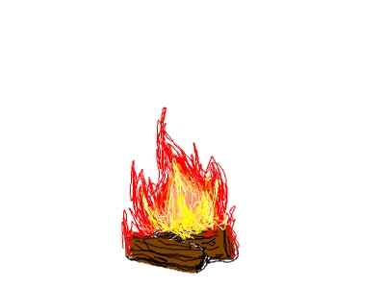
THE TABERNACLE
Part 5
The Priesthood
2

Slide 3
THE PRIESTLY LINE
Exodus 6: 16 - 27
AARON
JACOB
(Israel)
LEVI
KOHATH
AMRAM
MOSES
MOSES
Appointed by God for leading the people out of Egypt
Exodus 3: 10-22
NB – Moses was three years younger than his brother Aaron. Exodus 7: 7
AARON – the 1st High Priest
Appointed by God for the Priesthood - Exodus 28: 1
The sons of Aaron
Nadab, Abihu, Eleazar, Ithamar
Exodus 6: 23
3

Slide 4
The Priestly Service of the Tabernacle
SPHERE OF SERVICE - UNDERTAKEN BY -
The Courtyard work – dismantling, carting, carrying and re-erecting (e.g. – Numbers 3-4)
Entry into the Holy place (Hebrews 9: 6)
Offering of the Sacrifices (e.g. - Leviticus 1:7; 2:3; 6:9-11)
Entry into the Most Holy Place – once a year (Exodus 30: 10;
Hebrews 9: 7)
The tribe of Levi
The Priests - sons of Aaron of the tribe of Levi
The Priests
The High Priest – Aaron of the tribe of Levi
All the details given by God to Moses
Numbers 1:49-51
4

Slide 5
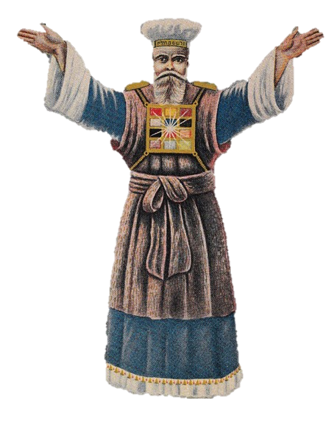
INSTRUCTIONS FOR MAKING THE PRIEST’S GARMENTS
Garments for Aaron the High Priest - Exodus 28: 1-39
The other Priests wore a Tunic, a Sash and a hat ; all white linen – Exodus 28: 40
The Tunic
The Turban
2 Onyx Stones on the shoulders
12 Precious Stones on the Breastplate
The Ephod
FOR GLORY AND FOR BEAUTY
Exodus 28: 2, 40
The Sash
The Robe of the Ephod
Bells and Pomegranates
All garments first worn at at their Consecration – Exodus 29
5

Slide 6
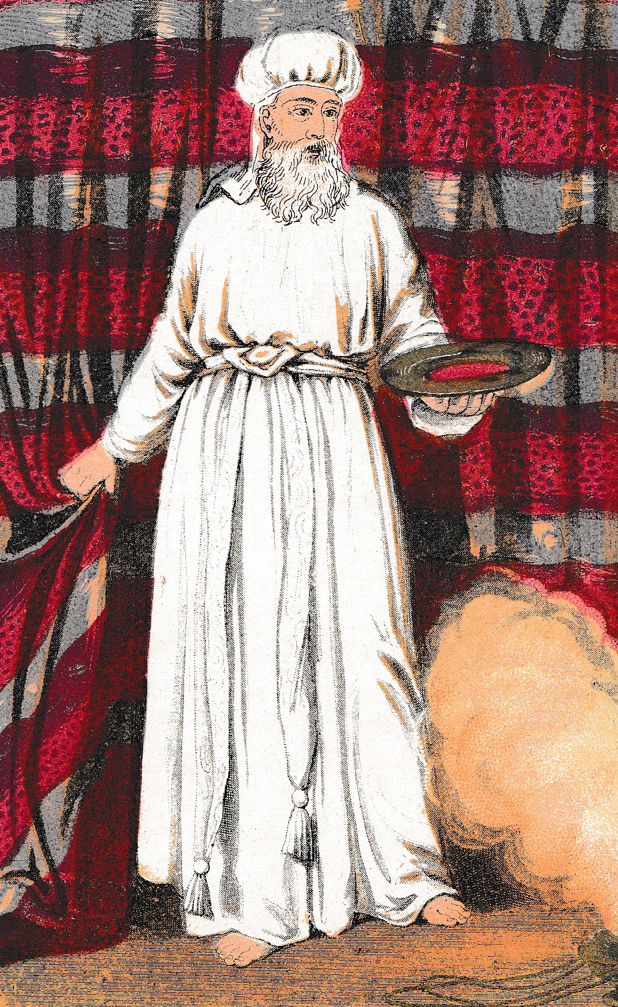
THE DAY OF ATONEMENT
The High Priest went into the Most Holy Place once a year, on the Day of Atonement.
It was an annual day of reconciliation between God and His people, Israel, where, through faith in the sacrifice of animals, they pictured what
the promised Saviour would do.
THE HIGH PRIEST
Before coming to the Mercy Seat, the High Priest would wash, change his clothing, and offer a sin offering for himself and his family. He also offered a sin offering on behalf of the people.
He carried some of the blood from both offerings and sprinkled it on and around the Mercy Seat. Leviticus 16
THE GREAT HIGH PRIEST
The Lord Jesus Christ gave Himself as a Sin Offering for the sins of all those who would believe in Him.
Hebrews 9: 12, 24
“… with His own blood he entered the Most Holy Place once for all, having obtained eternal redemption.”
“For Christ has not entered the Holy Places made with hands… but into heaven itself, now to appear in the presence of God for us….”
6

Slide 7
THE DAY OF ATONEMENT
God’s word, through Moses to all Israel - Leviticus chapter 23: 26-32
It was held on the tenth day of the seventh month each year (Sept-Oct)
– verse 27
No work to be done – disobedience resulted in being ‘cut-off from their people’ verses 28, 30
They were to ‘afflict their souls’ - The humbling of their souls for sin, and the making of their peace with God. verses 27, 29
They must offer an offering by fire to the LORD.
It was a holy convocation. verse 27
It was to be a Sabbath of solemn rest – from the evening of the ninth day to the evening of the tenth day. verse 32
The High Priest’s garments were linen Trousers, a Linen Tunic, a Linen Sash and a Linen Tuban (Leviticus 16: 4)
7

Slide 8
CHRIST’s PRIESTLY WORK ACCOMPLISHED
And every priest stands ministering daily and offering repeatedly the same sacrifices, which can never take away sins.
Hebrews 10: 11
†
But this MAN , after He had offered one sacrifice for sins forever,
sat down at the right hand of God….
Hebrews 10: 12
8

