Slide 1
The following Bible presentation includes notes and illustrations by the
Rev L G Stapleton
It also contains Colour Plates from the book – “Christ in the Tabernacle” (1877),
by Frank H White
The picture of the Tabernacle is taken from the CANDLE BOOKS – ‘Essential Bible Reference Series’ – ‘The Tabernacle’ by Tim Dowley - permission applied for.
Compiled by
Mark Stapleton
©Mark Stapleton 2024
1

Slide 2
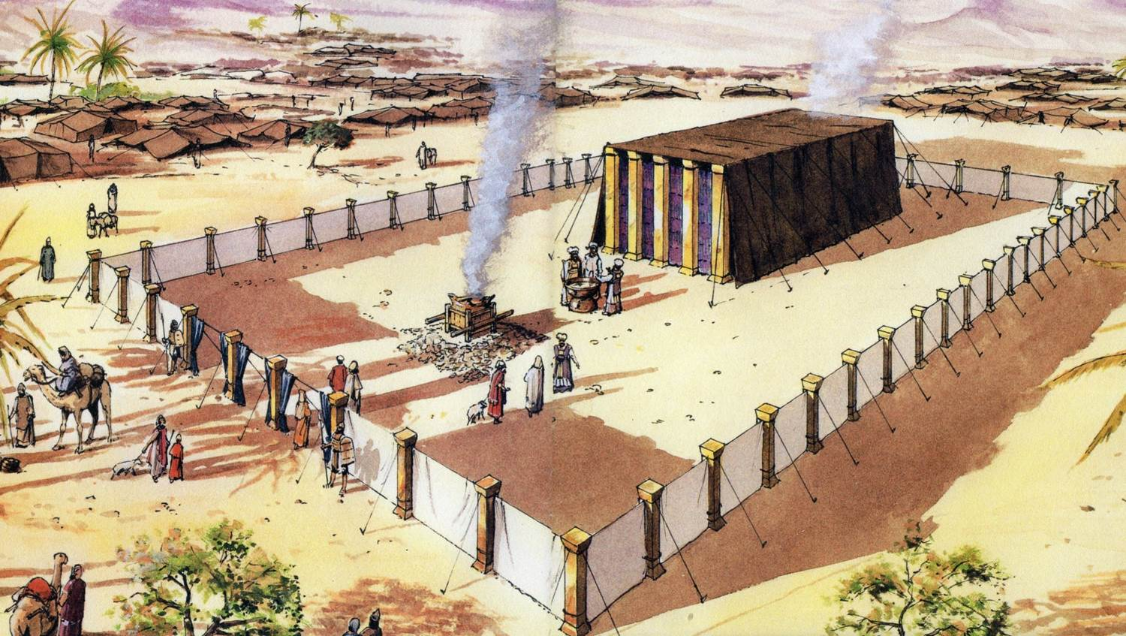
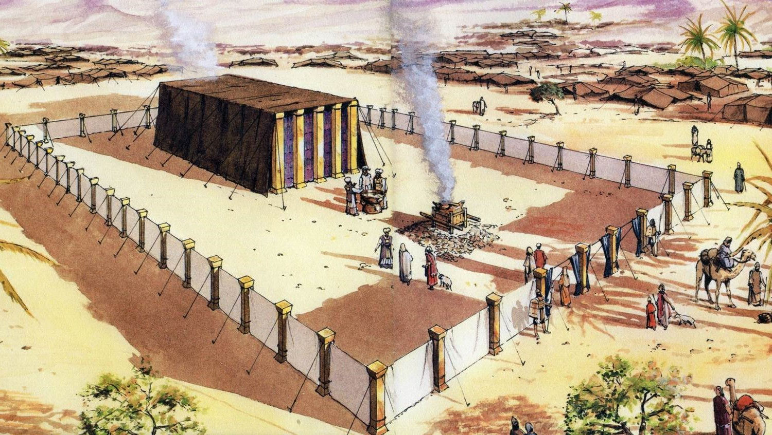
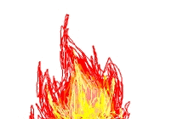
THE TABERNACLE
Part 4
Construction - inside
2

Slide 3
The Plan of the Tabernacle
(Not to scale)
The Laver
Altar of Incense
Table of Shewbread
NORTH
Ark of the Covenant
WEST
EAST
The Most Holy Place
Entrance
Veil/Curtain
The Outer Court
The Holy Place
The Candlestick
SOUTH
The Bronze Altar
3

Slide 4
THE PATTERN OF THE TABERNACLE
Plans - given in detail by God – Exodus chapters 25-31 – starting with the Ark of the Covenant
Plans - carried out in detail by Moses and the people – Exodus chapters 35-40
The Tabernacle speaks to the Christian believer of the LORD JESUS CHRIST
The Authority for using the Tabernacle for Spiritual lessons -
Hebrews 8:5; 9:8;
10: 19-22
NOTE - One CUBIT was the measurement from the tip of the big finger to the elbow, which is about ½ a metre.
4

Slide 5
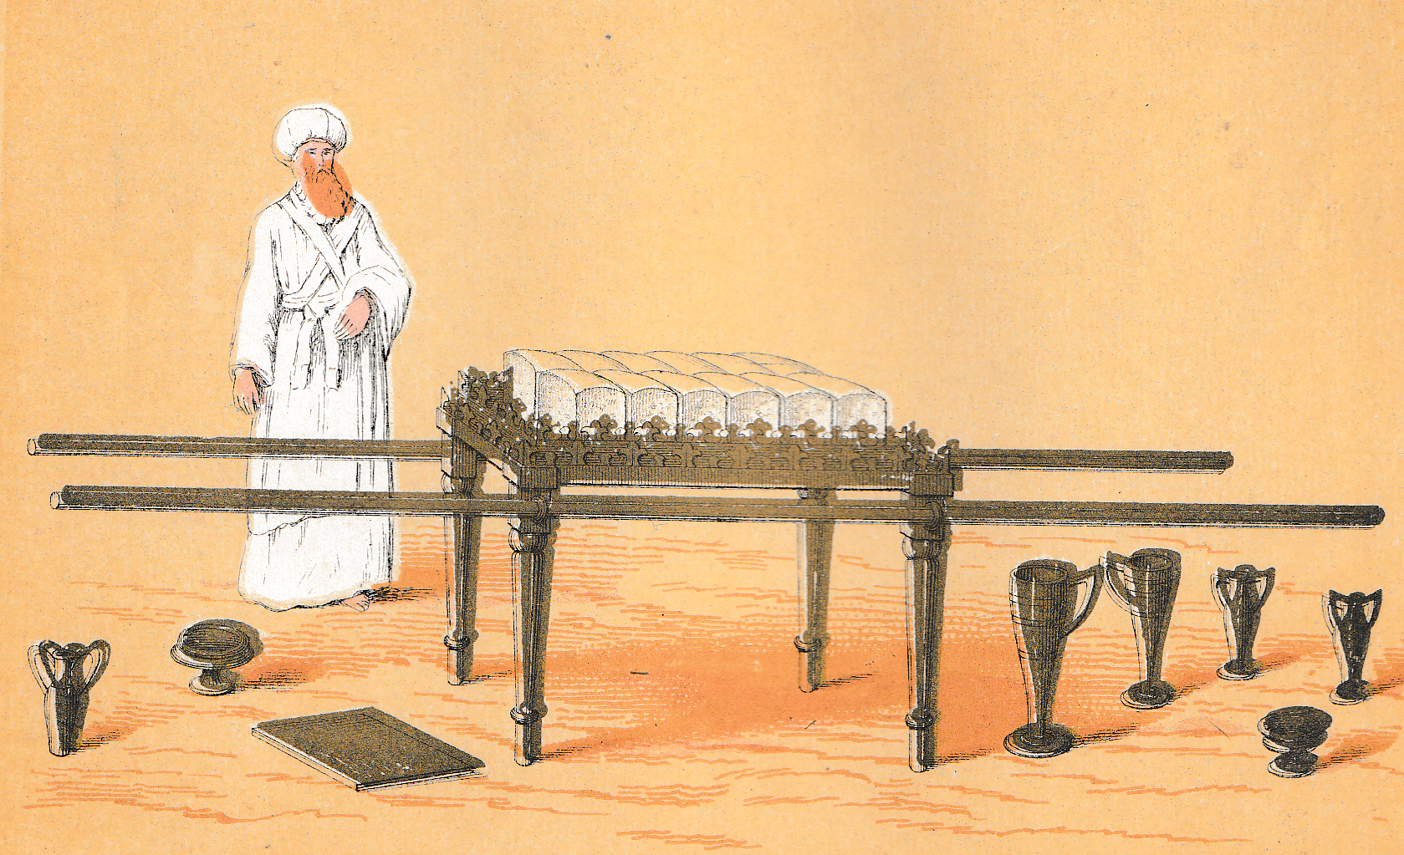
THE TABLE OF SHEWBREAD
(Exodus 25: 23-30; 37: 10-16)
THE SIZE: 2 cubits long x 1 cubit wide x 1 ½ cubits high.
Made of acacia wood, overlaid with gold.
Four rings for the two carrying poles – made from acacia wood, overlain with gold.
THE VESSELS: All dishes, bowls, spoons covers and jugs – all made of gold. No more bronze – sin judged is not to be reflected upon.
POSITION & PURPOSE: The table was place on the north side of the Holy Place, before reaching the inner veil. Only the Priests were allowed there.
The table was to hold the shewbread.
5

Slide 6
THE TABLE OF SHEWBREAD
(Leviticus 24: 5-9)
THE SHEWBREAD: Consisted of 12 loaves, or cakes, arranged in 2 rows of six.
‘Shewbread’, means - ‘the Bread of the presence’.
The Shewbread was made using fine flour, and baked with fire.
No leaven (yeast) was used.
Frankincense was put on each row. This was not incense, although it formed one of the ingredients of incense (Exodus 30: 34).
The Shewbread was changed each Sabbath day.
That which was removed was eaten by Aaron and his sons.
Jesus is the Bread of Life (John 6:35) to the believer priest. He is the sinless One (no leaven). We feed on Him for the maintenance of spiritual life – in the Holy place
6

Slide 7
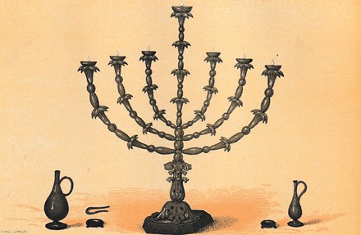
THE GOLDEN CANDLESTICK
(Exodus 25: 31-40; 27: 20-21; 30: 7-8; 37: 17-24; Leviticus 24: 1-4)
THE DETAILS – No size given. Made out of a talent of hammered pure gold. It consisted of a main shaft with 6 branches in pairs – a total of 7 lamps. There was also ornamental work on each branch.
THE INTRUMENTS – Snuffers, tongs and vessels, all of gold.
THE FUEL – Pure olive oil – pressed olives. A continual supply required. Trimmed and lit by the high priest (Aaron) – Exodus 30: 8.
7

Slide 8
THE GOLDEN CANDLESTICK
(Exodus 25: 37; 40: 24)
8
THE POSITION - It was place in the Holy Place, on the south side, opposite
the Table of Shewbread
THE PURPOSE – To give light in the Holy Place
THE MEANING – Christ is the Light of the World (John 9:5). The oil represents the Holy Spirit . The Glory of God is revealed by the Holy Spirit through Christ.
Gold beaten into shape – Isaiah 53: 10; Hebrews 2: 10. Last blow made it perfect.

Slide 9
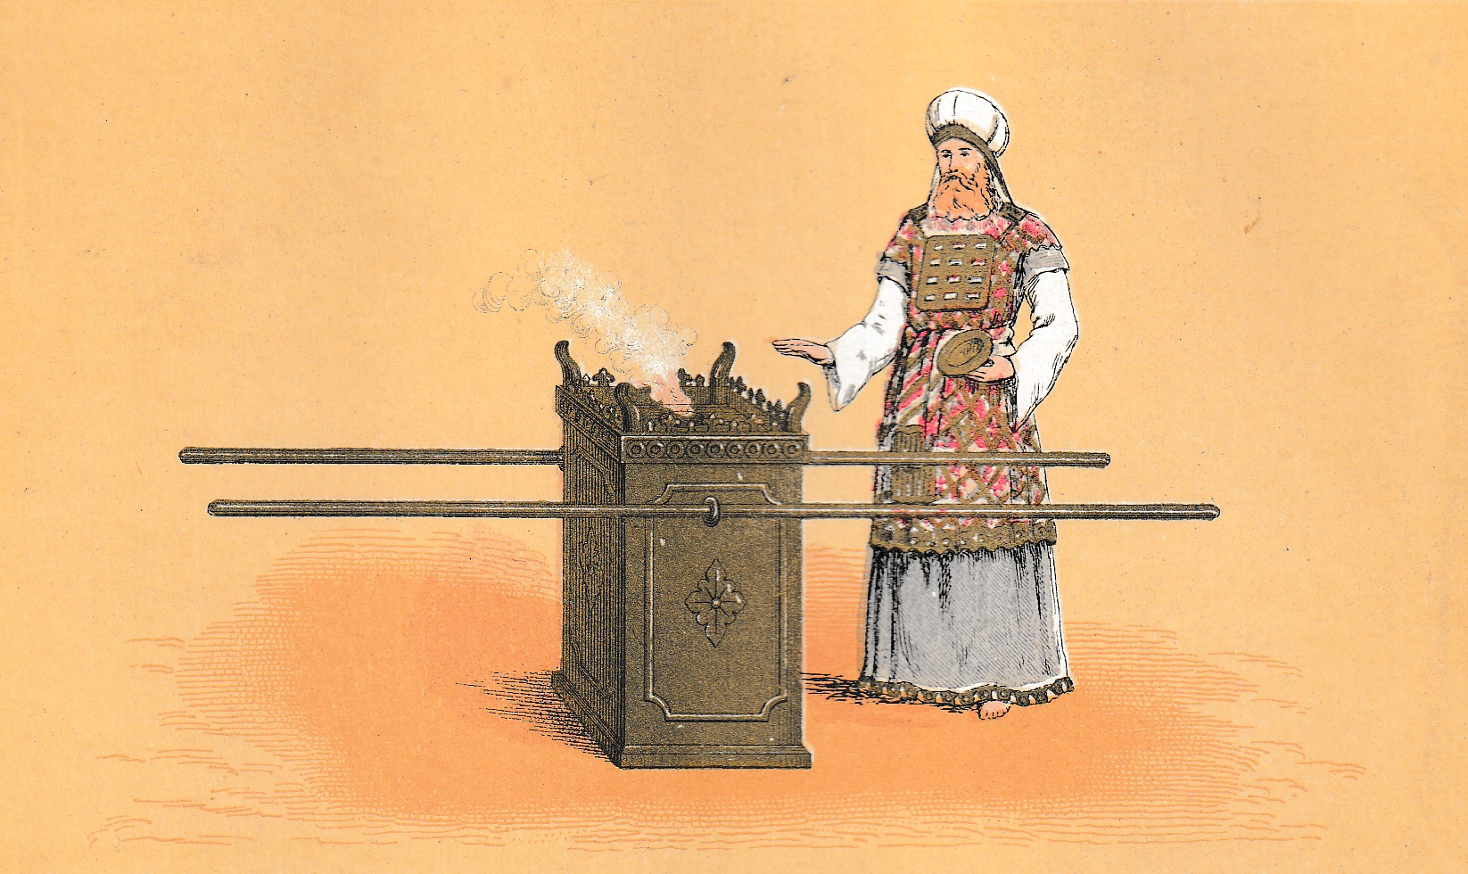
THE ALTAR OF INCENSE or THE GOLDEN ALTAR
Exodus 30: 1-10, 34-38; 37: 25-29,
THE DETAILS – It was 1 cubit square by 2 cubits high made of acacia wood and covered with gold. It was decorated with a golden crown, and had a horn on each corner. It was fitted with golden rings, through which 2 poles of acacia wood covered with gold, were used for carrying.
THE POSITION – In the Holy Place, in front of the veil that led to the Most Holy Place.
THE PURPOSE – For the burning of Incense (NOT for sacrifice)
9

Slide 10
THE ALTAR OF INCENSE or THE GOLDEN ALTAR
Exodus 30: 1-10, 34-38; 37: 25-28,
10
THE SIGNIFICANCE OF THE INCENSE –
It signified prayer in worship, and worship in prayer (Psalm 141: 2). It was used in approaching the mercy seat (the Most Holy Place) Leviticus 16: 12-13. The incense was a perfume which burned continually on the Altar, it was made especially for God. only used in worship, to be used only by the priests (2 Chronicles 26; 16-18); no other incense allowed
.. He always lives to make intercession for them
Hebrews 7: 25
THE SIGNIFICANCE OF THE ALTAR OF INCENSE
Linked with the bronze altar – blood from sacrifices put on the horns - Leviticus 4: 7
Linked with daily burnt offerings - Exodus 29: 39, 42
Linked with the Golden Candlestick
Sacrifice ascending without – prayer ascending within
The only basis for prayer is the atonement. The atonement is made effective by prayer

Slide 11
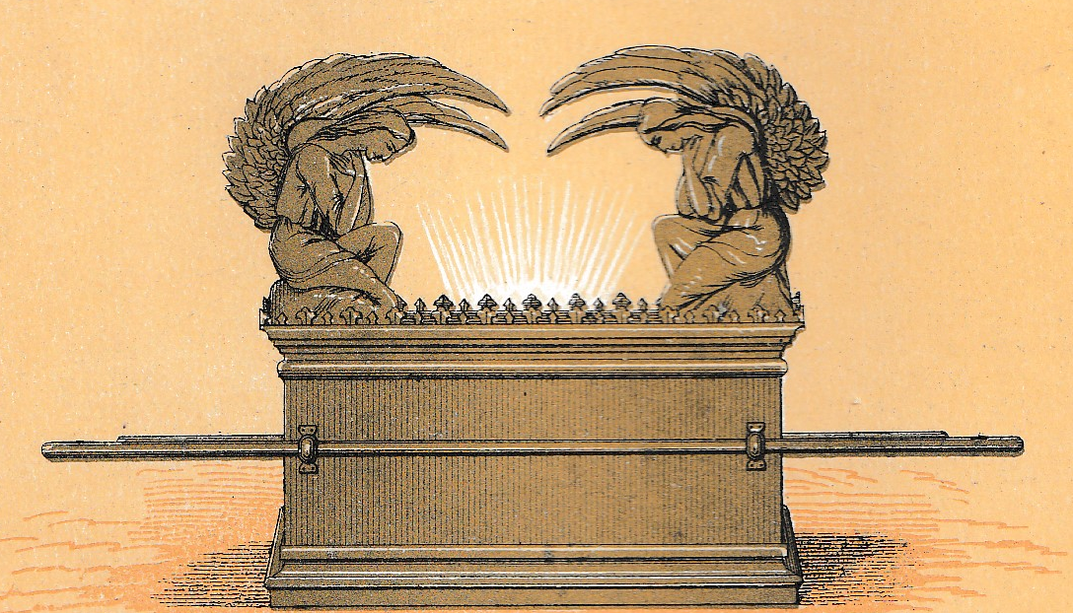
THE ARK OF THE COVENANT
(Exodus 25: 10-16; 37: 1-8)
11
THE STRUCTURE – the Ark of the Covenant was a box - 2½ cubits wide, 1½ cubits deep and 1½ cubits high. Made of Acacia wood, covered with gold, inside and outside.
There was a crown of gold around the top edge.
Two poles of Acacia wood, gold covered – used for carrying the Ark
THE POSITION – The only piece of furniture placed in the Most Holy Place.
Surmounted by the Mercy Seat and the Cherubim
THE PURPOSE - The preservation of the contents;
a base for the Mercy Seat; a basis of worship.

Slide 12
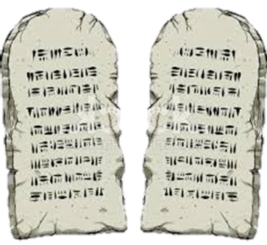
THE ARK OF THE COVENANT
(Exodus 25: 10-16; 37: 1-8)
12
THE CONTENTS
The Covenant was the Ten Commandments that God gave to His people through Moses at Horeb (Mt. Sinai), written on two tablets of stone by the hand of God
Exodus 19: 5
Exodus 32: 15 - 16
Exodus 34: 28-29
Deuteronomy 4: 31
Deuteronomy 5: 2-3
Our acceptance in worship – the basis is Christ and the New Covenant that is ours in Him (Luke 22: 20)
A reminder of God’s Holiness – seen in Christ
Psalm 40: 8
Also in the Ark of the Covenant was –
A pot of manna – a reminder of God’s faithfulness (Exodus 16: 32, 34) – now incorruptible – John 6 – seen in Christ
Aaron’s rod that budded – a reminder of God’s seal on His chosen leaders (Numbers 16: 5; 17: 2, 5) – resurrection seals Christ as God’s choice – our great High Priest

Slide 13
THE MERCY SEAT
THE STRUCTURE – It was made of pure gold and measured 2½ cubits wide x 1½ cubits deep. The height was not given. It was surmounted by 2 cherubim of pure beaten gold – each one facing inward, with wings over the Mercy seat
THE POSITION – It stood upon the Ark of the Covenant, of which it formed the lid.
ITS USE – Once a year on the Day of Atonement (Leviticus 16: 14) The place whereGod met and spoke with the High Priest for the year (Exodus 25: 22). Blood of the sin offering sprinkled on it - linked to the Bronze Altar.
13

Slide 14
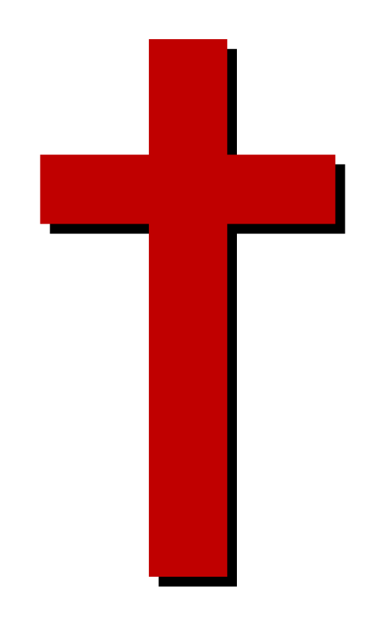
14
THE MERCY SEAT
ITS MEANING –
1. In the O.T. sin is covered on the grounds of offerings made and blood presented (Hebrews 10: 4; 9: 28; 9: 12) – based on the covenant (agreement) God had made.
2. The N.T. knows nothing of the atonement in the O.T. sense, for sin is not now covered, but put away.
3. In the N.T. the Mercy Seat (Hebrews 9: 5) is known as the propitiary. i.e. a place of receiving favour, forgiveness etc.
4. In the N.T. reconciliation is the right word – man approaches God on His terms,
(dealing with sin first) – through Christ
5. Now possible by reconciliation – God’s acceptance on the grounds of sin dealt with
(Hebrews 8: 1) – through Christ.
6. The Mercy Seat = the throne of grace (Exodus 25: 22; Hebrews 4: 16).
God’s better covenant – through Christ’s redeeming work at Calvary (Hebrews 8: 6)

