Slide 1
The following Bible presentation includes notes and illustrations by the
Rev L G Stapleton
It also contains Colour Plates from the book – “Christ in the Tabernacle” (1877),
by Frank H White
The picture of the Tabernacle is taken from the CANDLE BOOKS – ‘Essential Bible Reference Series’ – ‘The Tabernacle’ by Tim Dowley - permission applied for.
Compiled by
Mark Stapleton
©Mark Stapleton 2024
1

Slide 2
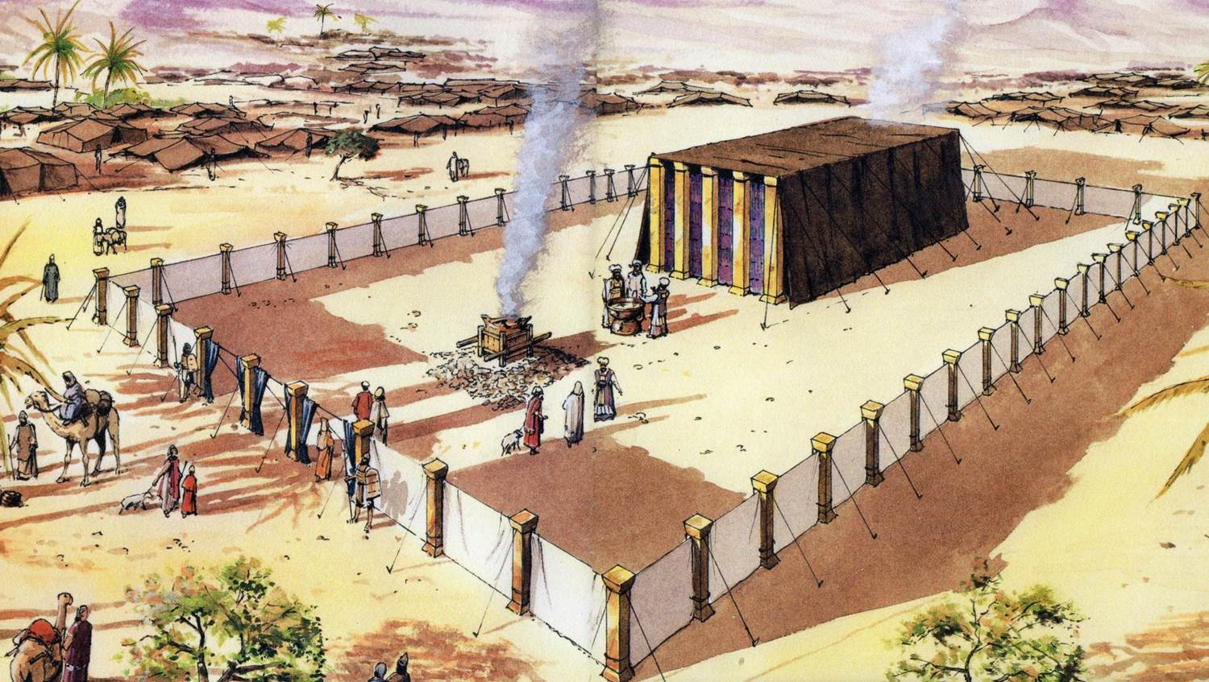
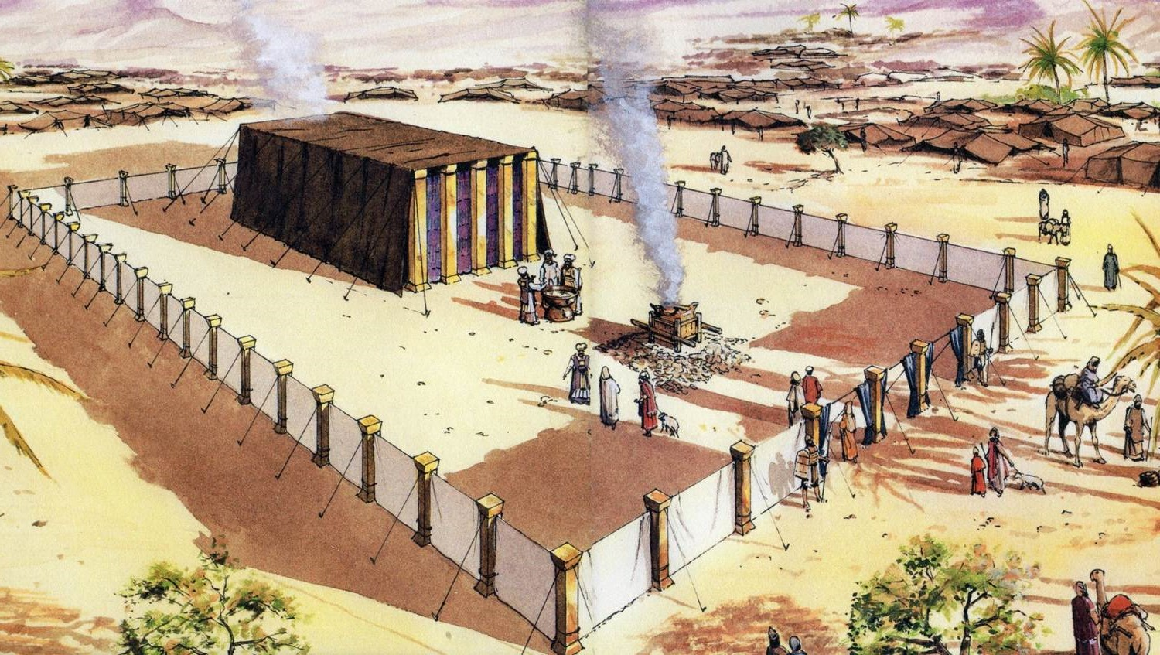
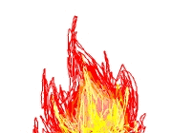
THE TABERNACLE
Part 3
Construction - outside
2

Slide 3
The Plan of the Tabernacle
(Not to scale)
The Laver
Altar of Incense
Table of Shewbread
NORTH
Ark of the Covenant
WEST
EAST
The Most Holy Place
Entrance
Veil/Curtain
The Outer Court
The Holy Place
The Candlestick
SOUTH
The Bronze Altar
3

Slide 4
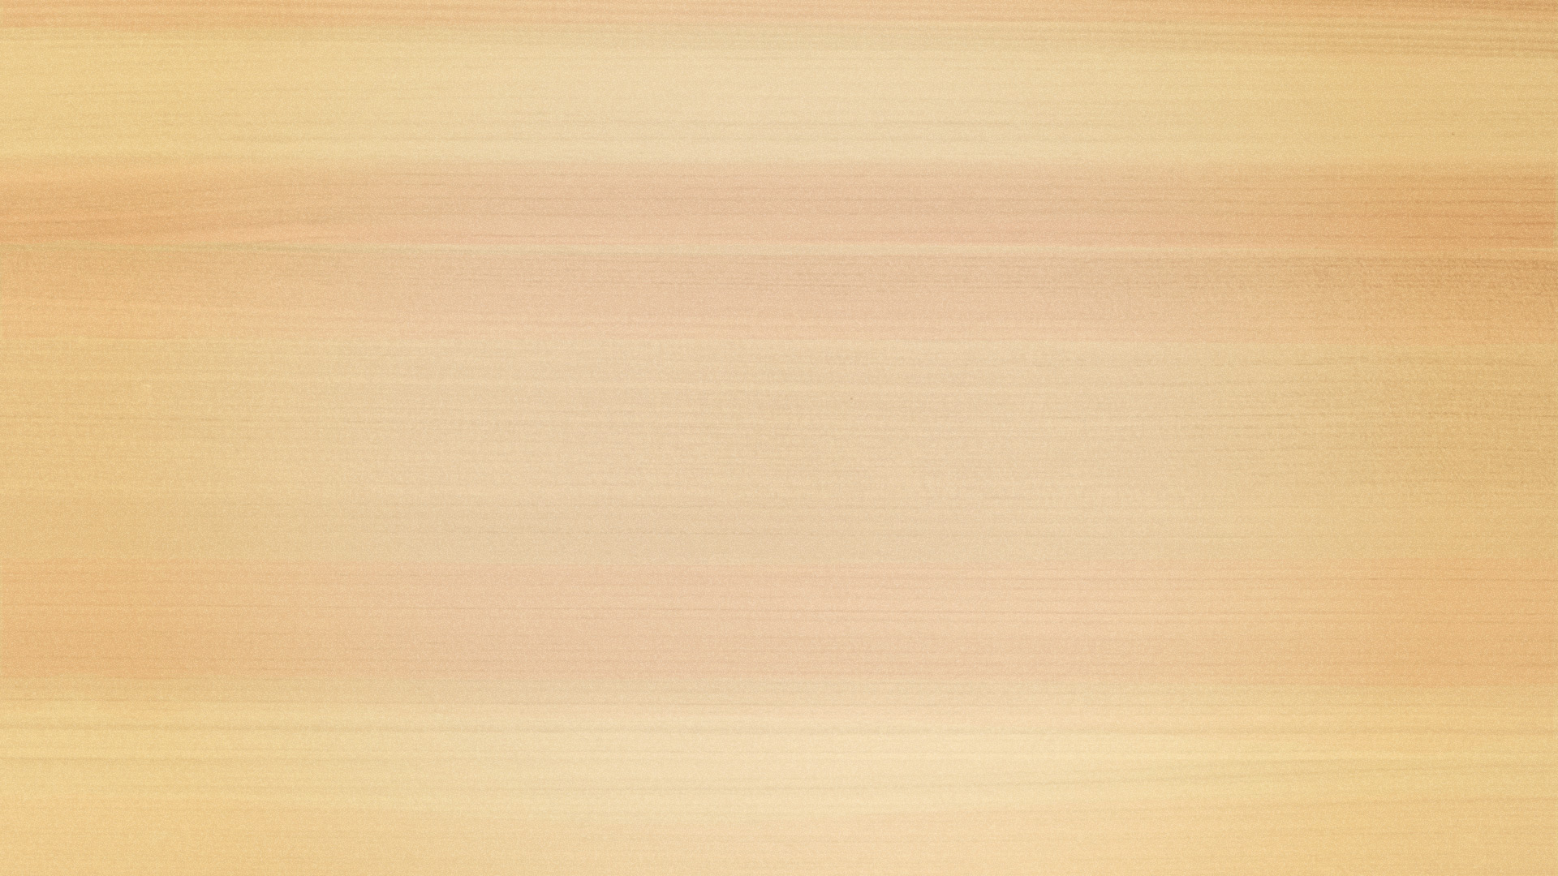
THE PATTERN OF THE TABERNACLE
Plans - given in detail by God – Exodus chapters 25-31 – starting with the Ark of the Covenant
Plans - carried out in detail by Moses and the people – Exodus chapters 35-40
The Tabernacle speaks to the Christian believer of the LORD JESUS CHRIST
The Authority for using the Tabernacle for Spiritual lessons -
Hebrews 8:5; 9:8-9;
10: 19-22
NOTE - One CUBIT was the measurement from the tip of the big finger to the elbow, which is about ½ a metre.
4

Slide 5
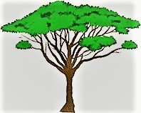
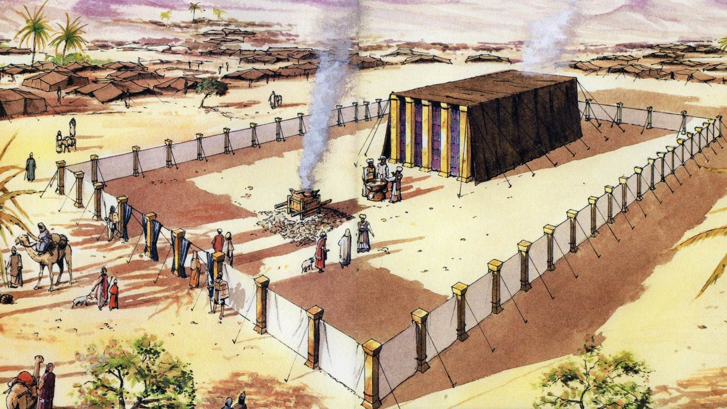
ACACIA WOOD
The Acacia tree was able to survive in harsh desert conditions. It was a very hard, durable wood which had a rich golden colour
Acacia Tree
The wood of the Acacia tree (NKJV), or the Shittah tree (AV) was used in the construction of the Altar of burnt Offering, the Ark of the Testimony, the Table for the Shewbread,
the Altar of Incense and the boards and bars of the sides of the tabernacle and
the pillars of the Holy and Most Holy Place.
5

Slide 6
THE OUTER COURT
bounded by a fence of curtains
20 pillars on the North & South sides – bronze sockets; with silver hooks, caps & bands, on which the curtains of white woven linen were hung
10 pillars on the West & East sides with bronze sockets - silver hooks, caps & bands.. On the middle 4 pillars on the East side hung the curtains of the entrance veil, made of blue, purple and scarlet thread and fine woven linen
WEST
NORTH
15 cubits
20 cubits
SOUTH
100 cubits
15 cubits
5 cubits
EAST
Exodus 27: 9-19
The entrance veil/curtain could be easily seen, was open to all and was the only way into the Outer Court. Fine white twined linen curtains formed a barrier - God demands righteousness. Too high to see over.
6

Slide 7
THE ALTAR OF BURNT OFFERING
Exodus 27: 1-8; 38: 1-7
THE BRONZE ALTAR
THE POSITION – In the outer Court – East end. It was the first thing a person met after entering through the entrance veil/curtain
THE PURPOSE – simply for the offering of sacrifices. The only place in the whole Tabernacle where sacrifice was made or allowed
7

Slide 8
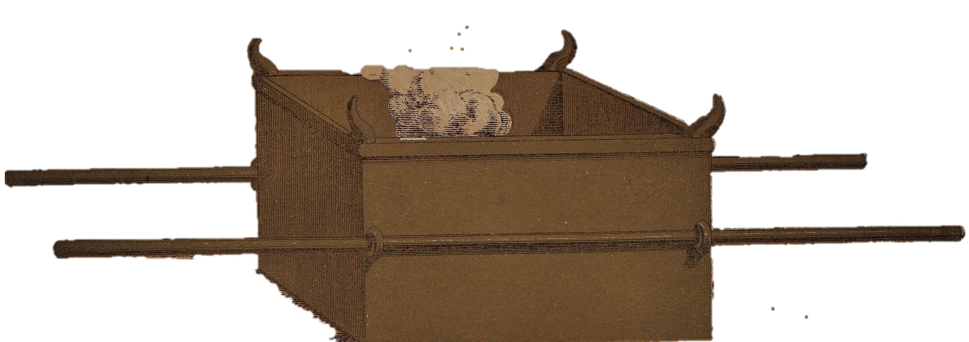
THE ALTAR OF BURNT OFFERING
The details
8
SIZE: 5 cubits square by 3 cubits high – made of acacia wood, overlaid with bronze (Exodus 27: 1-2). Probably raised up slightly with an earth slope, to remove ashes.
A bronze ring on each corner were to hold the two poles used for carrying the altar - made of acacia wood overlaid with bronze (Ex. 27: 6-7)
A horn on each corner made of acacia wood , overlaid with bronze (Ex. 27: 2)
Grating and 4 rings of bronze was placed ½ way up the inside of the altar (Ex. 27:4-5)
Pans shovels, basins, forks and firepans – all made of bronze (Ex. 27: 3)

Slide 9
THE ALTAR OF BURNT OFFERING
The teaching
9
The Horns were symbolic of power
(Deuteronomy 33: 17; 1 Kings 22: 11; Jeremiah 48:25 etc)
The Altar shows divine judgement – sacrifice was essential in approaching God (Hebrews 9: 22, 10:4, 12; 2 Corinthians 5: 21)
The fire was never to go out (Leviticus 6: 13)
The Altar represents the Cross of Calvary, which is open to the sinner

Slide 10
THE LAVER
LAVER
THE POSITION – In the outer Court. Between the Altar and the
entrance to the Holy Place (Exodus 30: 18)`
THE PURPOSE – for the priests (not all the Levites) for washing hands and feet
in preparation for service.
Penalty for not using it was death (Exodus 30: 19-21)
10

Slide 11
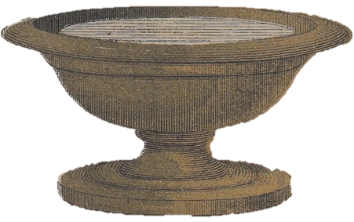
THE LAVER
The Materials – All Bronze
The Laver held water, and was made from the bronze mirrors
of the serving women at the door of the Tabernacle (Exodus 38: 8)
2. No size or shape given
The Significance
Used before coming to the Brazen altar (outward service)
Used before going into the Holy place (inward service)
Bronze altar showed sin dealt with by a judge
Laver shows offences dealt with as by a father
The Meaning
All believers are Priests – 1 Peter 2: 5, 9; Revelation 1: 5-6; 5: 10
Constant washing of water by the Word – Ephesians 5: 26; John 15: 3
We are cleansed from the guilt of sin at the Bronze altar – the Cross
We are cleansed from the defilement of sin daily at the laver – John 13: 10
NB – Psalm 24: 3 - 5 - Apply it re worship & service
Psalm 119: 9 – The need for daily Bible reading
11

Slide 12
THE TABERNACLE STRUCTURE
THE MOST HOLY PLACE
THE HOLY PLACE
12

Slide 13
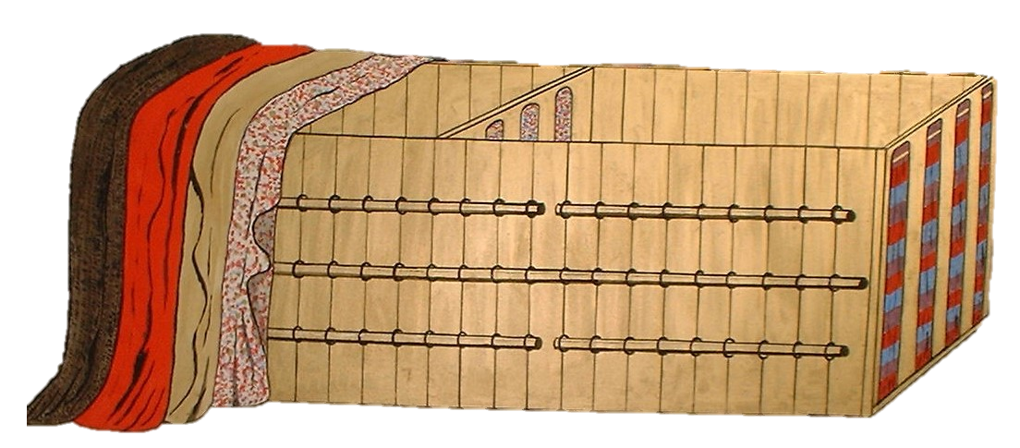
THE TABERNACLE STRUCTURE
Exodus 26: 1-27; 36: 8-38
BADGER SKINS (or seal skins?) – size not given
THE COVERINGS
The Holy Place
30 cubits
20 cubits
The Most Holy Place
10 cubits
RAM SKINS - dyed red – size not given
10 cubits
(not to scale)
LINEN – coloured red, blue and purple, with cherubim - formed the ceiling inside – visible only within – 5 x 28cu. Long x 4cu. Wide
GOATS’ HAIR – 11 x 30cu. Long x 4cu. Wide
13

Slide 14
THE TABERNACLE STRUCTURE
Exodus 26: 1-27; 36: 8-38
THE BOARDS
Each board was 10cubits high x 1½ cubits wide made out of acacia wood, covered with gold
(not to scale)
There were 20 boards on the North & South sides; 6 boards on the West side with 2 corner boards. Each board had two tenons at the bottom, to fit into the silver sockets.
Bars made of Acacia wood, covered with gold, slotted through gold rings,
strengthened the structure.
14

Slide 15
THE TABERNACLE STRUCTURE
Exodus 26: 1-27; 36: 8-38
15
SOCKETS FOR THE BOARDS
(not to scale)
The sockets were made of silver – from the silver offering (Exodus 38: 24-28)
There was a total of 100 sockets, each of 1 talent of silver
Note – the five sockets for the entrance to the Holy Place were made of bronze

Slide 16
THE TABERNACLE STRUCTURE
Exodus 26: 1-27; 36: 8-38
16
THE VAILS
The inner vail
The outer vail
(not to scale)
The Inner vail – made of linen, woven from blue, red and purple thread, with cherubim.. Hung upon 5 pillars of acacia wood, overlaid with gold, set in silver sockets.
The Outer vail – made of linen, woven from blue, read and purple thread. Hung upon 4 pillars of acacia wood, overlaid with gold, set in sockets of bronze.

Slide 17
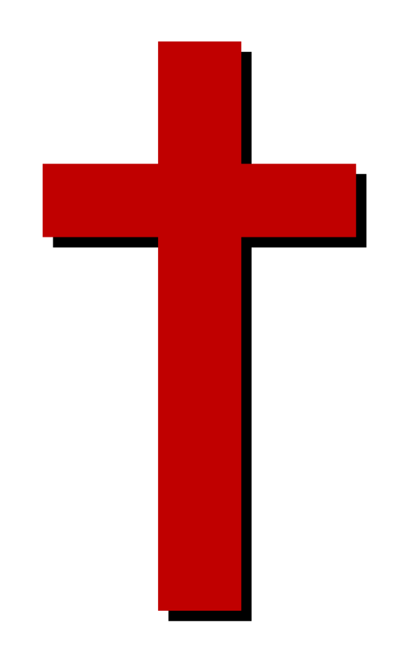
THE EASTERN ENTRANCE VEIL
Materials and colours all remind us of the Lord Jesus Christ
17
John 14: 6 –
I am the way, the truth, and the life. No one comes to the Father except through Me
John 10: 9 –
I am the door. If anyone enters by Me, he will be saved, and will go in and out, and find pasture.
The White linen = Righteousness
The Blue = the Heavenly
The Purple = Royalty and Priesthood
The Scarlett/Red = Sacrifice
Bronze Sockets for the posts = Sin Judged
Silver hooks and caps = Redemption

