Slide 1
The
This PowerPoint presentation is based on Bible notes and illustrations by the Rev L G Stapleton
The picture of the Tabernacle is taken from the CANDLE BOOKS – ‘Essential Bible Reference Series’ – ‘The Tabernacle’ by Tim Dowley - permission applied for.
Compiled by
Mark Stapleton
©Mark Stapleton 2024
1

Slide 2
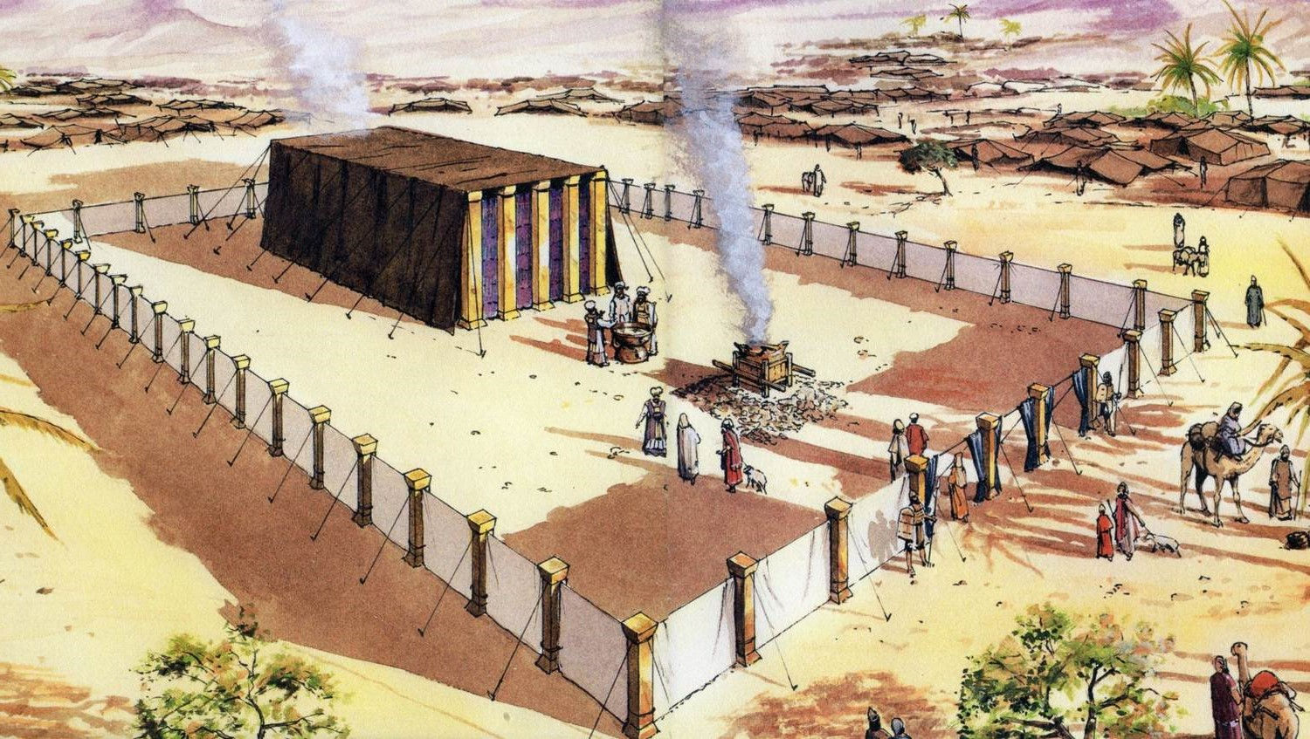
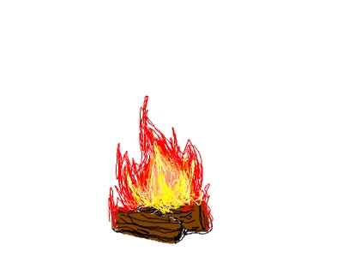
THE TABERNACLE
Part 2
God’s Plans
2

Slide 3

The Purpose of the Tabernacle
Key Verse: Exodus 25: 8
3
The Tabernacle was to be a special Tent that could be dismantled and transported from place to place. It signified God’s presence with His people; a place where God is worshipped and where sacrifices are made.
Most of the details regarding the building and use of the Tabernacle are found in the Books of Exodus, Leviticus and Numbers.
EXODUS
The Exodus from Egypt; the building of the Tabernacle
LEVITICUS
Instructions about the Tabernacle, sacrifices, worship and daily living
NUMBERS
Instructions for the journey through the desert with the Tabernacle

Slide 4
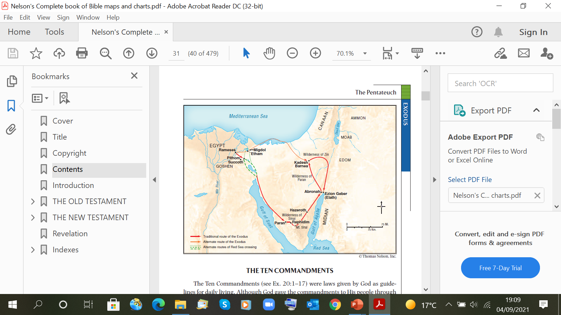
Mount Sinai
God gave Moses the Ten Commandments (Exodus 20)
TABERNACLE
PLANS GIVEN
“..according to the pattern which was shown you on the Mountain.”
Exodus
25:9, 40; 26:30 Numbers 8: 4
Acts 7:44
Hebrews 8:5
TABERNACLE
PLANS FULFILLED
“As the LORD Commanded Moses”
Exodus
chapters 35-40
Leviticus
8: 36
4

Slide 5
The Position of the tabernacle in the Camp
Numbers chapters 2 & 3
NORTH
TRIBES OF -
MANASSEH EPHRAIM BENJAMIN
TRIBES OF -
ISSACHAR JUDAH ZEBULUN
TRIBES OF -
ASHER DAN NAPHTALI
MOSES
AARON PRIESTS
GERSHONITES
MERARITES
WEST
TABERNACLE
EAST
KOHATHITES
TRIBES OF -
SIMEON REUBEN GAD
SOUTH
5

Slide 6
The Plan of the Tabernacle
(Not to scale)
Altar of Incense
Table of Shewbread
The Laver
NORTH
Ark of the Covenant
WEST
EAST
The Most Holy Place
Entrance
Veil/Curtain
The Outer Court
The Holy Place
The Candlestick
SOUTH
The Bronze Altar
Exodus 40: 1-33
6

Slide 7
METALS
In the Authorised (King James) Version of the Bible, the word BRASS is used to indicate the metal which is used to cover the Brasen Altar and its various instruments, the sockets for the posts surrounding the Outer Court, the sockets for the posts at the entrance to THE HOLY PLACE, and the construction of the Laver
Today, BRASS is known as an alloy of COPPER and ZINC.
In the New King James Version of the Bible, the word BRONZE is used to indicate the metal which is used for the items listed above. It was also used to make the fiery serpent in the Bible mentioned in Numbers 21: 4-9 – c/f John 3: 14.
Today, BRONZE is known as an alloy of COPPER and TIN.
Some commentators suggest that the metal used was purely COPPER.
In these presentations the New King James version of the Bible is quoted. The word BRONZE has therefore been used
7

Slide 8
The Silver Offering
8
Exodus 38: 25-28; Numbers 1: 46
The offering was based on the number of men aged 20 and over from (Israel) except for the tribe of Levi). Each man gave a half a shekel of silver (10 Gerahs). The total number of men was 603,550. This produced 100 talents + 1775 shekels of silver this was enough to produce the sockets for the sanctuary and the veil, together with the hooks for the pillars, and their capitals and bands.
Old Testament weights used were –
1 Talent = 60 Minas (1 Talent weighed about 30 kilos)
1 Mina = 50 Shekels
1 Shekel = 2 Bekahs (1 Bekah weighed about 6-7 grams)
1 Shekel = 20 Gerahs

Slide 9
Materials used in the building of the Tabernacle
GOLD
BRONZE
SILVER
SCARLET THREAD
BLUE THREAD
FINE LINEN
PURPLE THREAD
BADGER SKINS
ACACIA WOOD
GOAT HAIR
RAM SKINS
SPICES
OIL
PRECIOUS STONES
EXODUS 25: 1-7
9

Slide 10
THE SIGNIFICANCE OF THE COLOURS
(As usually accepted)
GOLD
THE DIVINE GLORY
RED
SACRIFICE
BLUE
THE HEAVENLY
PURPLE
ROYALTY & PRIESTHOOD
THE SIGNIFICANCE OF THE MATERIALS
SILVER
REDEMPTION
BRONZE
SIN JUDGED
WHITE LINEN
RIGHTEOUSNESS
ACACIA WOOD
HOLY MANHOOD
OIL
10
THE HOLY SPIRIT

Slide 11
God’s appointed workers
BEZALEL
Who was he?
He was the son of Uri, son of Hur of the tribe of Judah
Exodus 31:2
What did he do?
He produced artistic work in gold, silver and bronze; cutting and setting jewels; carving wood; various workmanship; able to teach
Exodus 31: 4-5. Exodus 35: 34
+ Many helpers (Artisans)
Exodus 36: 1-2, 8; 35: 10
11

Slide 12
God’s appointed workers
AHOLIAB
Who was he?
He was the Son of Ahisamach, of the tribe of Dan
Exodus 31: 6
What did he do?
He made the Ark in the Tabernacle; the mercy seat; the table for the shewbread + utensils; the gold lampstand + utensils; the altar of incense; the altar for burnt offerings; the laver; priestly garments; anointing oil; incense. Exodus 31: 6-11.
12
+ Many helpers (Artisans)
Exodus 36: 1-2, 8; 35: 10

Slide 13
GIVING
13
Willingly (Exodus 25: 2; 35: 5)
The people gave
Exodus 35: 20-29)
As a freewill offering (Exodus 35: 29)
More than enough (Exodus 36: 7)
They had also spoiled the Egyptians when they left Egypt – bringing with them gold, silver, clothing etc – Exodus 12: 35, Psalm 105: 37

Slide 14
†
The Lord Jesus Christ gave Himself
Willingly – Hebrews 10: 9 (‘I have come to do Your will, O God.’)
As a freewill offering – Hebrews 9: 14, 26 (…offered Himself without spot to God) (…to put away sin by the sacrifice of Himself), Ephesians 5: 2 (…given Himself for us, as an offering and a sacrifice – to God)
More than enough – 1 John 1: 7 (…cleanses us from all sin)
14

