Slide 1
The following series of PowerPoint Bible presentations includes notes and illustrations by the Rev L G Stapleton
ferences to dates from
References to dates are taken from THE ANNALS OF THE WORLD, James Ussher,
Archbishop of Armagh
Includes illustrations from the book ‘Christ in the Tabernacle’ (1877) by Frank H White
Scripture taken from the New King James Version Copyright © 1979 1980 1982 by Thomas Nelson, Inc. Used by permission. All rights reserved.
The picture of the Tabernacle is taken from the CANDLE BOOKS – ‘Essential Bible Reference Series’ – ‘The Tabernacle’ by Tim Dowley - permission applied for.
Compiled by
Mark Stapleton © 2024
1

Slide 2
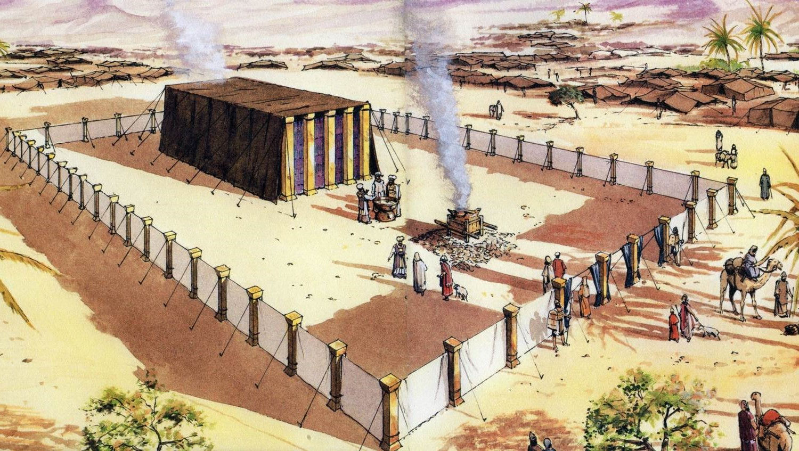
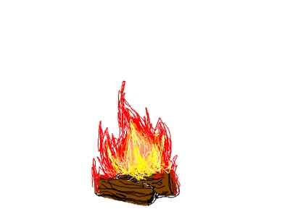
THE TABERNACLE
Part 1
Background
2

Slide 3
ABRAM changed to ABRAHAM
(Genesis 17: 5)
1996BC – 1821BC
Born in Ur of the Chaldees, buried in Mamre in Canaan
Lived 175 years
Genesis 15: 7; 25: 7, 9
c1922BC
The covenant promises given to Abram (Abraham) in Ur
(Genesis 12: 2-3; Acts 7: 2-3)
1. A NEW LAND (Canaan)
2. A NEW NATION (Israel)
3. A BLESSING TO THE FAMILIES OF THE EARTH
(Salvation through the Lord Jesus Christ)
3

Slide 4
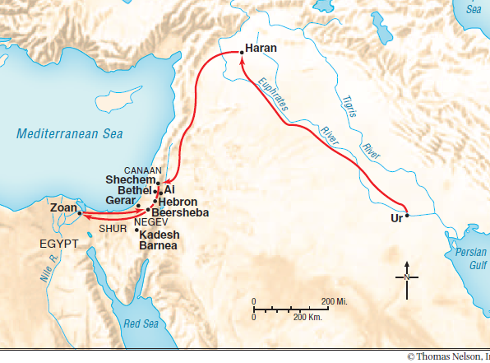
The Abraham’s journey from Ur to Canaan
(Genesis 12:1)
The time in Egypt was only temporary, during a time of famine in Canaan
(Genesis 12: 10; 13: 3)
4

Slide 5
ISAAC
1896BC – 1716BC
Lived 180 years (Genesis 35: 28)
Born when Abraham, his father was a 100 years old
Genesis 21: 5
Isaac was 40 years old when he married Rebekah
Genesis 25: 20
JACOB
1837BC – 1688BC
Lived 147 years (Genesis 47: 28)
Born when Isaac, his father, was 60 years old (Genesis 25: 26)
God changed Jacob’s name to Israel (Genesis 35: 10) He was 130 years old when he went to Egypt 1706BC (Genesis 47: 28)
5

Slide 6
LEVI
1756BC – 1619BC
Lived 137 years (Exodus 6: 16)
Levi was the 3rd son of Israel (Jacob)
Genesis 29: 34; 35: 23b-26
KOHATH
He was the son of Levi and died aged 133 years
(Exodus 6: 18)
Dates for his lifespan are unknown, but it is believed he was born in Canaan
His brothers were Gershon and Merari
6

Slide 7
AMRAM
1616BC – 1479BC
He was the son of Kohath and died aged 137 years
(Exodus 6: 18, 20)
His brothers were Izhar, Hebron, and Uzziel
MOSES
1571BC – 1451BC
He was the son of Amram and died aged 120 years (Deuteronomy 34: 7) His brother Aaron was
3 years older than him (Exodus 7: 7)
Moses led Israel out of Egypt when he was 80 years old – c1491BC
7

Slide 8
The time spent in slavery in Egypt
KEY VERSE
Galatians 3: 16-17
Now to Abraham and his Seed were the promises made. He does not say, “And to Seeds”, as of many, but as of one, “And to your Seed”, who is Christ. And this I say, that the law, that was four hundred and thirty years later, cannot annul the covenant that was confirmed before….
Exodus 12: 40 – shows that the ‘sojourning of the children of Israel who lived in Egypt was four hundred and thirty years.’ The margin indicates that that time included Canaan = (NKJV) Sam LXX i.e. the Samaritan Pentateuch and the Septuagint
The Call of Abraham was = c1922BC
The giving of the Law to Moses was = c1492BC
= 430 years
Call of Abraham – c1922BC; Jacob went to Egypt – c1706BC = c215 years
Jacob went to Egypt – c1706BC; the Law was given to Moses c1492BC = c215 years
8

Slide 9
Slavery in Egypt
The people of Israel suffered slavery under the Pharaohs for 215 years. (Exodus 1:8-14)
They multiplied and grew very mighty (Exodus 1:7, 20).
Population probably grew to 2-3 million - c1491 BC
The Exodus from Egypt – c1492 BC - was under the leadership of Moses – appointed by God
(Exodus 3:10)
9

Slide 10
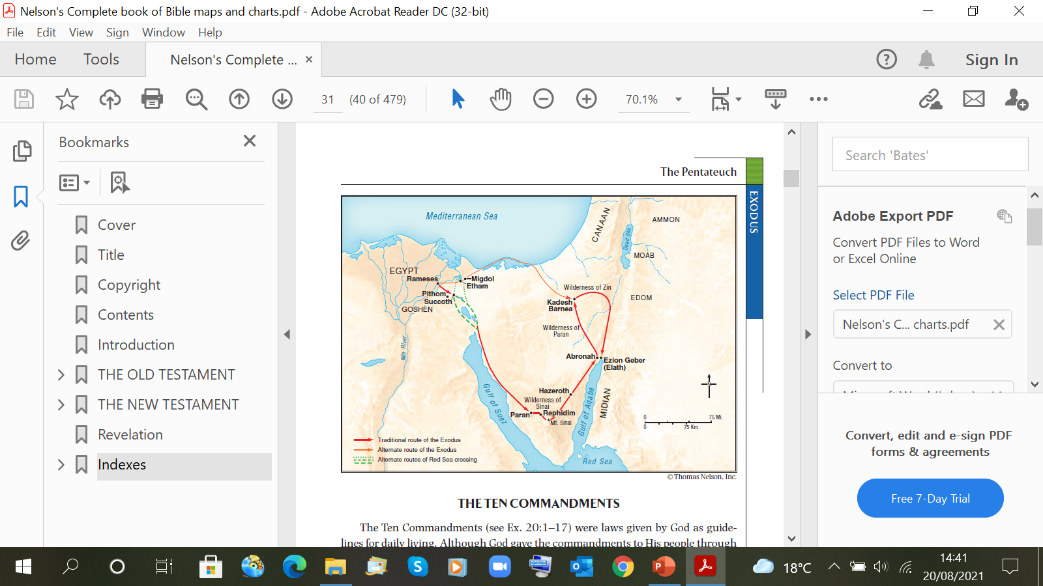
The journey through the wilderness
40 Years
wandering because of unbelief
Numbers 14:33
c1492 BC
To
c1452 BC
10

Slide 11
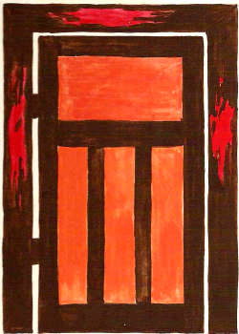
†
Leaving Egypt
The children of Israel were a Redeemed people –
All had to pass through the door on which the blood of a substitutional sacrificial lamb had been put (Exodus 12: 7)
All passed through the waters of the Red Sea (Exodus 14: 22)
All were brought out of a place of sin and slavery by God’s Mighty Arm (Exodus 14: 30)
(summed up in the words of Deuteronomy 6:23)
We are Redeemed through the blood of our Saviour – the Lord Jesus Christ – the only way – John 14: 6
11

