Slide 1
The following Biblical presentation is based on notes and illustrations by the Rev L G Stapleton
compiled by
Mark Stapleton
© Mark Stapleton 2016
1

Slide 2
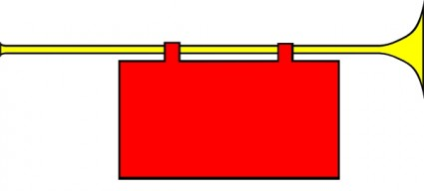
MALACHI
MY MESSENGER
2
Notes:
“Says the LORD of Hosts” – used 22 times in the book – NKJV & AV

Slide 3
MALACHI
Last book in the Old Testament. Ends with the possibility of God smiting the earth with a curse (Ch. 4 v. 6)
The last of the prophets – c.400 years of silence before the coming of the Lord Jesus Christ
Hebrews 1 v. 1-2
The book is dated about
420 B.C., 70 years after the return of Judah from exile
Concern about the neglect in the service of God’s House. Also concern about Zion’s prosperity; he encourages the people regarding the future
3

Slide 4
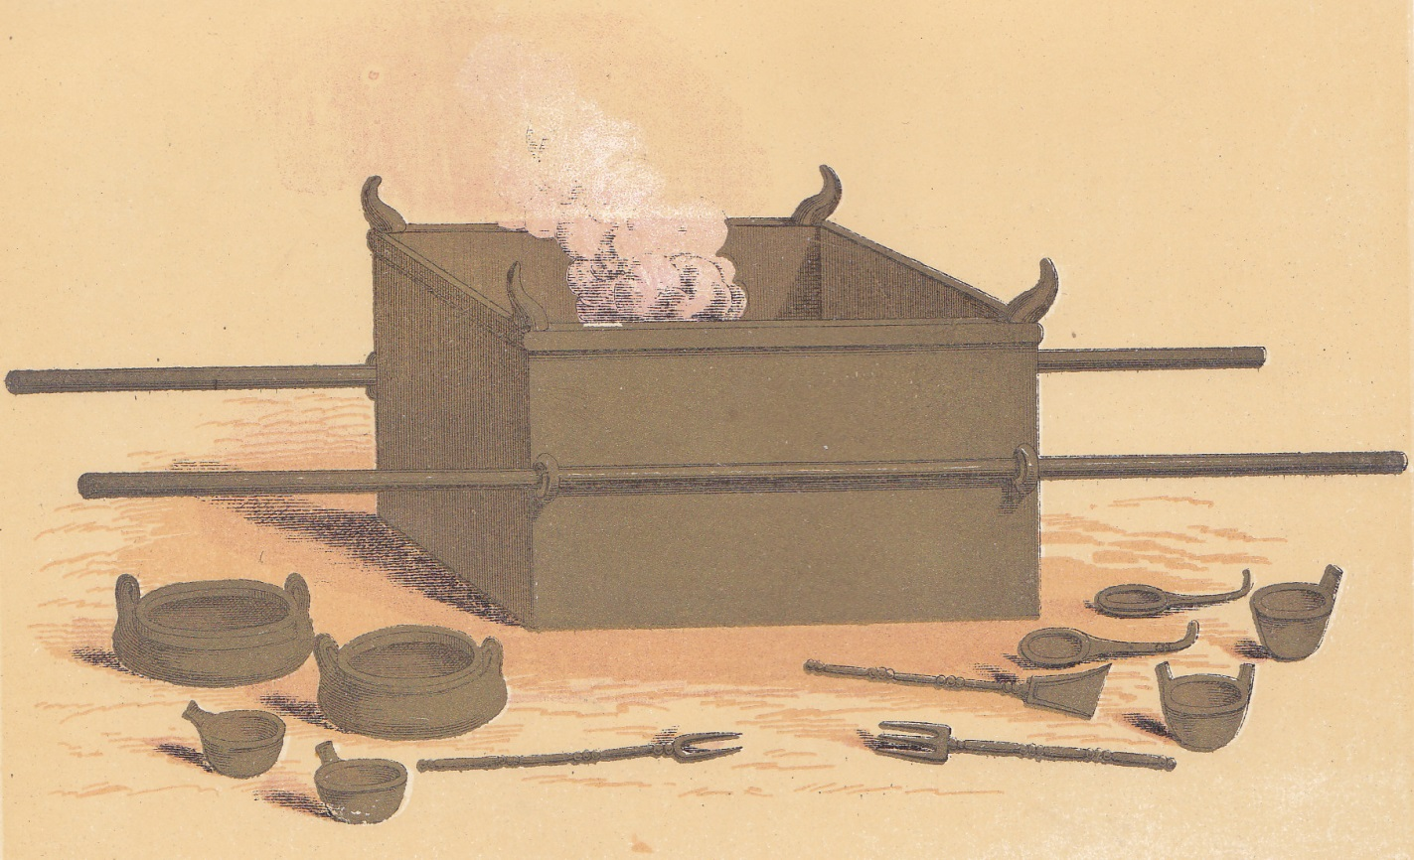
MALACHI
The Priests – In what way have we
despised God’s name?
Chapter 1 v. 6
Malachi – Worthless offerings
Chapter 1 vs. 7 – 14
(Deuteronomy 15 v. 21)
4

Slide 5
MALACHI
The Priests – In what way have we wearied God ?
Chapter 2 v. 17
WORDS
WORDS
WORDS
WORDS
WORDS
Malachi – you have wearied the LORD
with your words
Chapter 2 v. 17
5

Slide 6
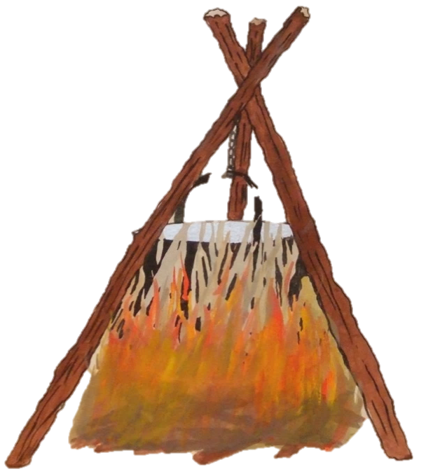
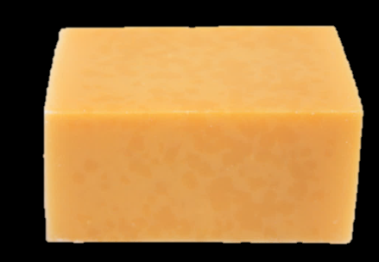


MALACHI
God’s dealing with the Priests
Chapter 3 v. 2
Fuller’s
soap
The Priests lacked purity in service and worship
Chapter 3 vs. 2-3, 7
6
Notes:
Fullers soap = Av, Launder’s soap=NKJV

Slide 7



MALACHI
The People – In what way have we robbed God ?
Chapter 3 v. 8
SELF
500
90 bushells
300 pieces
20 gallons
GOD
50
9 bushells
30 pieces
2 gallons
20
4
15
1
Malachi – Bring all the tithes into the storehouse
Chapter 3 v. 10
7

Slide 8
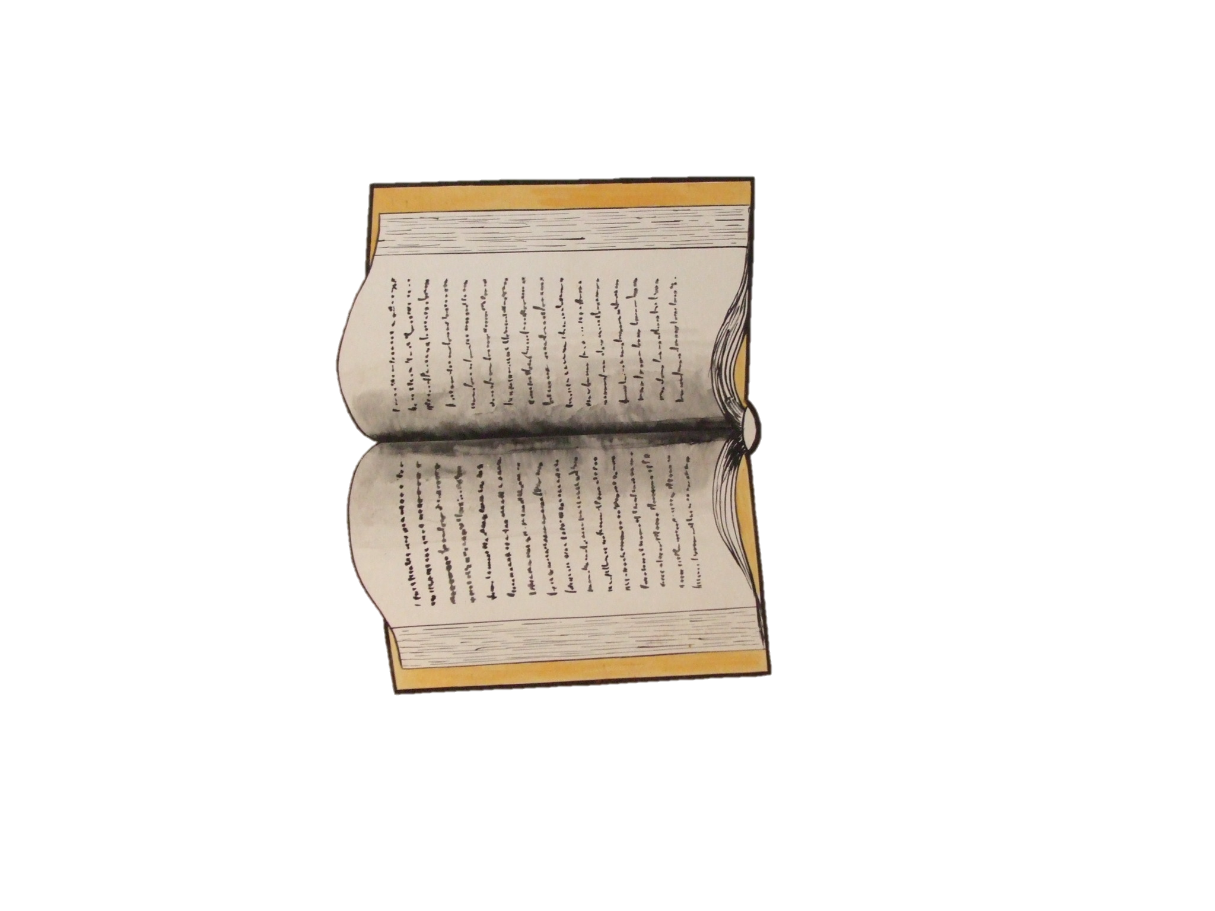
Then those who feared the LORD spoke to one another, and the LORD listened and heard them:
So a book of Rememberance was written before Him for those who fear the LORD and who meditate on His name. Chapter 3 v. 16
8

Slide 9
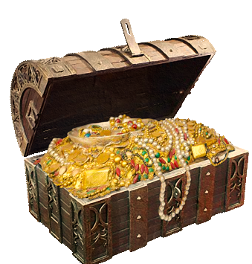


MINE
Chapter 3 verse17
(The LORD knows those who are His.
2 Timothy 2 v. 19)
9

Slide 10

RIGHTEOUSNESS
†
HEALING
Chapter 4 v. 2
10

