Slide 1
The following Biblical presentation is based on notes and illustrations by the Rev L G Stapleton
compiled by
Mark Stapleton
© Mark Stapleton 2016
1

Slide 2
ZECHARIAH
The
LORD
of
Hosts
(53 times)
2

Slide 3
ZECHARIAH
3
Has been known as the Prophet of hope
He was contemporary with Haggai
Prophesied about 520 BC, in the reign of Darius
His prophecy deals with the return of the children of Israel from exile
Much of his prophecy is in symbolic form
Like Haggai, his message was one of encouragement

Slide 4
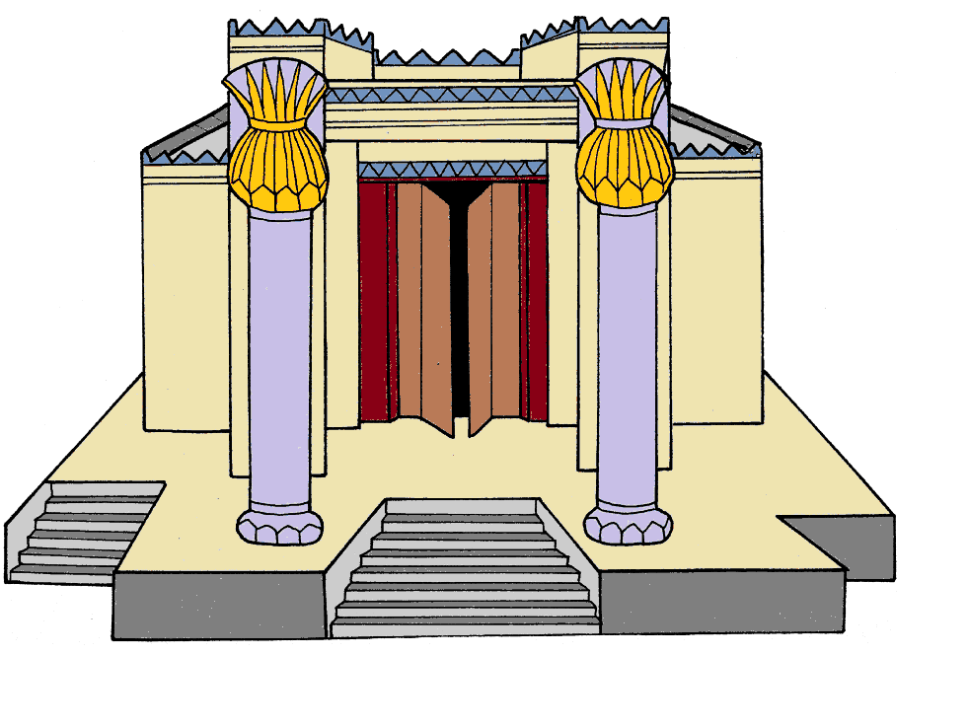
Encouragement - Chapters 1 – 6
The Temple will be re-built in Jerusalem.
.
Ch. 1 v. 16
4

Slide 5
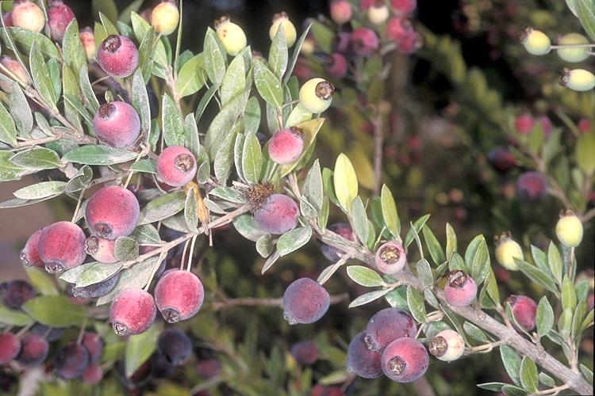
Encouragement - Chapters 1 – 6
The man among the myrtle trees – good and comforting words are spoken.
.
Ch. 1 vs. 11 - 13
5
Notes:
The Myrtle tree is an insect repellent; connected to the feast of Tabernacles. Myrtle's fruits and leaves are used in the cosmetics and medical industries. The plant has been mentioned as an antiseptic and connected to treatments for dysentery, eye diseases, headaches and more. In the past, it was even used to produce a soap called barda. Today, it is marketed under the commercial name Myrtol for the treatment of respiratory illnesses. Myrtle itself has the advantages of being evergreen, drought-resistant and highly fragrant. Myrtle flowers during the summer months, mainly between May and June. Secondary flowering lasts from summer to October. Flowers are white and fragrant, with five petals and many white stamens. Juicy, dark purple fruits mature in the fall.

Slide 6
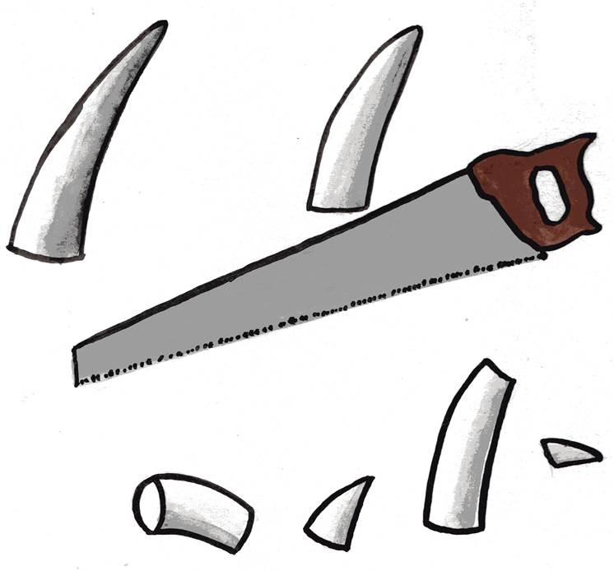
Encouragement - Chapters 1 – 6
Horns cut off – Gentile powers robbed of their power to hurt God’s people
Ch. 1 v. 18 - 21
6

Slide 7
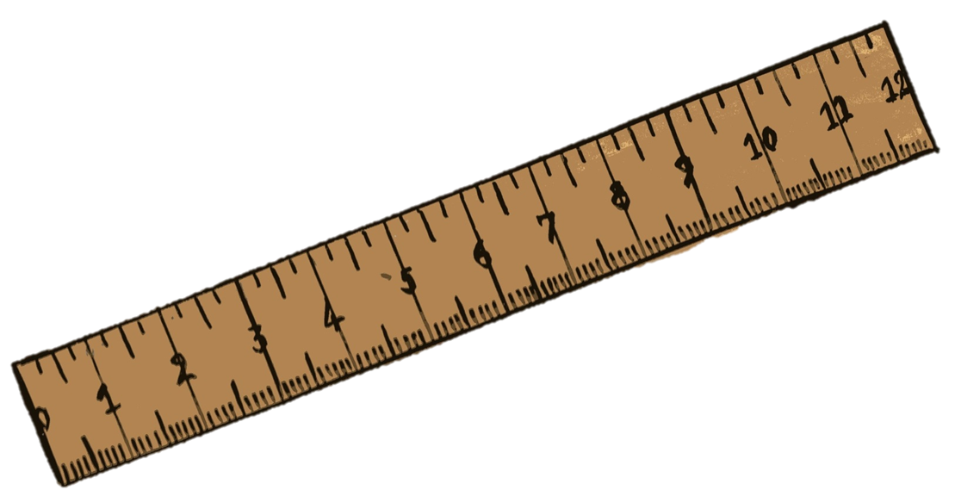
Encouragement - Chapters 1 – 6
A measuring stick - the re-building of Jerusalem is about to commence.
.
Ch. 2 v. 1
7

Slide 8
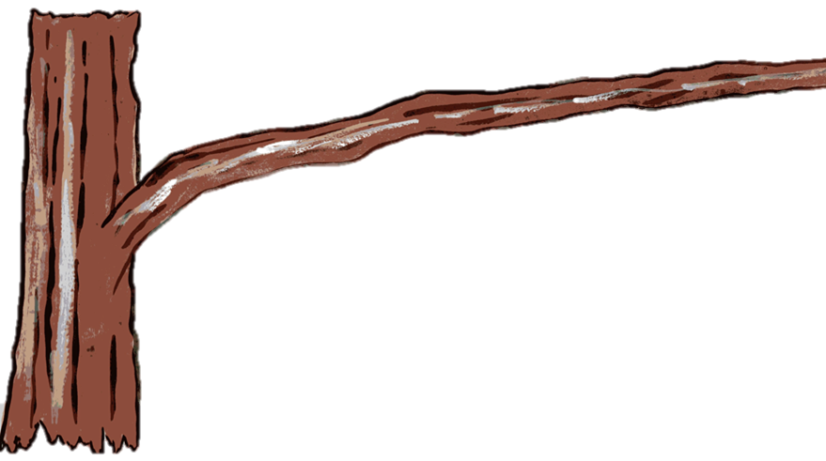
Encouragement - Chapters 1 – 6
The renewal of the priestly office and the promise of the BRANCH - MESSIAH
.
Ch. 3 v. 8
8

Slide 9
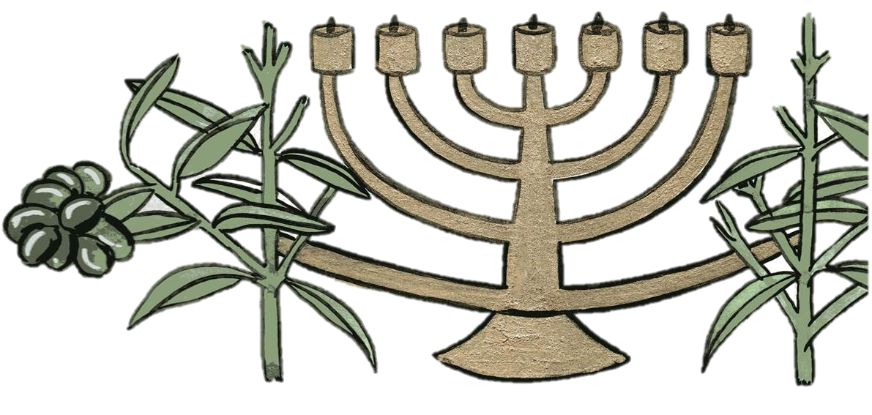
Encouragement - Chapters 1 – 6
The Candlestick and olive oil – the constant supply of God’s Holy Spirit.
Ch. 4 v. 6
9

Slide 10
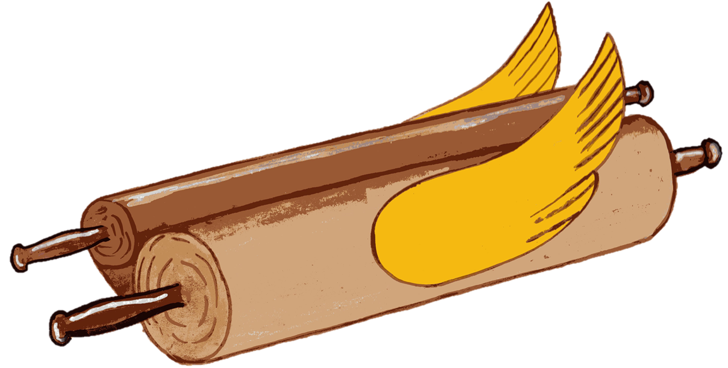
Encouragement - Chapters 1 – 6
The flying scroll – God’s word of judgement on the earth
.
Ch. 5 vs. 1 - 4
10

Slide 11
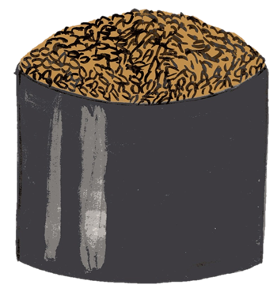
Encouragement - Chapters 1 – 6
A measuring container for an Ephah – a picture of wickedness being judged.
.
Ch. 5 vs. 5-11
11

Slide 12
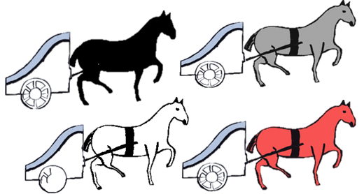
Encouragement - Chapters 1 – 6
Four chariots spoken of as being – “four spirits”, representing Divine Power.
.
Ch. 6 vs. 1 - 8
12

Slide 13
The word of the LORD came to Zechariah – chapter 7
Obedience is better than Fasting
Verses 1 - 7
Disobedience resulted in Captivity
Verses 8 - 14
13

Slide 14
The word of the LORD came to Zechariah – chapter 8
God is jealous for His people
Verses 1 - 2
Anticipation of what God will do for His people
Verses 3 - 23
14

Slide 15


Prophecy fulfilled – Chapters 9 - 13
“Palm Sunday”
Chapter 9 verse 9
Fulfilled –
John chapter 12 verses 12 - 15
15

Slide 16
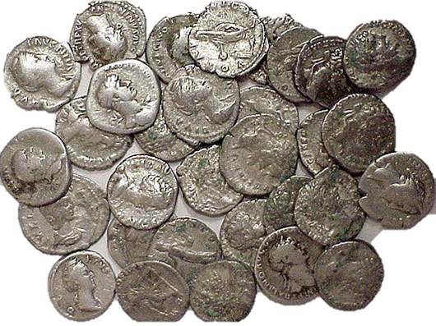
Prophecy fulfilled – Chapters 9 - 13
Thirty pieces of silver
Chapter 11 verse 13
Fulfilled –
Matthew chapter 27 verses 9 - 10
16

Slide 17

Prophecy fulfilled – Chapters 9 - 13
Wounds on the Cross
Chapter 12 verse 10
.
Fulfilled –
John chapter 19 verses 34, 37
17

Slide 18
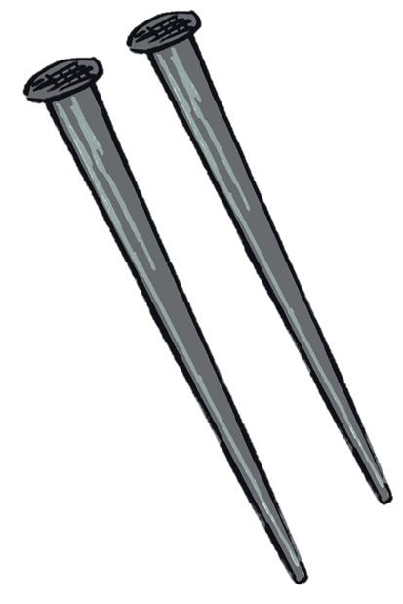
Prophecy fulfilled – Chapters 9 - 13
Wounds on the Cross
Chapter 13 verse 6
.
Fulfilled –
John chapter 20 verse 25
18

Slide 19
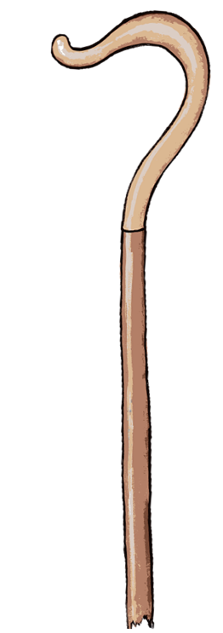
Prophecy – Chapters 7 - 13
The smitten shepherd
Chapter 13 verse 7
.
Fulfilled –
Matthew chapter 26 verse 31
19

Slide 20
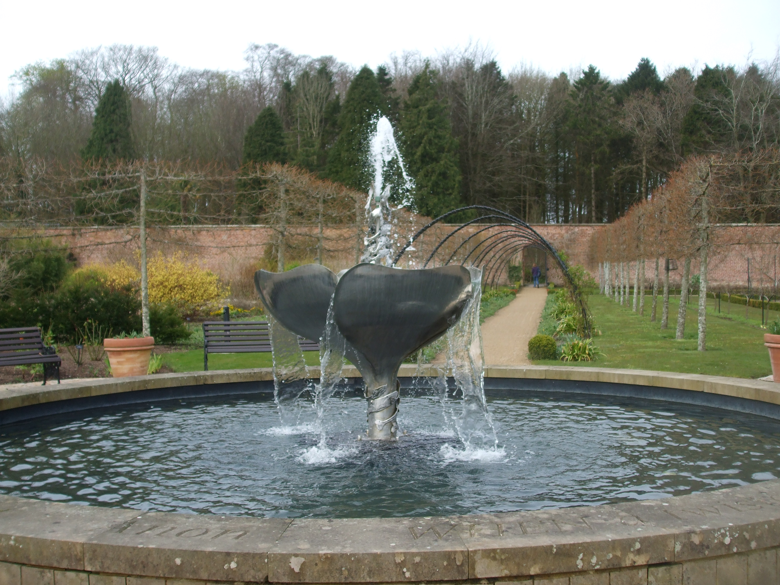
Prophecy – Chapters 7 - 13
A fountain for sin and uncleanness
Chapter 13 verse 1
†
.
Fulfilled –
1 John chapter 1 verses 7 - 9
20

Slide 21

A Glorious climax – chapter 14
return - verse 4
reign as King - verse 9
The LORD’s -
sovereignty - verses 16-17
Holiness - verses 20-21
21

