Slide 1
The following Biblical presentation is based on notes and illustrations by the Rev L G Stapleton
compiled by
Mark Stapleton
© Mark Stapleton 2016
1

Slide 2
HAGGAI
CONSIDER
Ch. 1 v. 5
CONSIDER
Ch. 1 v. 7
CONSIDER
Ch. 2 v. 15
CONSIDER
Ch. 2 v. 18
2

Slide 3
HAGGAI
3
The first Prophet after the return of Judah from 70 years Babylonian captivity
Haggai was contemporary with Zechariah
Prophesied about 520 BC, in the 2nd year of King Darius
For further information – see Ezra ch. 5 vs. 1-2

Slide 4
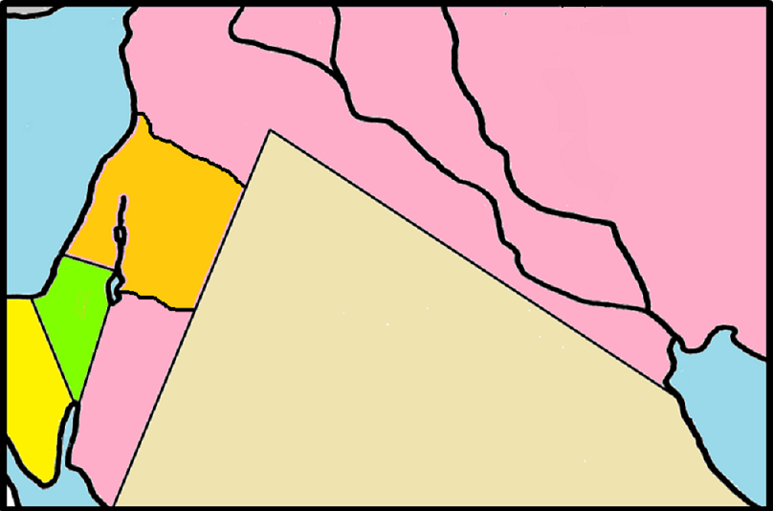
THE RETURN OF GOD’s PEOPLE
4
● Jerusalem
Babylon
Zerubbabel returned with 49,897 people – c. 536BC
Ezra Chapters 1 – 6
Ezra returned –
c. 458BC
Ezra Chapters 7 - 10

Slide 5
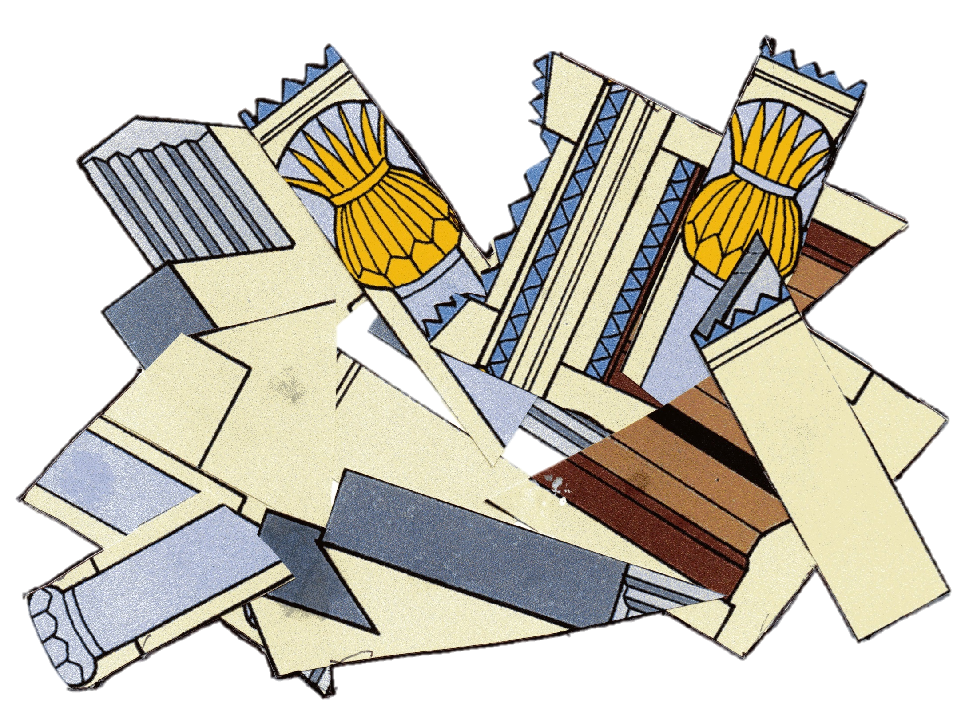




“… and this temple to lie in ruins? Ch. 1 v. 4
“Is it time for you yourselves to dwell
in panelled houses…”
5

Slide 6

Self First
or
Earning wages to put into
a bag with holes
God First
Ch. 1 v. 9b
Ch. 1 v. 6b
6

Slide 7
Zerubbabel
+
Joshua the son of Jehozadak
the high priest
+
All the people
⬇
Obeyed the voice of the Lord
And the words of Haggai the prophet
⬇
The people feared the presence
of the LORD
Ch.1 v. 12
7

Slide 8
God’s promise to His people
Ch. 1 v.13
(Matthew 28 v. 20)
8
“I am with you”
Work on the re-building of the temple starts
Ch. 1 v. 14

Slide 9



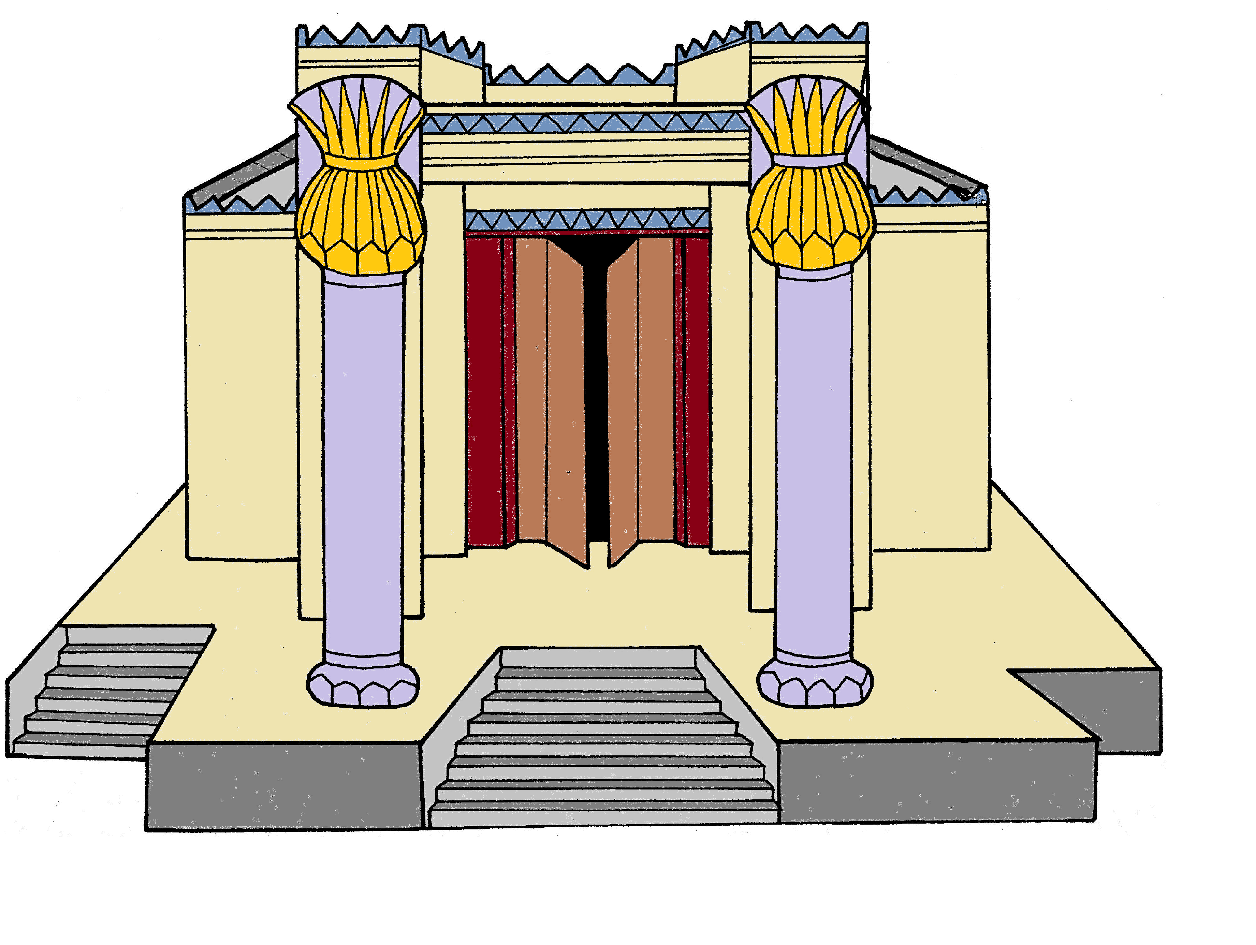
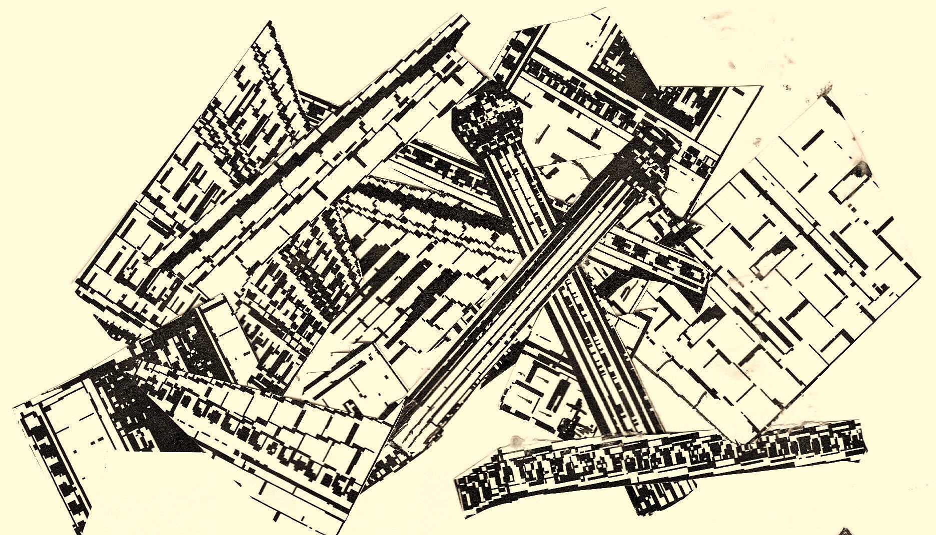
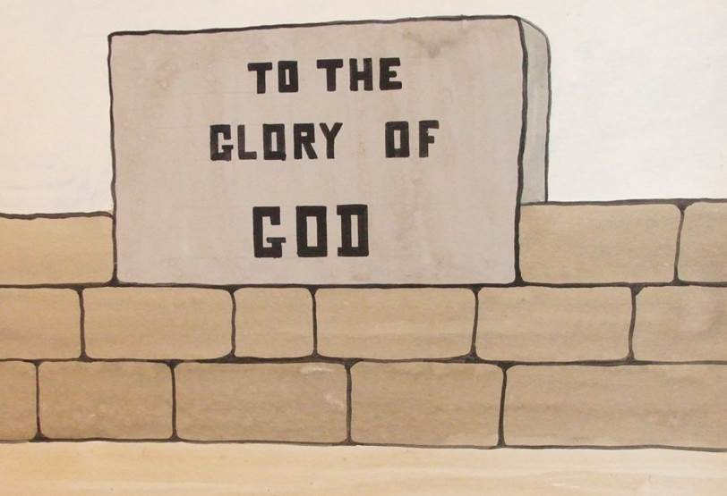
THE TEMPLE
“…And in this place I will give peace”, says the LORD of hosts
Ch. 2 v. 9
The former Glory
Ch. 2 v.3
(Pre-exile)
The promised Glory Ch. 2 v.9
(Post-exile)
The destruction of the Temple
2 Chronicles 36
“The silver is Mine, and the gold is Mine”, says the LORD of hosts
Ch. 2 v. 8
JUDGEMENT
BLESSING
9
Notes:
“And in this place I will give peace” = looking forward to the Prince of Peace, the Lord Jesus Christ.

Slide 10
THE PEOPLE ARE DEFILED
Holy contact does not impart Holiness
Ch. 2 v. 12
…Haggai answered and said, “‘So is this people, and so is this nation before Me,’ says the LORD, ‘and so is every work of their hands; and what they offer there is unclean…
Ch. 2 v. 14
Sinful contact imparts uncleaness
Ch. 2 v. 13
10

Slide 11


†
VICTORY
Ch. 2 v. 22
But thanks be to God, who gives us the victory through our Lord Jesus Christ.
1 Corinthians 15 v. 57
11

