Slide 1
The following Biblical presentation is based on notes and illustrations by the Rev L G Stapleton
compiled by
Mark Stapleton
© Mark Stapleton 2016
1

Slide 2
Zephaniah
IN
THAT
DAY
2

Slide 3
Zephaniah
His genealogy goes back to Hezekiah
Ch. 1 v. 1
He was contemporary with Jeremiah
Jeremiah 1 v. 2
Written about 627 BC
before Judah’s exile into Babylon
Prophesied in the reign of Josiah (642-610 BC) King of Judah
Ch. 1 v. 1
He was probably instrumental in the revival in Josiah’s time
3

Slide 4
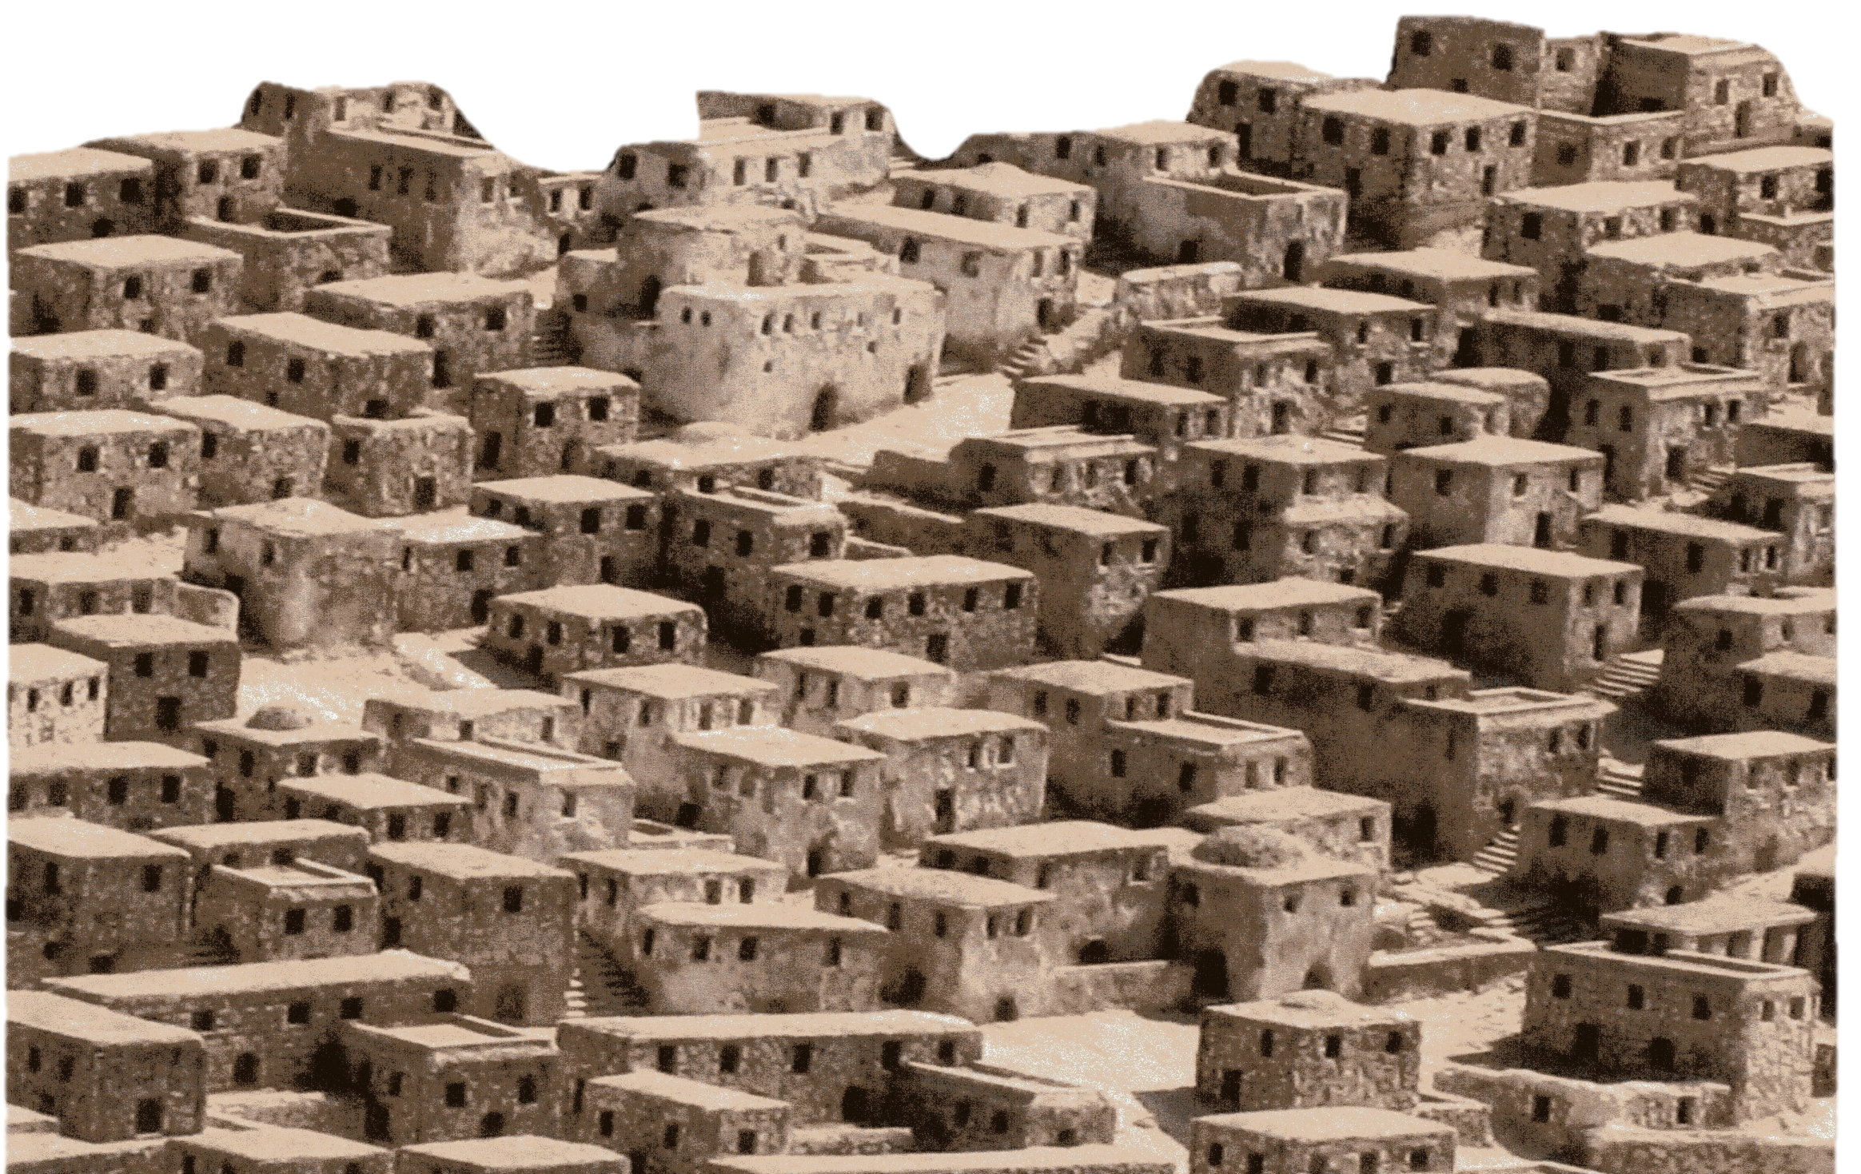

Zephaniah
IDOLS
Chapter 1 vs. 2-13
4
Notes:
God’s day of judgement against Judah – the searching out in Jerusalem, v.12, condemnation of false worship, vs.4-6

Slide 5
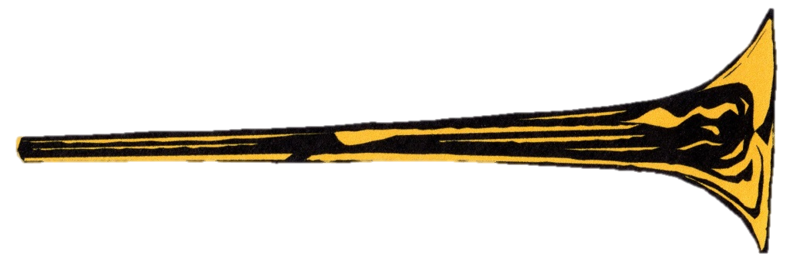


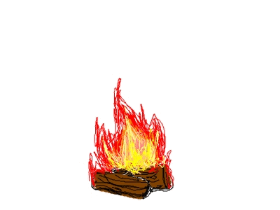

Zephaniah
5
REPENTANCE
Ch. 2 vs 1-3
THE DAY OF JUDGEMENT
Chapter 1 vs. 14-18

Slide 6
The Wickedness of Jerusalem
Chapter 3 vs. 1 - 2
God’s people are called to -
OBEY HIM
HEED HIM
God’s call goes unheeded -
except superficially under King Josiah’s reforms
TRUST HIM
APPROACH HIM
6

Slide 7
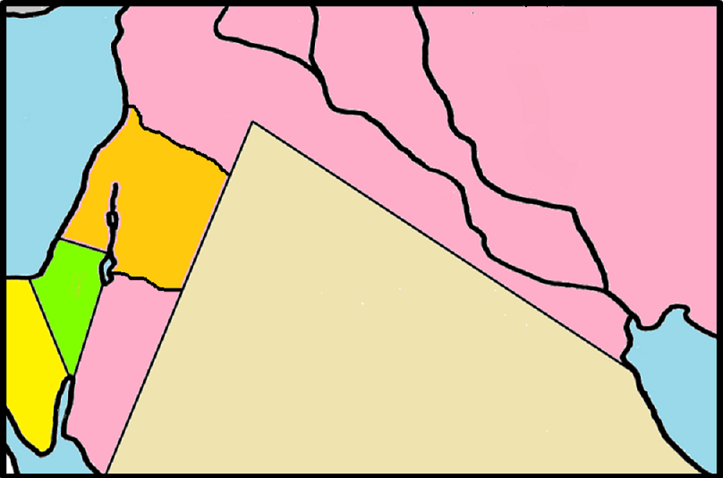

Judgement on the enemies
of God’s people
Chapter 2
7
NINEVEH
PHILISTIA
AMMON
JUDAH
MOAB
ETHIOPIA

Slide 8
GOD’S DAY OF RESTORATION
Ch. 3 vs. 3-20
Zephaniah foresees not only God’s people going into exile, but also being restored 70 years later in their own land as the Remnant (v. 13)
This involves all those who are true to Him
8

Slide 9
HE WILL SAVE
Ch. 3 v. 14-17
†
THANKSGIVING
PRAISE
He shall see of the travail of His soul and shall be satisfied. Isaiah 53: 11
9
REJOICE

