Slide 1
The following Biblical presentation is based on notes and illustrations by the Rev L G Stapleton
compiled by
Mark Stapleton
© Mark Stapleton 2016
1

Slide 2
HABAKKUK
HOW LONG ?
Ch. 1 vs. 2-4
WHY ?
Ch. 1 vs. 12-17
2

Slide 3
HABAKKUK
All we know about Habakkuk is in chapter 1 v. 1. He calls himself a Prophet – the only one in the Old Testament to do so.
The Northern kingdom of Israel has been carried away captive (722 BC). Nineveh has fallen (612 BC).
The Chaldeans are soon coming in power to capture the Southern kingdom of Judah. (586 BC)
The book was written about 600 BC
and is about Judah. Habakkuk is contemporary with the prophet Jeremiah
3

Slide 4
HABAKKUK
God’s dealings with Judah in judgement
TWO QUESTIONS
1.
Why does God allow His people to be punished by a nation more wicked than themselves ?
2.
How long will God allow such a situation to go on ?
4

Slide 5
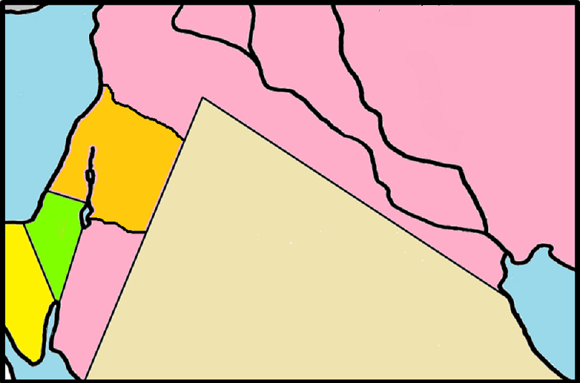
Judah to be taken into captivity by the CHALDEANS
Chapter 1
● Nineveh
CHALDEA
● Jerusalem
JUDAH
Babylon 
EGYPT
5

Slide 6
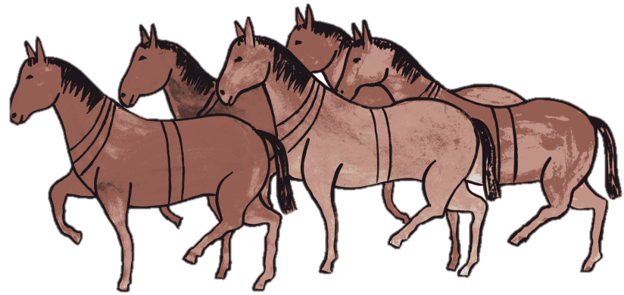

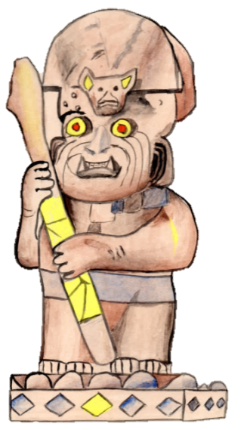
THE CHALDEANS
BITTER, HASTY
Ch.1 v.6
SWIFT
Ch. 1 v. 8
TERRIBLE, DREADFUL
Ch.1 v.8
ARROGANT, PROUD
Ch. 1 v.10
WORLD DOMINATION
Ch.1 vs.14-17
IDOL WORSHIP
Ch.2 vs.18-19
6

Slide 7
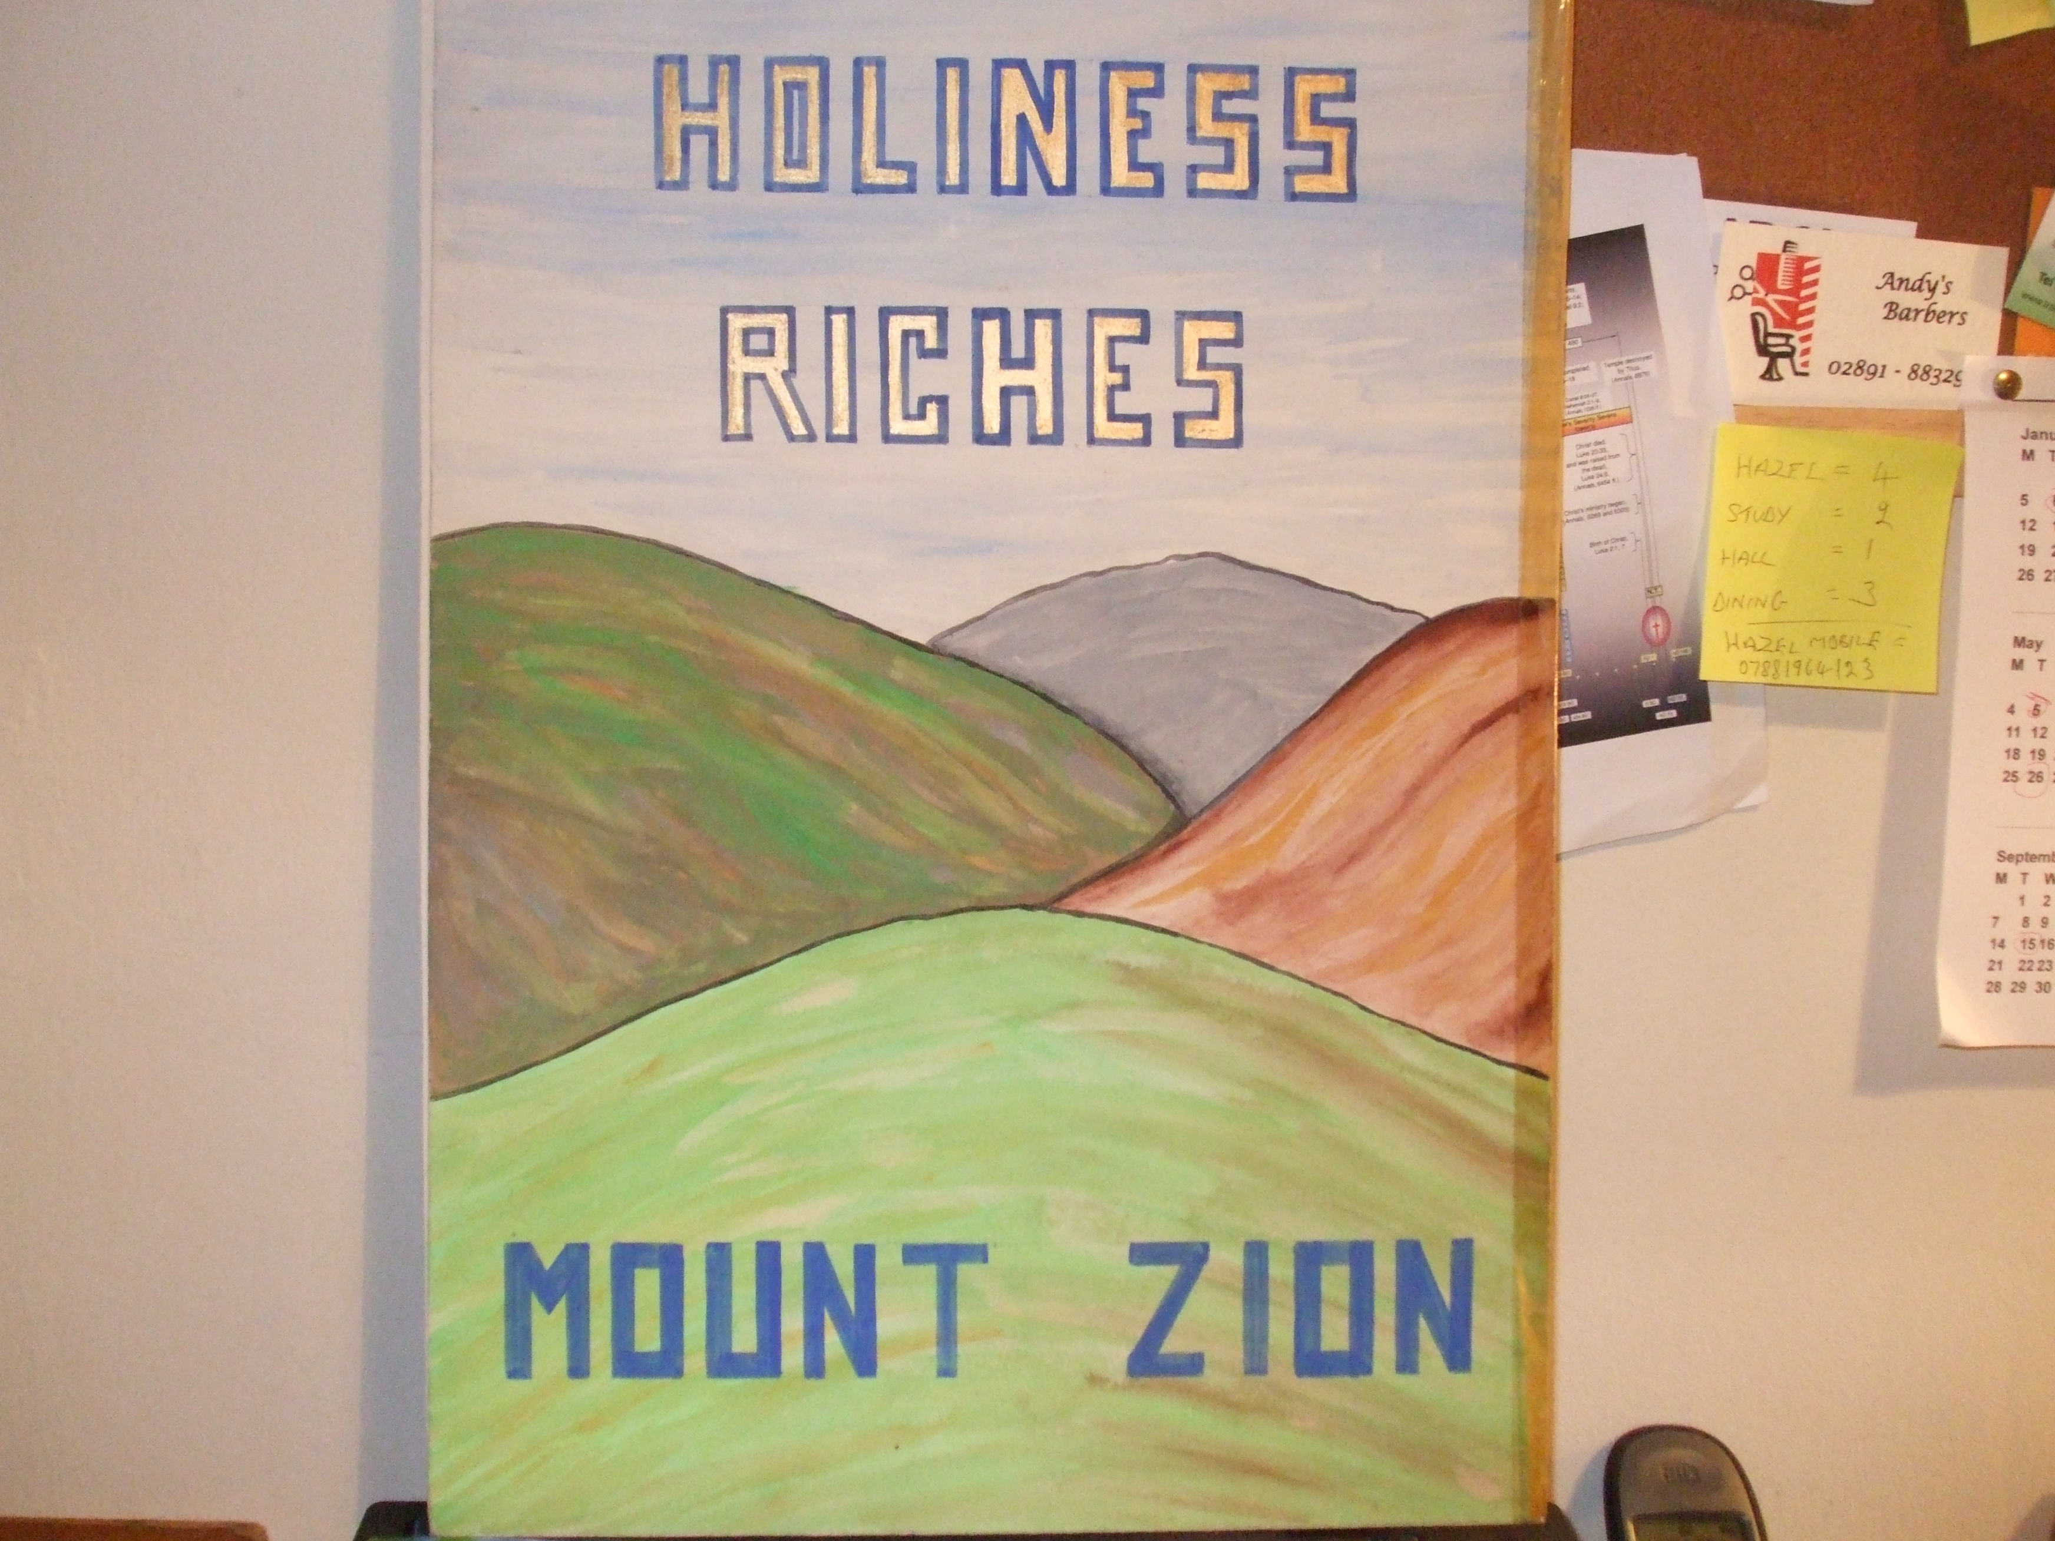

HABAKKUK
7
WOE
God answers his question
Chapter 2 vs.2
WOE
WOE
WOE
WOE
Ch.2 vs.6, 9, 12, 15, 19

Slide 8

THE PROPHET’s PRAYER
God’s Mercy
Ch. 3 v. 2
God’s Glory
Ch. 3 vs. 3-4
God’s Power
Ch. 3 v. 4-11
God’s Salvation
Ch. 3 v. 13
A SONG (Psalm) OF PRAISE
8

Slide 9
The just …
†
Romans 1 v. 17
Galatians 3 v. 11
Hebrews 10 v. 38
God’s people to hold on by faith for eventual justification
Ch. 3 vs. 17-19
For the Christian now –
Romans 5 v. 1
… shall live by .. Faith
Ch. 2 v. 4
9

