Slide 1
The following Biblical presentation is based on notes and illustrations by the Rev L G Stapleton
compiled by
Mark Stapleton
© Mark Stapleton 2016
1

Slide 2
NAHUM
AN
UTTER
END
Chapter 1 verse 9
2

Slide 3
NAHUM
3
Little known - he was an Elkoshite. Possibly a village either in Galilee or in the south west of Judah.
Ch. 1 v. 1
His name means – Comforter or Consolation
(cf - Ch. 3 v. 7)
He brought a Message of good news to Judah when delivered from Assyria
Ch. 1 vs. 7 & 15
Prophecy against Nineveh, capital of Assyria
Ch. 1 v. 1
Prophesied about 660 - 640 BC between City of No overthrown – ch. 3 v. 8, and fall of Nineveh
Ch. 3 v. 7
Probably contemporary with the prophets Zephaniah, Habakkuk and Jeremiah

Slide 4
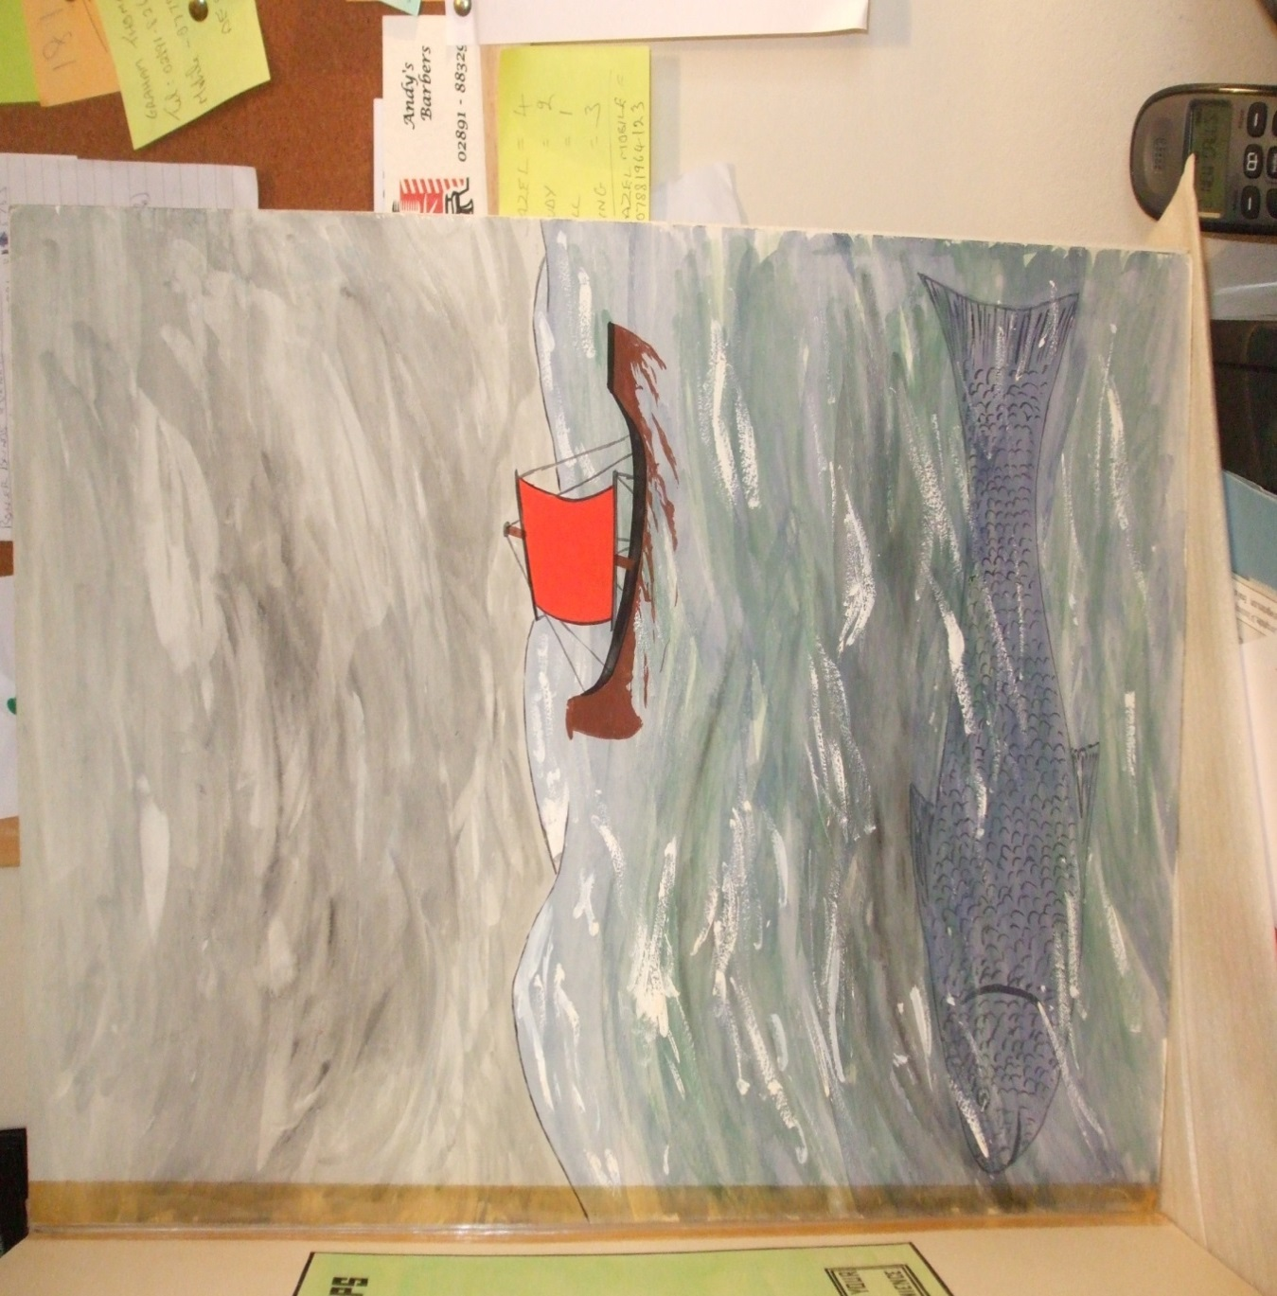
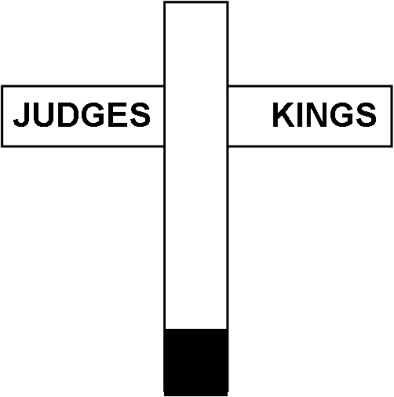


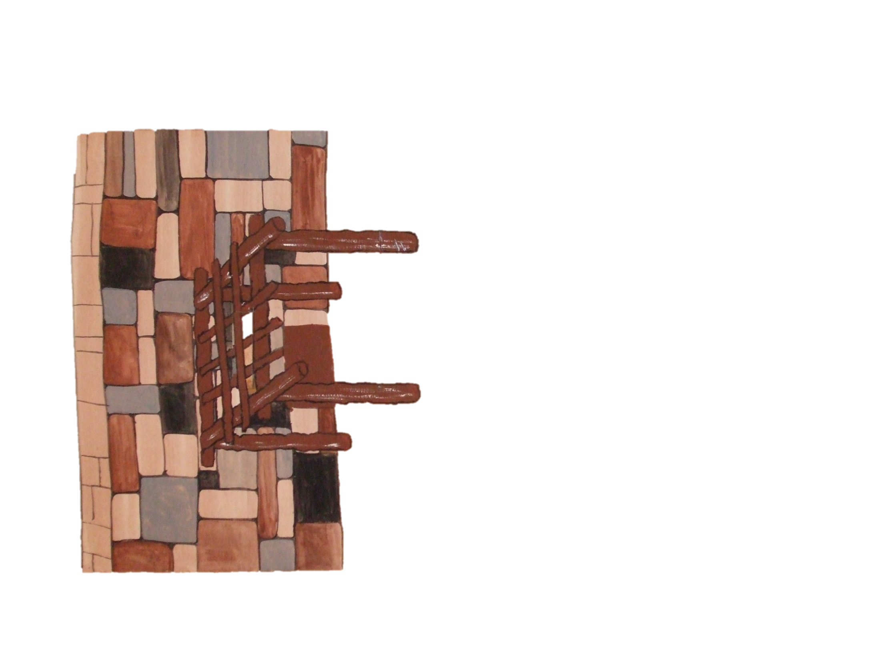

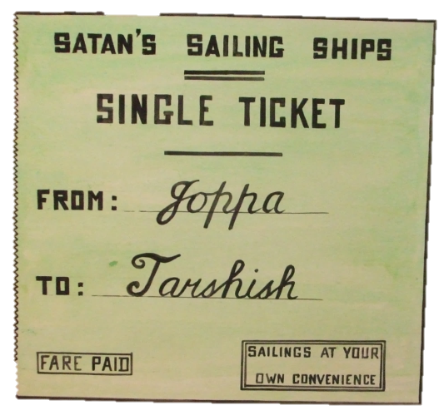


150 YEARS AGO
JONAH
PREACHED
NINEVEH
REPENTED
BUT…
JOPPA NINEVEH
DAY
1
DAY
2
DAY
3
4

Slide 5
…BUT
JUDAH TIMES
ASSYRIAN
ATROCITIES
TO END
Chapter 1 verses 8, 9 and 15
(612 B.C.)
5

Slide 6


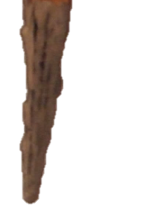

The Destruction of Nineveh
6
The invading army
Chapter 2 v. 3-4

Slide 7
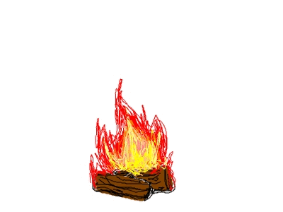


Total Destruction of Nineveh
Chapter 3 (cf. No in Egypt – vs. 8-10)
The city falls to the Babylonian Empire
7
Notes:
The City of Nineveh is near the present day city of Mosul. Remaining ruins of Nineveh were ransacked by ISIS in February 2015

Slide 8



GOOD NEWS
†
Hebrews 2 vs. 14-15
Chapter 1 v. 13
8

