Slide 1
The following Biblical presentation is based on notes and illustrations by the Rev L G Stapleton
compiled by
Mark Stapleton
© Mark Stapleton 2016
1

Slide 2
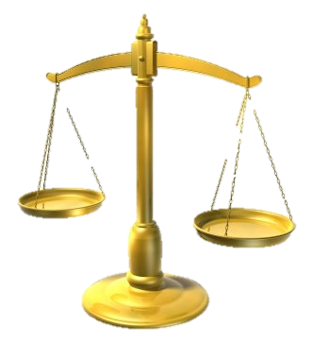
MICAH
COMING JUDGEMENTS
2

Slide 3
MICAH
A Prophet from
Moresheth – a town near Gath, in South West Judah
Ch. 1 v.1
His name means
“Who is like Jehovah?”
His message was to Jerusalem and Samaria against Social Injustices. Ch. 2 vs. 1-2
He was contemporary with the Prophet Isaiah,
He was active between 758 and 700 BC
He prophesied during the reigns of Jotham, Ahaz and Hezekiah, Kings of Judah
Ch. 1 v.1
3

Slide 4
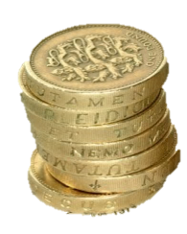
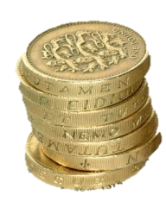
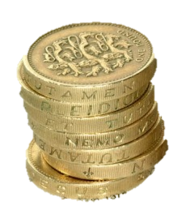

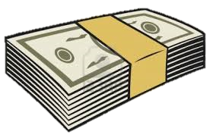
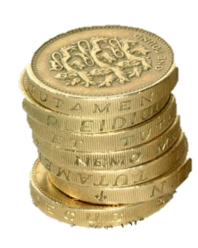

MICAH
Personal gain -
PRINCES
PRIESTS
PROPHETS
Chapters 2 and 3
4

Slide 5
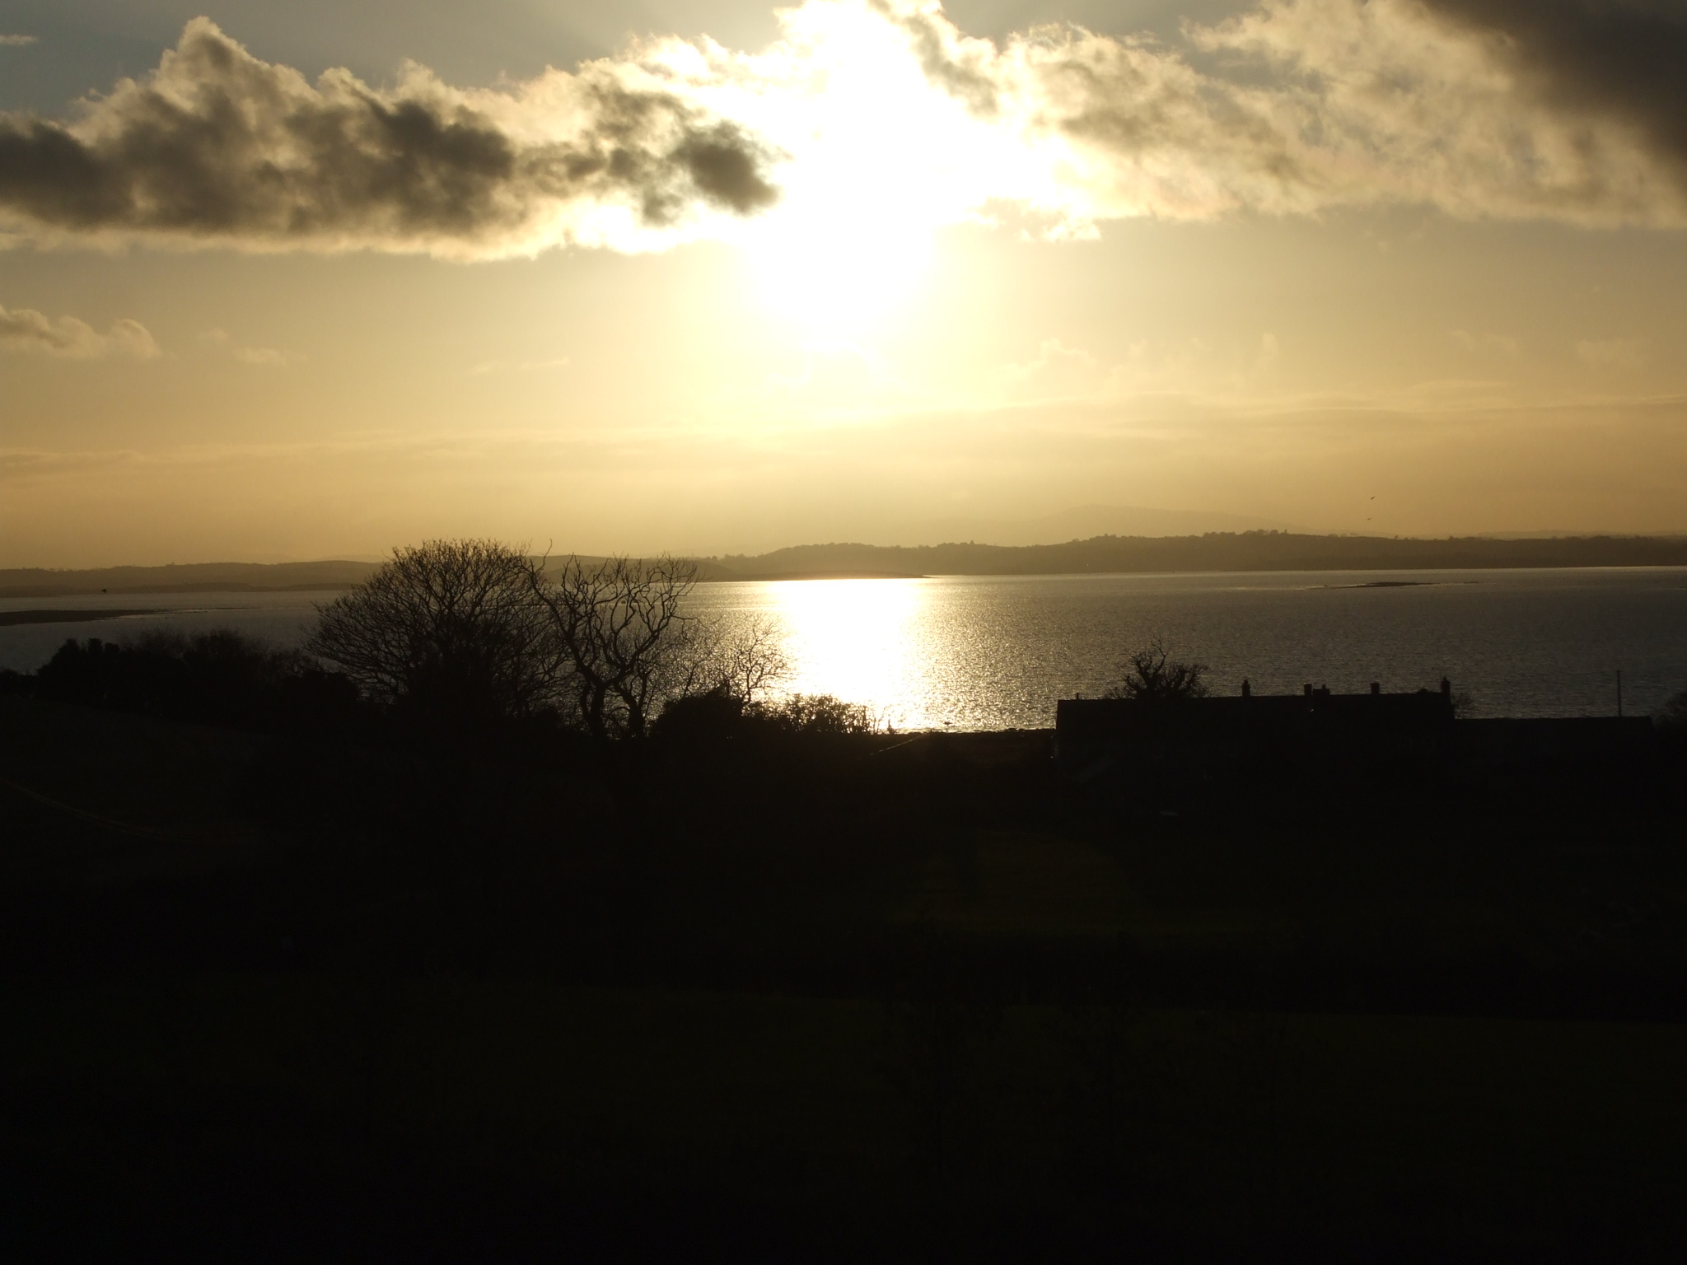
MICAH
THE COMING DARKNESS
IN THE NATION’S SPIRITUAL EXPERIENCE
CHAPTER 3 Verse 6
THE DESTRUCTION OF JERUSALEM AND CAPTIVITY IN BABYLON IS FORESHADOWED
CHAPTER 4 Verse 10
5

Slide 6
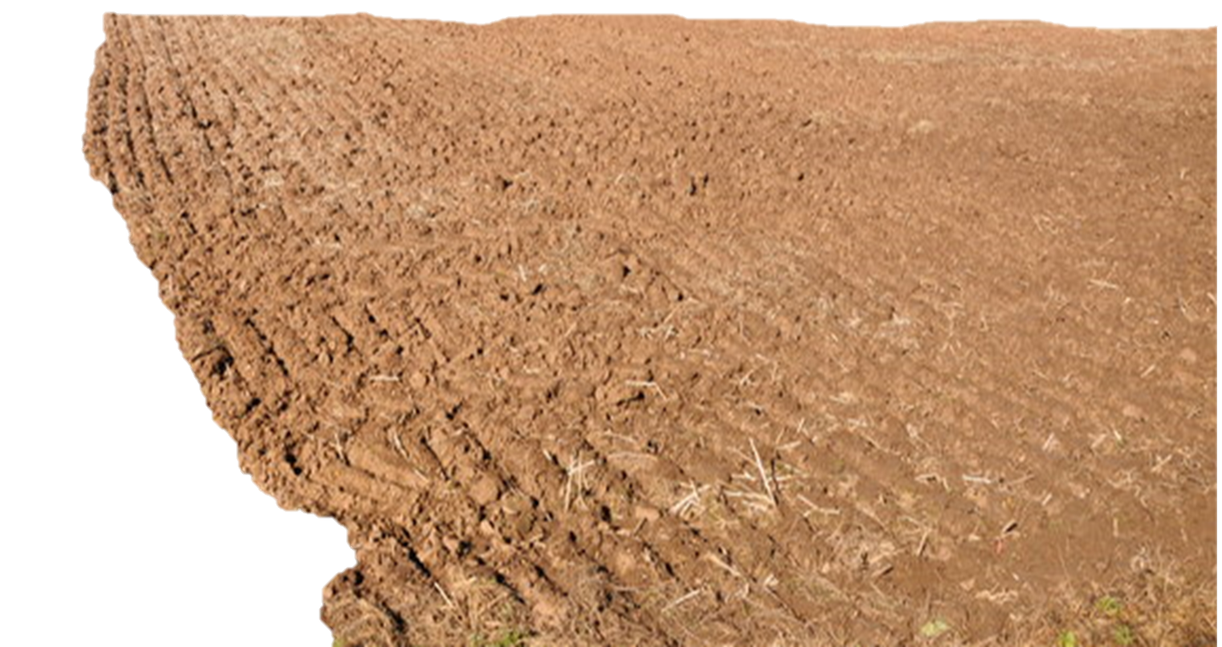
ZION
…shall be ploughed
like a field
chapter 3 vs. 12
6

Slide 7
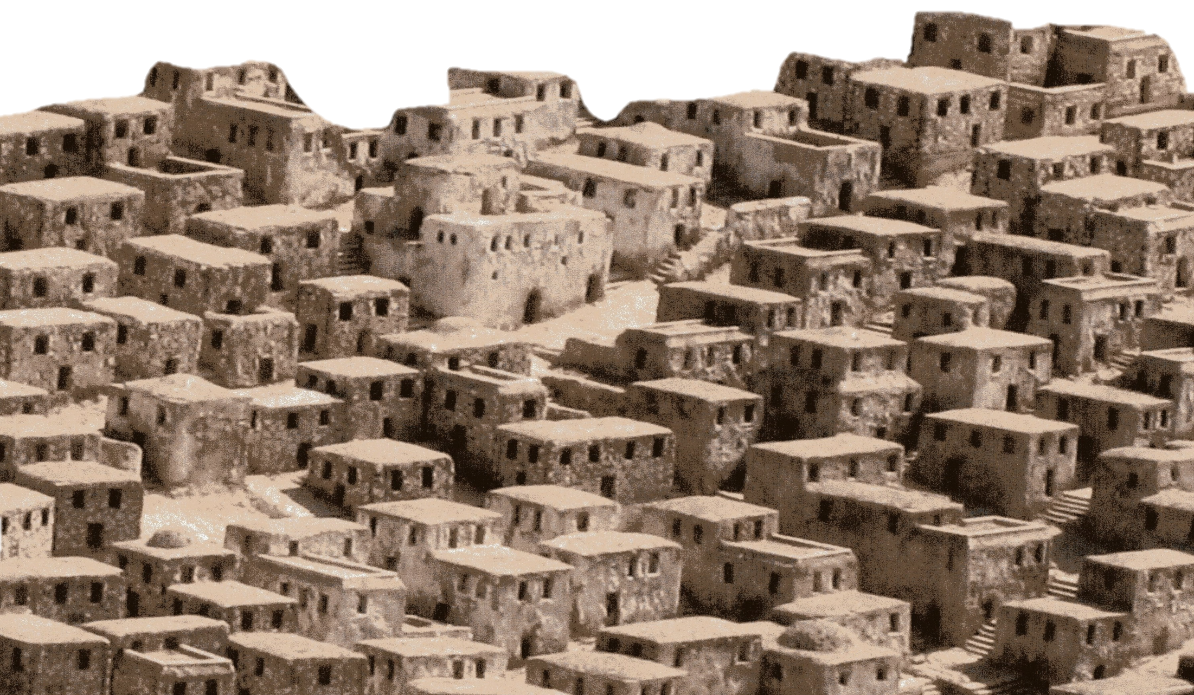
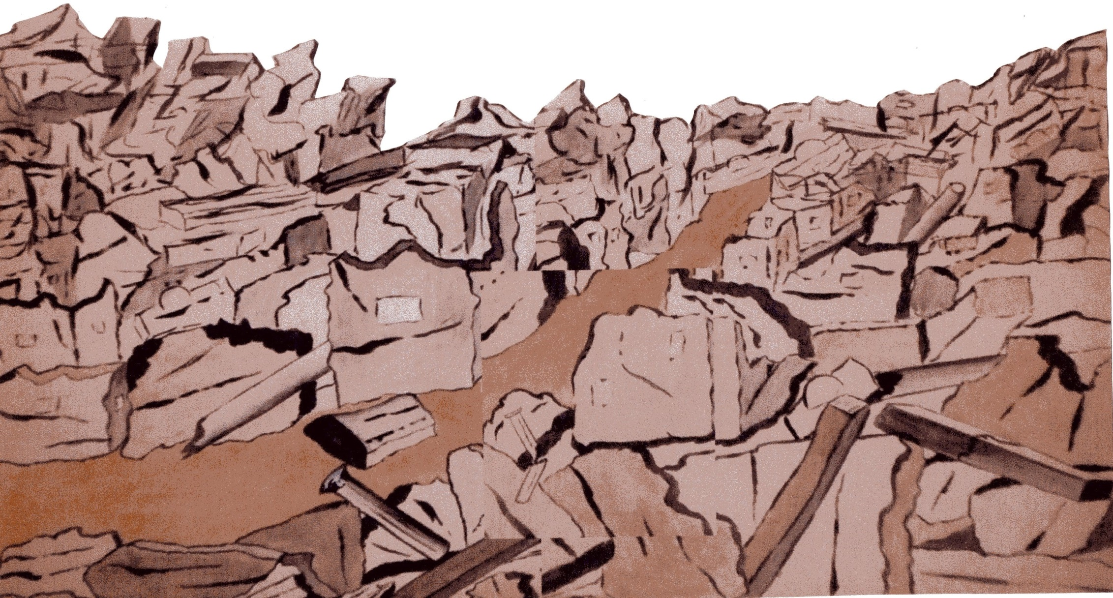
JERUSALEM
…shall become
a heap of ruins
chapter 3 vs. 12
7

Slide 8
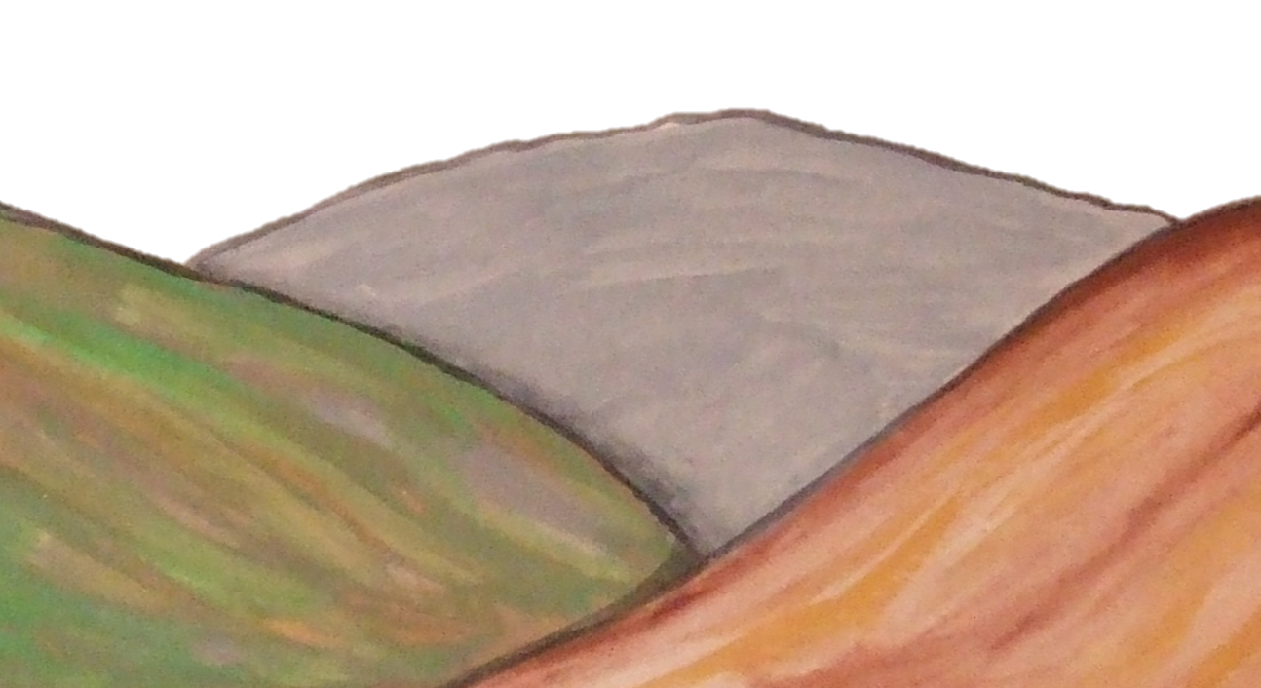
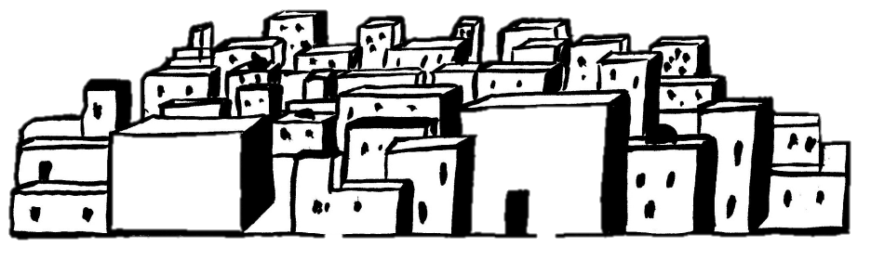
Now it shall come to pass in the latter days…
…that the mountain of the LORD’s house shall be established on the top of the mountains…
Chapter 4 v. 1
8

Slide 9


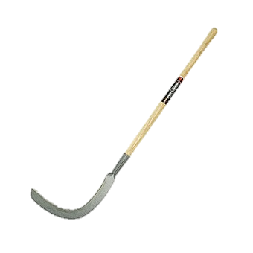
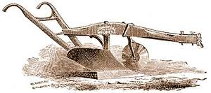
Now it shall come to pass in the latter days…
… they shall beat their swords into plowshares, and their spears into pruning hooks…
Chapter 4 v. 3
PEACE
9

Slide 10
God pleads with Israel
Chapter 6
God’s demands on His people
verse 8
This is based on His redemptive work in their history. Verses 3-5
Israel’s injustice to be punished
Verses 9-16
10

Slide 11
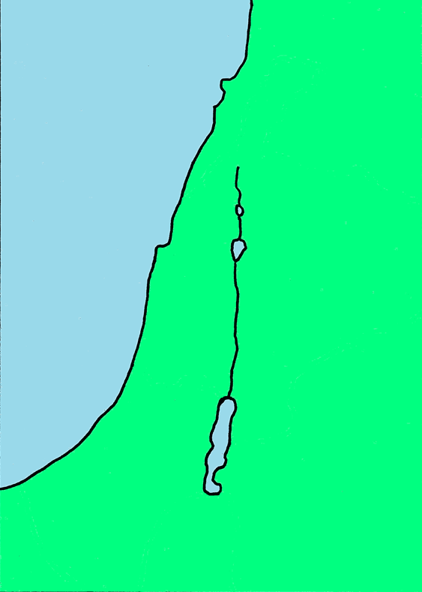
MICAH’s
forward vision
The deliverance and preservation of the remnant of Jacob.
Chapter 5 verses 7-8
The coming Messiah
Chapter 5 verse 2
BETHLEHEM
11

Slide 12
PARDON
CHAPTER 7 v.18
†
SIN
COMPASSION
CHAPTER 7 v. 19
COVENANT KEEPING
CHAPTER 7 v.20
12

