Slide 1
The following Biblical presentation is based on notes and illustrations by the Rev L G Stapleton
compiled by
Mark Stapleton
© Mark Stapleton 2016
1

Slide 2
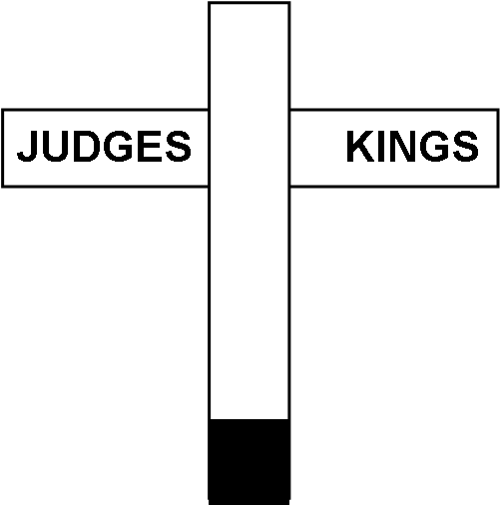

JONAH
JOPPA NINEVEH
2

Slide 3
3
JONAH
Mentioned in 2 Kings 14 v. 25 when King Jeroboam 2nd reigned in Israel.
c 800 BC
Contemporay with the prophets Amos and Hosea
God’s message to Nineveh, (capital of Assyria) – repent, judgement imminent.
Ch. 1 v. 2
God’s dealings with Nineveh, a large Gentile city, shows His love for the whole Gentile world
God’s dealings with Jonah, His servant, because of and in spite of, his disobedience

Slide 4
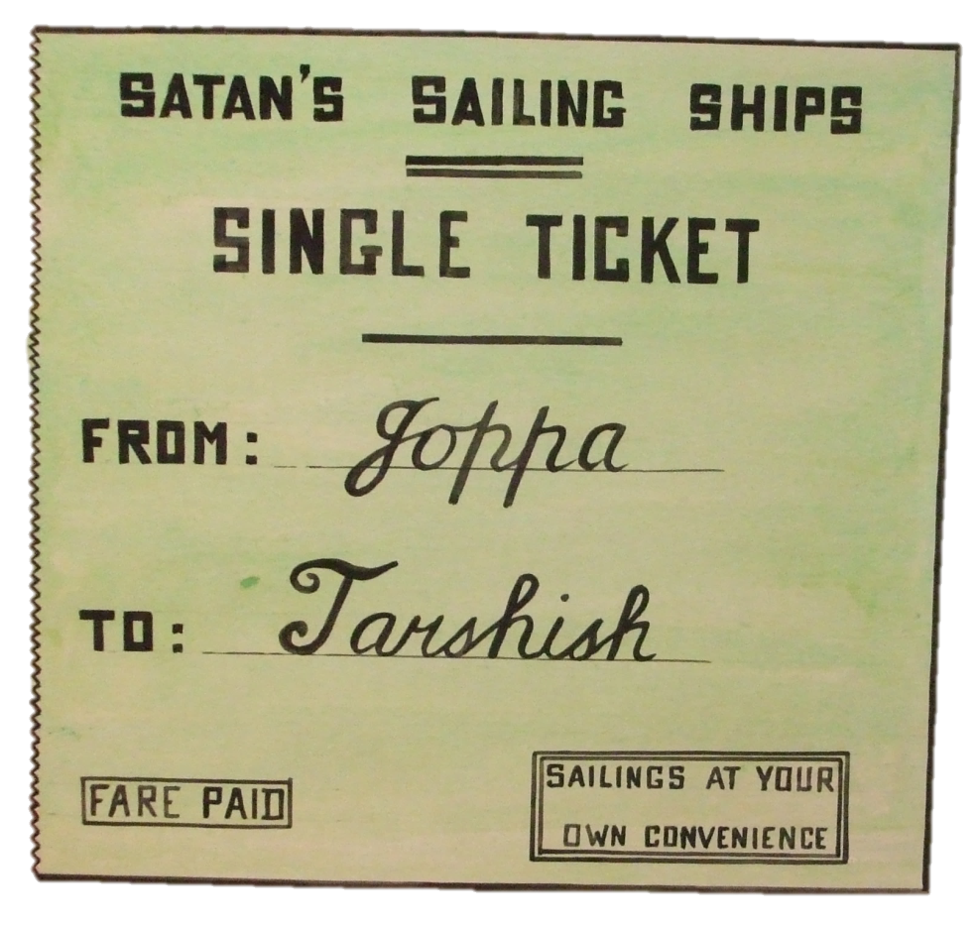
JONAH
His disobedience
Ch. 1 v. 3
4

Slide 5
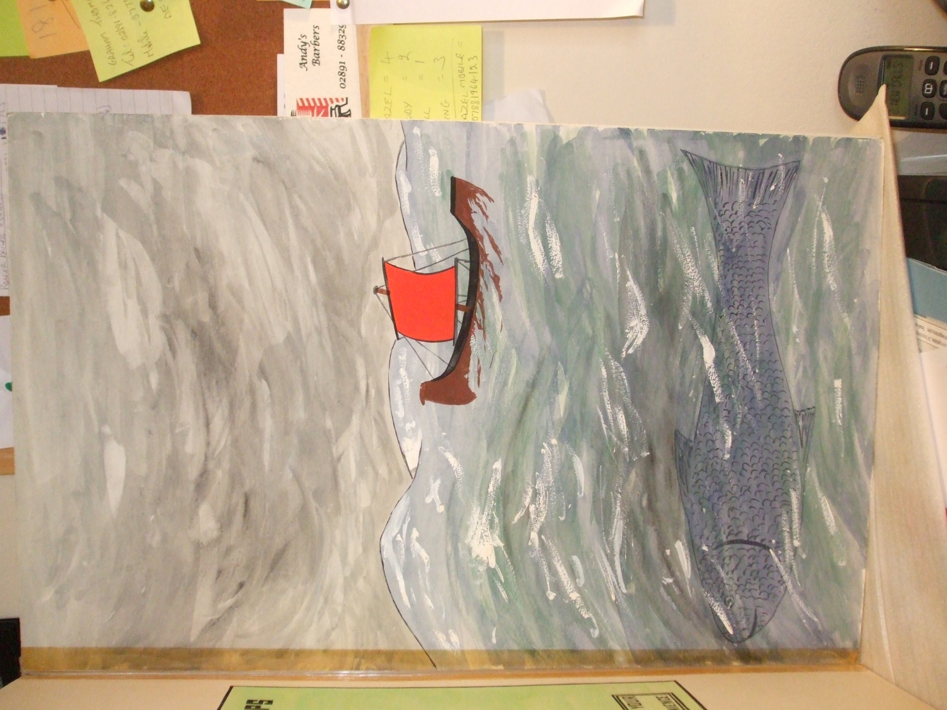
The Lord sent a storm
Ch. 1 v. 4
The Lord prepared a great fish to swallow Jonah.
Ch. 1 v. 17
5

Slide 6

DAY
1
DAY
2
DAY
3
Matthew 12 v. 40
PRAYER
CHAPTER 2
6

Slide 7
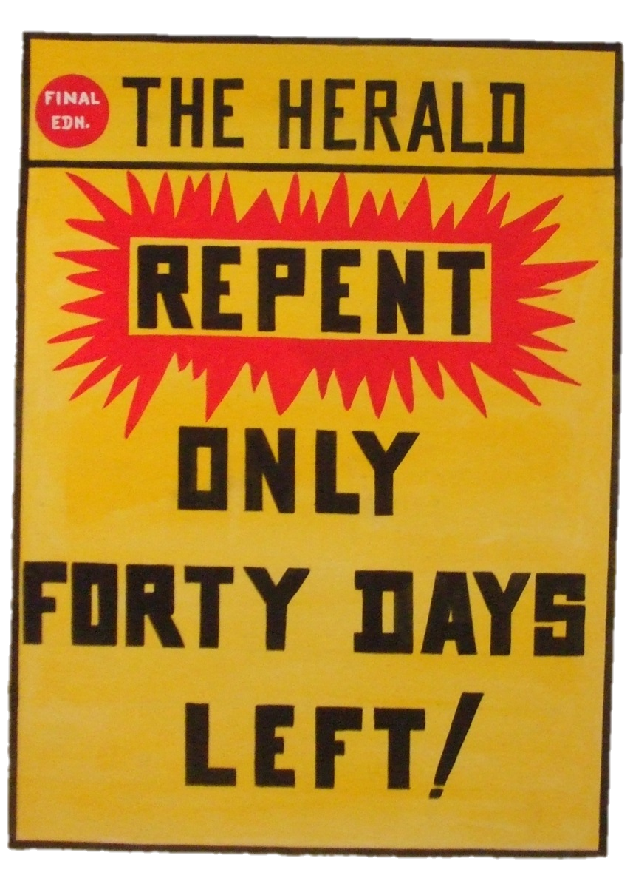
The Word of the LORD came to Jonah the second time.
Chapter 3 vs. 1-4
7

Slide 8

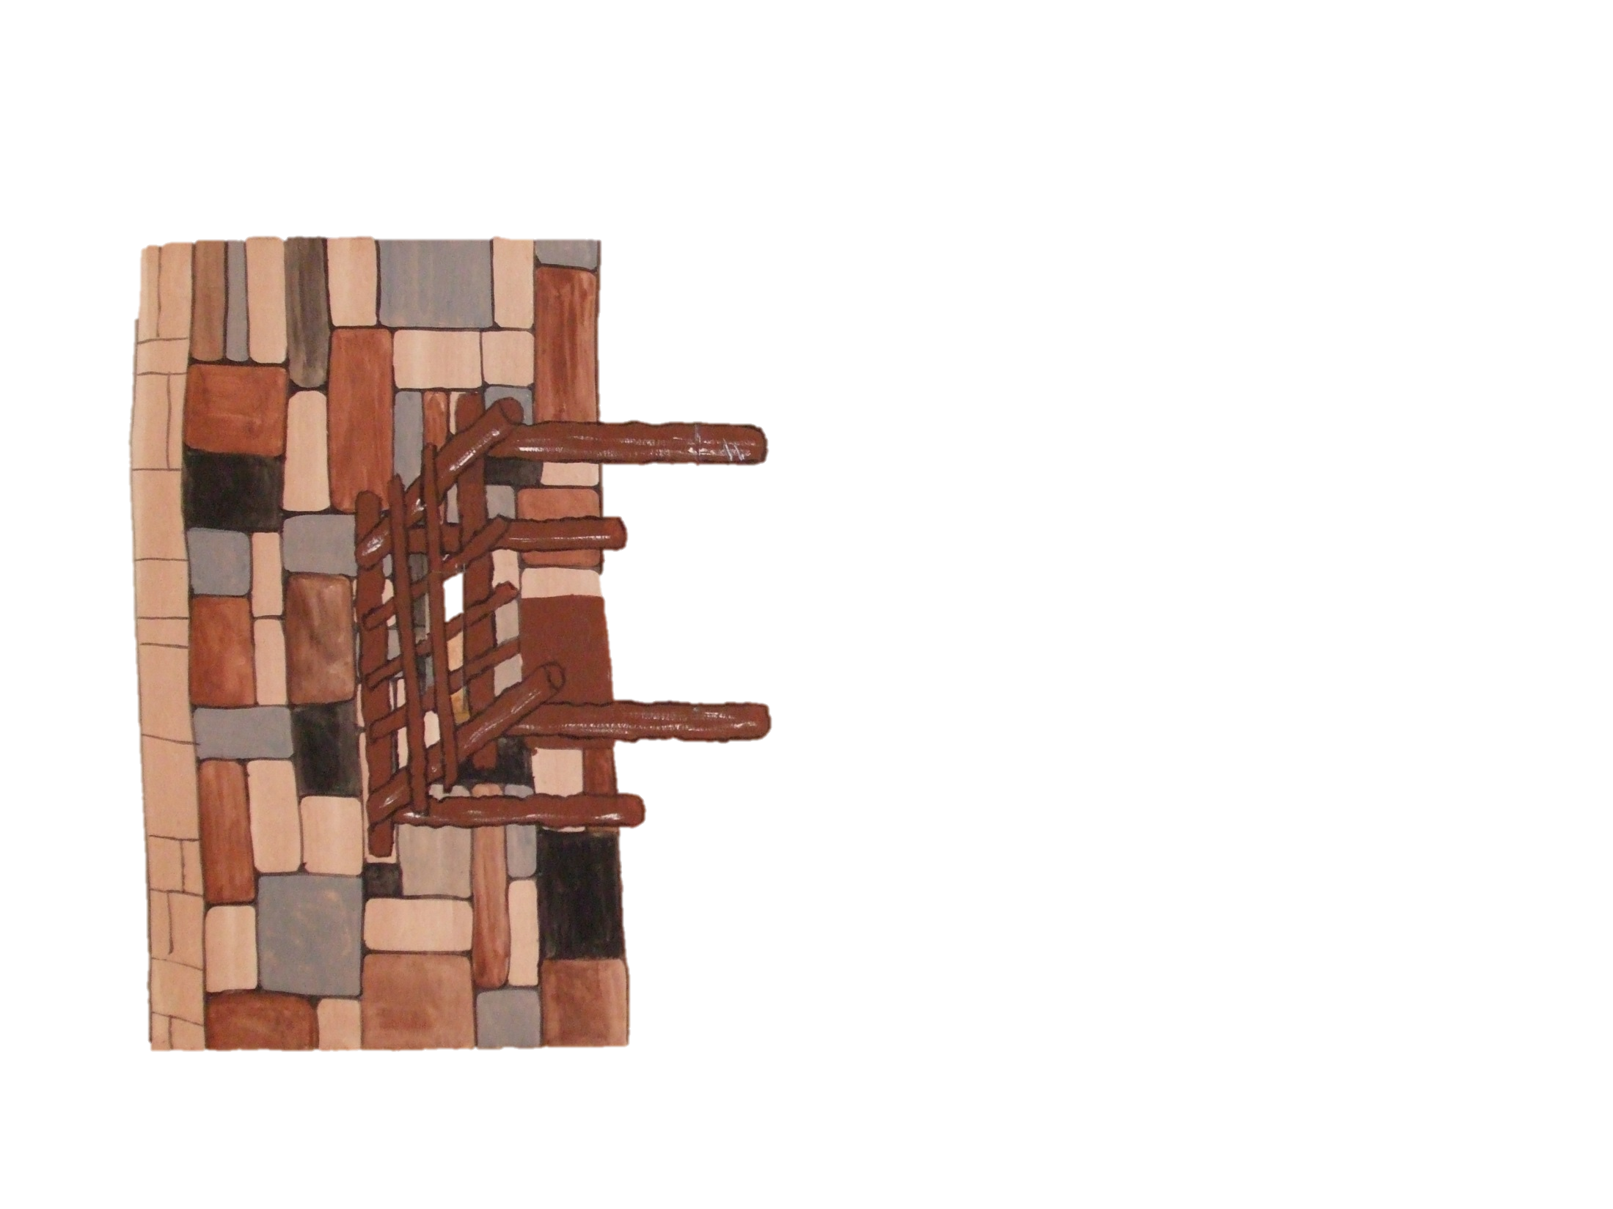


The Lord prepared a plant and a worm
Ch. 4 vs. 6, 7
8

Slide 9
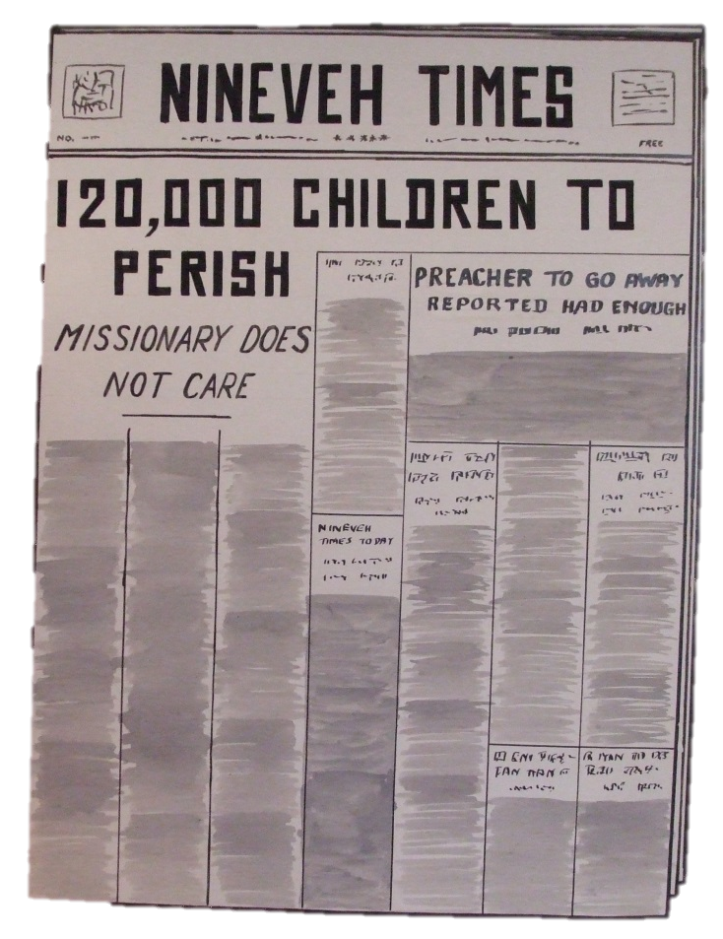
JONAH SULKS
9
Ch. 4 v. 8
GOD’s MERCY
Ch. 4 vs. 9-11

Slide 10
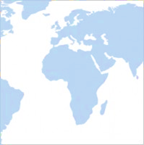
FOR GOD SO LOVED THE WORLD …
†
JOHN 3 v. 16
10

