Slide 1
The following Biblical presentation is based on notes and illustrations by the Rev L G Stapleton
compiled by
Mark Stapleton
© Mark Stapleton 2016
1

Slide 2
OBADIAH
Judgement upon Edom and the calamity of Israel/Judah
2

Slide 3
OBADIAH
Shortest book in the
Old Testament.
Only one chapter of
21 verses
Obadiah is hard to identify; it was unlikely that he was the same as Ahab’s steward in 1 Kings 18, because it was after the date of the fall of Jerusalem
He wrote after the captivity of Jerusalem and the Southern Kingdom of Judah in 586 BC
(verses 10-14)
The book is about the Edomites
It is not addressed to God’s people in Israel or Judah.
3

Slide 4
ABRAHAM
ISAAC
ESAU
JACOB
ISRAEL
EDOM
4

Slide 5
ISRAEL
EDOM
Ezekiel 25 v. 12
Malachi 1 vs. 3-4
Joel 3 v. 19
Bitter hatred between brothers
Genesis 27 v. 41
Edomites refused to allow Israel through
their land on their way to Canaan
Numbers 20 vs. 14-21
Joined other nations against Judah
Jeremiah 49 vs. 7-19
5

Slide 6
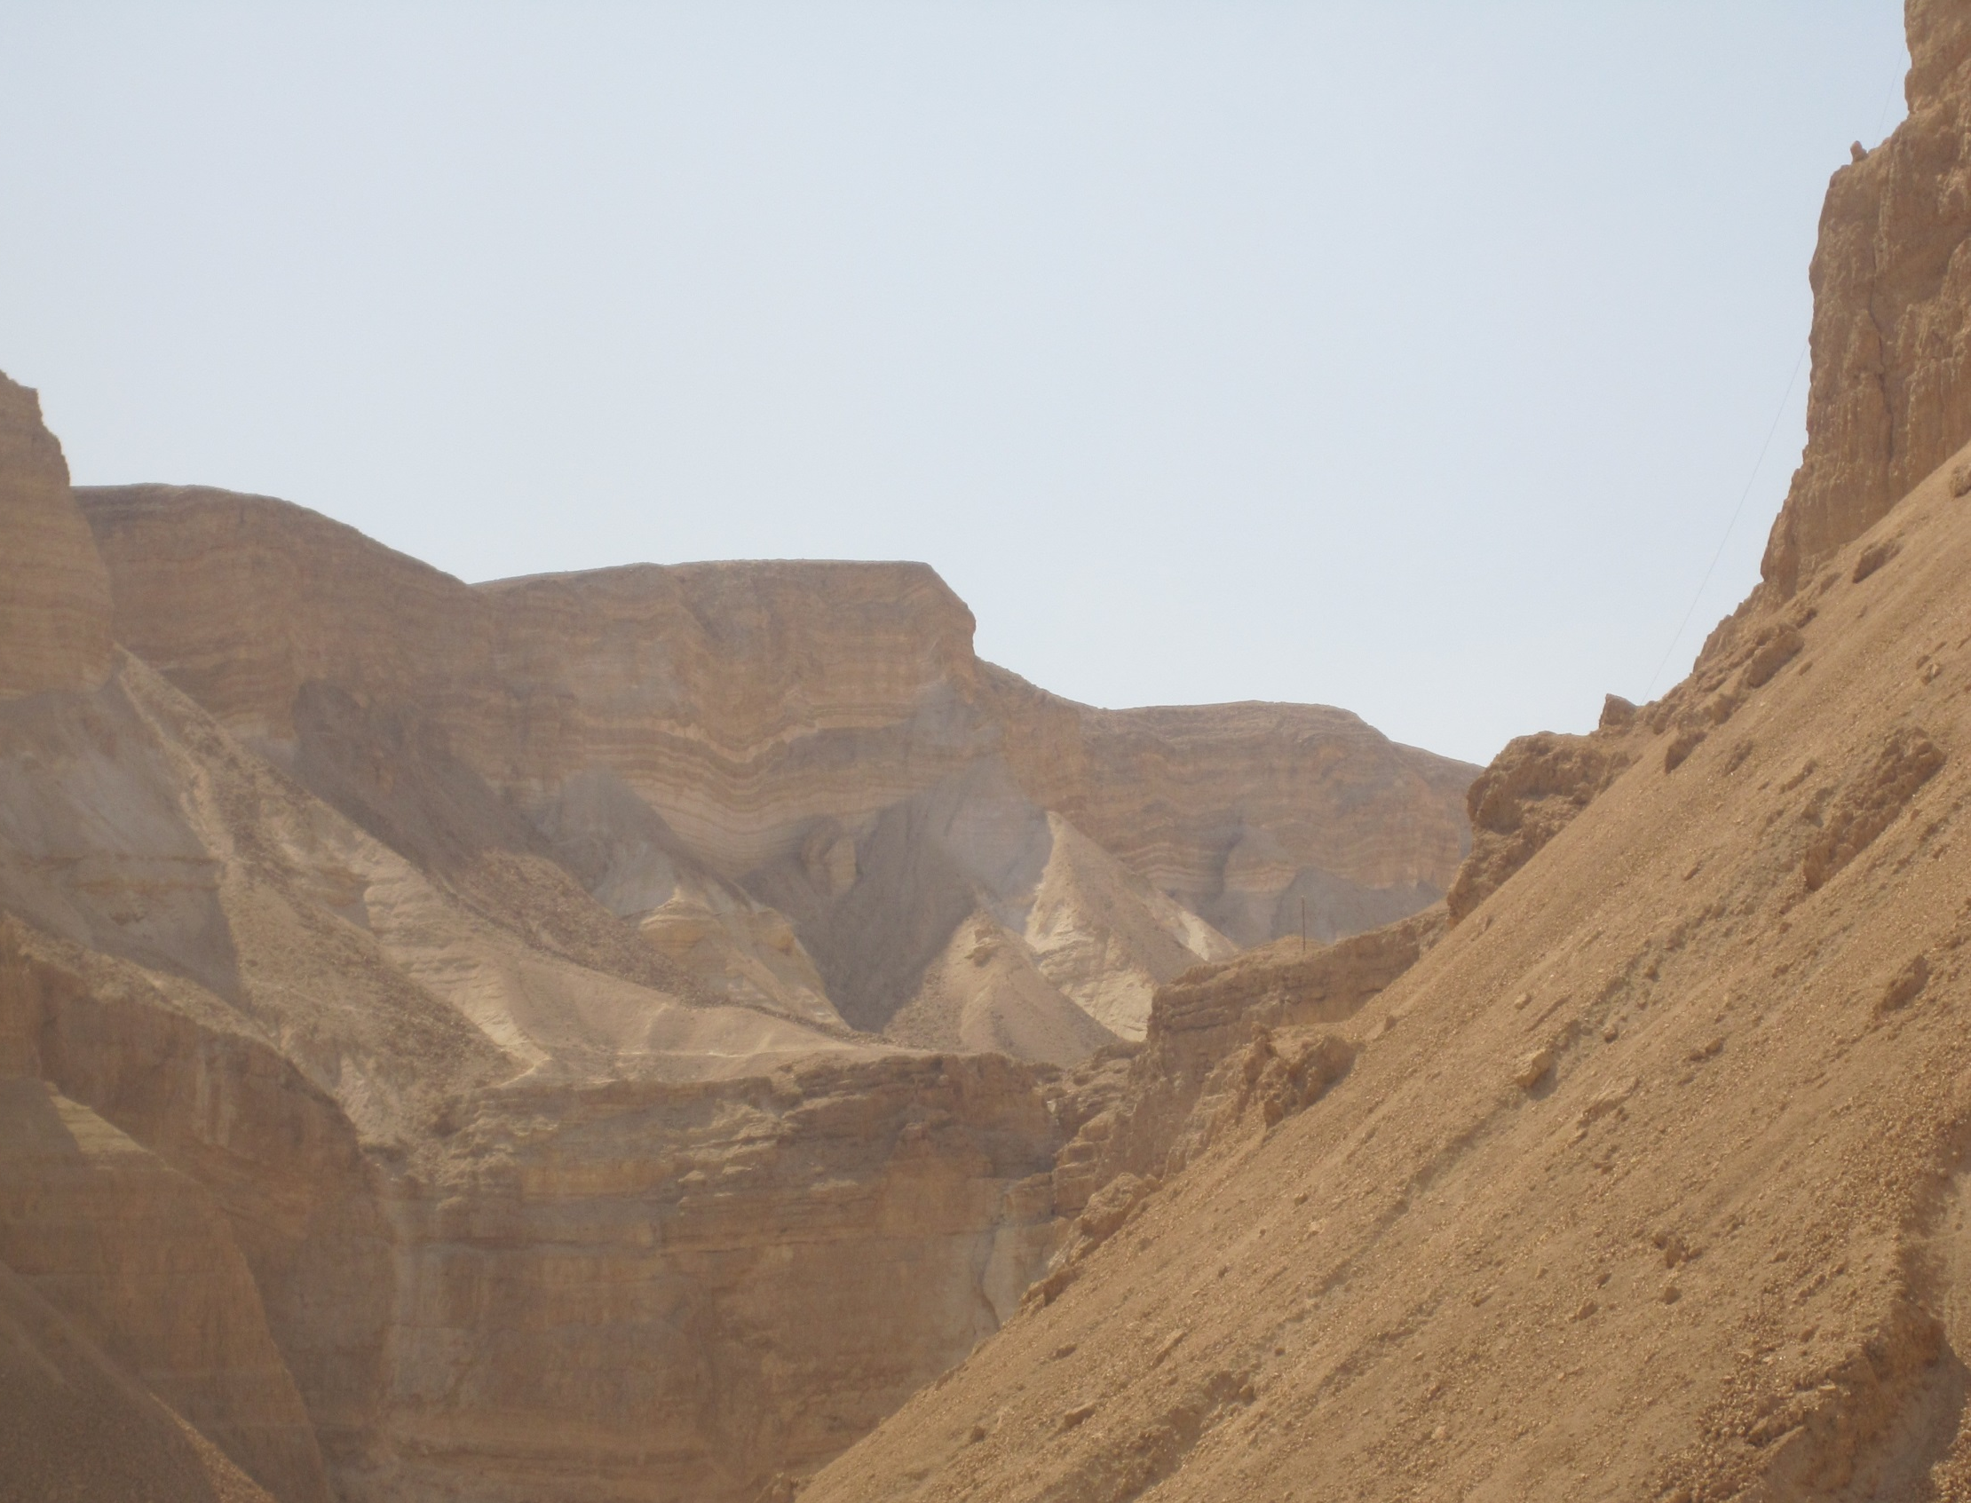

EDOM
Devastating judgement to come. v. 8-9
Humbled – made small. Verse 2
Living among the rocks is no escape. Verse 3
They will be brought down. Verse 4
Hidden things revealed. Verse 6
6
Notes:
Verses 3-4 may refer to the rock city of Petra, one of the cities of Edom

Slide 7
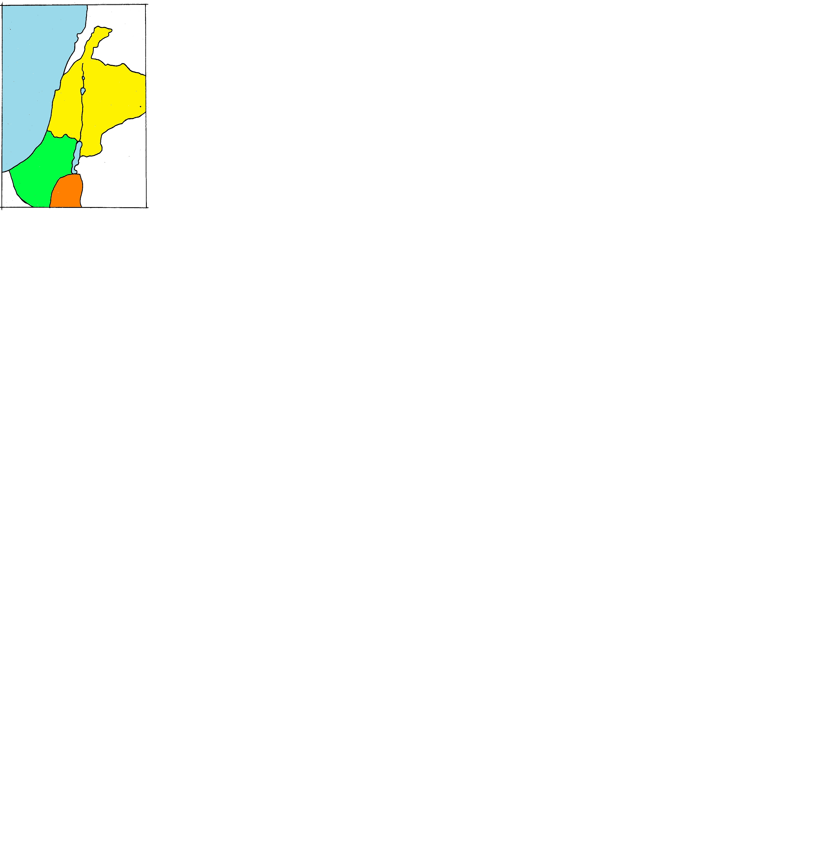
EDOM and ISRAEL
VIOLENCE
v. 10
GLOATING
v. 12
ISRAEL
Jerusalem 
JUDAH
DISTRESS
v. 12
EDOM
CALAMITY
v. 13
7

Slide 8
EDOM and ISRAEL
VIOLENCE
v. 10
GLOATING
v. 12
THE DAY OF THE LORD … IS NEAR V. 15
ISRAEL
YOUR REPRISAL SHALL RETURN UPON YOUR OWN HEAD V. 15
Jerusalem 
JUDAH
DISTRESS
v. 12
EDOM
CALAMITY
v. 13
8

Slide 9
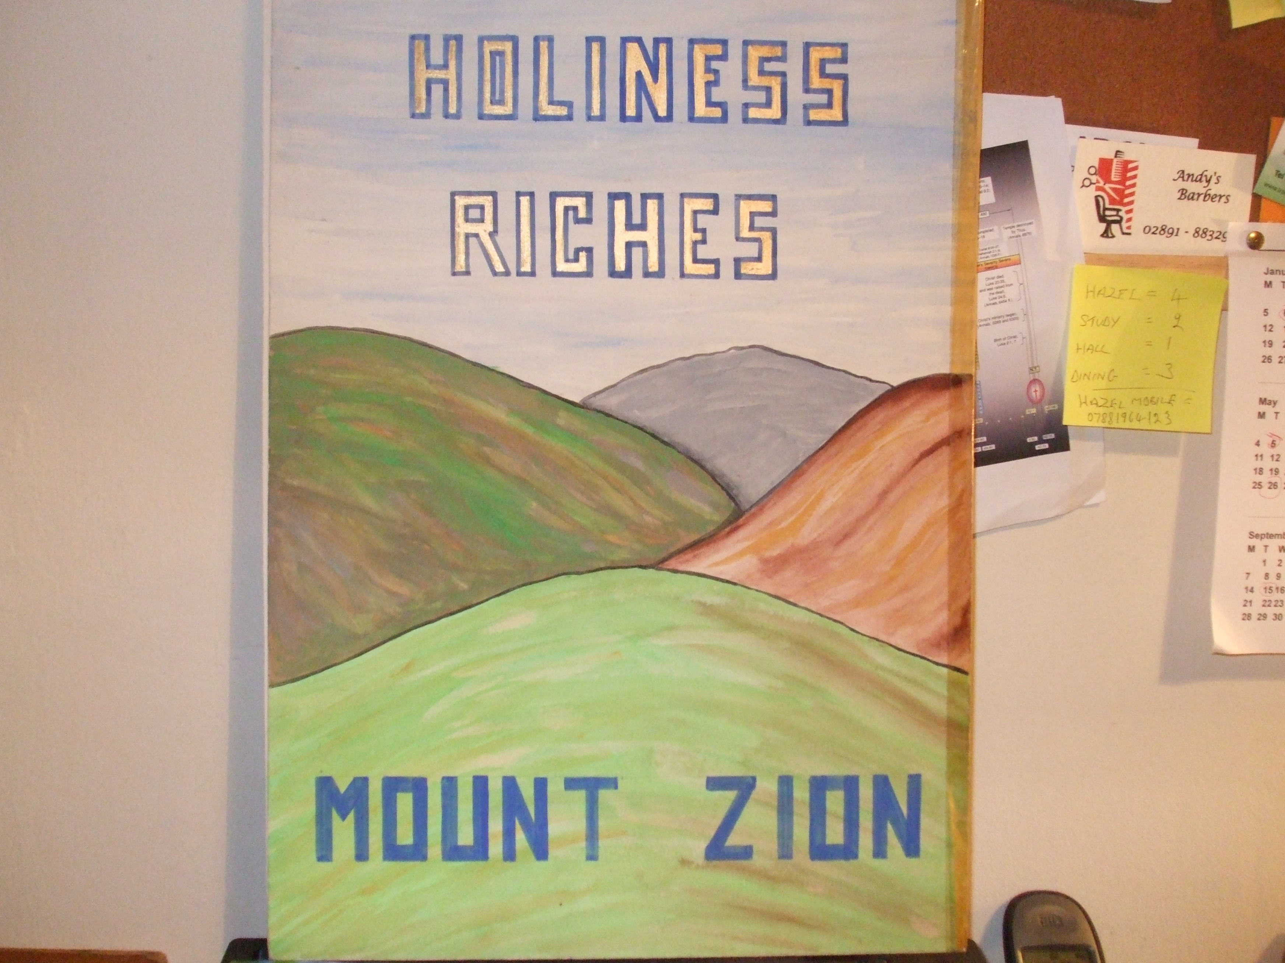
†
DELIVERANCE
HOLINESS
RICHES
CALVARY
MOUNT ZION
v. 17
The kingdom shall be the Lord’s v. 21
9

