Slide 1
The following Biblical presentation is based on notes and illustrations by the Rev L G Stapleton
compiled by
Mark Stapleton
© Mark Stapleton 2016
1

Slide 2
AMOS
The
Sheepbreeder
Ch. 1 v.1
…and a tender (gatherer) of sycamore fruit Ch. 7 v.14
2
Notes:
Sycamore trees mentioned here were probably like wild figs, and are different from the UK sycamore which does not have any fruit

Slide 3
AMOS
CONTEMPORARY
with Hosea (Israel) and Isaiah and Joel (Judah)
UNKNOWN
Ch. 1 v. 1
From Tekoa
c 810-773 BC
PROPHESIED during the reigns of Uzziah (Judah) Jeroboam 2
(Israel)
UNIMPORTANT
Ch. 7 v. 14-15
No prophet
UNWANTED
Ch. 7 v. 12
Never to prophesy again at Bethel
PROPHESIED against Israel
c. 793 BC; born in Judah
3
Notes:
Tekoa was 12 miles south of Jerusalem – relatively unknown

Slide 4
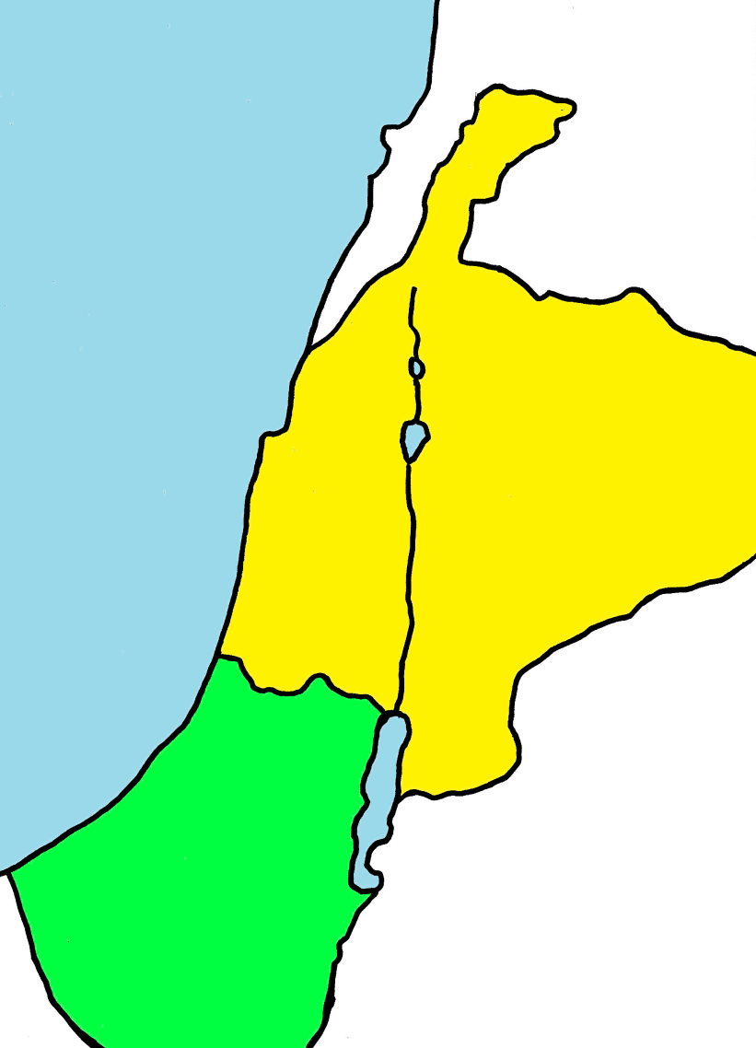
AMOS
4
JUDGEMENT ON THE NATIONS
On Judah (Southern Kingdom) – because of disobedience to God’s Word. Ch. 2 vs. 4-5
SYRIA
TYRE
On the nations around - because of their treatment of God’s people. Ch.1 v.3 – Ch.2 v.3
ISRAEL
On Israel (Northern Kingdom) – because of the unreality of their religious life. Ch. 2 v. 6 onwards
AMMON
PHILISTIA
MOAB
JUDAH
EDOM
Notes:
Note- the phrase – “for three transgressions … and for four” – may be taken as meaning that some of their deeds were enough to justify judgement, but all not their deeds was more than sufficient justification.

Slide 5

AMOS
Social injustices of the day
Ch. 2
v. 6
Luxurious ease of the rich
Ch. 6
vs. 4-6
ISRAEL
Irritation when God’s laws interfere with money making
Ch. 8 v. 5
Cheating in business dealings
Ch. 8
v. 5-6
5
Notes:
Disobedience = transgression. (Transgressing or breaking of God’s Law)

Slide 6
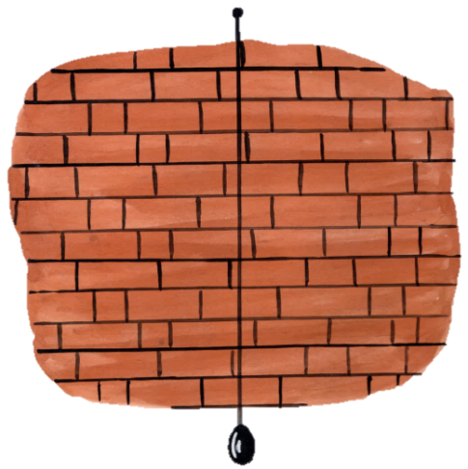
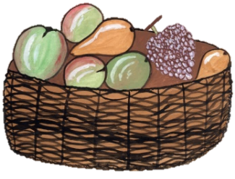







AMOS
God’s coming judgement
Ch. 7 v. 7
Ch. 8 v. 1
Ch. 3 v. 14
“You have not returned to Me”
Ch. 4 vs. 6, 8, 9, 10, 11
Amos intercedes -
“It shall not be,” said the LORD
Ch. 7 v. 1
Ch. 7 v. 4
6
Notes:
Chapter 5 v. 21 – hate/despise of the feast days
The basket of fruits = the end of the summer.
Intercession by Amos on behalf of the people – ch. 7 vs. 2 & 15.

Slide 7
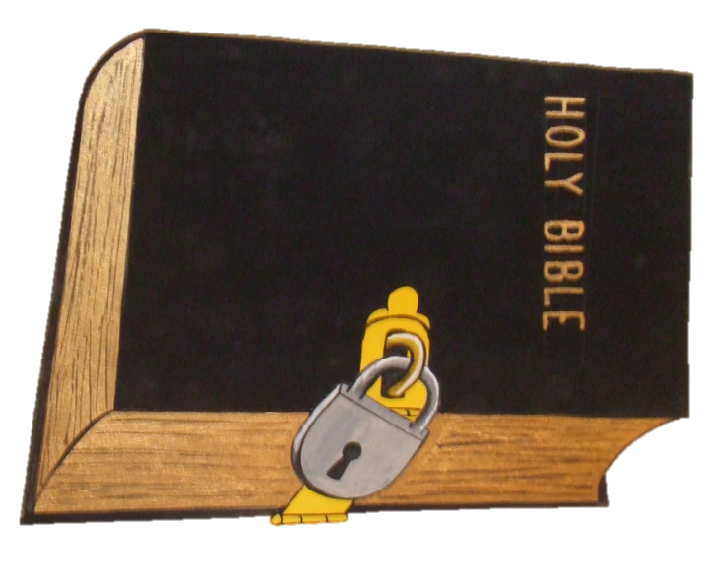
AMOS
…a famine … of hearing the words
of the LORD. Ch. 8 v. 11
DISOBEYING GOD’S WORD
CRYING OUT FOR GOD’S WORD (v. 12)
7

Slide 8
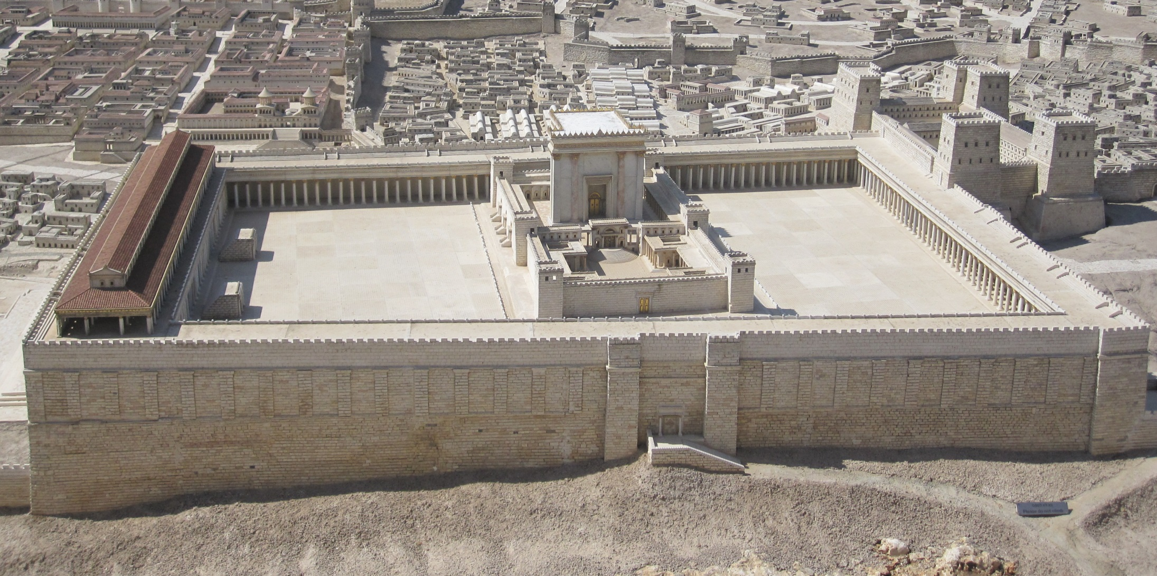
RESTORATION
Chapter 9 vs. 11-15
(Quoted in Acts chapter 15 vs. 6-18)
PROMISED
8

Slide 9
†
RETURN UNTO ME
Jeremiah ch. 29 v. 13
- an answered search
Revelation ch. 22 v. 17
- a gracious invitation
“You have not returned to Me” - Sin has to be dealt with
9

