Slide 1
The following Biblical presentation is based on notes and illustrations by the Rev L G Stapleton
compiled by
Mark Stapleton
© Mark Stapleton 2016
1

Slide 2

JOEL
THE
DAY
OF
THE
LORD
2

Slide 3
JOEL
3
(Jehovah is my God)
First main division – The Day of the LORD = Judgement. A call to repentance
ch. 1 v. 1 to ch.2 v.17
Second main division – The Day of the LORD = deals with the restoration of those who have repented
ch. 2 v. 18 – ch.3 v.21
All that is known about Joel is that he was the son of Pethuel
ch. 1 v. 1
Date of Prophecy cannot be certain. Generally thought to be between Hosea and Amos - approx. 800 B.C.
He speaks to the Southern Kingdom of Judah, with special reference to Jerusalem. No mention of the Northern Kingdom of Israel

Slide 4

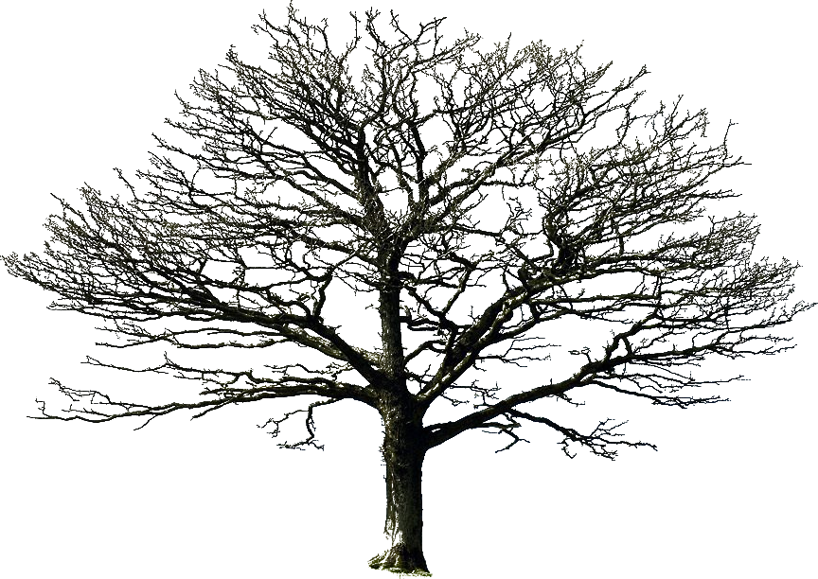
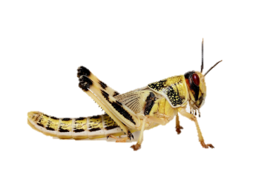
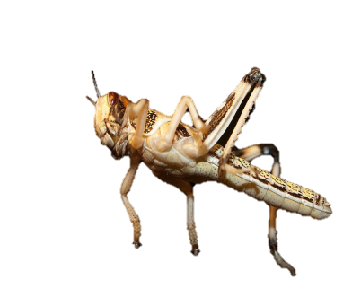

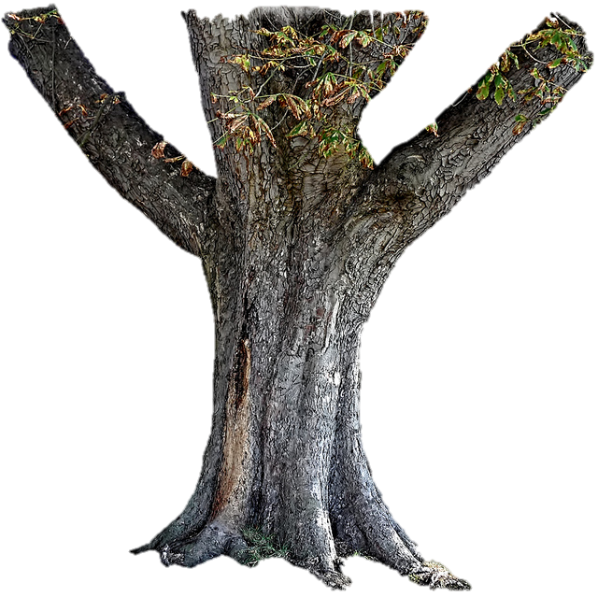

DESOLATION
Chapter 1 verses 4, 7, 10-12, 17-18
4

Slide 5
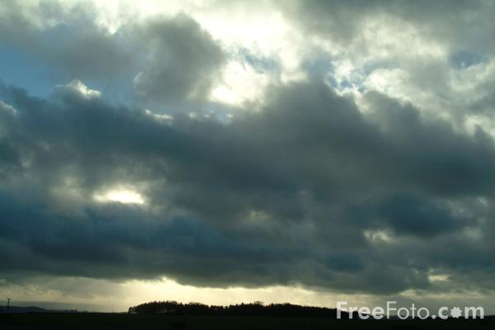
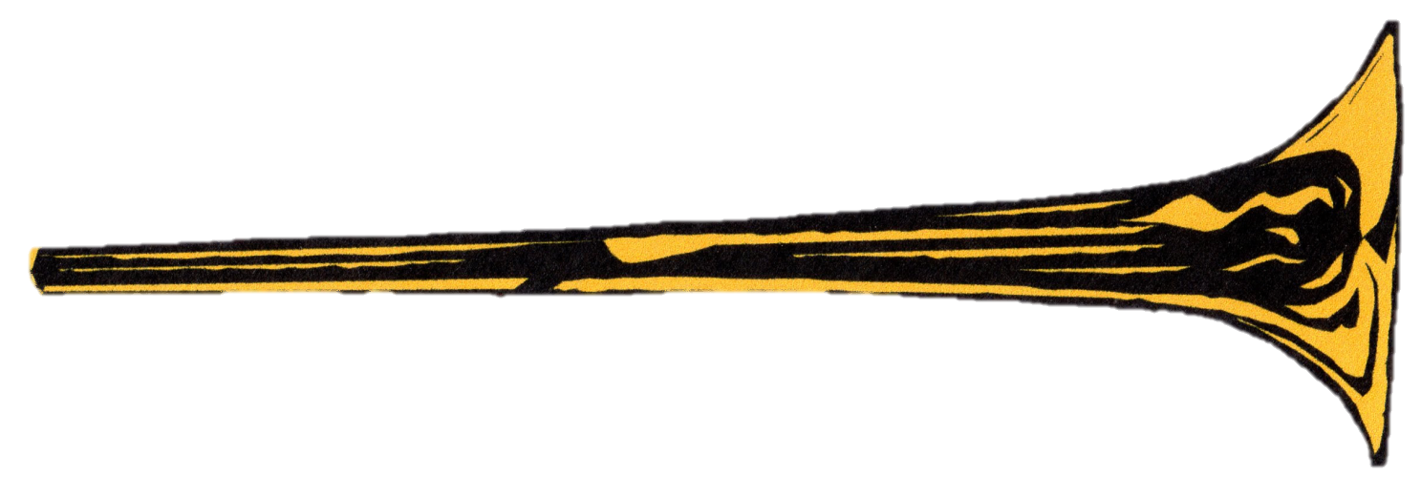

THE DAY OF THE LORD
Chapter 2
Darkness
v. 2
Heathen
invasion
v. 2-3
God intervenes - v. 11
5

Slide 6
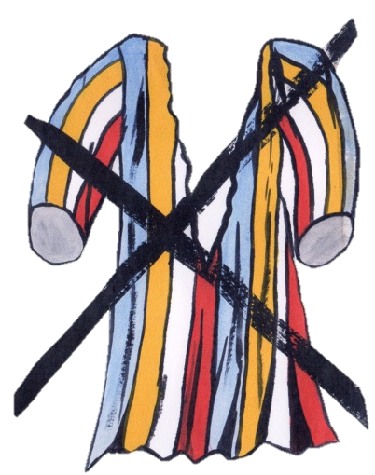


A CALL TO REPENTANCE
Chapter 2
Sound an alarm – v. 1
Call a sacred assembly – v. 15
…and not your garments – v. 13
Rend your heart v. 13
6

Slide 7



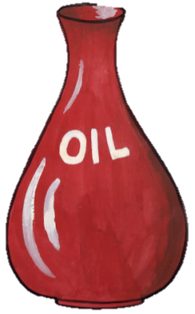


A CALL TO REPENTANCE
Chapter 2
Call a sacred assembly – v. 15
Fear not – v. 21
v. 19/22
v. 19
v. 22
v. 19
Promises – vs. 18-27
7
v. 25

Slide 8
JOEL
Chapter 2
verses 28 - 32
PENTECOST
Partially fulfilled in
Acts chapter 2
verses 16 - 21
8
Notes:
The application of Joel 2 v. 28-32 not only came to pass on the day of Pentecost but also upon the christian Church thereafter – both Jew and Gentile

Slide 9

JOEL
Chapter 3
The FINAL day of the LORD
(verse 14)
The Nations gather together against Judah
Verses 1 – 2, 9 - 10
WAR
God’s power will be shown
verse 16
9

Slide 10
JOEL
Chapter 3
The Valley of decision =
Valley of judgement. Verse 14
Enemies desolated
Verse 19
God’s people safe
Verse 20-21
The final victory
Verse 21
10

Slide 11
…now is the day of Salvation
2 Corinthians 6 v. 2
†
Seek the LORD while He may be found…
Isaiah 55 v. 6
11

