Slide 1
The following Biblical presentation is based on notes and illustrations by the Rev L G Stapleton
compiled by
Mark Stapleton
© Mark Stapleton 2016
1

Slide 2
HOSEA
RETURN
2
Notes:
The word “Return” is used 17 times, in different ways, in this book (NKJV).

Slide 3
3
HOSEA
Main Divisions –
Chapters 1 – 3 – the Prophet’s personal domestic experience.
Chapters 4 – 14 – God’s dealings with a similarly unfaithful Israel
The name Hosea means “Salvation”. He prophesied regarding the Northern Kingdom of Israel, from about
770-697 BC.
Kings who reigned during Hosea’s ministry were – Uzziah, Ahaz, and Zedekiah (Kings of Judah), and Jeroboam the son of Joash (King of Israel). Ch. 1 v. 1
Hosea is the first of what is known as the Minor Prophets. Only because of their shortness compared with the Major Prophets of Isaiah, Jeremiah, Daniel and Ezekiel
Hosea was partly contemporary with the Prophets Amos and Isaiah, and could have been the last Prophet before the Dispersion of Israel in 722 BC.

Slide 4

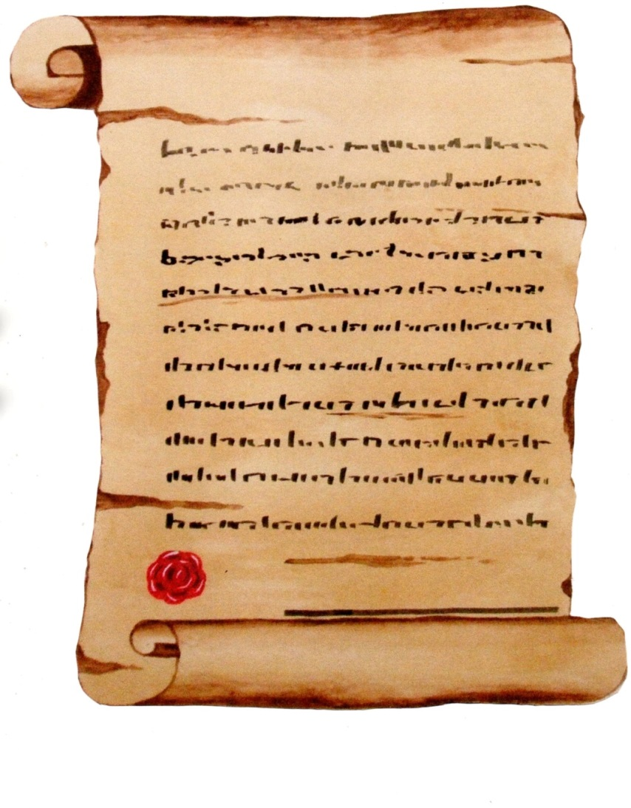
HOSEA
4
MARRIAGE
VOWS
LOVE
ALL SPURNED
LOYALTY
FIDELITY
The Story of Gomer
chapter 1
Notes:
In spite of this sad situation, Hosea loves Gomer so much that he buys her back – Ch. 3 v. 2.

Slide 5

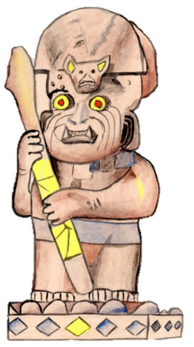
HOSEA
EPHRAIM
ISRAEL
Chapter 4 v.17
JEHOVAH
IDOLS
5

Slide 6
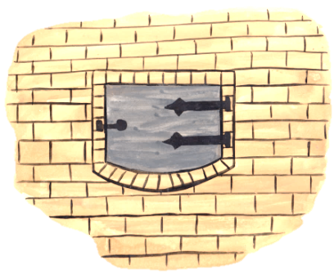
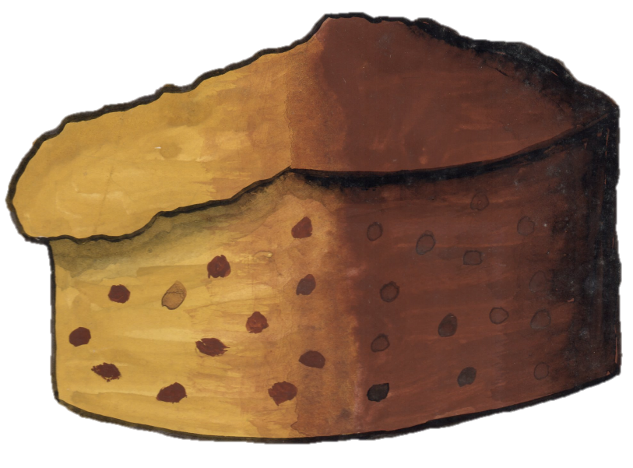

HOSEA
Ephraim is a cake unturned
ch. 7 v. 8
(Distasteful)
Israel is an empty vine
ch. 10 v. 1
(Unfruitful)
6
Notes:
The result of being ‘joined to idols’ is that Ephraim has become distasteful and unfruitful

Slide 7
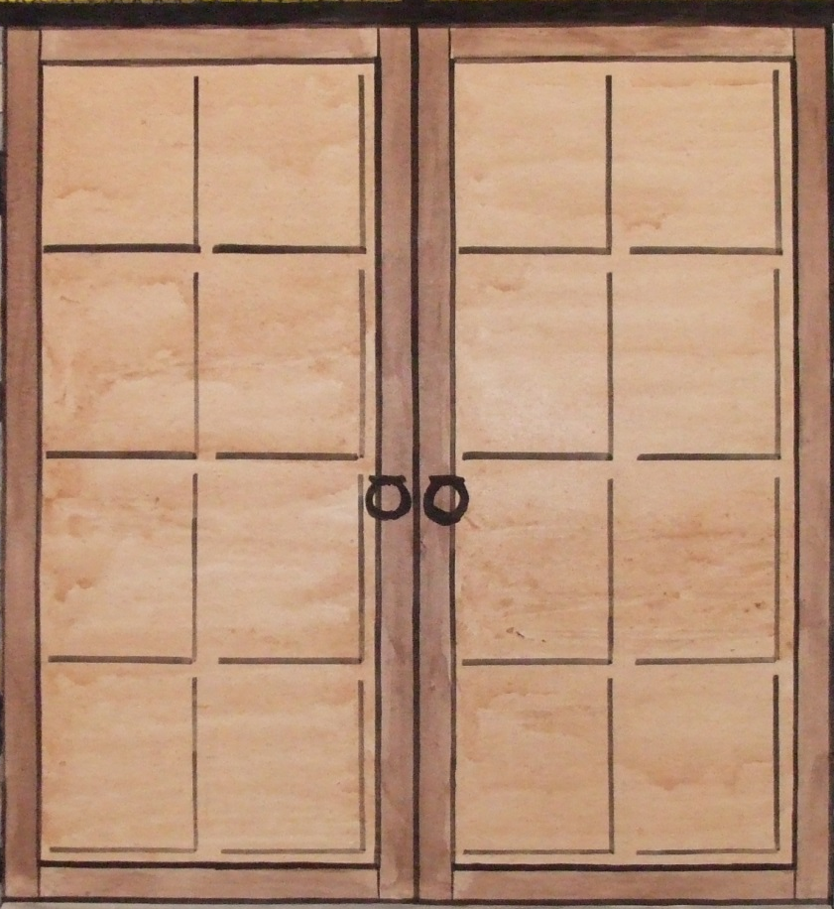
HOPE
The Valley of Achor as a door of hope
Chapter 2
verse 15
7
(Joshua Chapter 7 verses 18-26)

Slide 8





HOPE
SIN
⬇
CONFESSED
⬇
JUDGED
⬇
FORSAKEN
8

Slide 9
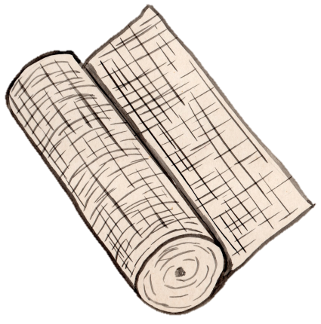
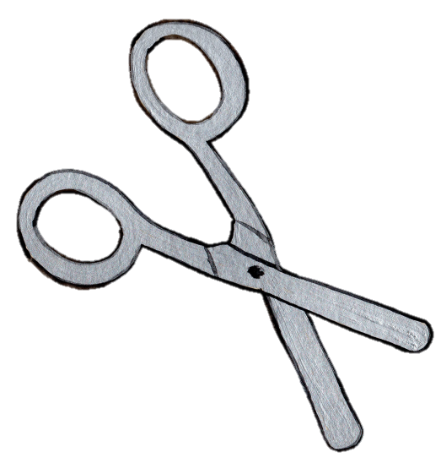
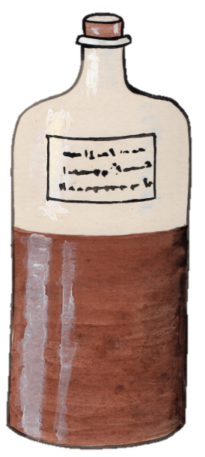

HEALING
I will heal their backsliding … ch. 14 v. 4
9

Slide 10
GOD SO LOVED THE WORLD
John 3 v. 16
†
I will redeem
ch.13. v.14
(=Payment)
I will Ransom
ch.13. v.14
(=Deliverance)
I will love them freely … ch. 14 v. 4
10

