Slide 1
The following Biblical presentation is based on notes and illustrations by the Rev L G Stapleton
compiled by
Mark Stapleton
© Mark Stapleton 2016
1

Slide 2
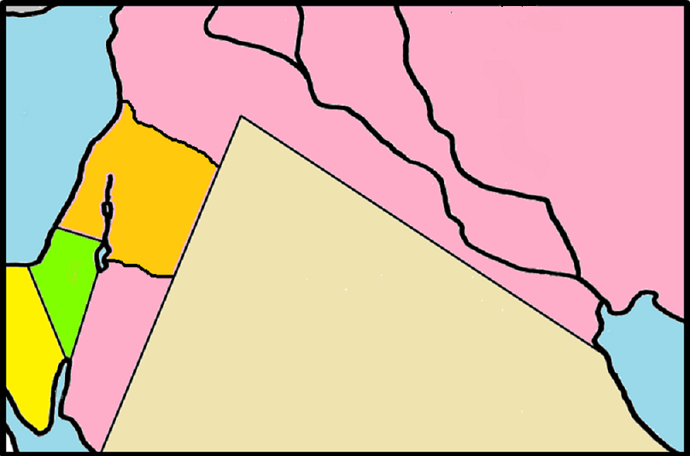
DANIEL
ISRAEL
● Jerusalem
Babylon 
JUDAH
Daniel 1 vs.1
2

Slide 3
DANIEL
3
A prisoner of war, when Babylon overran Judah (ch. 1 vs.1-4)
Was contemporary with Jeremiah, Ezekiel, Nehemiah, Haggai, Zerubbabel and Zechariah
Lived a long life and exercised considerable political influence spanning the 3 kingdoms of Babylon, Media and Persia (ch.1 v. 21)
The book has a great deal to do with the Gentile world powers rather than with God’s people, the Jews
The book is largely Apocalyptic in style – i.e. it reveals or unveils things by the use of visions and symbols
Lived at the time of kings Nebuchadnezzar, Belshazzar, Darius and Cyrus

Slide 4
NEW NAMES
OLD
NEW
Daniel
Belteshazzar
(God is Judge)
(Bel protect the king)
Hananiah
Shadrach
(God is Gracious)
(Command of Aku)
Mishael
Meshach
(Who is what God is?)
(Who is as Aku?)
Azariah
Abed-Nego
(God is Keeper)
(Servant of Nego)
Daniel ch. 1 vs. 6-7
4

Slide 5

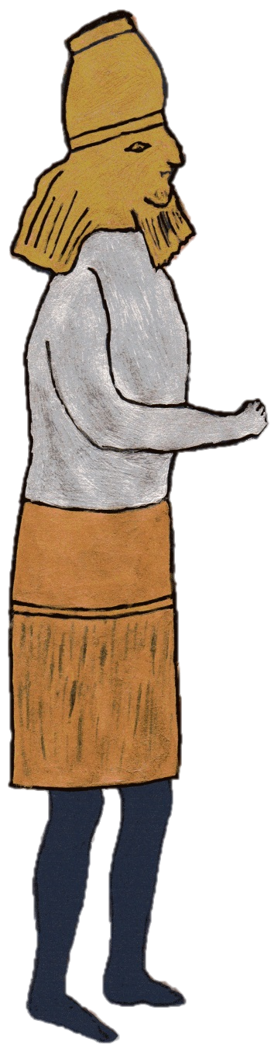
Nebuchadnezzar’s forgotten dream
Babylon
Persia
Greece
Rome
(Gold)
(Silver)
(Bronze)
(Iron and Clay)
5
Daniel chapter 2

Slide 6

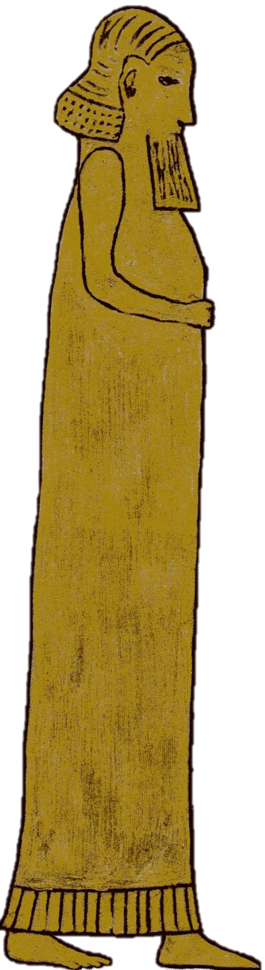


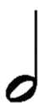

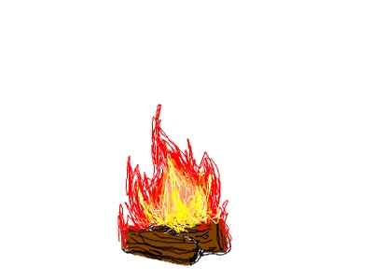
Nebuchadnezzar’s image of gold
6
Shadrach
Meshach
Abed-Nego
+ 1
90 ft
BUT
IF
NOT….
Daniel chapter 3

Slide 7
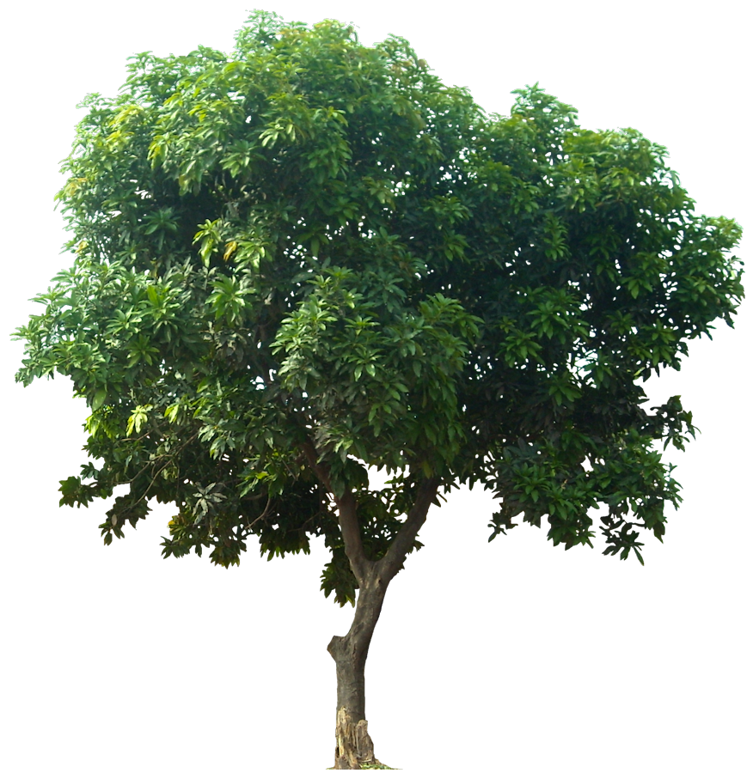
Nebuchadnezzar’s second dream
He tells Daniel the dream. vs. 10 - 18
Daniel explains the dream. vs. 19 - 27
7
Daniel Chapter 4

Slide 8
Nebuchadnezzar’s second dream
He tells Daniel the dream. vs. 10 - 18
His humiliation
vs. 28 - 33
His boasting
v. 30
…break off your sins
v. 27
…your dwelling shall be with the beasts of the field
v. 32
…you shall eat grass like the oxen
v. 32
…until you know that the Most High rules… v. 32
Daniel explains the dream. vs. 19 - 27
8
Daniel Chapter 4

Slide 9
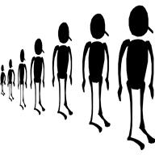
Belshazzar’s feast
They drank wine, and praised the gods
of gold and silver, bronze and iron,
wood and stone. v. 4
One thousand guests
9
Daniel Chapter 5

Slide 10

Belshazzar’s feast
Mene Mene
God has numbered your kingdom and finished it. v.26
Tekel
You have been weighed in the balances and found wanting. v.27
Your kingdom has been divided
and given to the Medes and Persians.
v. 28
Upharsin
(Peres)
You have not glorified God. v.23
That very night Belshazzar was slain. v. 30
King Darius the Mede received the Kingdom. v. 31
10
Daniel Chapter 5

Slide 11
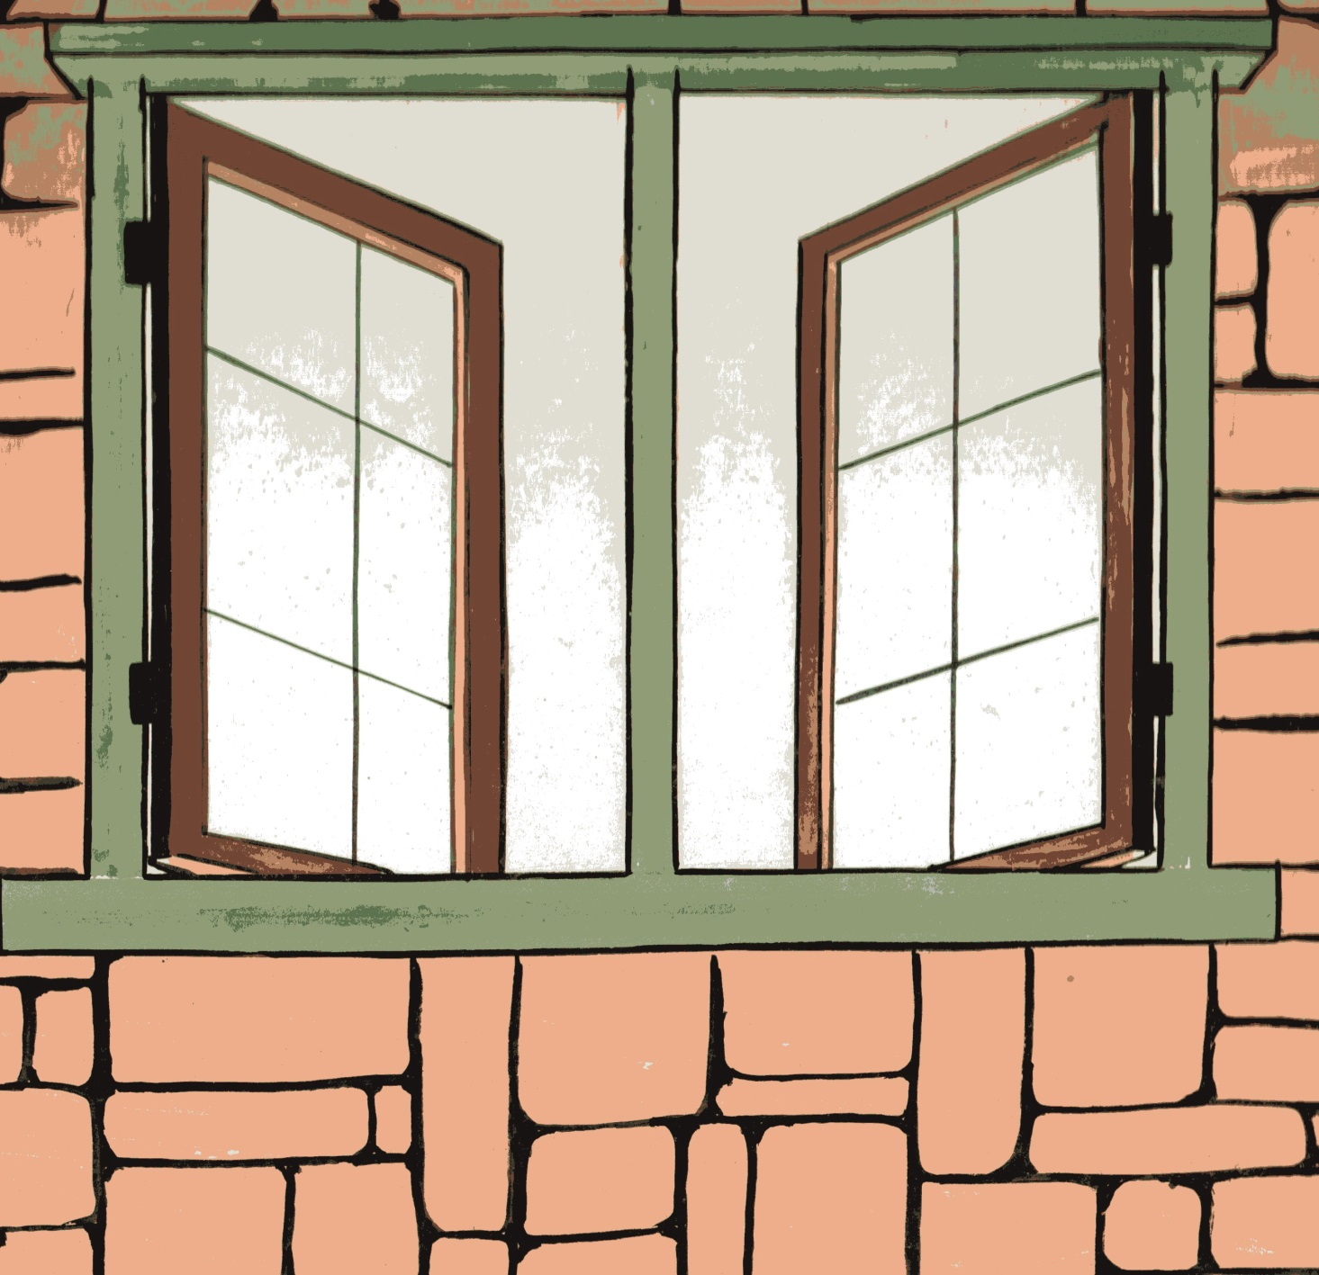
Darius – No Petitions
Daniel prayed three times a day v.10
11
Daniel Chapter 6

Slide 12


Darius – No Petitions
“Your God , whom you serve continually, He will deliver you” v.16
“Has your God… been able to deliver you from the lions?” v.20
“My God sent His angel and shut the lions’ mouths, so that they have not hurt me…” v.22
12
Daniel Chapter 6

Slide 13
Daniel’s prayer for his people
Remembers Jeremiah’s word from God, about Jerusalem’s 70 years of desolation
Chapter 9 v. 2
Confesses his sin and the sin of his people
Chapter 9 v. 4-13
Pleads for God’s mercy on His people
Chapter 9 v. 16-18
Asks God to hear and answer his prayer
Chapter 9 v. 19
13

Slide 14
Daniel’s prophecy for his people
Gabriel tells Daniel that – “70 weeks are determined for your people and for your holy city…” Chapter 9 v. 24
7
+ 62
+ 1
70 weeks x 7
=490 years
After 69 weeks (of years) Messiah is cut off. v. 25, but not for Himself, v. 26
14

Slide 15
†
The Coming of the Messiah
15
Daniel chapter 9 verses 25-26
The End Days – the book is sealed ch. 12 v.4
The Books were opened - Revelation ch. 20 v.12

