Slide 1
The following Biblical presentation is based on notes and illustrations by the Rev L G Stapleton
compiled by
Mark Stapleton
© Mark Stapleton 2016
1

Slide 2
The Word of the LORD came to Ezekiel. Chapter 1 vs.3
Q. When did it come?
During the Captivity of the southern kingdom of Judah in Babylon
Ch. 1 v. 2
Q. Where was he when it came?
By the River Chebar, in the land of the Chaldeans (Babylonians)
Ch. 1 v. 3
2

Slide 3
EZEKIEL
He ministered for about 22 years
He was a Priest
Ch.1 v. 3
His name means – “The God who strengthens”
He was married – his wife died suddenly on the day the King of Babylon came against Jerusalem
Ch.24 vs. 15-18
He prophesied at the time of the Captivity of the Southern Kingdom of Judah, with Jeremiah and Daniel
3

Slide 4
The Main Divisions of Ezekiel’s Ministry
1
Chapters 1-24
The punishment of Judah (Southern Kingdom)
2
Chapters 25-32
The punishment of the Gentile nations round about
3
Chapters 33-48
The restoration of the whole of Israel
4

Slide 5
The
Glory
of
the
LORD
Chapter 1 vs. 26-28
The Glory withdrawn from the
Southern Kingdom of Judah. Chapters 1-24
5

Slide 6
A Message of Woe
Lamentations
Mourning
Woe
Chapter 2 v. 9-10
6

Slide 7
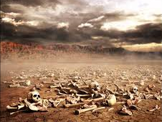
The Valley of Dry Bones
Chapter 37
Can these
bones live?
7
Notes:
Primarily this refers to the people of Israel. Would they ever be a nation again? Would they be resurrected? This can also refer to conversion – a soul, dead in trespasses and sins, can only be made alive again through the Lord Jesus Christ

Slide 8
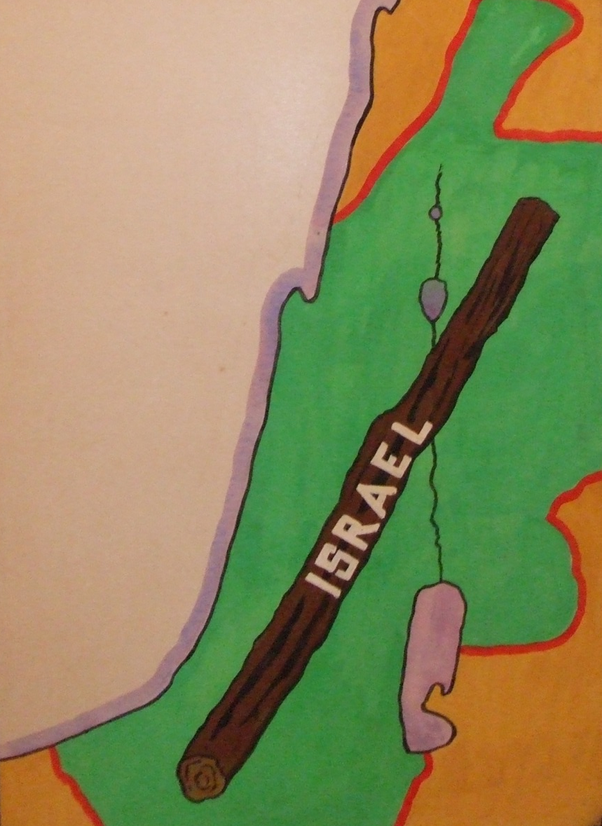
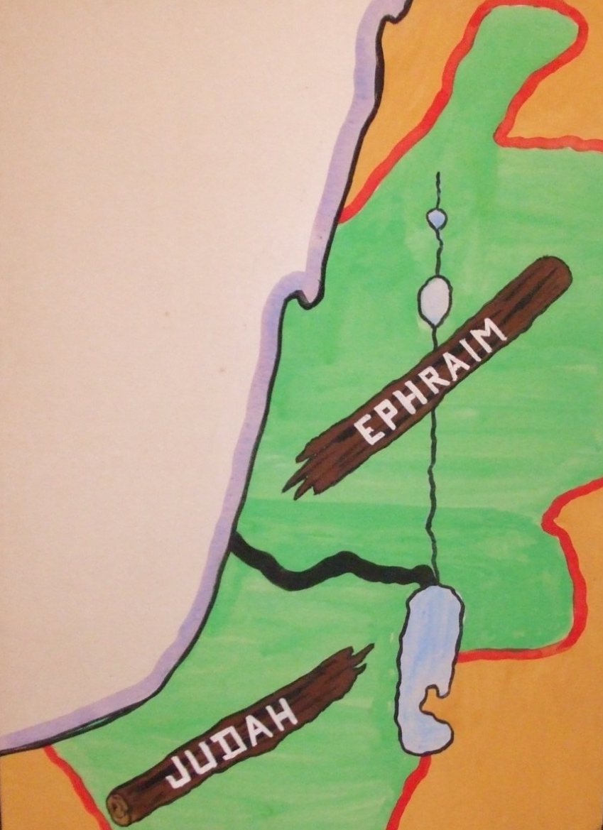
Restoration of the land
8
Chapter 11 vs. 14-20, 37 vs. 15-28

Slide 9
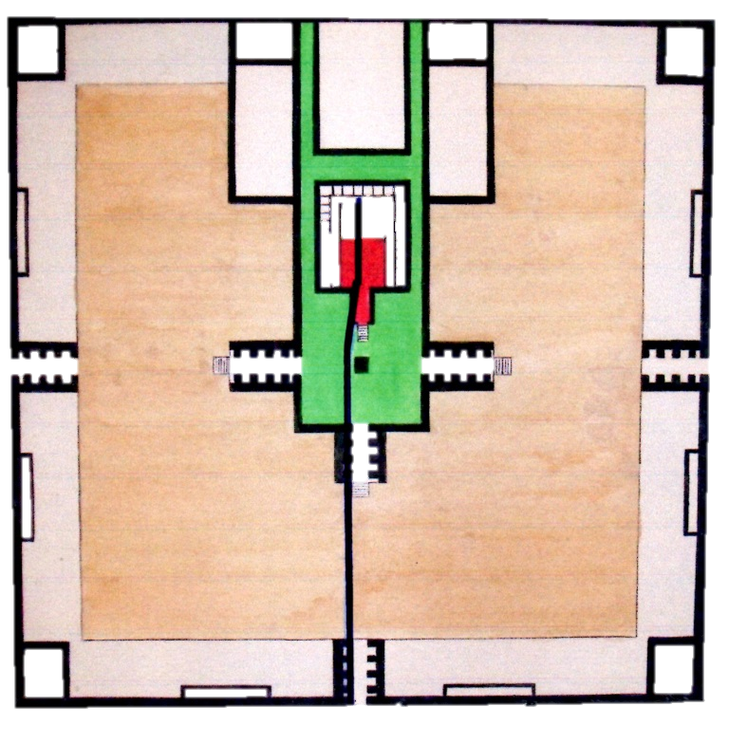
A New City, A New Temple
THE EAST GATE
The Plans -
Chapters 40-43
East Gate reserved for the Prince. Chapter 44
9

Slide 10

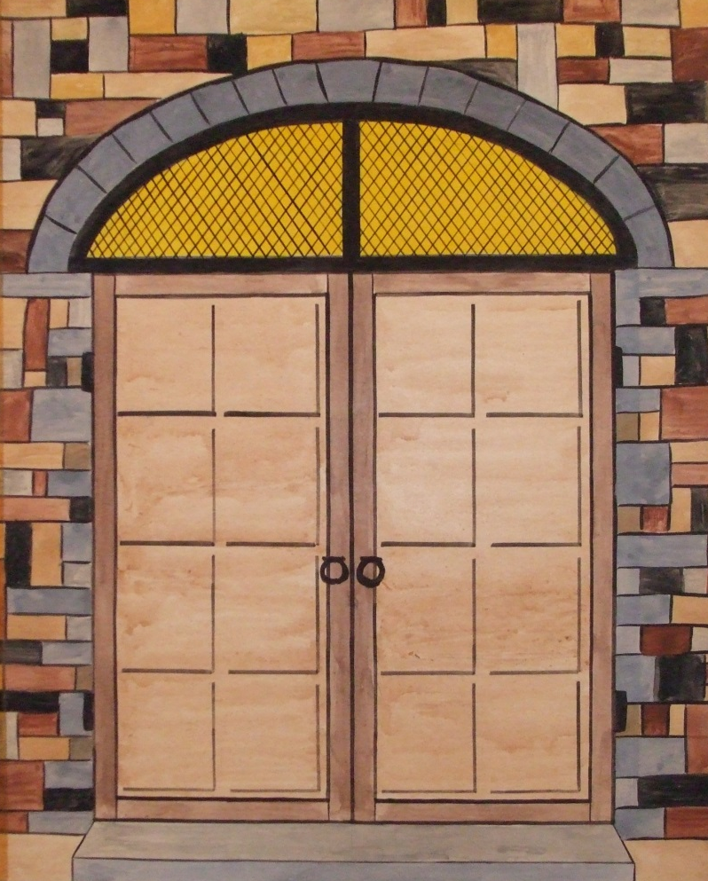

†
Jesus said: “I am the WAY, the TRUTH and the LIFE…” John 14 v. 6
THE EAST GATE
Chapter 47
They shall bear fruit Ezekiel 47 v.12
10
JEHOVAH SHAMMAH – “The Lord is there” – Ezekiel 48 v. 35

