Slide 1
The following Biblical presentation is based on notes and illustrations by the Rev L G Stapleton
compiled by
Mark Stapleton
© Mark Stapleton 2016
1

Slide 2

LAMENTATIONS
OF
JEREMIAH
2

Slide 3
LAMENTATIONS
Jeremiah cried because of the sins of God’s people.
The price of sin is terrible
Ch. 1 v. 7-8
The Lord Jesus Christ also wept: – at the death of Lazarus (John 11 v. 35), and over Jerusalem (Luke 19 v. 41)
3

Slide 4
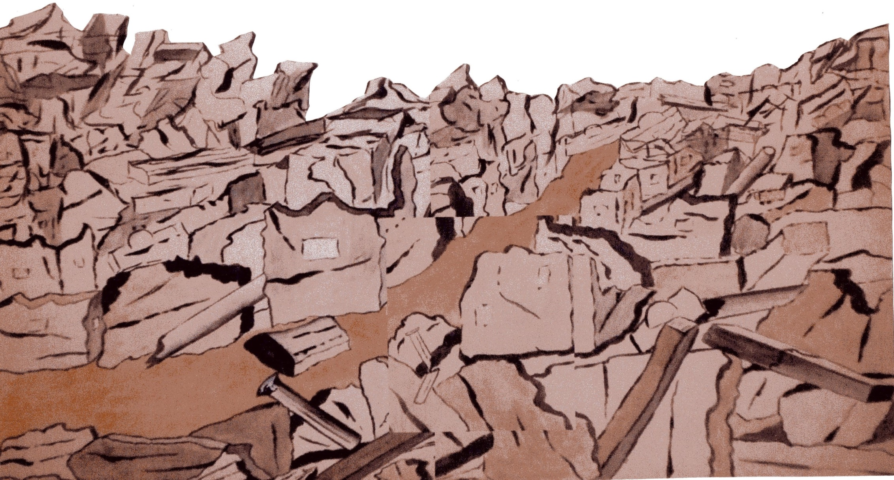
Jerusalem becomes an object of contempt, ridicule, laughter and scorn. Ch.2 vs. 15-16
THE PERFECTION of BEAUTY
Chapter 2 v.15
God’s Word fulfilled. Ch.2 v. 17
The disbelief of the nations. Ch.4 v. 12
4

Slide 5
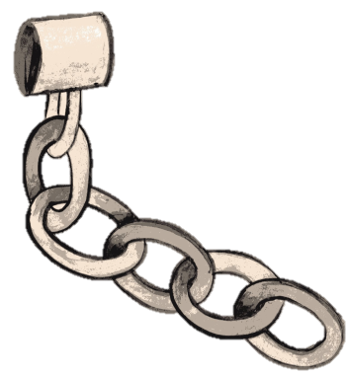
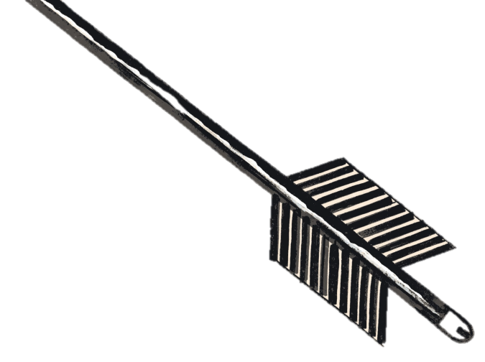

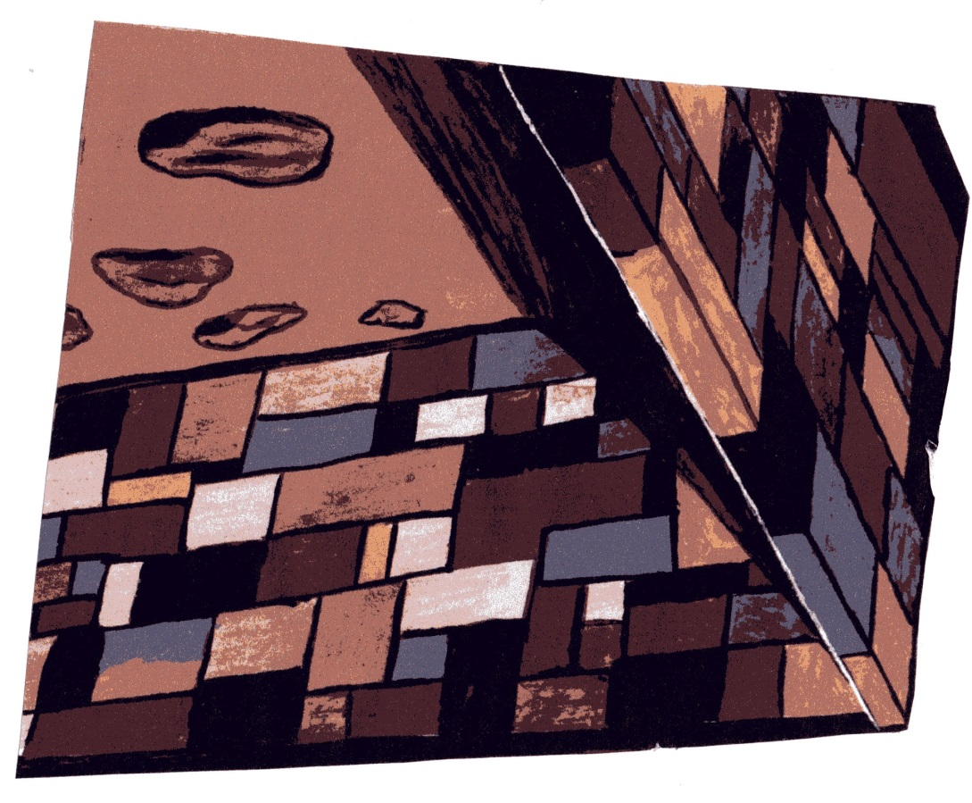
Jeremiah’s anguish and frustration
Chapter 3
v. 12 - He… has set me up as a target for the arrow
v. 7 – He has made my
chain heavy
v.7 – He has hedged me about so that I cannot get out
5

Slide 6
Jeremiah’s confidence and
trust in God
Chapter 3 vs. 22-24
Great
God’s faithfulness
is
Your
Judah’s unfaithfulness
faithfulness
6

Slide 7
Jeremiah’s prayer
Chapter 5
He confesses, and identifies himself with the sin of the people of Judah.
v. 16
He prays for God to turn him and the people of Judah back to Himself
v. 21
1 John Chapter 1 vs. 9
7

Slide 8
†
Is it nothing to you, all you who pass by?
Chapter 1 v.12
8

