Slide 1
The following Biblical presentation is based on notes and illustrations by the Rev L G Stapleton
compiled by
Mark Stapleton
© Mark Stapleton 2016
1

Slide 2
JEREMIAH
“Thus
says
thE
LORD”
2
Notes:
The New King James Version of the Bible uses the word – “says”, not “saith” as in the Authorised Version

Slide 3
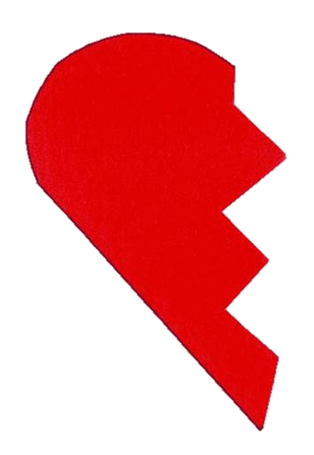

JEREMIAH
Has been called the prophet of the broken heart.
His plea to Judah (Southern Kingdom)
3
Idolatory - ch.10
Return – ch.4
REPENT
Backsliding – ch.8
Amend – ch.4
False prophets – ch.23
Covenant Broken – ch.11
God’s certain judgment
God’s eternal love
Notes:
He called for repentance time and time again.
The word – return occur 47 times.

Slide 4
JEREMIAH
Called to be a prophet
Chapter 1 vs. 4-9
Prophesied about 40 years after Isaiah’s death, from 626 BC to 586 BC
Prophesied from the reign of King Josiah (Southern Kingdom of Judah) until the time of the Captivity
in 586 B.C.
His call for repentance went unheeded
Chapter 36 vs. 24
Israel, the Northern Kingdom, had already gone into dispersion. The lesson , however, had not been learnt by Judah, the Southern Kingdom
4

Slide 5
JEREMIAH
God’s word of judgement on the nations:
Israel chapters 1-5
Egypt chapter 46
Babylon chapters 50-51
Philistia chapter 47
Elam chapter 49
Moab chapter 48
Kedar & Hazor - chapter 49
Ammon chapter 49
5
Damascus chapter 49
Edom chapter 49

Slide 6
JEREmiah
Prophesied that:
Judah (Southern Kingdom) would go into Captivity in Babylon. Chapter 25 v.11-12
(this happened in 586 BC)
Those in Captivity would return to their homeland 70 years (this was fulfilled under the leadership of Zerubbabel and Ezra .
Chapter 29 v. 10)
6

Slide 7
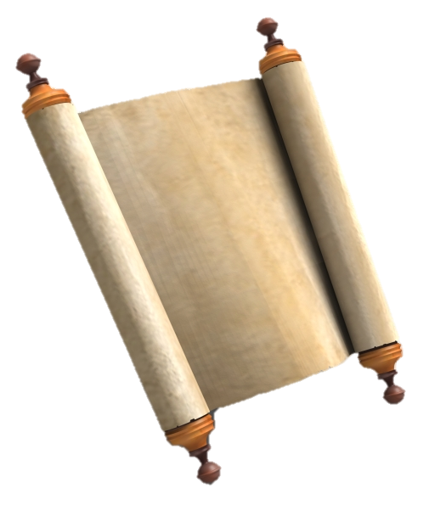
JEREmiah
God instructed him to purchase a field against the eventual return of the people from the Captivity in Babylon. Chapter 32, vs.6-10
TITLE
DEEDS
Baruch, the scribe looks after the deeds. God promises His people that they will again own property and land in Judah. Verses 13-15
7

Slide 8
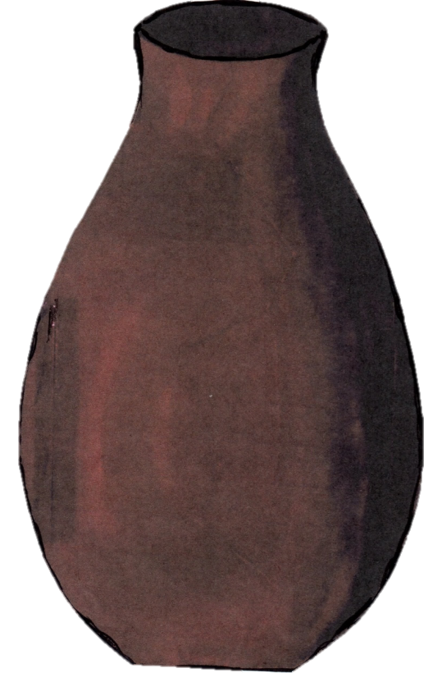
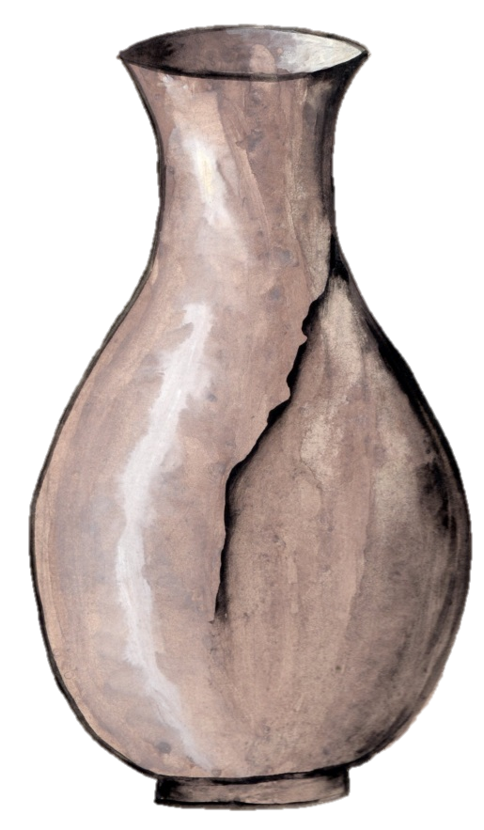
JEREMIAH
visits the potter’s house
Chapter 18
8
…so he made it again… vs.4

Slide 9
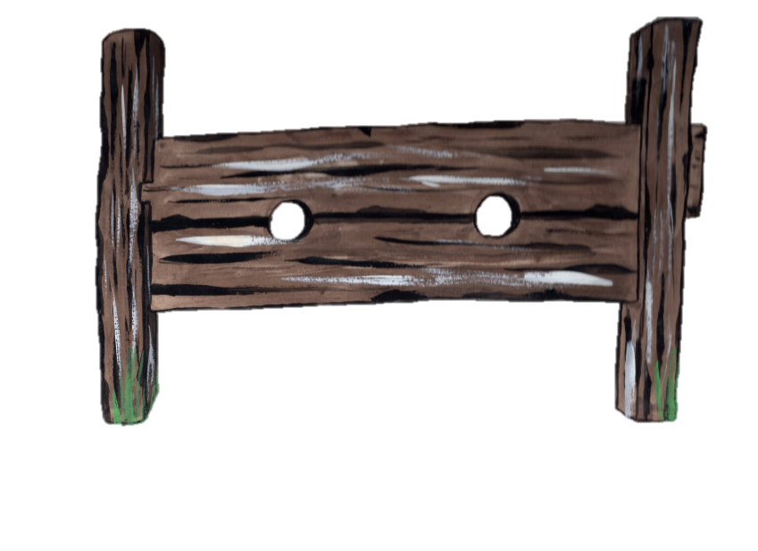
JEREMIAH
In the stocks
Chapter 20
Unpopular ministry – vs. 7-18
9

Slide 10


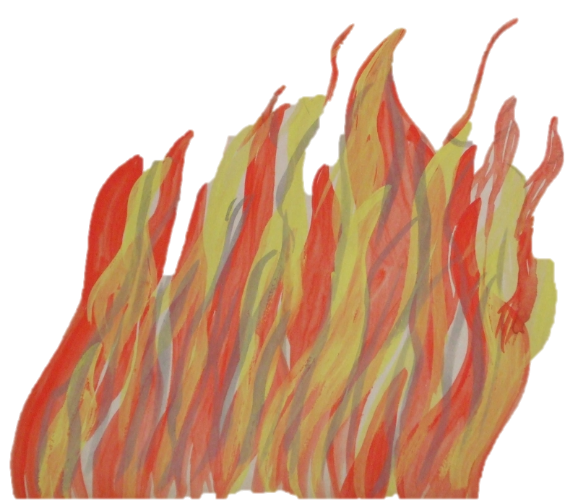
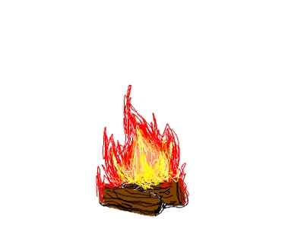
JEREMIAH
God’s word read to the King and people -
Chapter 36
The scroll re-written by faithful Baruch
vs.27-32
Destroyed in the fire by King Jehoiakim
vs. 20-26
10

Slide 11
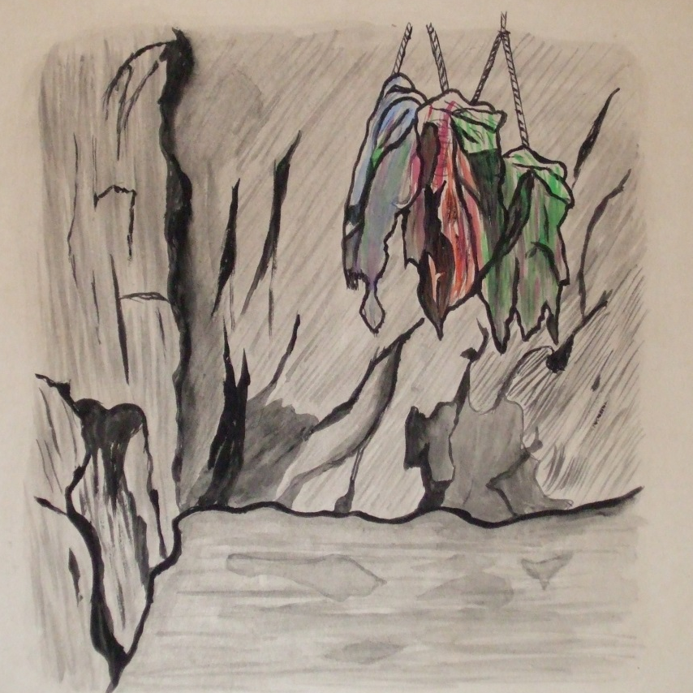
JEREMIAH
in the dungeon
Chapter 38
11
Ebed-Melech, the Ethiopian, rescues him (vs. 8-13)

Slide 12
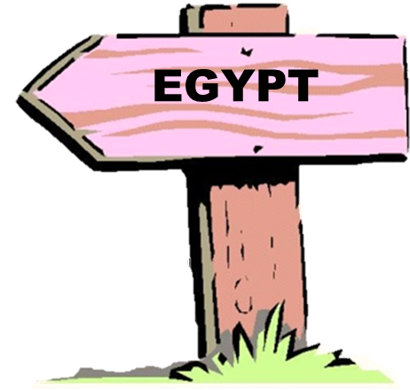

JEREMIAH
Taken to Egypt
Chapter 43
The proud men of Judah refuse to obey the word which God had given to Jeremiah – that they should not go to Egypt.
vs. 1-7
Jeremiah taken by force to Egypt. God’s punishment on His people in Egypt prophesied.
Ch. 43 vs. 6
12

Slide 13
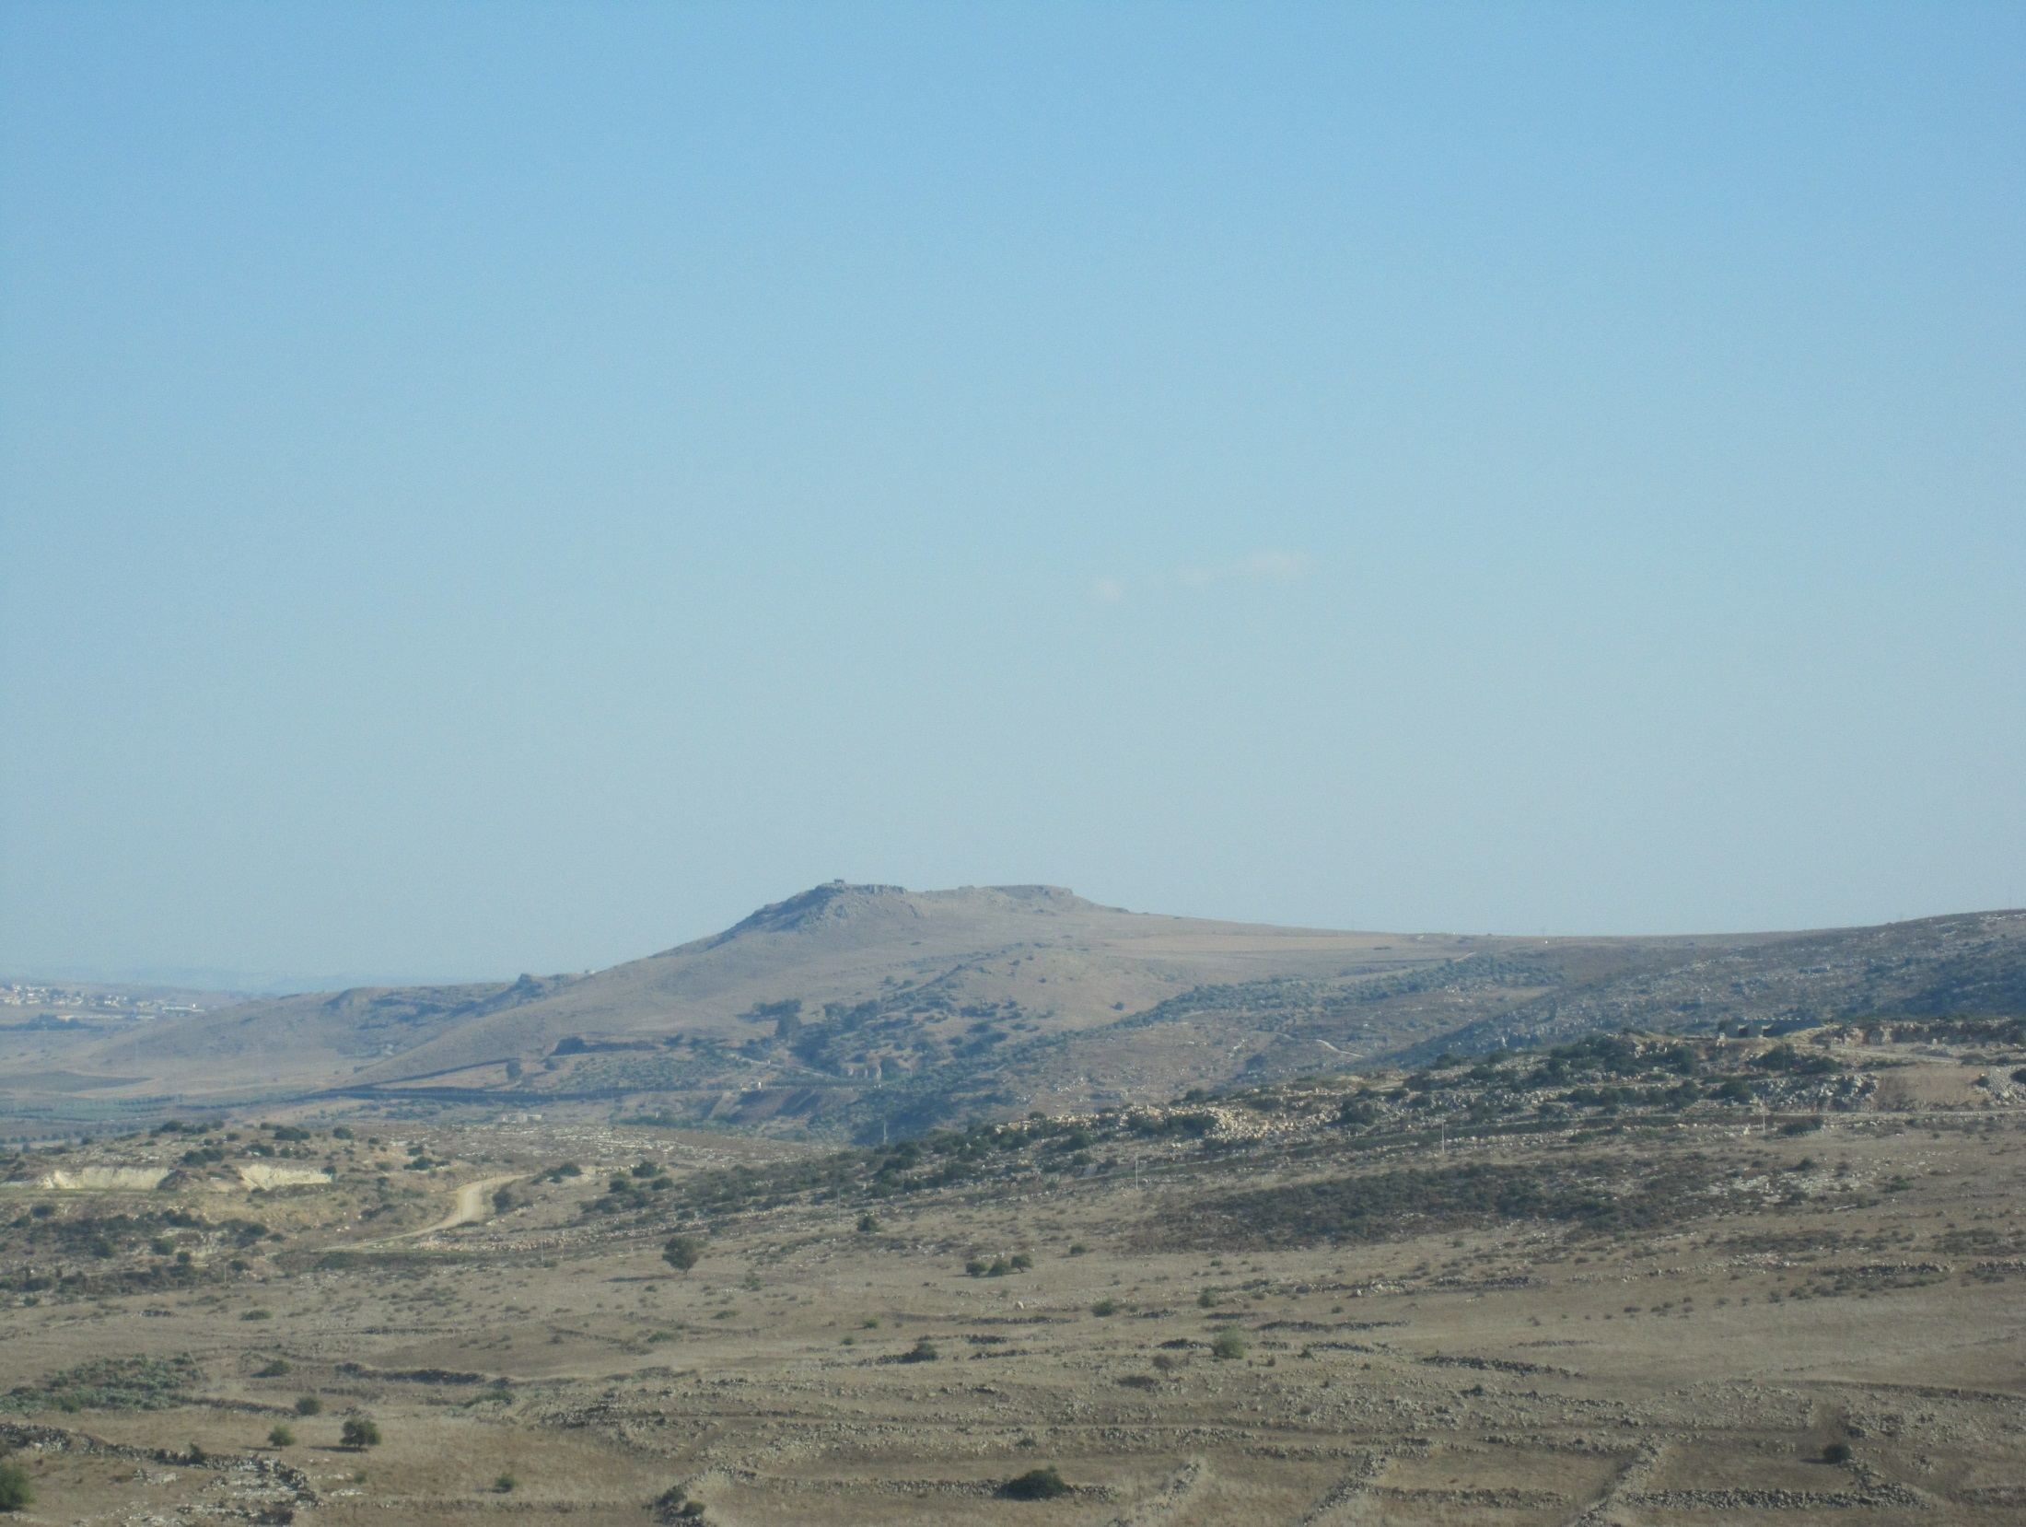
JEREMIAH
Chapter 50
13
The Lord Jesus Christ is:
The True Shepherd
John 10 vs. 1-5
The Good Shepherd
John 10 vs.7-18
The Shepherd who knows His Sheep
John 10 vs. 22-30
My people have been lost sheep. v. 6
Their shepherds have led them astray. v. 6
Israel is like scattered sheep. v.17
Notes:
In this chapter, Jeremiah is speaking about the judgement to come on Babylon. The people of Judah (Southern Kingdom) had gone astray from God, their own ‘shepherds’ – the priests and kings, had led them astray. Because of their sin they were to be taken into Captivity in Babylon. The Northern Kingdom of Israel had already been taken and scattered among the nations.

Slide 14
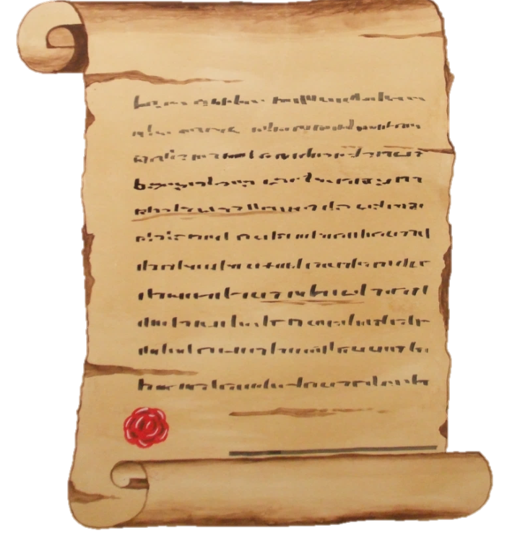
JEREMIAH
THE NEW COVENANT
†
speaks of the new, individual and perpetual Covenant. Chapter 31 vs. 31-34
The New Covenant is realised in the
Lord Jesus Christ
Luke 22 v. 20
14

