Slide 1
The following Biblical presentation is based on notes and illustrations by the Rev L G Stapleton
compiled by
Mark Stapleton
© Mark Stapleton 2016
1

Slide 2
ISAIAH
THE HOLY ONE
OF ISRAEL
2

Slide 3
ISAIAH
Isaiah, the son of Amoz, prophesied in the days of Kings Uzziah, Jotham, Ahaz and Hezekiah.
Isaiah’s ministry was c 770-697BC and lasted for about 60 years
Isaiah prophesied mainly to the Southern Kingdom of Judah
The Lord Jesus quotes from Isaiah, chapters 6, 9, 29, 40, 42, 53, 61.
Some of Isaiah’s ministry is seen in 2 Chronicles chapters 26-32,
2 Kings chapters 19-20
The name Isaiah, means – The Salvation of Jehovah
3

Slide 4
ISAIAH
God’s Holiness
Isaiah’s three pointed message
Man’s Sin
The Promise
of Salvation
4

Slide 5
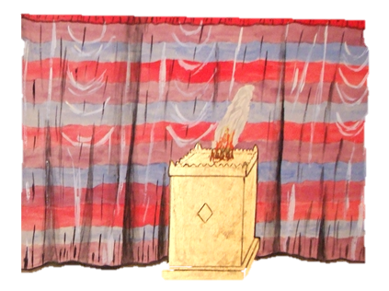
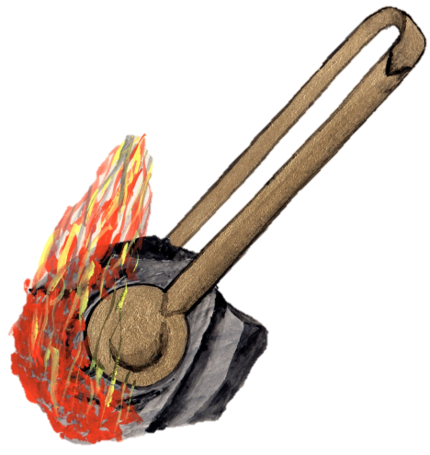

God’s Holiness
Chapter 6
Verse 6
The word ‘Holy’ is used over 50 times in the Book
Verse 7
Verse 6
5

Slide 6
Man’s Sin
6
False worship of God
The people were rich and prosperous, and lived in luxury
There was oppression, injustice
Enemies judged in earlier chapters – Babylon, Moab, Syria, Egypt, Tyre etc
See: chapter 29 vs.13-15, chapter 59 vs. 1-13, chapter 65 vs, 1-5

Slide 7

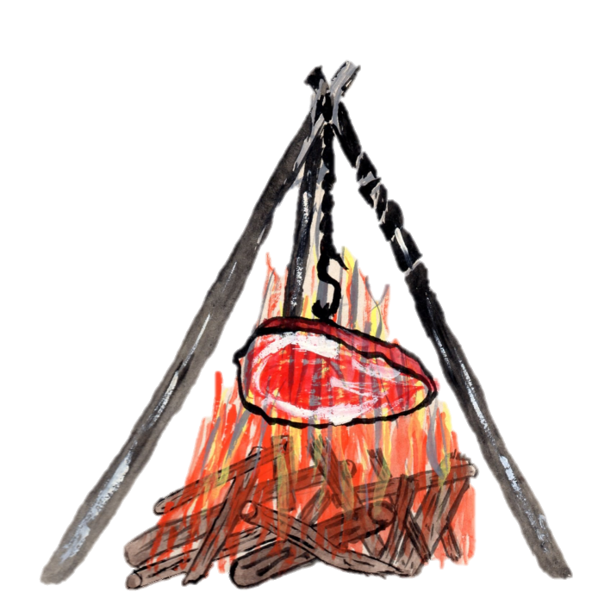

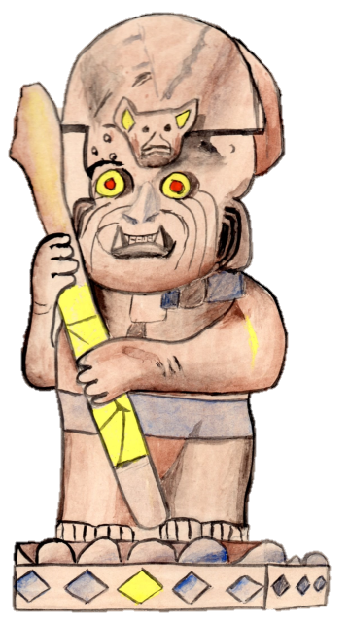
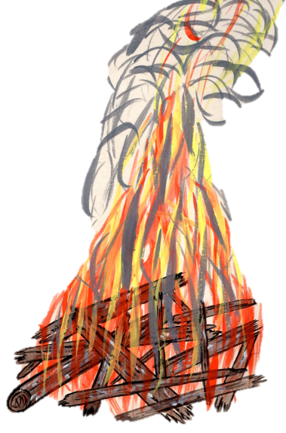
Man’s Sin
Chapter 44
The foolishness of idolatry – the work of men’s hands
7

Slide 8
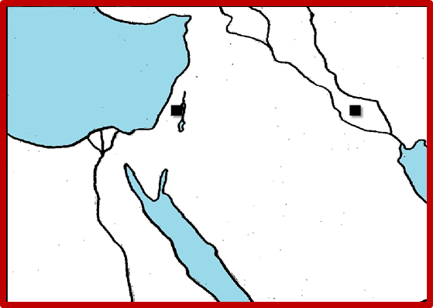
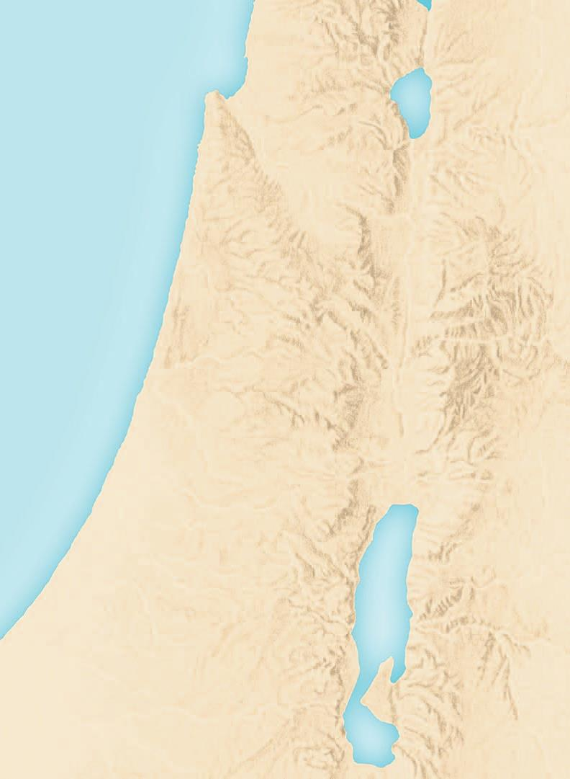


ISAIAH’s PROPHECY
(FOREtelling God’s dealings with His people in the future)
PROMISED RETURN
EARTHLY MINISTRY
PROMISED SAVIOUR
ULTIMATE PEACE
8

Slide 9
A KING SHALL REIGN
†
HIS DEATH –
Chapter 53
HIS RESURECTION –
Chapter 25 v. 8
Wonderful Words
Chapter 1 v. 18
Chapter 9 vs.6-7
Chapter 40 vs. 1-2
Chapter 40 v. 31
Chapter 43 v. 2
Chapter 45 v.22
Chapter 55 v. 1
Chapter 59 vs.1-2
HIS GLORIOUS REIGN –
Chapter 11 v. 3-6, Chapter 32
9

