Slide 1
The following Biblical presentation is based on notes and illustrations by the Rev L G Stapleton
compiled by
Mark Stapleton
© Mark Stapleton 2016
1

Slide 2
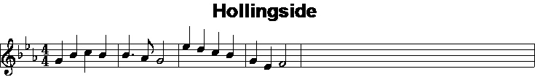
THE
SONG
OF
SONGS
2
Notes:
The music is the tune – Hollinside – Jesu’ lover of my soul …
The steps in courtship, marriage

Slide 3
THE SONG OF SOLOMON
The third book by Solomon – Proverbs
Ecclesiastes
Solomon wrote 1005 songs
1 Kings 4
vs.29, 32
Song of Songs – this is the best Song
Sometimes known as Canticles
Eastern in its setting
It is a story of two people in love
3

Slide 4
THE SONG OF SOLOMON
The relationships in this book can be seen as being between -
1.
Jehovah and Israel
Isaiah 54 v. 5
2.
Christ and the Church
Ephesian 5 v.25
3.
Christ and the Christian believer
Romans 7 v. 4
4

Slide 5

THE SONG OF SOLOMON
DRAW
ME
Chapter 1 v. 4
5
Notes:
Love draws us – and especially the love of Christ
His love has been declared – we can respond to its’ power.

Slide 6
THE SONG OF SOLOMON
The bride
I am my beloved’s
I am my beloved’s
My beloved is mine
Wonder and amazement
Submission and servanthood
Devotion and Belonging
I am his
His desire is towards me
My beloved is mine
Chapter 6 verse 3
6
Chapter 2 verse 16
Chapter 7 v. 10

Slide 7


THE SONG OF SOLOMON
The Rose of Sharon – ch. 2 v.1
The Lily of the valley – ch. 2 v. 1
ALTOGETHER LOVELY
Chapter 5 verse 16
All fair, no spot – ch. 4 v.7
Chief among 10,000 – ch. 5 v.10
7
Notes:
The song is about the loved one.

Slide 8
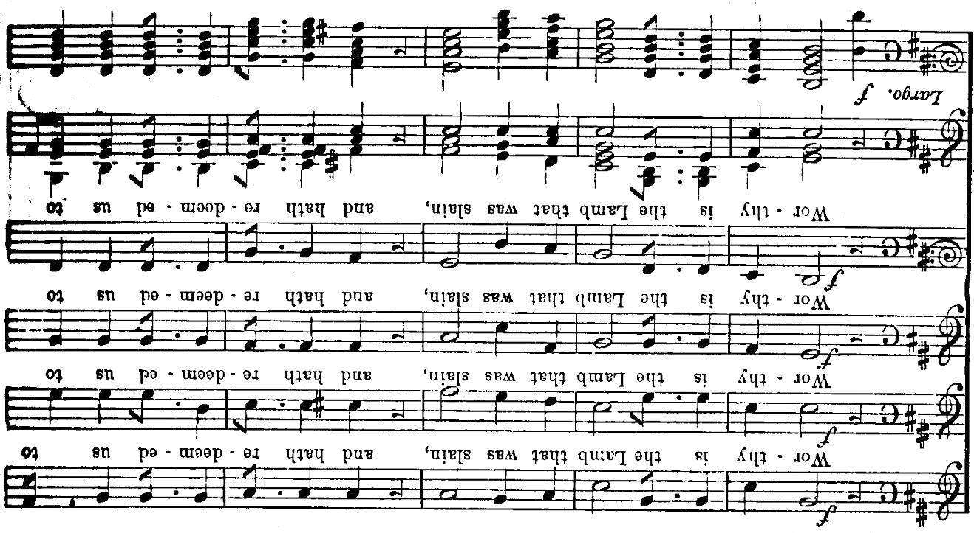
†
A NEW SONG
WORTHY IS THE LAMB
Revelation 5 V. 12
8
Notes:
Christ’s love goes far beyond this – TO THE CROSS – Galatians 2 v.20b
The Christian has a new song because of the Cross
This song is the best in the universe and in all time.
If we are in love with the Lord Jesus Christ NOW, and are His, we shall join in the New Song then.

