Slide 1
The following Biblical presentation is based on notes and illustrations by the Rev L G Stapleton
compiled by
Mark Stapleton
© Mark Stapleton 2016
1

Slide 2

ECCLESIASTES
Solomon – the Preacher
NOTHING NEW
UNDER THE SUN
2

Slide 3

VANITY
VANITY
VANITY
WORK
2 v.11
WISDOM
1 v.16-18
GOODS
2 v.4
MONEY
2 v.8
VANITY
VANITY
VANITY
POWER
2 v.7
PLEASURE
2 v.1
3
VANITY = empty, pointless, futile, insignificant, hollow, unreal

Slide 4
4
Ch. 3 v. 2
Born
Ch. 3 v. 3
Hate
Build
Silent
Laugh
Ch. 3 v. 4
Lose
Gain
Ch. 3 v. 6
Weep
Speak
Break
Love
Ch. 3 v. 7
Die
Ch. 3 v. 8
A TIME FOR EVERYTHING

Slide 5
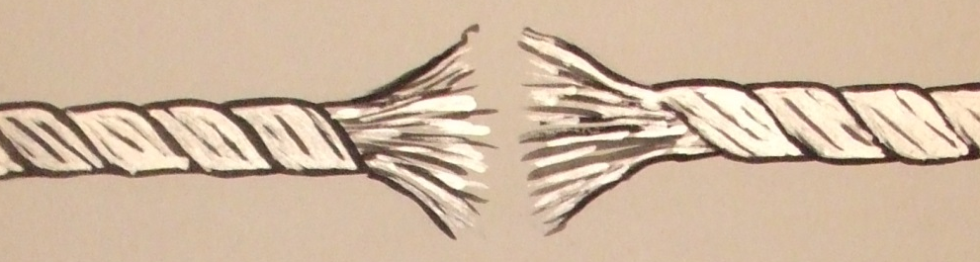

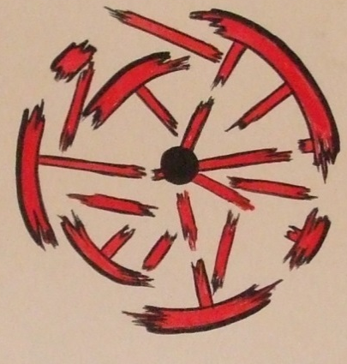

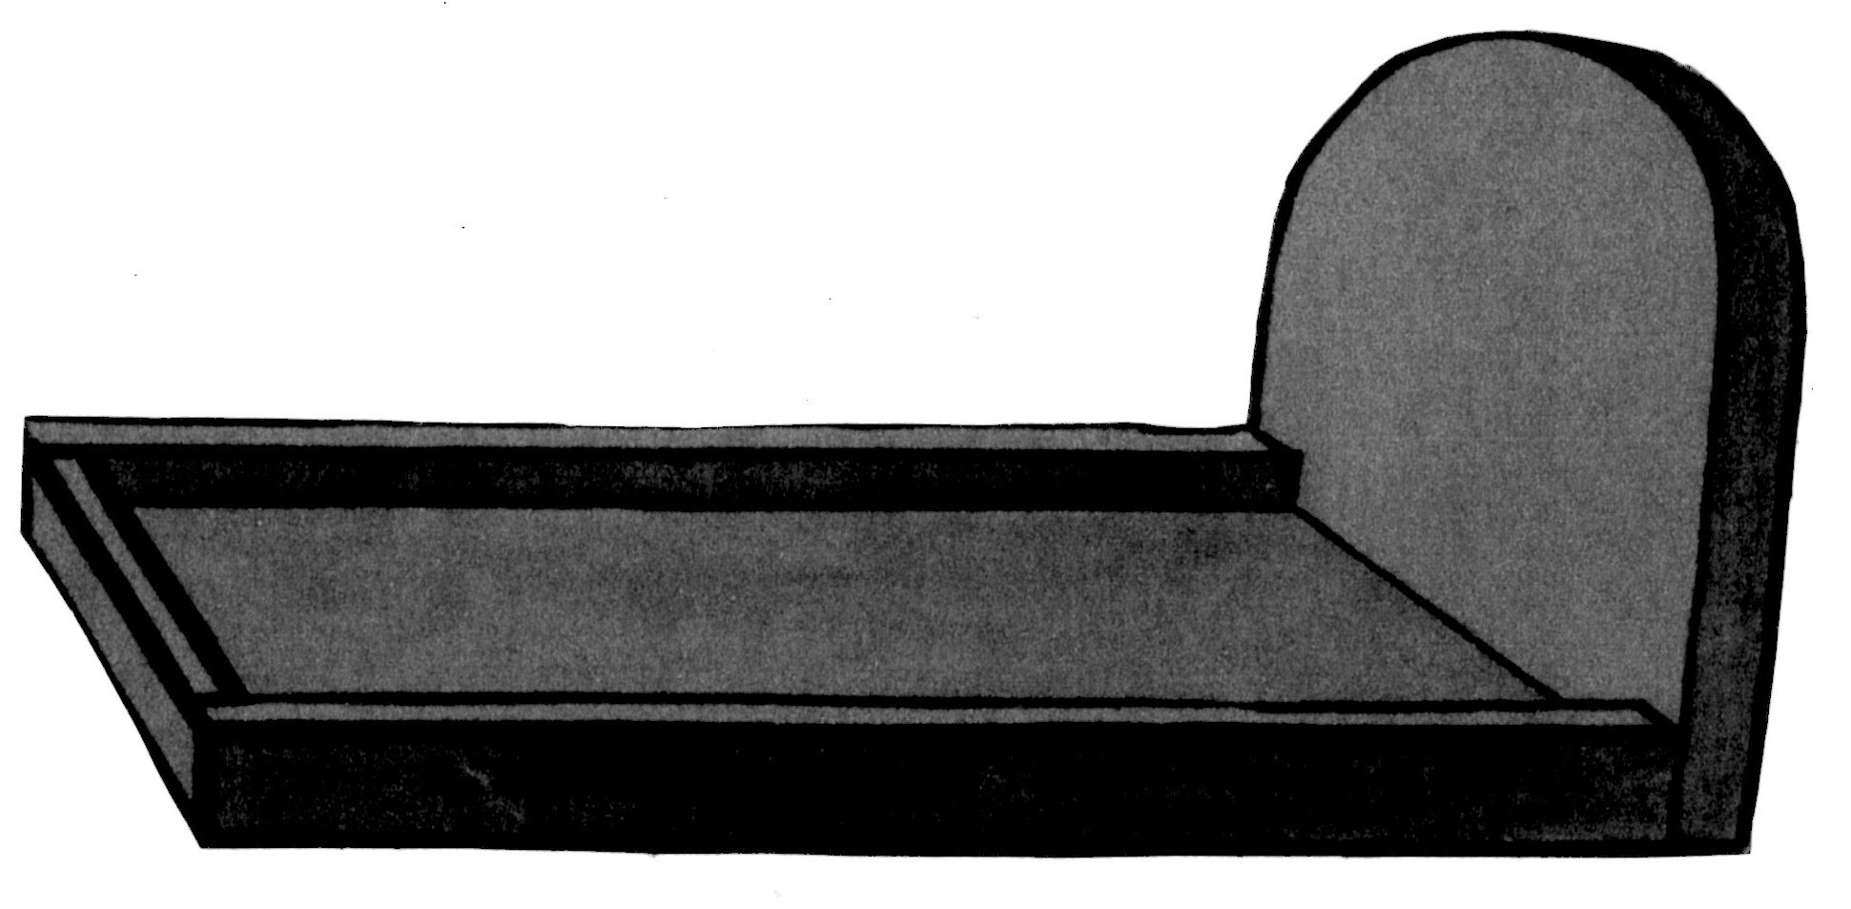
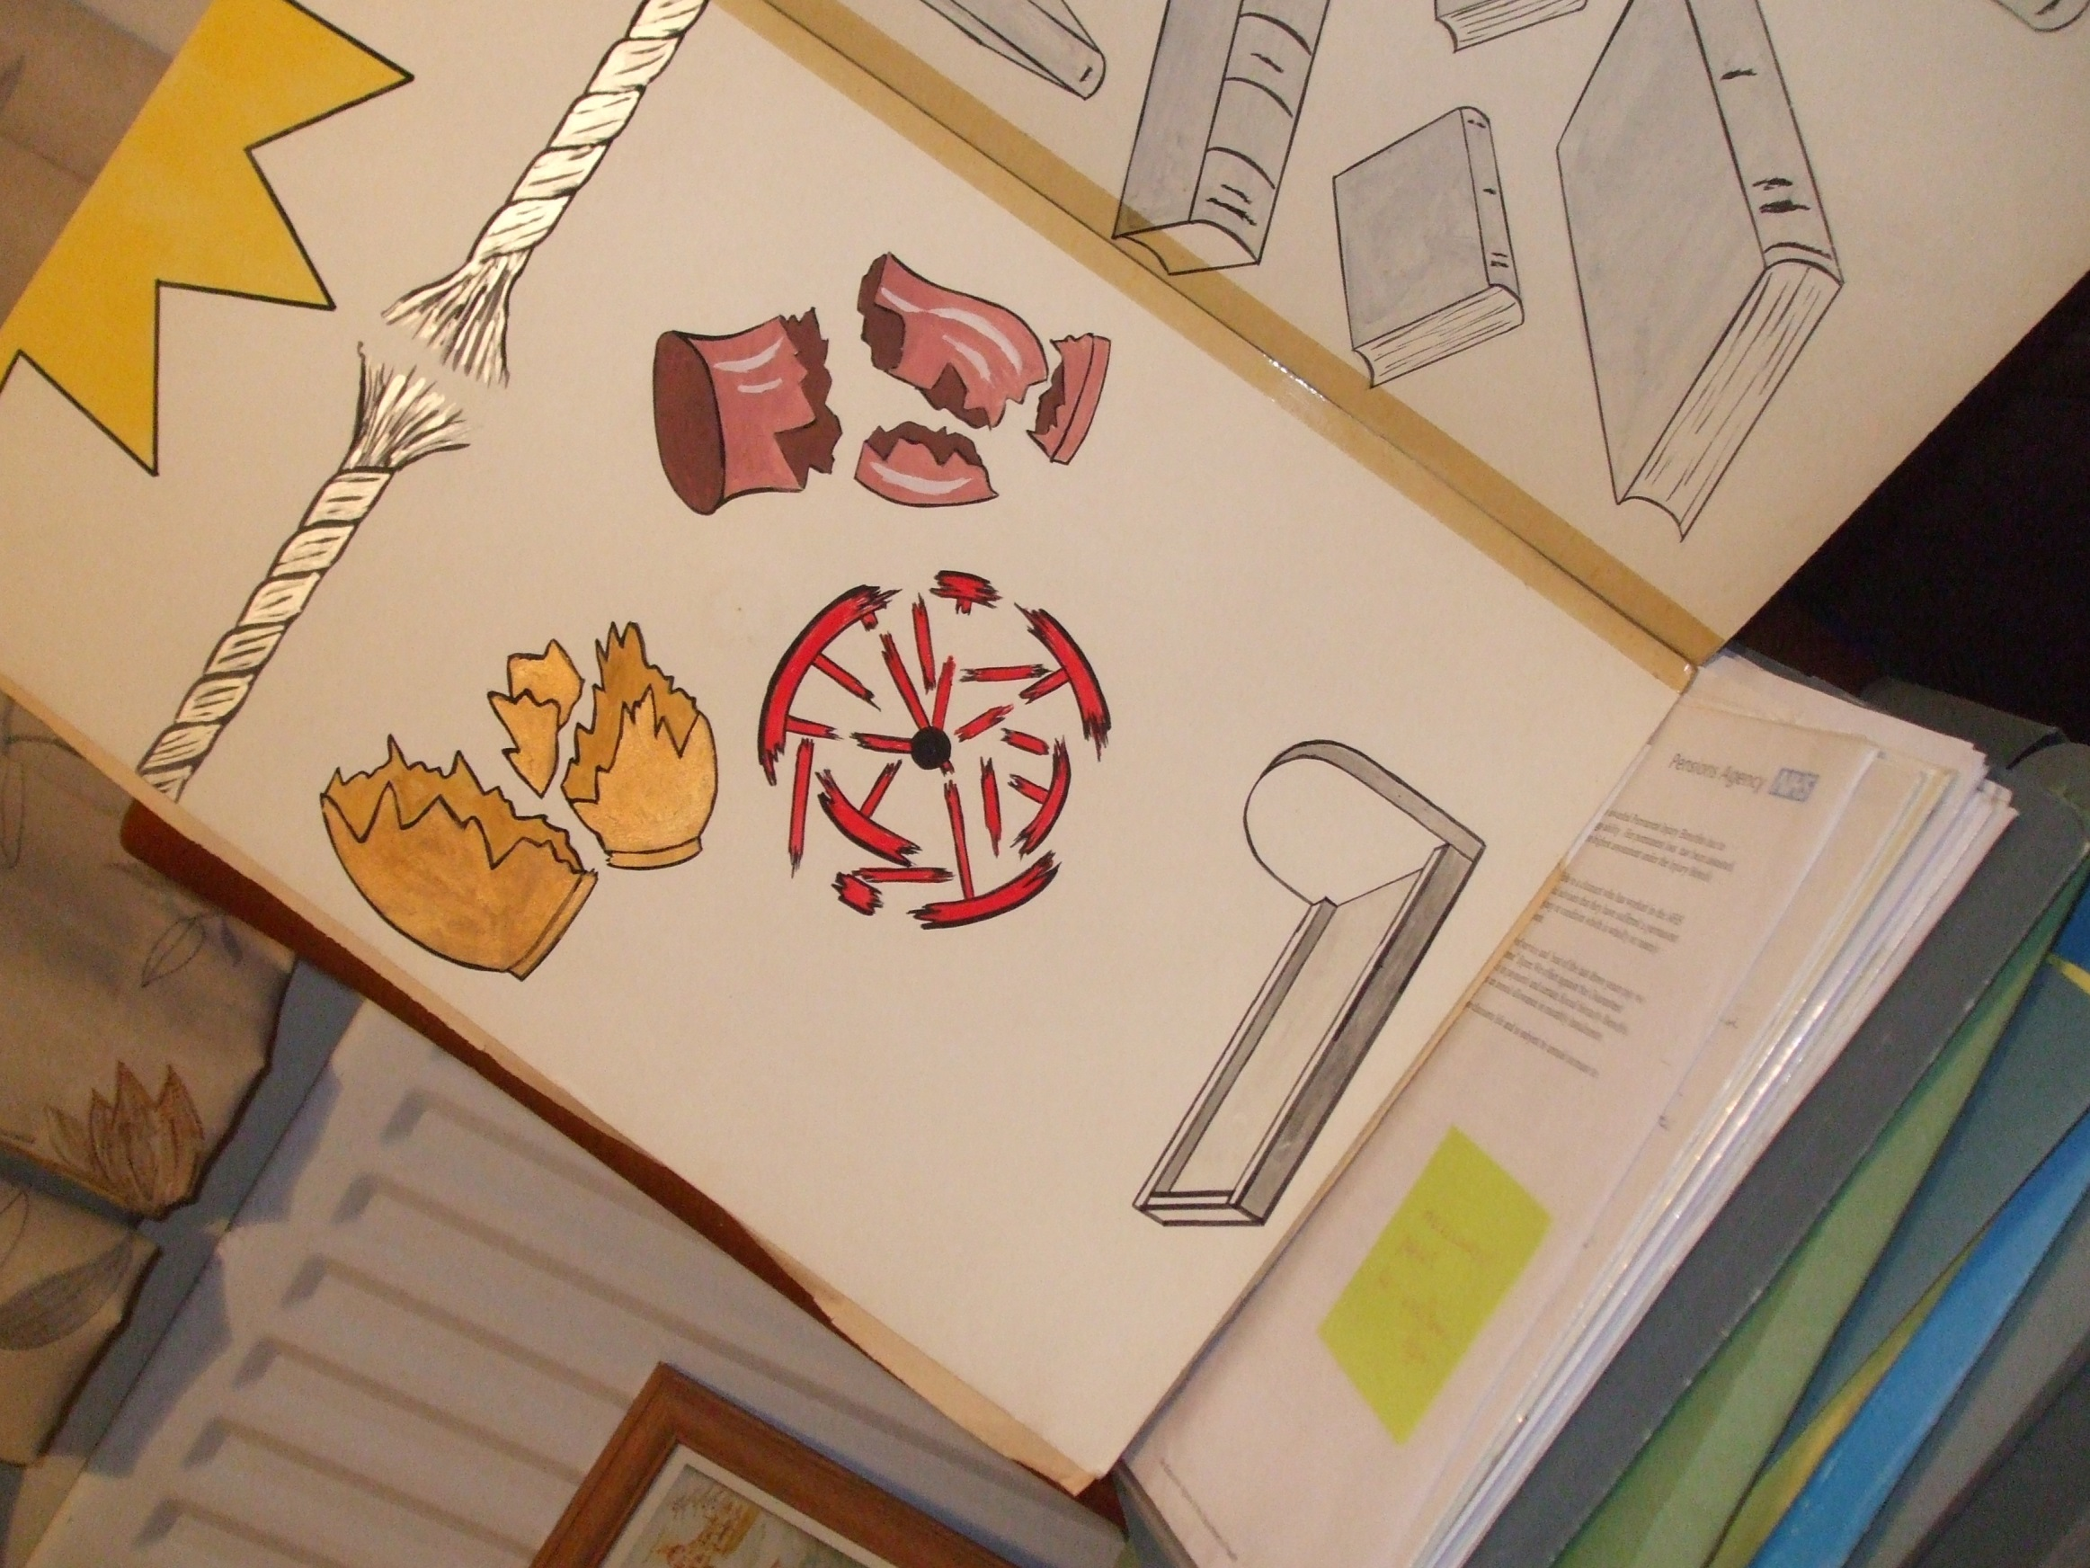
Chapter 12
- OLD AGE -
5

Slide 6
Remember now your Creator in the days of your youth,
before the difficult days come …
Chapter 12 vs.1
“Vanity of vanities,” says the Preacher, “All is vanity.”
Chapter 12 vs. 8
6

Slide 7






Chapter 12 vs. 9-12
Man’s wisdom gathered into books
7

Slide 8
Chapter 12 vs. 9-12
Man’s wisdom gathered into books
Chapter 12 vs. 13
Fear God and keep His commandments
THE
LAW
8

Slide 9
Ecclesiastes
UNDER THE SUN
NO REDEMPTION
NO HOPE
VANITY OF VANITIES – ALL IS VANITY
DISMAL FAILURE
9

Slide 10
†
Deliverance from sin
Redemption
Hope
Life
10

