Slide 1
The following Biblical presentation has been assembled from notes and illustrations by the Rev L G Stapleton
compiled by
Mark Stapleton
© Mark Stapleton 2016
1

Slide 2
PROVERBS
HOW
TO
LIVE
WISELY
(Heavenly rules for earthly living)
2

Slide 3
PROVERBS
3
God gives wisdom to Solomon
1 Kings 3 vs. 5-12
No stories
to tell
No history
recorded
Proverbs recorded by Solomon
Chapters 1-29
Proverbs recorded by Agur
Chapter 30
Proverbs recorded by Lemuel
Chapter 31

Slide 4


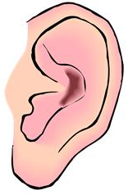
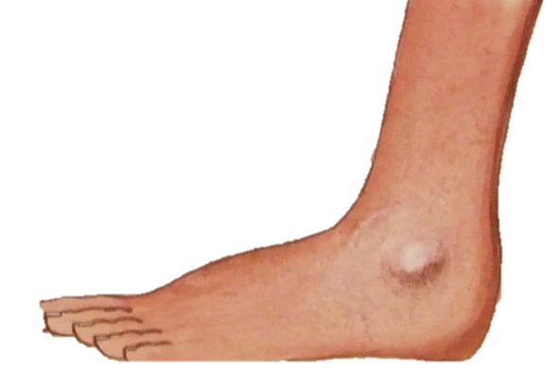
WISE ADVICE
4
Proverbs 4 vs. 24
Proverbs 4 vs. 25
Proverbs 4 vs. 23
Proverbs 4 vs. 20
Proverbs 4 vs. 26, 27

Slide 5

WISE THINGS
Ant – Ch. 30 vs. 25
Coney (rock badger – like a rabbit) – Ch. 30 vs. 26
Locust – Ch. 30 vs. 27
Spider – Ch. 30 vs. 28
5

Slide 6





WISE WARNINGS
Proverbs 4 vs. 14
Proverbs 11 vs. 1
Proverbs 14 vs. 9
Proverbs 14 vs. 12
Proverbs 27 vs. 1
6
Notes:
Proverbs 4 v. 14 – the path of the wicked
Proverbs 11 v. 1 – dishonest scales
Proverbs 14 v. 9 – keep away from sin
Proverbs 14 v. 12 – the wrong way to go
Proverbs 27 v. 12 – don’t boast about tomorrow
WARNINGS – disregard at your peril

Slide 7
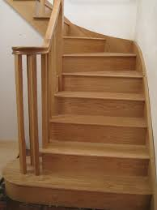
WISE STEPS
Proverbs 18 v. 24
Proverbs 18 v. 10
Proverbs 8 v. 33
Proverbs 3 v. 5
Proverbs 1 v. 7
7
Notes:
Proverbs 1 v. 7 – Wisdom starts with the fear of the LORD
Proverbs 8 v. 33 – Hear instruction and be wise
Proverbs 18 v. 10 – The name of the LORD is a strong tower
Proverbs 3 v. 5 – Trust in the LORD with all your heart
Proverbs 18 v. 24 – the LORD will not disappoint - ..there is a friend who sticks closer than a brother

Slide 8
†
GOD’s WISDOM
1 Corinthians 1 v. 23-24
Christ is the power and wisdom of God
1 Corinthians 1 v. 30
Christ became wisdom for us
Chapter 8 – Christ in creation
John 1 v.3 – All things were made through Him, and without him nothing was made that was made
WISE CHOICE
8
Notes:
WISDOM OF GOD – in sending His Son to die for us
WISE CHOICE – God chose His only begotten Son, the Lord Jesus Christ

