Slide 1
The following Biblical presentation is based on notes and illustrations by the Rev L G Stapleton
compiled by
Mark Stapleton
© Mark Stapleton 2016
1

Slide 2
THE BOOK OF PSALMS
THE
BIBLE
HYMNBOOK
BOOK – 1
PSALMS 1 - 41
BOOK - 2
PSALMS 42 - 72
BOOK – 3
PSALMS 73 - 89
BOOK – 4
PSALMS 90 - 106
BOOK – 5 PSALMS 107 - 150
2

Slide 3

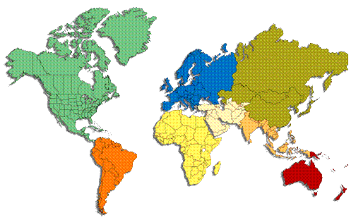

Our God , our help in ages past
Ps.33
Ps.90
POWER
Ps.19
Ps.8
3

Slide 4
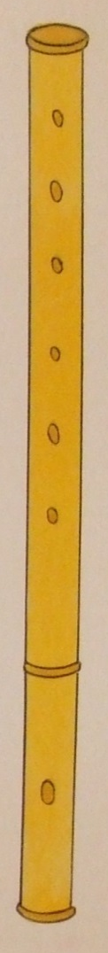


O Bless the Lord, my soul
Ps.117
Ps.135
Ps.145-150
Ps.103
PRAISE
Ps.113
Ps.112
4

Slide 5
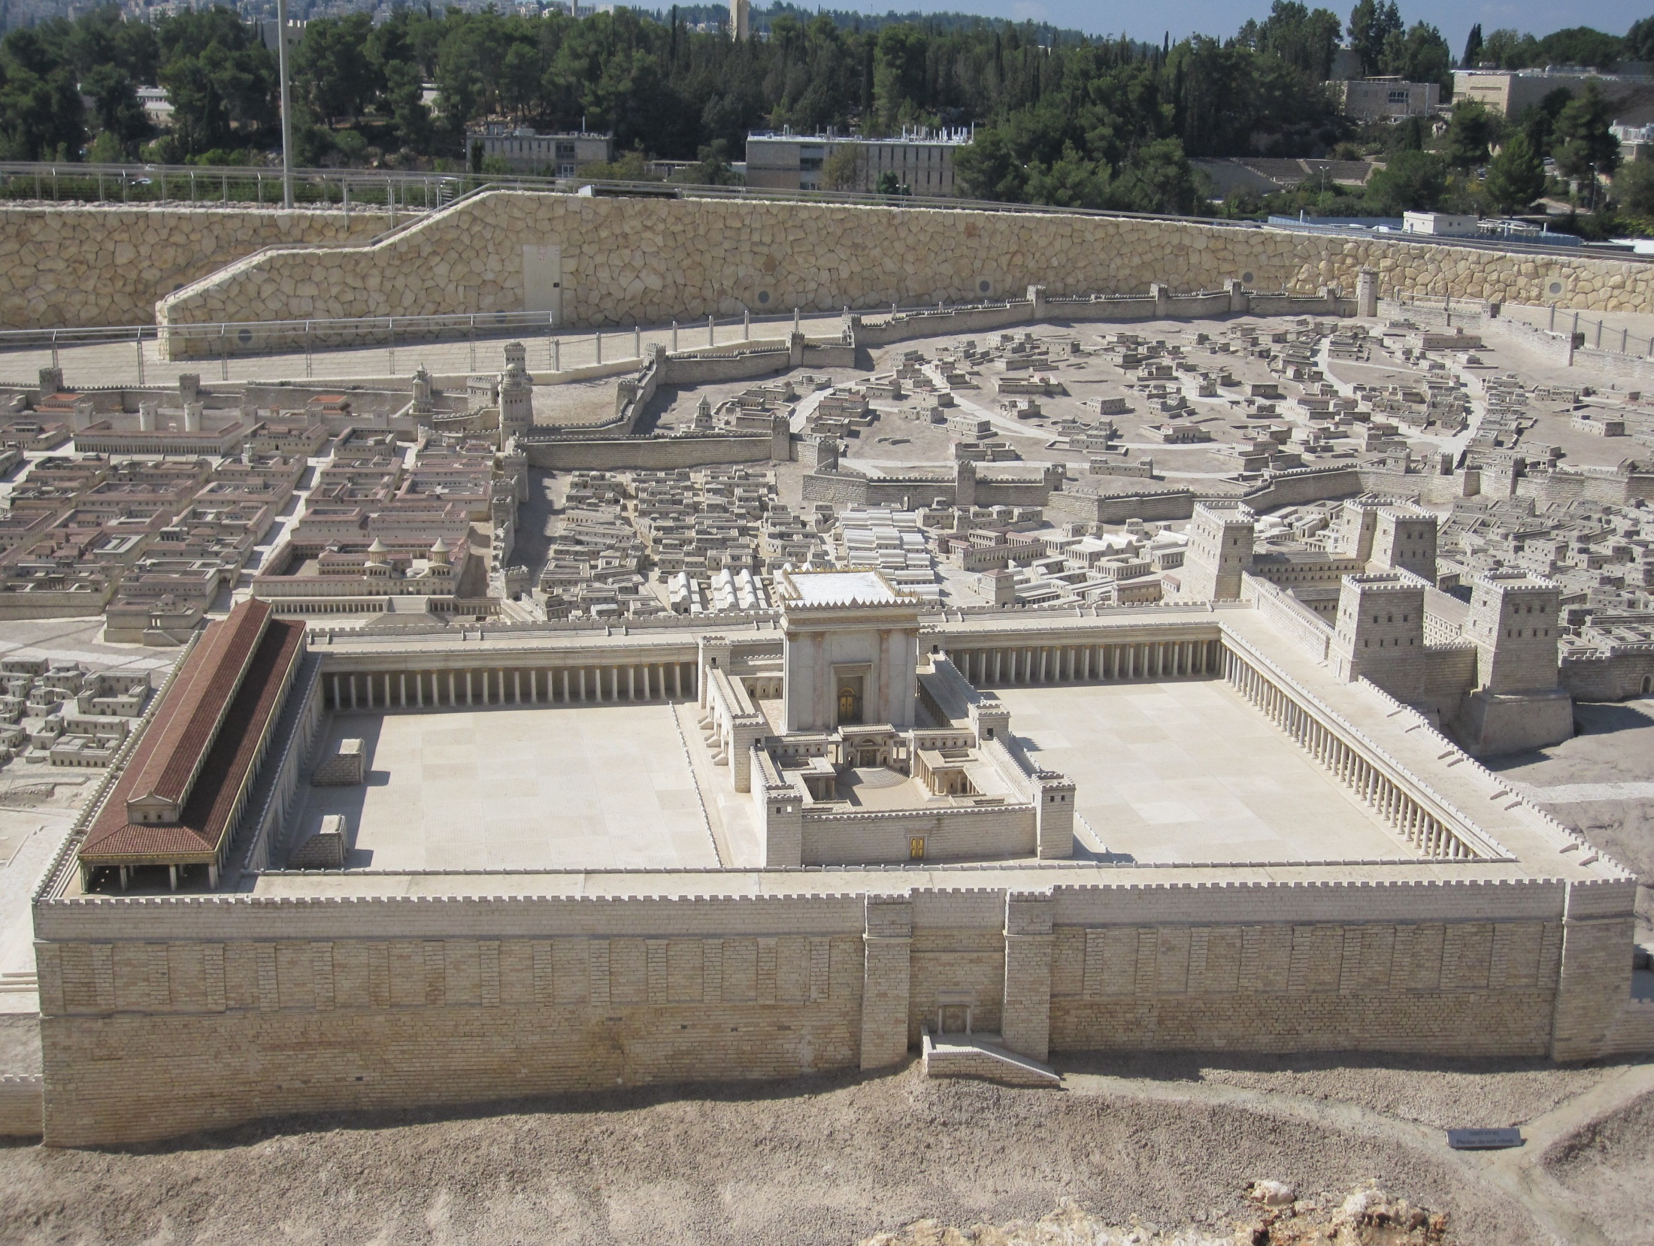
How pleased and blest was I
Ps.43
Ps.120-134
Ps.84
Ps.42
PILGRIMAGE
5

Slide 6
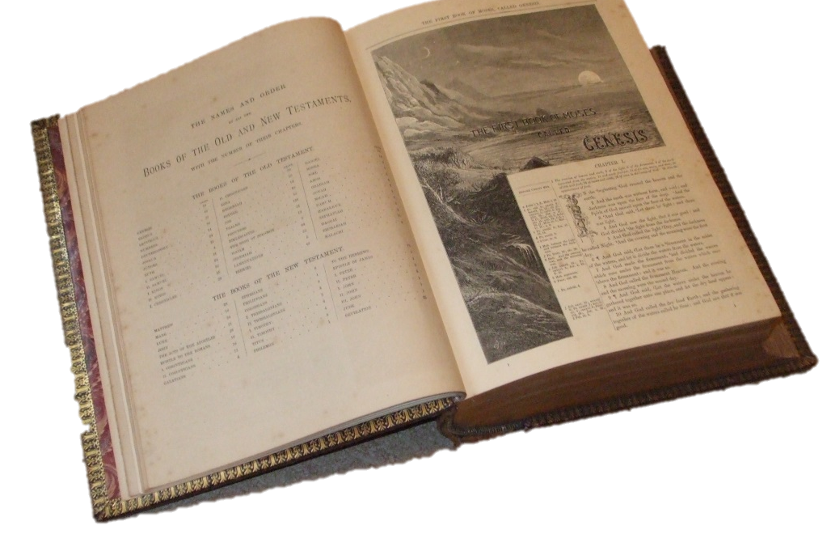
Thy word is like a garden, Lord
God’s -
Law
Judgements
Word
Statutes
Testimonies
Commandments
Precepts
Psalm 119
PRECEPTS
6

Slide 7
Show me myself, O holy Lord
ENVY
LIES
ANGER
Ps.38
PRIDE
Ps.32
HATRED
Ps.6
DECEIT
GREED
JEALOUSY
Ps.130
PENITENCE
Ps.51
7

Slide 8
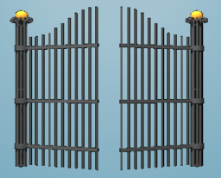
†
Lift up your heads, ye mighty gates
MESSIAH
Prince of peace
Ps.2
Ps.24
Ps.110
Ps.96-99
PROMISE
Ps.16
Ps.47
8

