Slide 1
Mark Stapleton
© Mark Stapleton 2014
The following Biblical presentation is based on notes and illustrations by the Rev L G Stapleton compiled by
Mark Stapleton
© Mark Stapleton 2016
1

Slide 2
?
JOB
2

Slide 3
JOB
Satan challenges the integrity of God’s man under suffering. Ch. 1 v.9 .
Satan appears as the accuser of the brethren.
Revelation 12 v.10
The book is usually spoken of as dealing with the sufferings of Job.
James 5 v. 11
Satan says that good health is essential for such faithfulness. Ch. 2 v.5
Satan asserts that Job’s faithfulness to God is for what he can get out of it, and that it rests on his material prosperity. Ch. 1 vs. 8-11
God accepts Satan’s challenge, and gives him license to do what he wants to do but limitations are imposed. Ch. 1 v.12, 2 v. 6
3

Slide 4

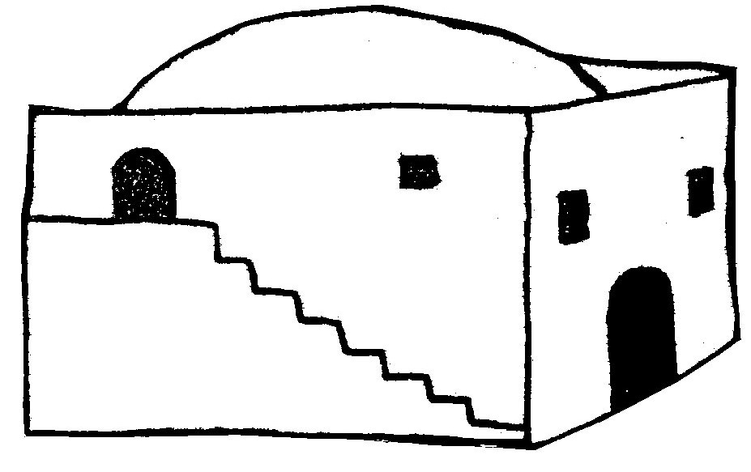
JOB
1 vs. 14-15
1 vs. 14-15
1 vs. 16
1 vs. 17
1 vs. 19
1 vs. 19
HEALTH
2 vs. 5-6
4

Slide 5
JOB
WHY?
WHY?
WHY?
WHY?
WHY?
WHY?
HEALTH
WHY?
5

Slide 6
JOB
Answer is easy – Job has sinned
Show me how I have
sinned
God is just; if you were right He would answer and deliver – therefore Job is a hypocrite
Eliphaz
4 v.7
Job
6 v.24
Bildad
8 vs.3, 6
Job
9 v.2
Of course God is just
Zophar
11 vs.4-6
Job is both a hypocrite and a liar
Job
16 v.2, 4
I am as clever as they are
Suffering is for the good of the sufferer
etc. etc.
Elihu
Ch. 32-37
6

Slide 7
God answers Job
out of the whirlwind but does not give an answer
Chapters 38-42
God’s power underlined
Ch. 38 v.4
God’s sovereignty declared
Ch. 40 v.2
Job’s Submission – chapter 40 vs.3-5
Repentance – chapter 42 vs.6
7

Slide 8
JOB
Testing by Satan
Allowed by God
God is always right!
Job 42 v.12
x 2
x 2
x 2
x 2
8

Slide 9
?
†
He was innocent – the just for the unjust
1 Peter 3v.18
He learned obedience by the things He suffered
Hebrews 5 v.8
The captain of our salvation was
made perfect through suffering
Hebrews 2 v.10
9

Slide 10
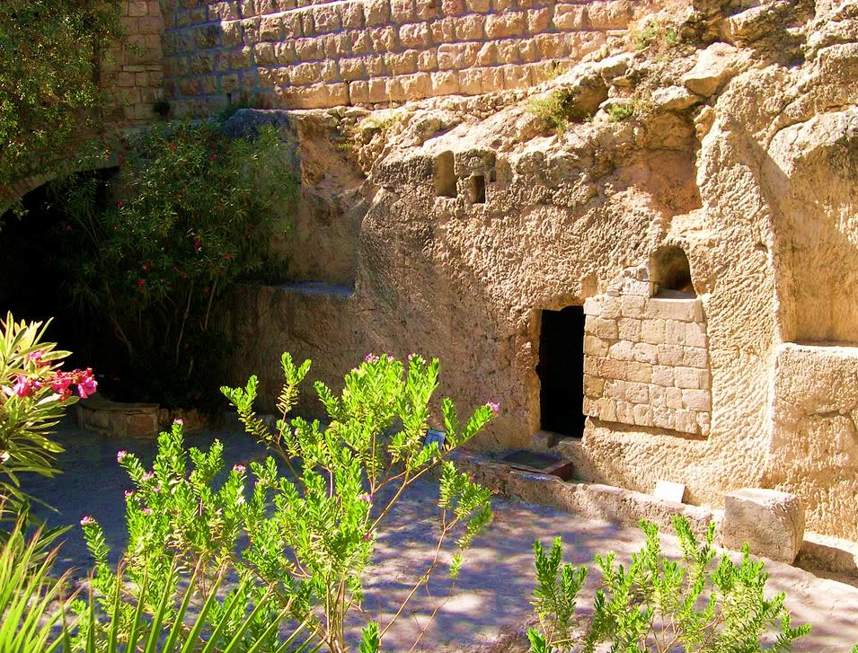
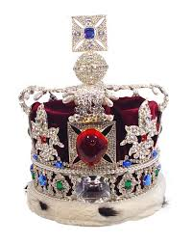

JOB
10

Slide 11
JOB
I Know that my Redeemer lives
Job 19 v.25
11

