Slide 1
The following Biblical presentation is based on notes and illustrations by the Rev L G Stapleton compiled by
Mark Stapleton
© Mark Stapleton 2016
1

Slide 2


ESTHER
The Empire of the Medes and Persians
King Ahasuerus (Xerxes 1st
(c.486-464 BC)
Father of
King Darius – Daniel 11 v.1
The story of a Queen
2

Slide 3
THE MAIN CHARACTERS
Ahasuerus
(King Xerxes 1st )
His Queen was Vashti
(Chapter 1)
Mordecai – a Jewish captive descended from Kish, a Benjaminite, cousin to Esther. (Ch. 2)
Haman (Prime Minister) – an Agagite (Amalekite) -
(1 Samuel 15 vs. 8)
The Amalekites were the first enemies of the Israelites. (Exodus 17 vs. 8)
Esther – an insignificant orphan who, in the purposes of God, became a Queen. Cousin to Mordecai. (Ch. 2 vs. 7, 15, 4 vs. 13-14)
3

Slide 4
THE STORY
The King’s decree cannot be cancelled, only amended – the Jews are allowed to defend themselves
(Ch. 8-9)
.10.
A second banquet given by Esther reveals the plight of the Jews and the infamy of Haman, who is now executed (Ch. 7)
.9.
The King, unable to sleep, reads the Royal records discovers Mordecai had foiled an assassination attempt on the King’s life, and so decides to honour Mordecai
(Ch. 6 vs. 1-3)
.7.
The King requires Haman to give honour to Mordecai
(Ch. 6 vs 4-11)
.8.
Queen Vashti refuses to come to King Ahasuerus’s banquet. She is deposed, and a search is made for a new Queen. A decree is sent out by the King ordering wives to honour their husbands (Ch. 1)
.1.
Esther is chosen as Queen by King Ahasuerus
(Ch.2 vs. 16-17)
.2.
Mordecai discovers an assassination plot to harm the King
(Ch.2 vs. 21-22)
.3.
Mordecai is given honour. The story is commemorated in the Feast of Purim
(Ch. 9-10)
.11.
The King promotes Haman to Prime Minister but Mordecai does not give him homage; he arranges revenge on all the Jews. A decree is issued to destroy the Jews
(Ch. 3 vs. 5, 8-9, 15)
.4.
Mordecai mourns the decree. Esther hears of it and resolves to do something (Ch. 4)
.5.
Esther dares to go into the King’s presence. The King holds out the sceptre for her to touch showing her acceptance into court; she invites him to a feast. Haman is also invited and he boasts of his popularity. A gallows is erected for Mordecai (Ch. 5)
.6.
4

Slide 5
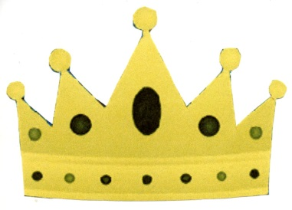
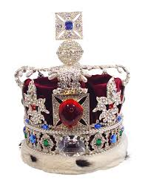
ESTHER
5
LOYALTY
HUMILITY
Ch. 7 vs.3-4
Ch. 4 v.16
COURAGE
FAITH
Ch. 4 v.11
Ch. 4 vs.16
PRAYER
JOY
Ch. 8 vs.3-7
Ch. 8 vs.16
Notes:
Her LOYALTY to her people although she was Queen. (chapter 7 v. 3-4)
Her HUMILITY in submitting to the King and to Mordecai (chapter 4 verse 16).
Her COURAGE in entering the King's presence (chapter 4 verse 11).
Her FAITH - acting in dependence on God and on the prayers of God's people (chapter 4 verse 16).
Her PRAYER seen in intercession for the destruction of the enemy and for the deliverance of her people (chapter 8 verses 3-7).
Her JOY shared with her people, for a miraculous deliverance (chapter 8 verse 16; chapter 9 verse 19).
Mordecai's faith in the purposes of God - God would use one means or another (chapter 4 verse 14).

Slide 6

†
ESTHER
6
LOYALTY
HUMILITY
Ch. 7 vs.3-4
Ch. 4 v.16
COURAGE
FAITH
Ch. 4 v.11
Ch. 4 vs.16
PRAYER
JOY
Ch. 8 vs.3-7
Ch. 8 vs.16
Ch. 4 v. 11, Ch. 5 v. 2, Ch. 8 v. 4
Hebrews 10 vs. 19-22

