Slide 1
The following Biblical presentation is based on
notes and illustrations by the Rev L G Stapleton
compiled by
Mark Stapleton
© Mark Stapleton 2016
1
Notes:
Title page

Slide 2
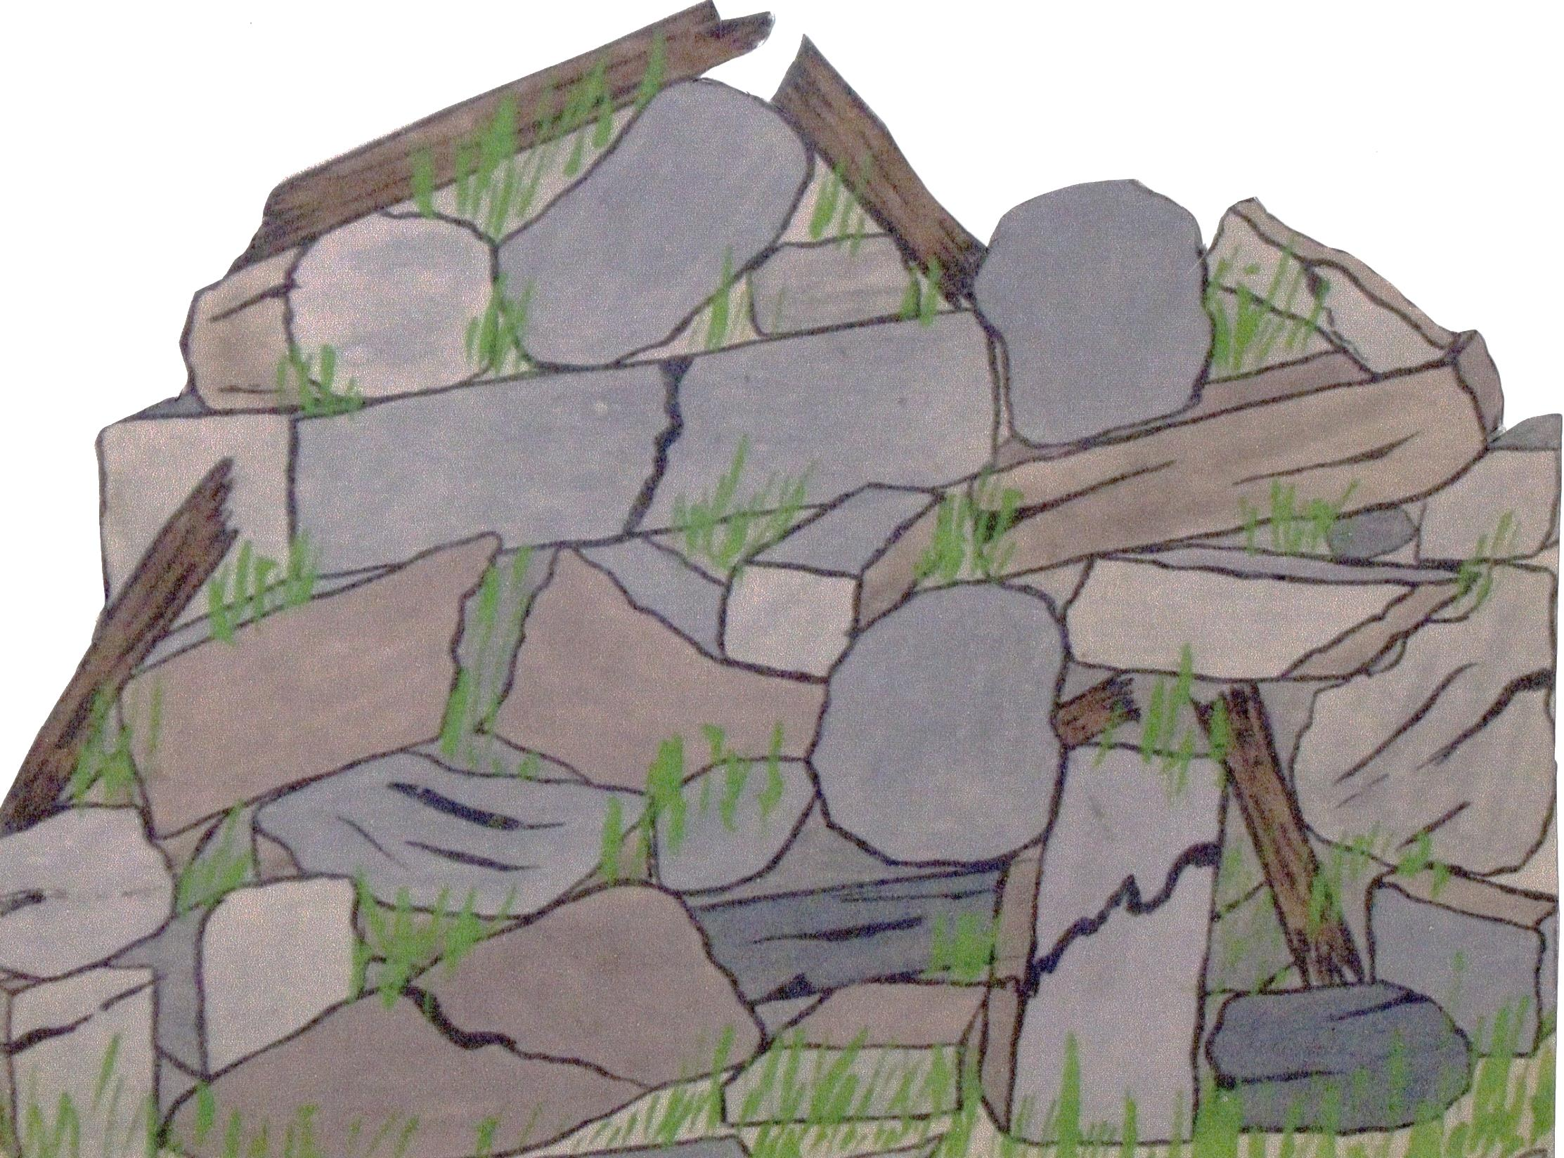
NEHEMIAH
A book of prayer and action
2

Slide 3
THE SITUATION
Nehemiah, living in Babylon, hears from a relative of the ruined state of the gates and walls of Jerusalem, and the peoples’ distress.
Chapter 1 verse 3.
NEHEMIAH’S PRAYER
Chapter 1 verses 4-11
The integrity of God’s character –
Your servants
Your people
Your redeemed
Your great power
Your strong hand
3

Slide 4
THE MAN
Nehemiah -
was the Kings cupbearer
Chapter 1 vs. 11
was humble with God, bold with men
Chapter 2 vs. 4-5
petitioned the King
Chapter 2 vs. 5
prayed to God
Chapter 1 v. 11, 2 v.4, 4 v.4,
5 v.19,
13 v.14, 31
was careful for detail
Chapter 2 vs. 7-8
went to see Jerusalem for three days
Chapter 2 vs. 11
c. BC 444
and makes a night survey
Chapter 2
vs. 12-15
4

Slide 5
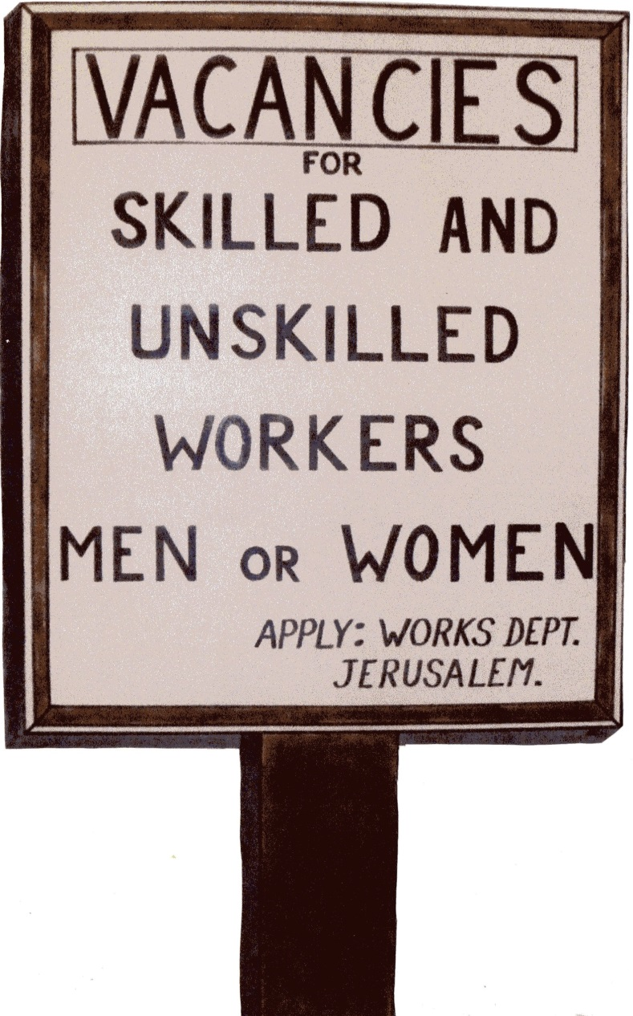
THE WORKERS
Chapter 3
Merchants
Goldsmiths
Priests
Perfumers
Men from Jericho
Sons and
Daughters
Men from Gibeon
Leaders
High Priest
Gatekeepers
5
Notes:
There was a job for everybody (chapter 3)
God’s work can only be done by God’s people (chapter 2 verse 20)
God’s work can only be done by God’s people (chapter 2 verse 20)
The systematic building of the wall (chapter 3)

Slide 6

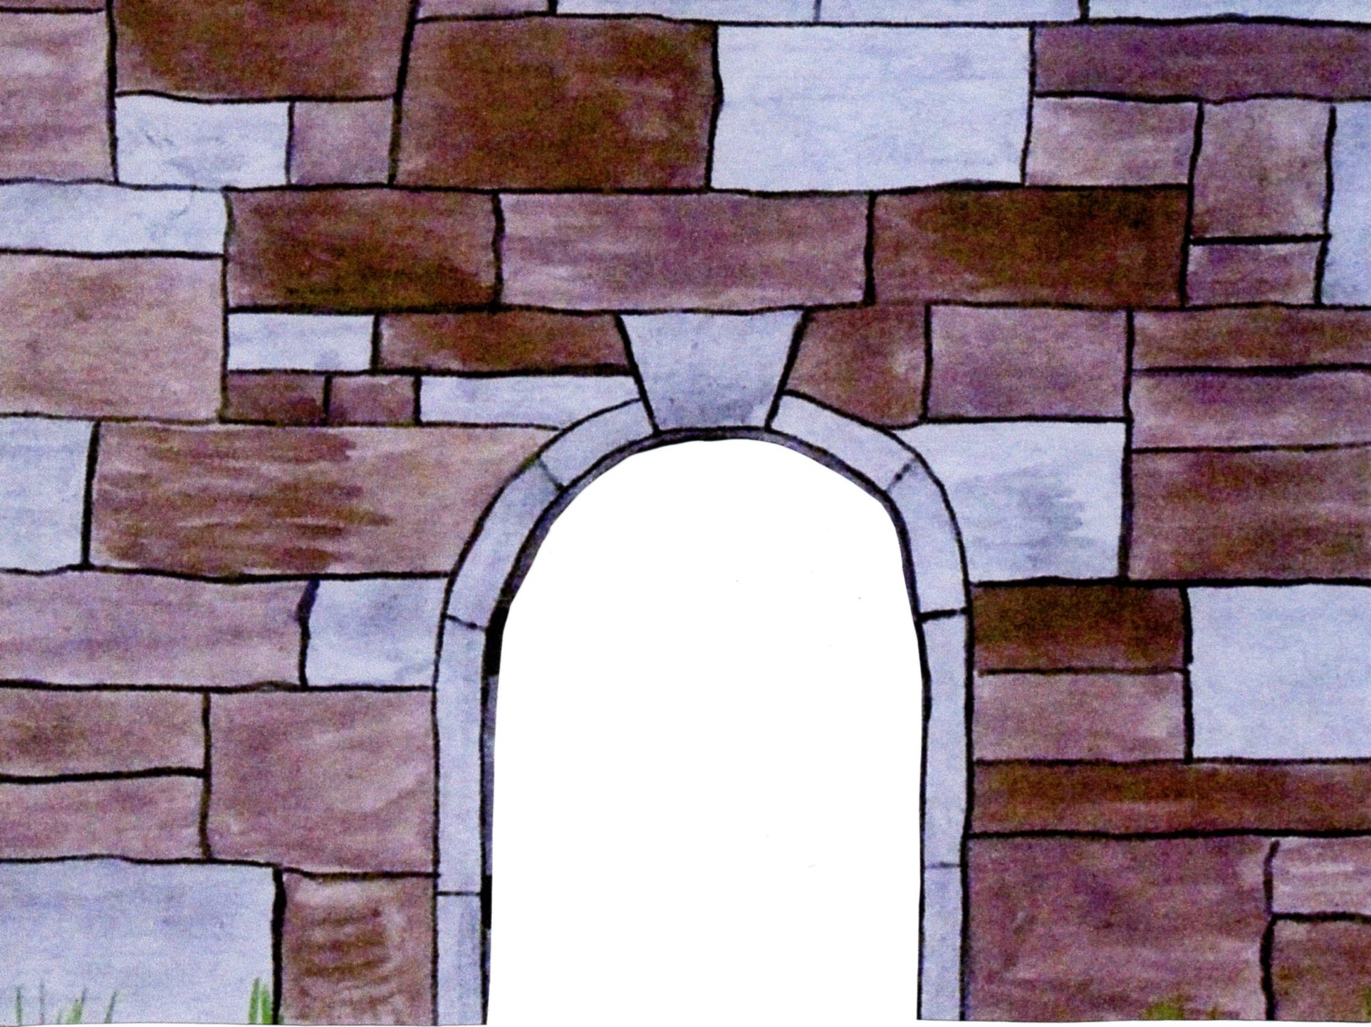
THE ENEMY
Sanballet
the Horonite
Tobiah
the Ammonite
Ch. 2 vs. 10
Family connection under pressure
6 v.18
False spiritual counsel given
6 v,10-12
Ridicule
2 v. 19, 4 v.3
Sidetracking attempted
6 v.2
Personal profit insinuated
6 v.6-7
Discouragement
infectious
4 v.10
Spiritual work is Satan versus God
2 v. 10
Good deeds paraded
6 v.19
Threatening letters received
6 v.17
Outright attack
threatened 4 v.8
6

Slide 7

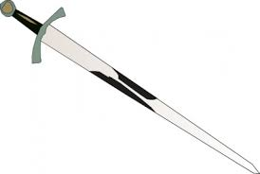
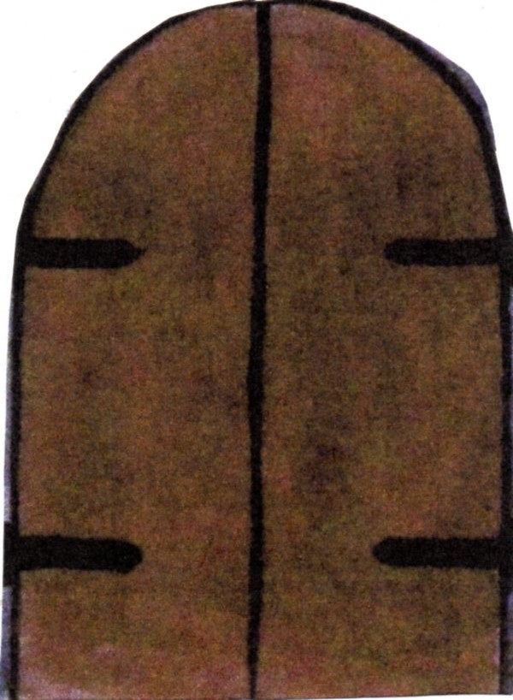
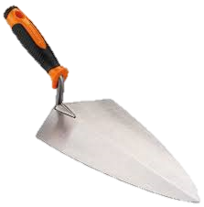
THE WALL IS DEFENDED AND GUARDED
Chapter 4 vs. 16-23
THE WALL IS BUILT AND COMPLETED IN 52 DAYS
Chapter 6 VS. 15
7

Slide 8
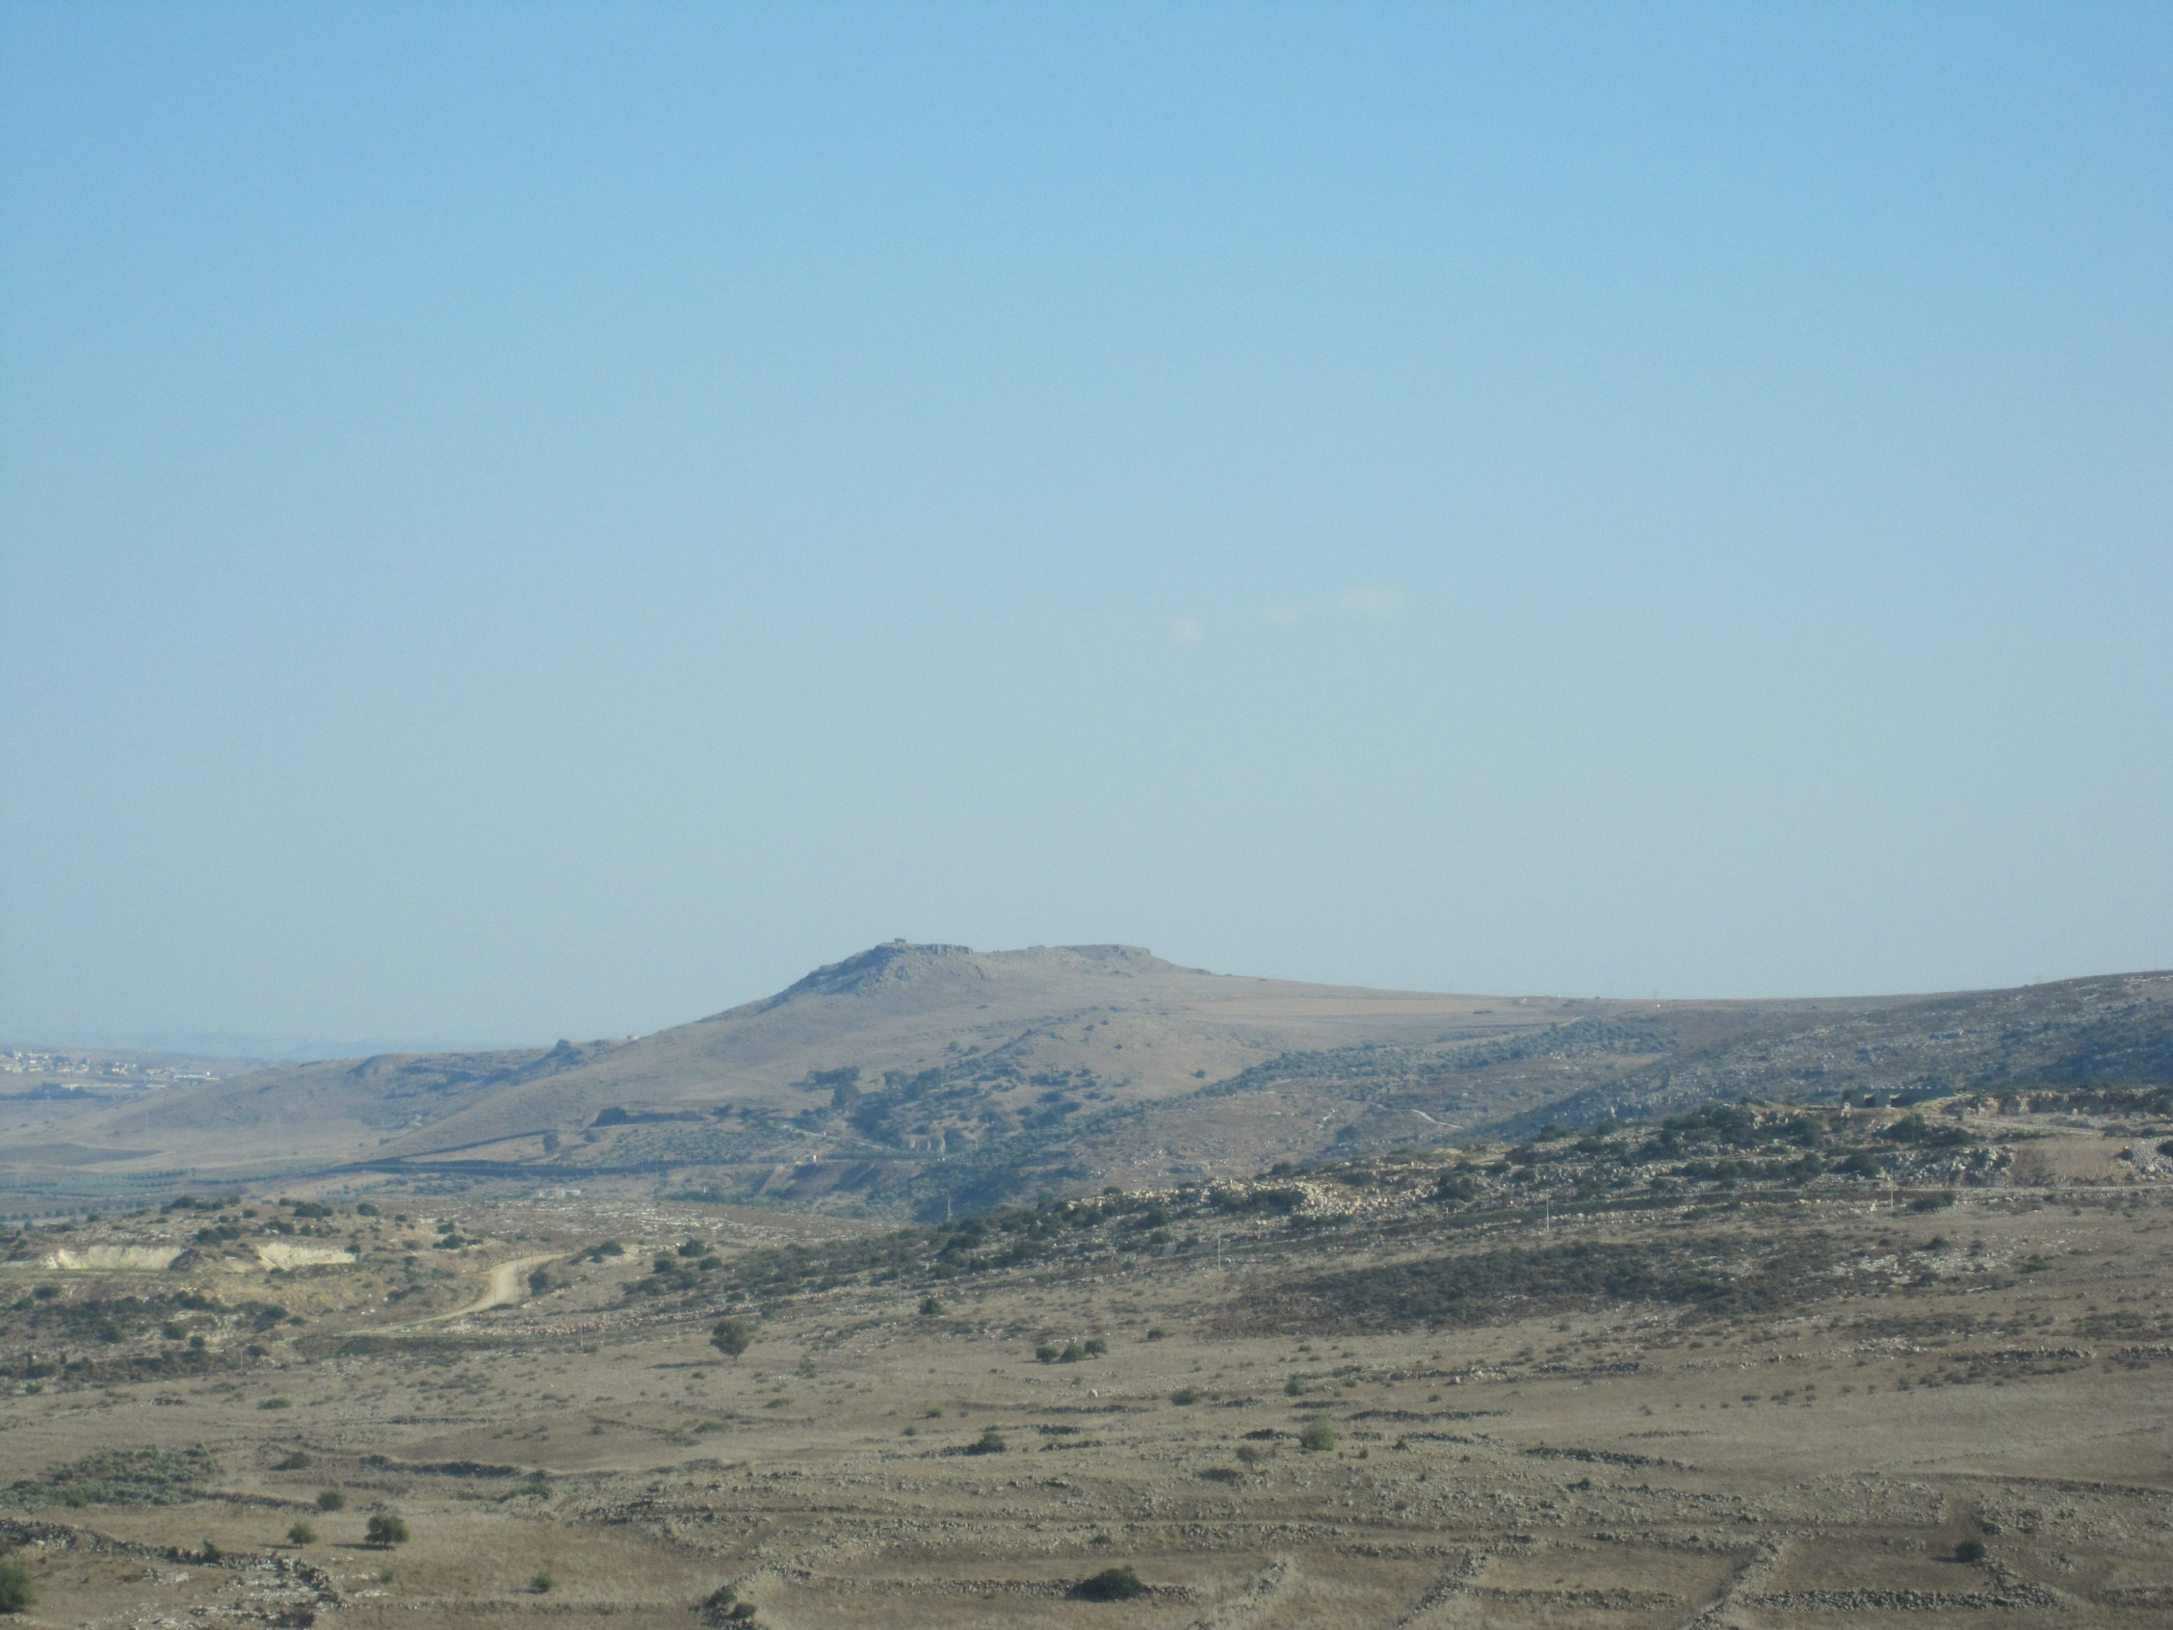
THE ORDERING OF THE CITY
EZRA READS THE LAW (chapter 8)
LIFE MUST BE ACCORDING TO
THE WORD OF GOD
8
TITHE
←Chapter 10
PROPERTY
SABBATH
LEVI
Chapter 12 →
TIME
←Chapter 13

Slide 9
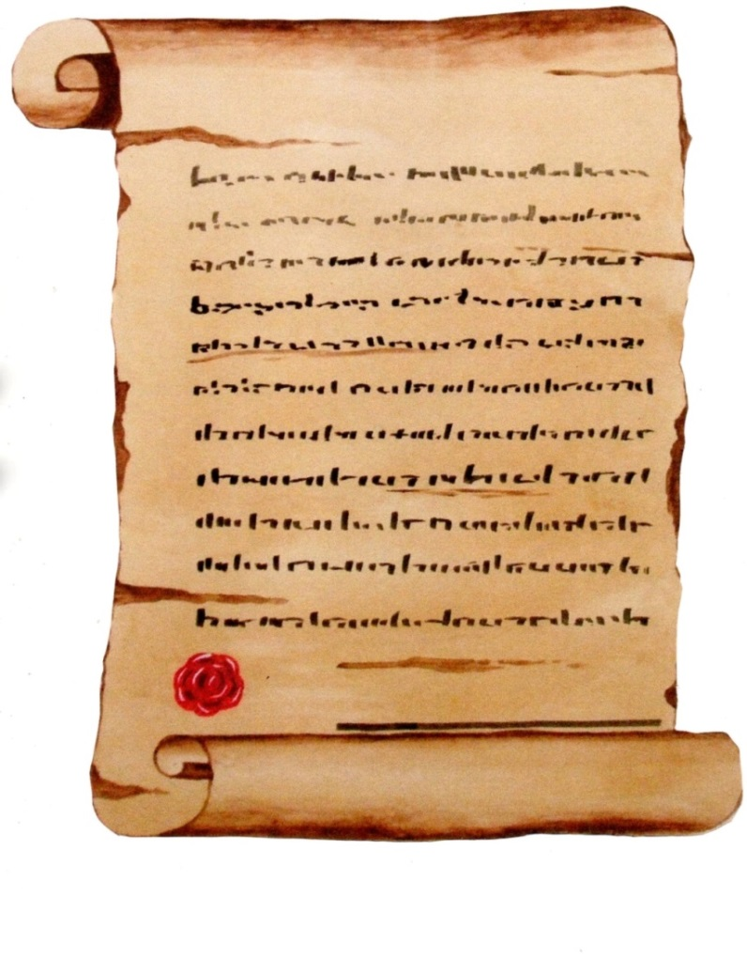
THE COVENANT
Chapter 10
An agreement with God
– but not kept
Chapter 13
9

Slide 10


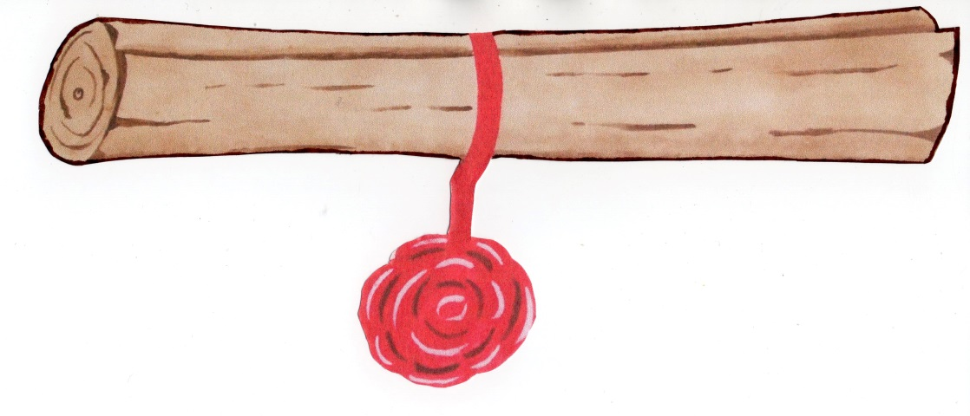
THE NEW COVENANT
Chapter 10
†
An agreement with God
– but not kept
Luke 22 v 20
John 3 v 16
Chapter 13
10

