Slide 1
The following Biblical presentation is based on
notes and illustrations by the Rev L G Stapleton
compiled by
Mark Stapleton
© Mark Stapleton 2016
1

Slide 2
THE BOOK OF EZRA
The books of Ezra and Nehemiah were once bound together as one book
The book of Ezra deals with the return of God’s people to Judah, particularly to Jerusalem, led
by Zerubbabel and Ezra
God’s people had been in captivity for 70 years in Babylon
(Jeremiah 25 vs. 8-14)
The Babylonian Empire had been crushed by Persia – King Cyrus reigns
(Ch. 1 v. 1)
2

Slide 3
PROPHETS
During the period covered by the book of Ezra the prophets Haggai and Zechariah prophesied.
Haggai -
Helped in the
re-building of the Temple -
Ezra 5 vs. 1-2
Encouraged the people- Ezra 6 vs.14
Haggai 2 vs. 18-19
Rebuked the people -
Haggai 1 vs. 1-15
Zechariah –
Encouraged the people in the re-building of the Temple -
Ezra 6 v. 14
Had much to say about the returning Jews Zechariah -
1 vs. 12,
2 vs. 3-5,
4 vs. 6,
8 vs. 4-5
3

Slide 4
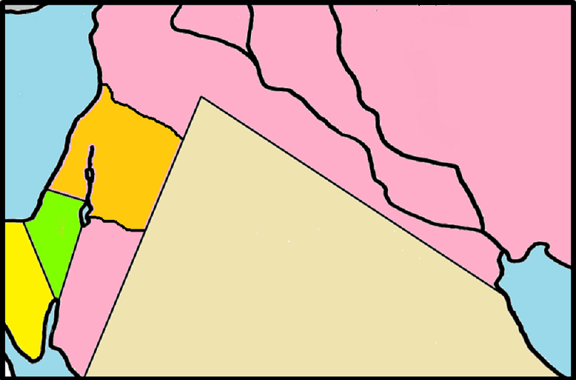
THE RETURN OF GOD’s PEOPLE
. Jerusalem
.Babylon
Zerubbabel returned with 49,897 people – c. BC 536
Chapters 1 - 6
Ezra returned –
c. BC 458
Chapters 7 - 10
4

Slide 5
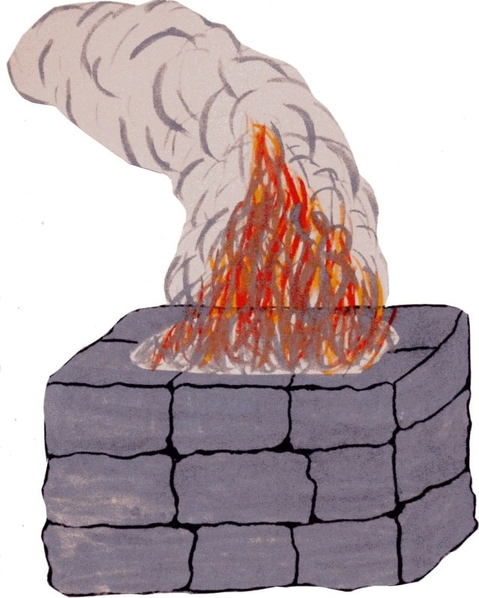
Zerubbabel
Worship restored
Chapter 3 vs. 1-6
5

Slide 6

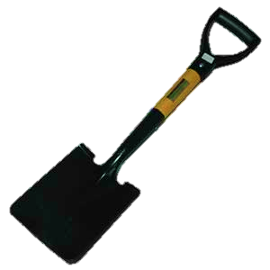

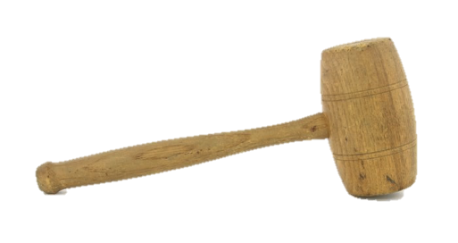
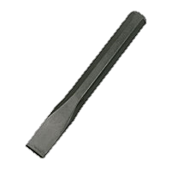
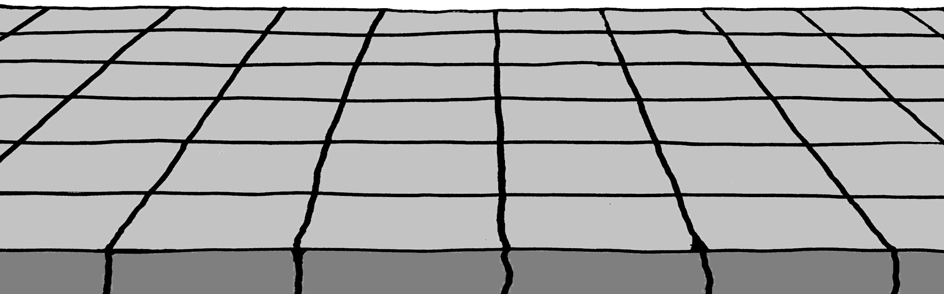
Zerubbabel
Temple foundations laid
Chapter 3 vs. 8-13
6

Slide 7
Zerubbabel
3. Opposition to the building
The work is stopped by
King Artaxerxes 1st of Persia
Pretence
vs. 2
Accusations
vs. 7-22
Threats
vs. 16
Chapter 4
5
7

Slide 8
Zerubbabel
4. Letters were written
From
Tattenai
The Govenor
To
King Darius
From
King Darius
To
Tattenai
The Govenor
Chapters 5 + 6
5
8

Slide 9
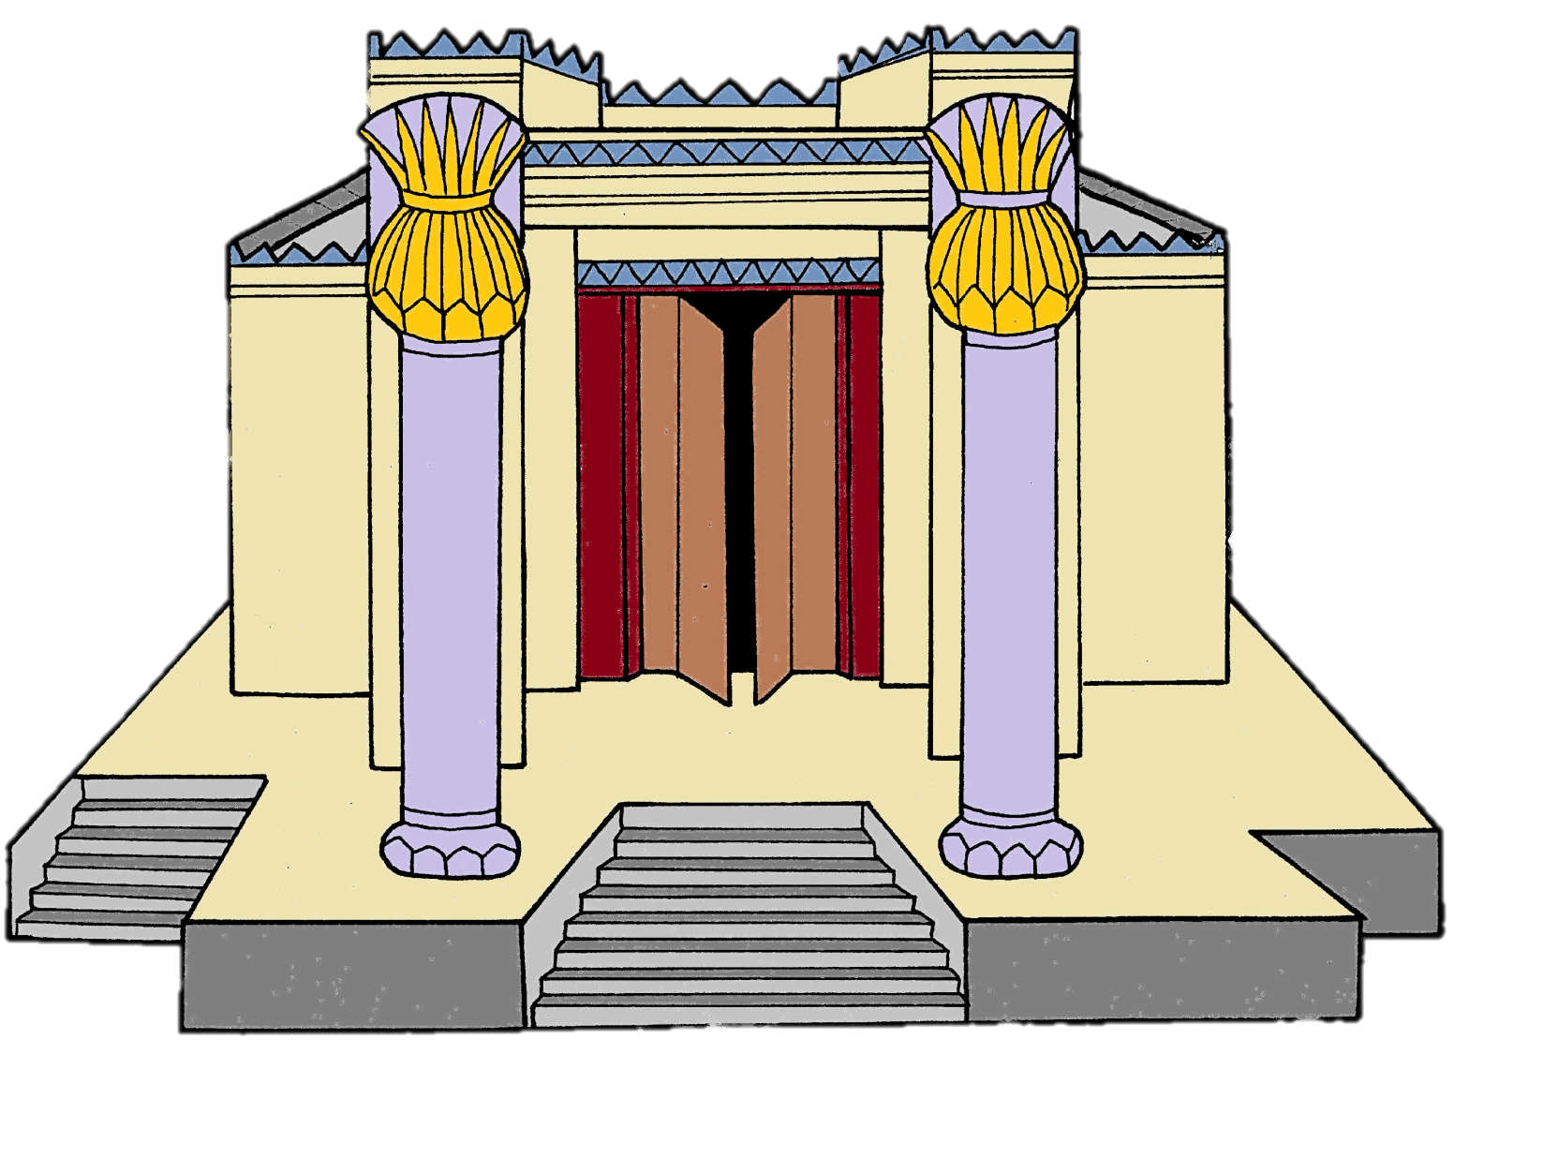
Zerubbabel
5. Building resumed
From
Tattenai
The Govenor
To
King Darius
From
King Darius
To
Tattenai
The Govenor
The Temple completed - ch. 6 v. 15
The Passover celebrated – ch. 6 v. 19
5
9

Slide 10

Ezra
A descendant of Aaron; he was a skilled
Scribe in the Law of Moses
(Chapter 7 vs. 6 & 9)
His ambition – to seek the Law of God with all his heart; to obey the Law of God in his life and to teach the Law of God to His people
(Chapter 7 vs. 10)
10

Slide 11
Ezra
The basis of all that he taught
THE TEN
COMMANDMENTS
Artaxerxes 2nd encourages Ezra in his letter -
…to live according to God’s Law
(Chapter 7 vs. 23)
…to apply the teaching of God’s Law
(Chapter 7 vs. 26)
11
Notes:
Life was to be lived according to God’s Law (Ch. 7 v.23) – this is true for Christians of all ages.

Slide 12
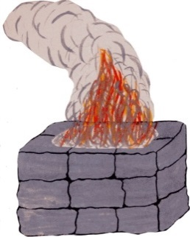
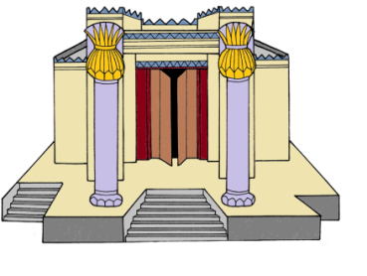
Ezra
SIN
Ezra discovers sin in the Lord’s people
Chapter 9
verses 1-2
He was -astonished
Chapter 9 verse 3
INTERMARRIAGE WITH PAGANS
He made confession
Chapter 9 verses 6-7
He expresses the peoples’
ingratitude
Chapter 9
verses 8-10
THE TEN
COMMANDMENTS
12

Slide 13
†
Ezra
SIN
Ezra discovers sin in the Lord’s people
Chapter 9
verses 1-2
He was -astonished
Chapter 9 verse 3
INTERMARRIAGE WITH PAGANS
SIN DEALT
WITH
Chapter 10
He made confession
Chapter 9 verses 6-7
He expresses the peoples’
ingratitude
Chapter 9
verses 8-10
REPENTANCE
Chapter 10
13

