Slide 1
The following Biblical presentation is based on
notes and illustrations by the Rev L G Stapleton
compiled by
Mark Stapleton
© Mark Stapleton 2016
1

Slide 2
SECOND CHRONICLES
The
Church
Records
2

Slide 3
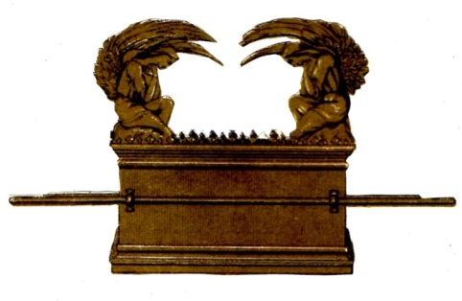
SOLOMON
Chapters 1 - 9
THE BUILDING OF THE TEMPLE
There was a trade agreement with Hiram, King of Tyre – materials and labour
Chapter 2
The Temple was completed when the Ark was installed
Chapter 5
The site of the Temple was Mount Moriah.
Chapter 3 vs. 1
(where David offered a sacrifice and possibly the place of the Crucifixion)
3

Slide 4
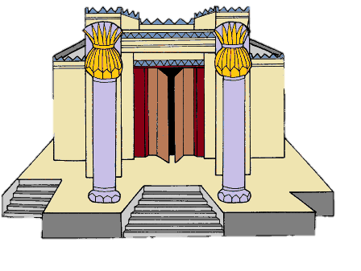
SOLOMON
Chapters 1 - 9
4
THE DEDICATION OF THE TEMPLE
THE GLORY OF THE LORD
FILLED THE HOUSE OF THE LORD
Chapter 5 vs. 14
Dedicatory Prayer
Chapter 6
WORK AND PRAYER MUST ALWAYS GO HAND-IN-HAND

Slide 5
A WARNING TO THE PEOPLE
Chapter 7 verses 19 - 22
Given to Solomon by God
Previously spoken by the prophets
Disobedience led to Captivity
5

Slide 6
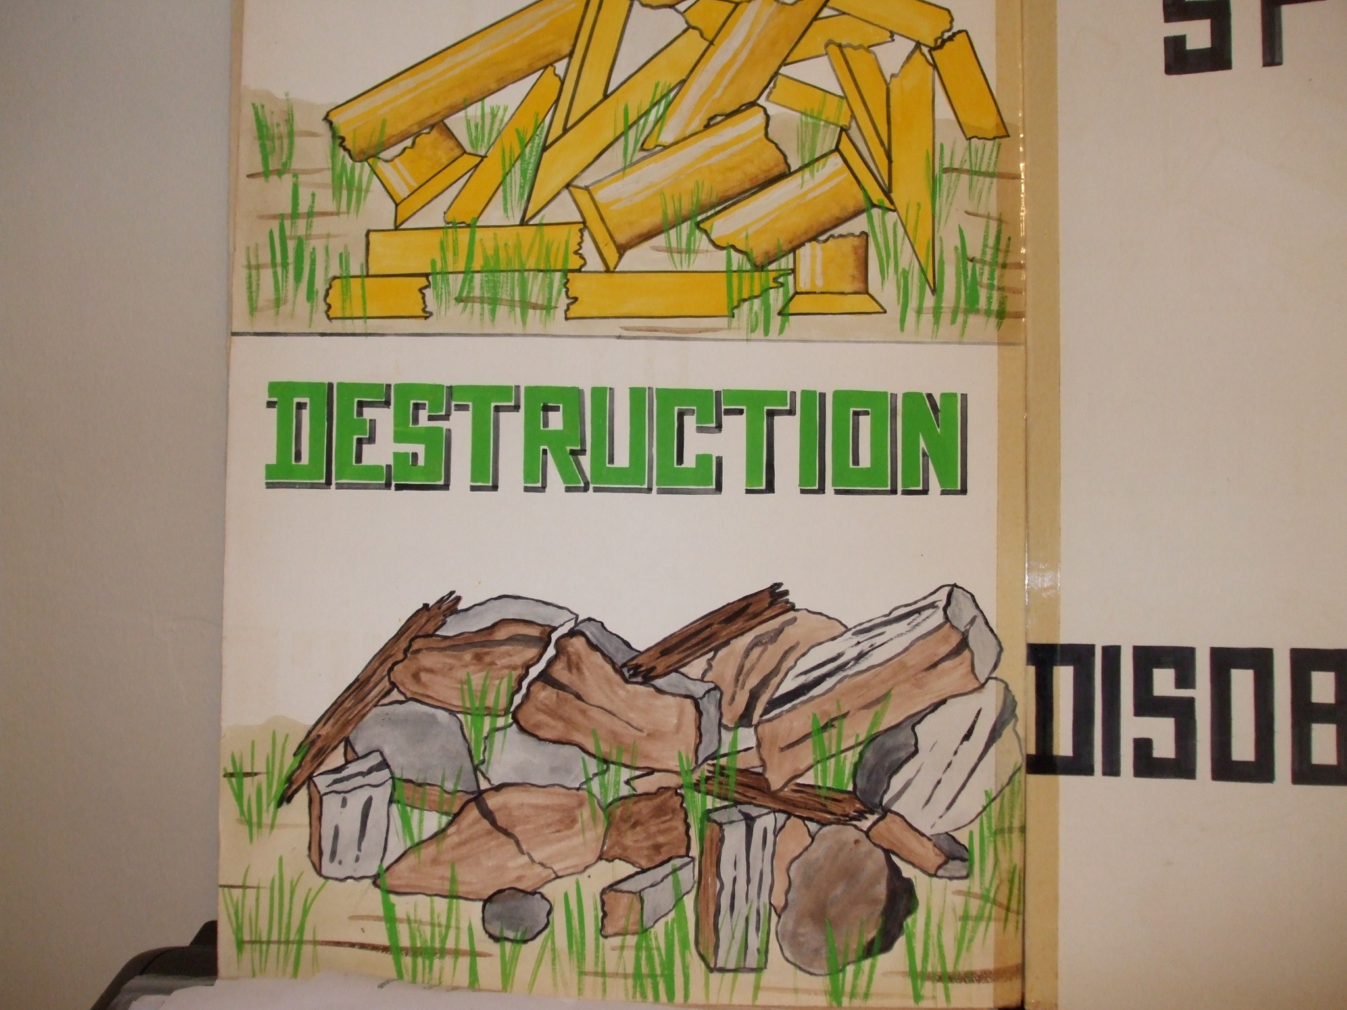
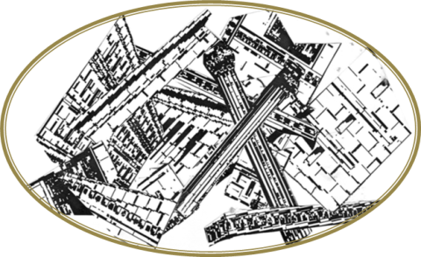
A WARNING TO THE PEOPLE
Chapter 36 verses 15 - 21
(2 Kings chapter 17)
Southern Kingdom of Judah overcome by Nebuchadnezzar and taken to Babylon in
586 BC.
Returned to Judah 70 years later under Zerubbabel and Ezra. Nehemiah rebuilt the wall
Northern Kingdom of Israel overpowered by Assyria under Sennacharib and dispersed among the nations in
722 BC. The Assyrians brought in other nationalities, and their own, to occupy the land e.g. the Samaritans
Walls of Jerusalem broken down
Temple burned
6

Slide 7
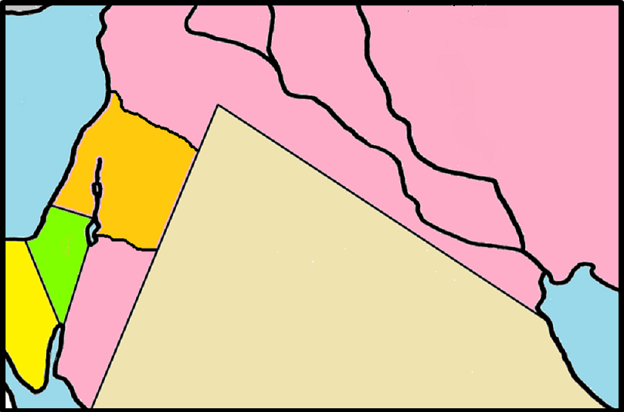
THE CAPTIVITY
ISRAEL
● Jerusalem
JUDAH
Babylon 
DESERT
7

Slide 8
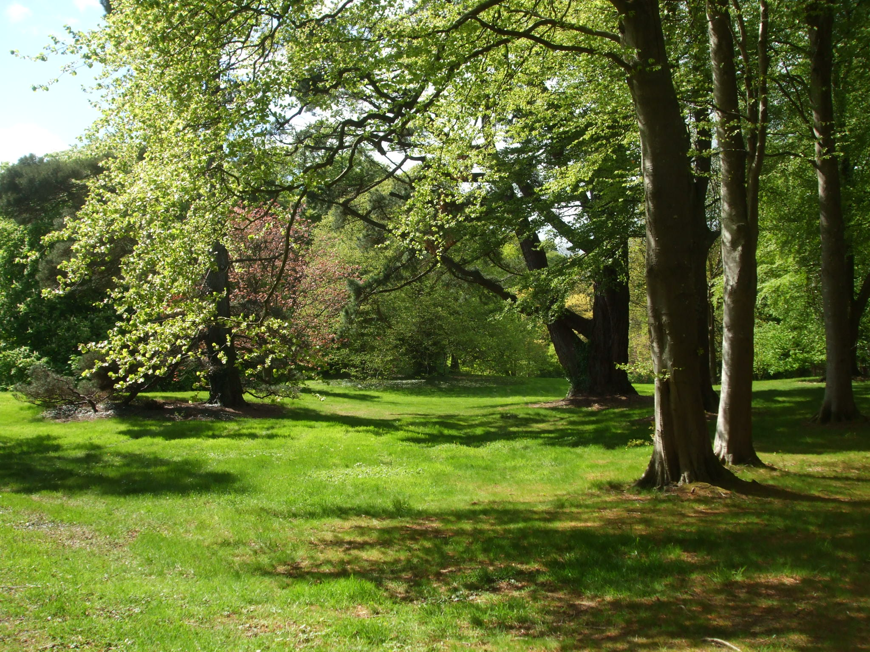
†
DISOBEDIENCE
was the reason for God’s awful judgement on
Judah and Israel
In the Garden of Eden, everything was spoilt by DISOBEDIENCE
Genesis chapter 3
…by one Man’s obedience many will be made righteous
Romans 5 verse 19
8

