Slide 1
The following Biblical presentation is based on
notes and illustrations by the Rev L G Stapleton
compiled by
Mark Stapleton
© Mark Stapleton 2016
1

Slide 2
FIRST CHRONICLES
2
The
Church
Records
Events in Judah, the Southern Kingdom
Chapters 1-9 deal with genealogies
Chapter 10 deals with
the death of Saul
Chapters 11-29 deal with the life of David
Looking at events from the Priestly (Church)
point of view

Slide 3
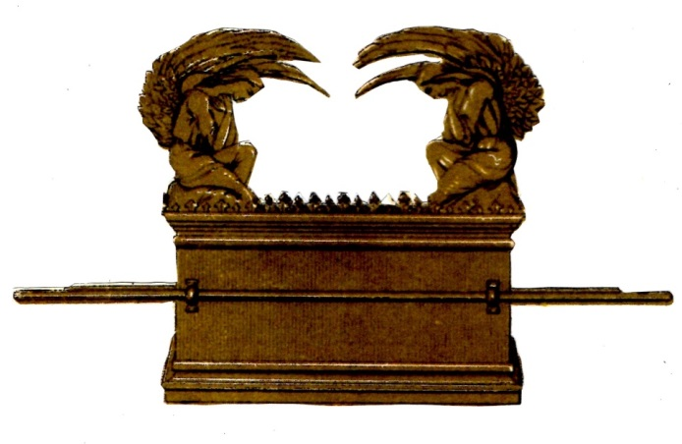
The Ark of the Covenant -
… in the Tabernacle in the wilderness (Exodus), symbolised God’s Presence
God’s Holiness
God’s Mercy
… was carried by the priests when Jericho was defeated
Joshua 6
… was captured by the Philistines; the glory departs from Israel (Ichabod) –
1 Samuel 4 vs. 11, 21
… was not used during Saul’s reign
1 Chronicles 13
(except in
1 Samuel 14 v.18)
… remained in Kirjath Jearim for nearly 70 years
David felt that it should return to its place at the heart of the nation
1 Chronicles 13
3

Slide 4
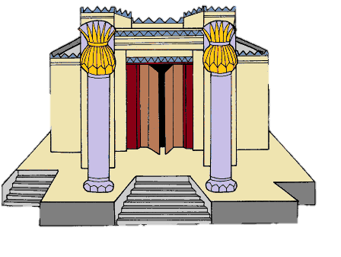
PREPARATIONS FOR THE BUILDING OF THE TEMPLE
David wanted to build, but God forbade him
1 Chronicles 28 v. 2-3
Solomon is given the Divine plan, and will build the Temple when he becomes King
1 Chronicles 28 v. 6, 12
David contributes his own gold and silver to the work, and praises and magnifies God’s name
1 Chronicles 29 vs. 1-20
4

Slide 5

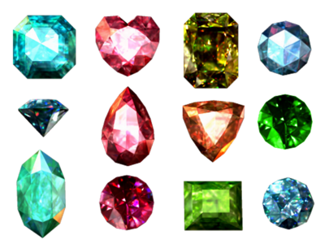

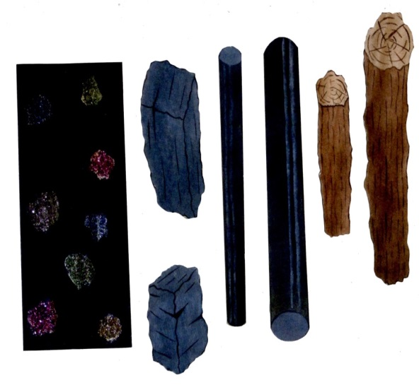



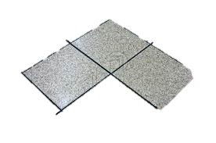

PREPARATIONS FOR THE BUILDING OF THE TEMPLE
GOLD
PRECIOUS
STONES
BRONZE
List of materials
IRON
WOOD
MARBLE
SILVER
DAVID COLLECTS MATERIALS
Chapter 29
5

Slide 6

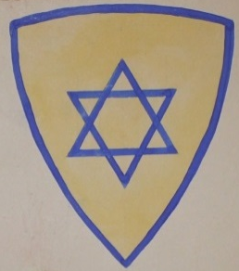
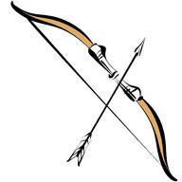
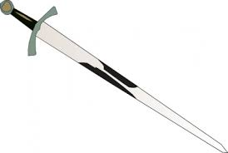
DAVID’s ARMY
Chapter 12
Verses 24/34
They were –
Joined to David
(v. 8)
Entirely his
(vs. 33/38)
Disciplined
(v. 38)
Verse 34
Verse 2
Verses 33/37
6

Slide 7
DAVID’s ARMY
Chapter 12
TRUE
TO
DAVID
“We are yours, O David”
v.18
7

Slide 8
THE CHRISTIAN’s WARFARE
Ephesians 6
TRUE
TO
CHRIST
†
OUR LOYALTY
“We are Yours!”
8

