Slide 1
The following Biblical presentation is based on
notes and illustrations by the Rev L G Stapleton
compiled by
Mark Stapleton
© Mark Stapleton 2016
1

Slide 2
SECOND KINGS
The
Royal
Records
2

Slide 3
SECOND KINGS
This book covers about 250 years
Israel
(Northern Kingdom)
19 bad kings
(Jeroboam 1st is the 1st king)
Jeroboam 1st
is linked with the phrase –
“ …which made Israel to sin”
Judah
(Southern Kingdom)
12 bad kings
8 good kings
3

Slide 4
“…did evil in the sight of the LORD”
Evil deeds
Idolatry
4
AHAB
PEKAHIAH
Selfishness
Evil
deeds
AHAZ
JEHOAHAZ
Evil
deeds
Riches
Sin
MANASSEH
Disobedience
Baal worship
Evil deeds
JEHU
PEKAH
MENAHEM
KINGS OF ISRAEL AND SOME KINGS OF JUDAH

Slide 5

“… did what was right”
ASA
JEHOSHAPHAT
JOTHAM
AMAZIAH
JOASH
UZZIAH
(AZARIAH)
HEZEKIAH
JOSIAH
KINGS OF JUDAH
5

Slide 6
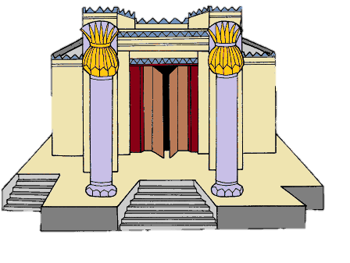
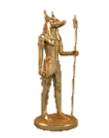
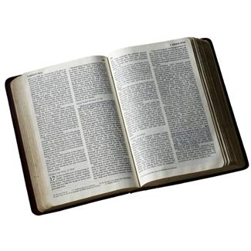
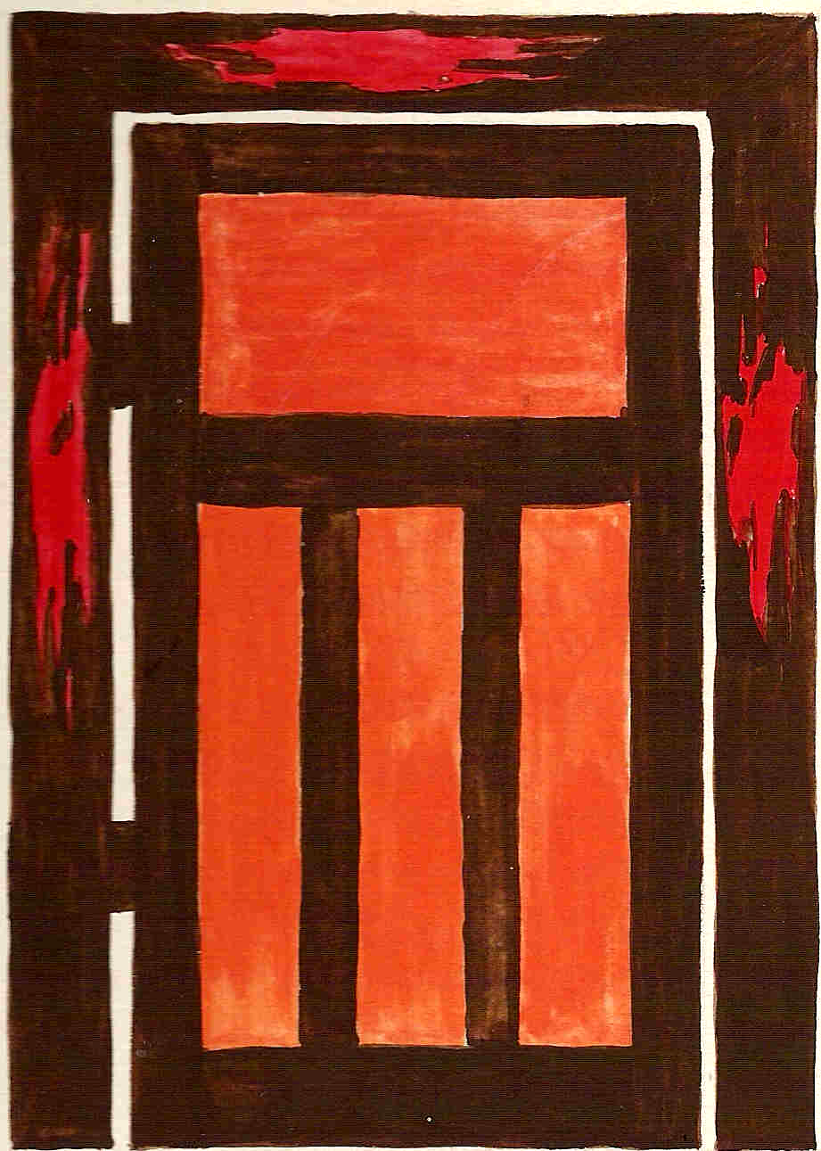
“… did what was right”
Joash (Chapter 12) repaired the temple
Hezekiah (Chapter 16) destroyed idolatrous worship
Josiah (Chapter 22) restored the Word of God and
re-established the Passover
6

Slide 7
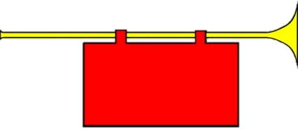
THE PROPHETS
THUS SAYS THE LORD
God’s call to the people, through the Prophets, was always a call to repentance, based on His constant love for them.
7

Slide 8

THE PROPHETS
THUS SAYS THE LORD
Elijah, Elisha and Isaiah
Other Prophets who spoke during the time of 2 Kings: –
Jeremiah, Hosea, Joel, Amos, Obadiah, Jonah, Micah, Nahum, Habbakuk, Zephaniah
8

Slide 9
THE PROPHETS
THUS SAYS THE LORD
THE PEOPLE’S RESPONSE -
NO
9

Slide 10
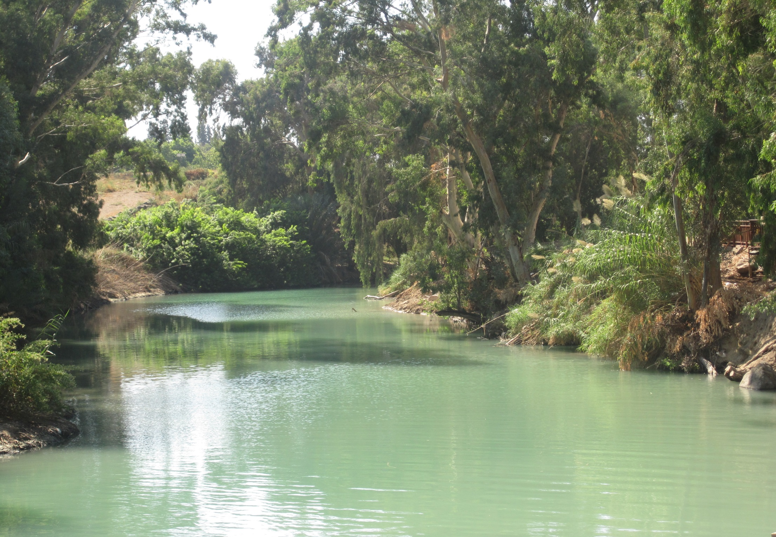
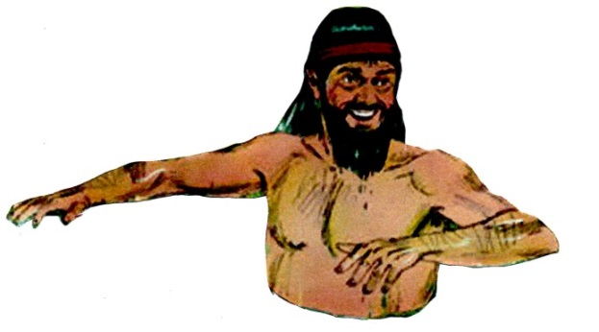
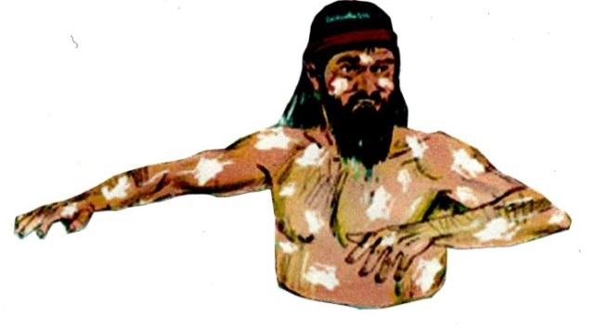
THE PROPHET ELISHA and NAAMAN
2nd Kings chapter 5
10

Slide 11
…the blood of Jesus Christ God’s Son cleanses us from all sin. 1 John 1 v. 7
†
THE PROPHET ELISHA and NAAMAN
2nd Kings chapter 5
11

