Slide 1
The following Biblical presentation is based on
notes and illustrations by the Rev L G Stapleton
compiled by
Mark Stapleton
© Mark Stapleton 2016
1

Slide 2
First Kings
The
Royal
Records
2

Slide 3

SOLOMON
His wealth
1 Kings 10 verses 14 - 27
3

Slide 4

SOLOMON
His wisdom
1 Kings 4 vs. 29 – 33,
10 vs. 23 – 24
Book of Proverbs
4

Slide 5
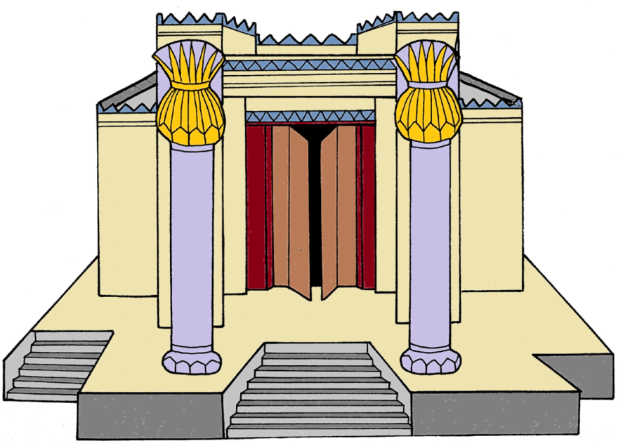
SOLOMON
His work
1 Kings chapters 5 & 6
Note: The erection of the Temple is also dealt with in the book of
2 Chronicles
5

Slide 6
SOLOMON’s DOWNFALL
and what followed
1 Kings 11 vs. 1-5
Many wives turn his heart from the Lord
He disobeys God
He worship idols
1 Kings 11 vs. 26-40
His servant Jeroboam 1st rebels against him
The prophet Ahijah tells Jeroboam 1st of the impending division of the country into two parts
6

Slide 7
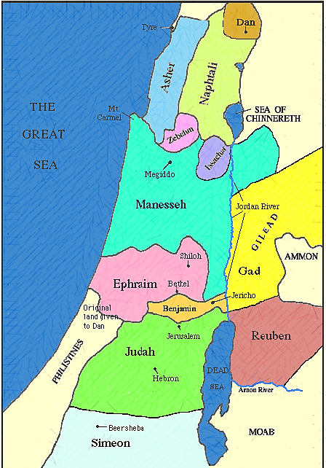

THE DIVIDED KINGDOM
Northern Kingdom
Israel
10 tribes
King Jeroboam 1st
Israel
Manasseh
Southern Kingdom
Judah
2 tribes
King Rehoboam
Judah
Nelsons Complete Book of Bible Maps and Charts © GeoNova
c. 975 B.C.
7

Slide 8
THE DIVIDED KINGDOM
The Kings of Judah
Rehoboam –
1 Kings14 vs.21-31
Abijam –
1 Kings 15 vs. 1-8
Asa –
1 Kings 15 vs. 9-24
Jehoshaphat –
1 Kings 22 vs. 41-50
Only three Kings ruled over the united kingdom.
They were Saul, David and Solomon.
Adonijah, David’s surviving son tried to take over the kingdom; David confirms that Solomon is the rightful successor.
8

Slide 9
THE DIVIDED KINGDOM
Some of the Kings of Israel
Jeroboam 1st –
1 Kings 12 vs.25 – 14 vs. 20
Nadab –
1 Kings 15 vs. 25-31
Baasha –
1 Kings15 vs. 32 – 16 vs. 7
Elah –
1 Kings 16 vs. 8-14
Zimri –
1 Kings 16 vs. 15-20
Omri –
1 Kings 16 vs. 21-28
Ahab –
1 Kings 16 vs. 29 – 22 vs. 40
Ahaziah –
1 Kings 22 vs. 51-53
Elijah was the prophet at the time Ahab was King
1 Kings chapters 17 - 20
9

Slide 10
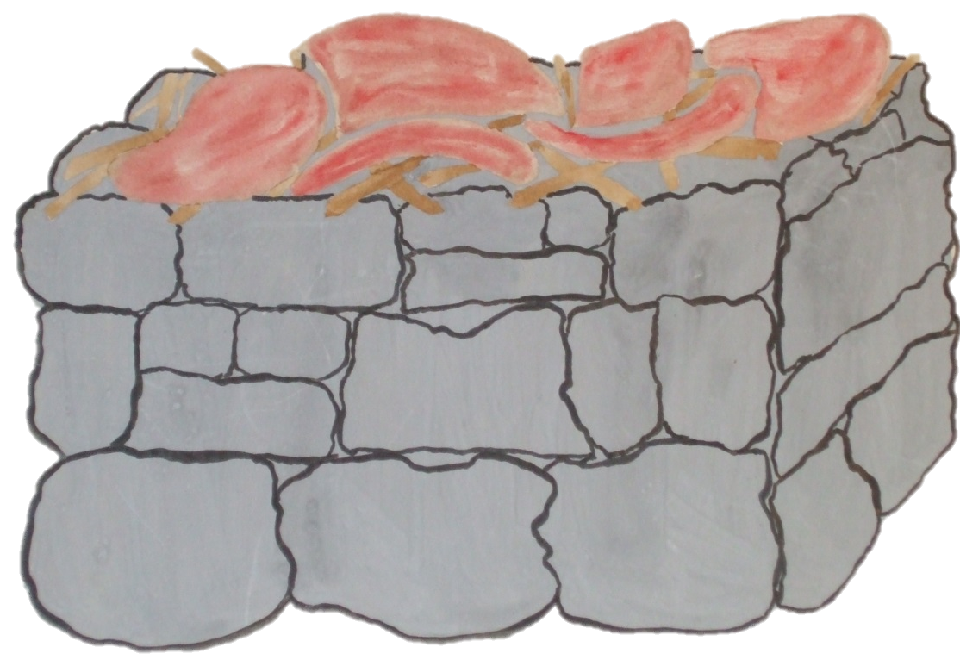
Carmel
Perhaps he is meditating
O Baal, hear us!
How long will you falter between two opinions?
(Ch. 18 v.21)
O Baal, hear us!
Perhaps he is busy
PROPHETS
OF
BAAL
O Baal, hear us!
ELIJAH
Perhaps he is on a journey
Perhaps he is sleeping
O Baal, hear us!
10

Slide 11
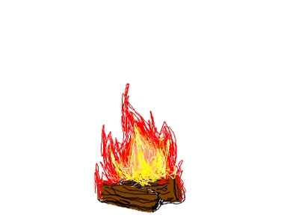


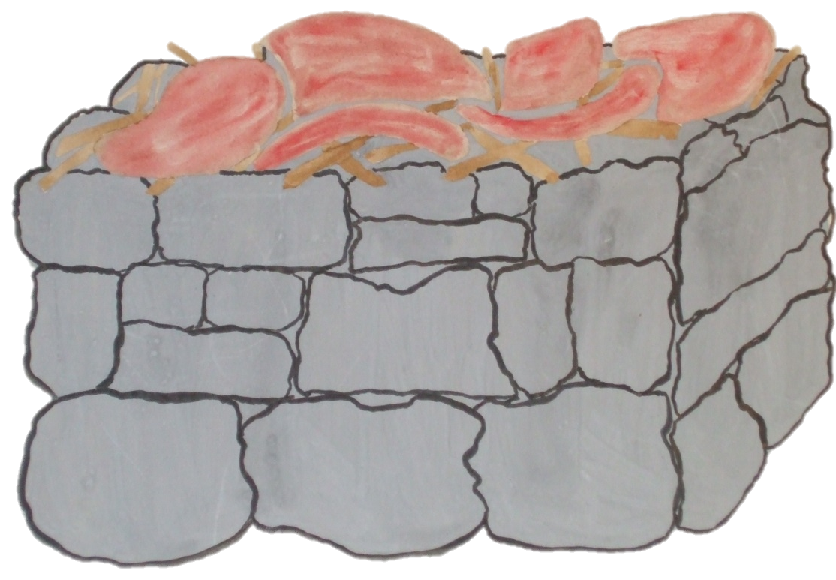
Carmel
Elijah –
“O LORD hear me!” – verse 37
11

Slide 12
Calvary
†
HOW
LONG
WILL
…now is the day of Salvation.
2 Corinthians
6 vs. 2
YOU
F
ALTER
(1 Kings 18 vs.21)
12

