Slide 1
The following Biblical presentation is based on
notes and illustrations by the Rev L G Stapleton
compiled by
Mark Stapleton
© Mark Stapleton 2016
1

Slide 2


SAMUEL
The Star of David
Part Two
2

Slide 3
SAMUEL
The first and second books of Samuel were once one book
The Books of Samuel and Kings give the Political or Monarchical (Royal) view
Chronicles gives the Priestly (Church) or Theocratic view of the same historical events
David’s reign in Hebron began about
1055 B.C.
Part Two
3

Slide 4

King David
Roll of Honour
Adino
Eleazer
Shammah
2 Samuel 23 vs. 8-12
4

Slide 5
King David
Record of Dishonour
Wrong desire
Bathsheba
2 Samuel 11
Murder
Uriah
2 Samuel 11
Deceit
Nathan
2 Samuel 11/12
Pride
Census
2 Samuel 24
5

Slide 6
King David
His confessions
2 Samuel 12 vs. 13
Psalm 51
2 Samuel 24
vs. 10,17
6

Slide 7
King David
7
Result of Dishonour
Bathsheba’s child dies
2 Samuel 12 vs.15-23
David experiences
war throughout
his reign
2 Samuel 12 vs.10
(1 Kings 5 vs.3)
Three days’ plague sent on Israel
2 Samuel 24
vs. 10-17
Note: David was not allowed to build the new Temple in Jerusalem, but he did collect materials for it. See 1 Chronicles 22

Slide 8
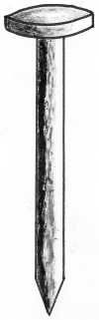
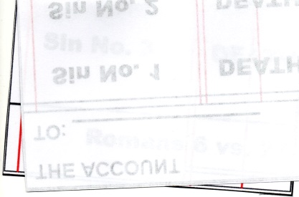
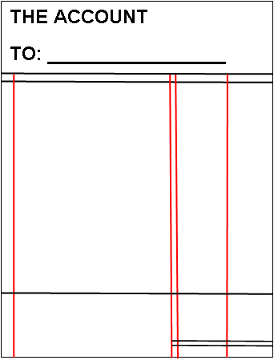
DEBT TO BE PAID
THE ACCOUNT
TO: _________________
Sin No. 1
DEATH
Sin No. 2
DEATH
THE DOUBLE
Sin No. 3
DEATH
Romans 6 vs. 23
Isaiah 40 vs.2
8

Slide 9
†
THE DEBT HAS BEEN PAID
THE DOUBLE
Colossians 2 vs.14
9

