Slide 1
The following Biblical presentation is based on
notes and illustrations by the Rev L G Stapleton
compiled by
Mark Stapleton
© Mark Stapleton 2016
1

Slide 2
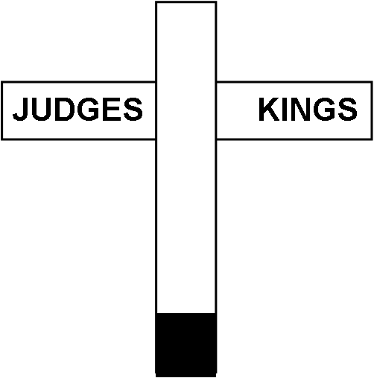
SAMUEL
Part One
2

Slide 3

FIRST SAMUEL
(Known in the Authorised version of the Bible as the “First Book of the Kings”)
There are six books dealing particularly with the history of the people of Israel
First Samuel
Second Samuel
First Kings
Second Kings
First Chronicles
Second Chronicles
3

Slide 4
FIRST SAMUEL
Three main characters –
Samuel
Chapters 1 - 7
Saul
Chapters 8 - 15
David
Chapters 16 - 31
4

Slide 5
SAMUEL
SAMUEL
SAMUEL
The sons of Eli were corrupt
1 Samuel 2 v.12
SAMUEL
SAMUEL
…the word of the
LORD was rare in those days: there was no open vision (revelation)
1 Samuel 3 v. 1
“Speak, for Your servant hears.”
1 Samuel 3 vs.10
5

Slide 6
SAMUEL
Last of the Judges, known as a Prophet (formerly called a Seer – chapter 9 v. 9)
Led the people out of their failure to live as a Theocracy into a Monarchy
i.e. from a people ruled by God to a people ruled by a King
This was God’s permissive will
for Israel, not His directive will
6

Slide 7
Israel asks for a King
Because:
1. Samuel’s sons - Joel and Abijah
(chapter 8 vs. 1,3,5) -
Turned aside after dishonest gain
Took bribes
Perverted justice
2. The people wanted to be like other nations (chapter 8 vs.5,20)
God allowed them to have a King but tragic results followed (c/f Psalm 106 vs.15)
7

Slide 8
Choosing the first King
Samuel warns the people of the result of their request for a King (chapter 8
vs. 10-22)
Tribe of
BENJAMIN
Family of
MATRI
Ch. 10 v.21
KISH
God tells Samuel to anoint Saul
as King
(chapters 9-10)
SAUL
8

Slide 9
KING SAUL’s DOWNFALL
His Failure –
His unlawful sacrifice
(ch. 13 vs. 1 - 12)
His Failure –
He disobeys God’s command
(ch 15 vs. 3, 9)
The Consequences –
His kingdom would discontinue
(ch. 13 vs. 14)
His Failure –
He consults a medium
(ch. 28 vs. 7, 8)
The Consequences –
God tears the Kingdom out of his hand
(ch. 28 vs. 17)
The Consequences –
Rejected by God
(ch. 15 vs. 26)
Saul and his sons die in battle
Ch. 31 vs.6
9

Slide 10
GOD’S CHOICE
The sons of Jesse
ELIAB
ABINADAB
SHAMMAH
NETHANEEL
RADDAI
OZEM
DAVID | X
10

Slide 11
GOD’S CHOICE
DAVID
A man after God’s own heart
1 Samuel 16 v. 7
Anointed to be King by Samuel
secretly at Bethlehem
1 Samuel 16 vs. 12-13
Note: David was not anointed (crowned) publicly as King until later
(2 Samuel chapter 2)
11

Slide 12
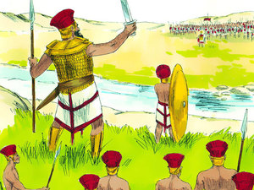
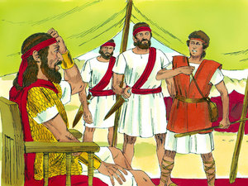
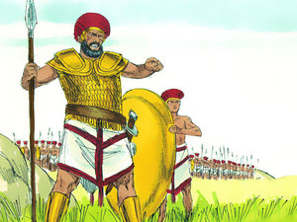
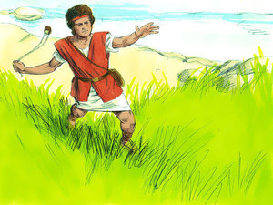
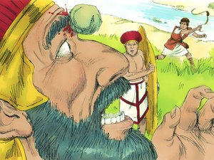
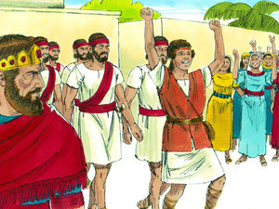
DAVID & GOLIATH
12
Goliath cursed David by his gods
1 Samuel 17 vs.43
David said, “I come to you in the name of the LORD of hosts…”
1 Samuel 17 vs.45

Slide 13

GOD’S CHOICE
The ultimate successor to the Throne of David
†
Luke 1 vs. 32.33
King of Kings – Revelation 17 vs. 14
13

