Slide 1
The following Biblical presentation is based on
notes and illustrations by the Rev L G Stapleton
compiled by
Mark Stapleton
© Mark Stapleton 2016
1

Slide 2
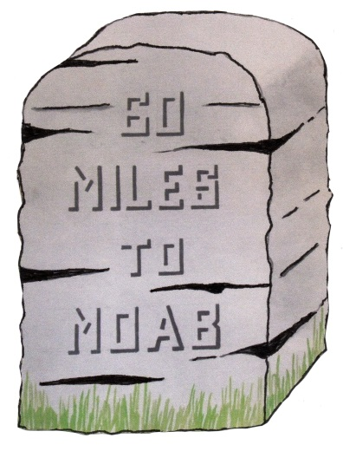
RUTH
Elimelech
= Naomi
Mahlon
= Ruth
Chilion
= Orpah
Chapter 1 vs. 1 - 5
2

Slide 3
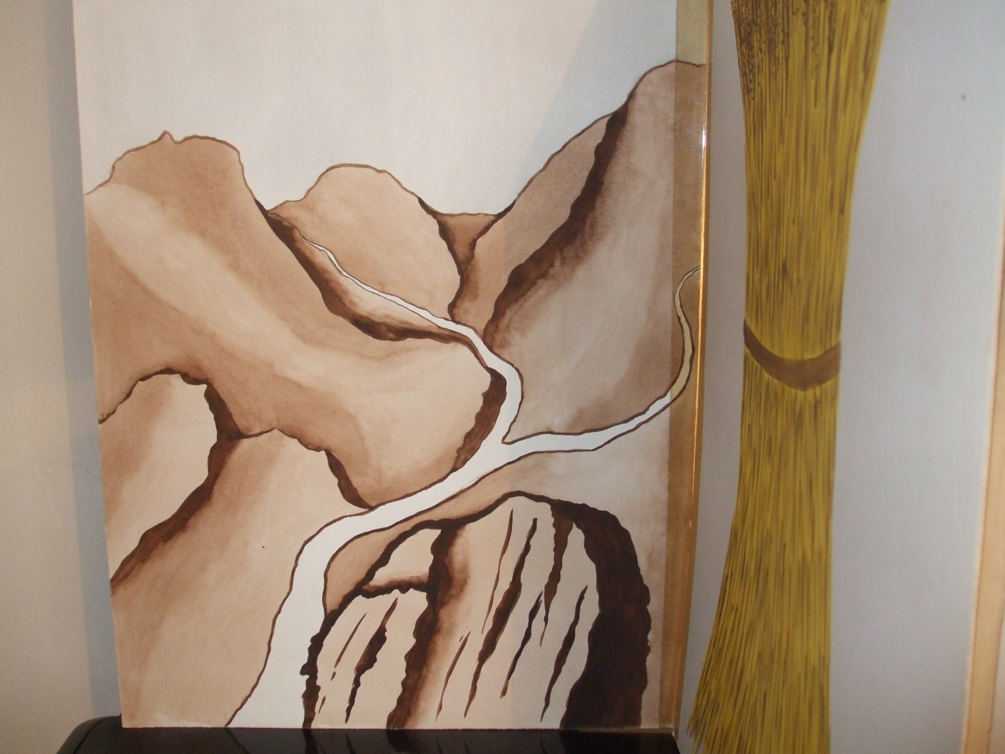
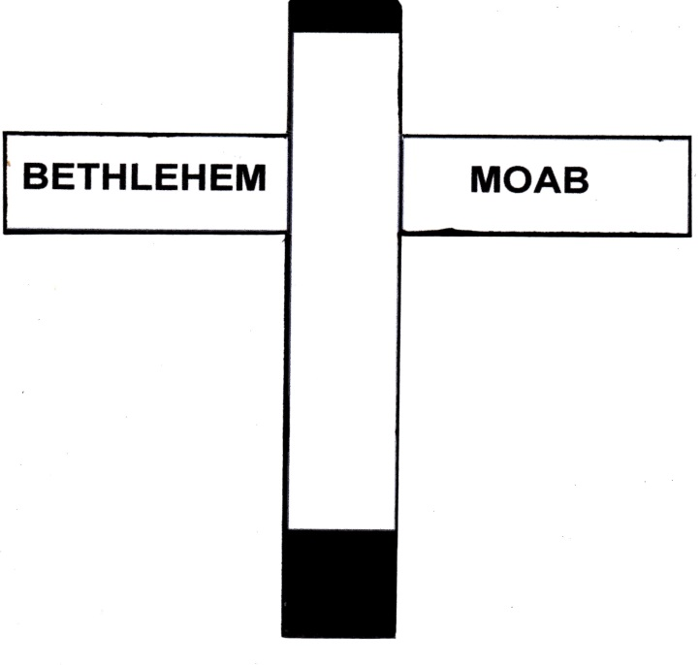
Chapter 1 vs. 6 - 18
Naomi
Ruth
BETHLEHEM
MOAB
Orpah
3

Slide 4
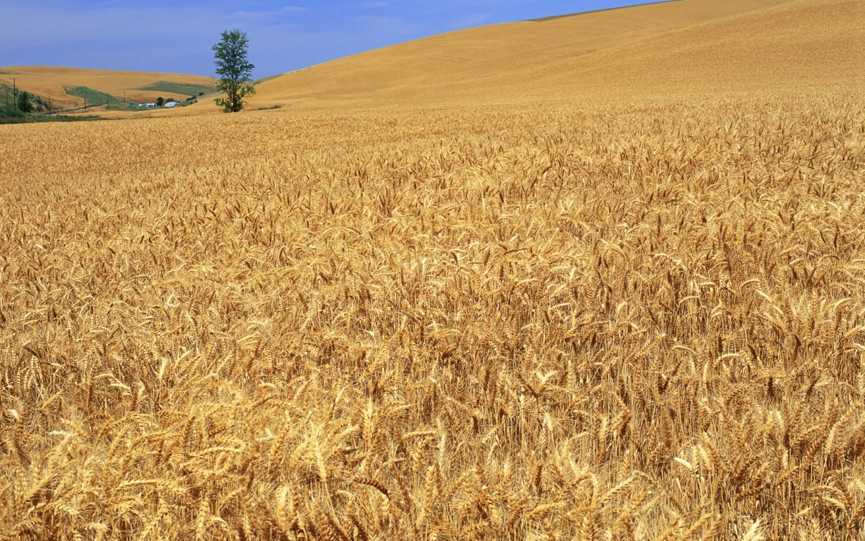
BETHLEHEM
Chapters 2 - 4
Ruth and Naomi come to Bethleham at the time of the barley harvest
Ruth gleans in the field of Boaz, a wealthy relation of Elimelech
Naomi had sold land that belonged to Elimelech
Boaz is kind to Ruth ; she claims his protection, and help in redeeming the land
Note - in chapter 2:
Guidance – verse 3; Grace – verses 8-9
Protection – verse 9; Provision – verse 16
Plenty – verses 17-18
4

Slide 5
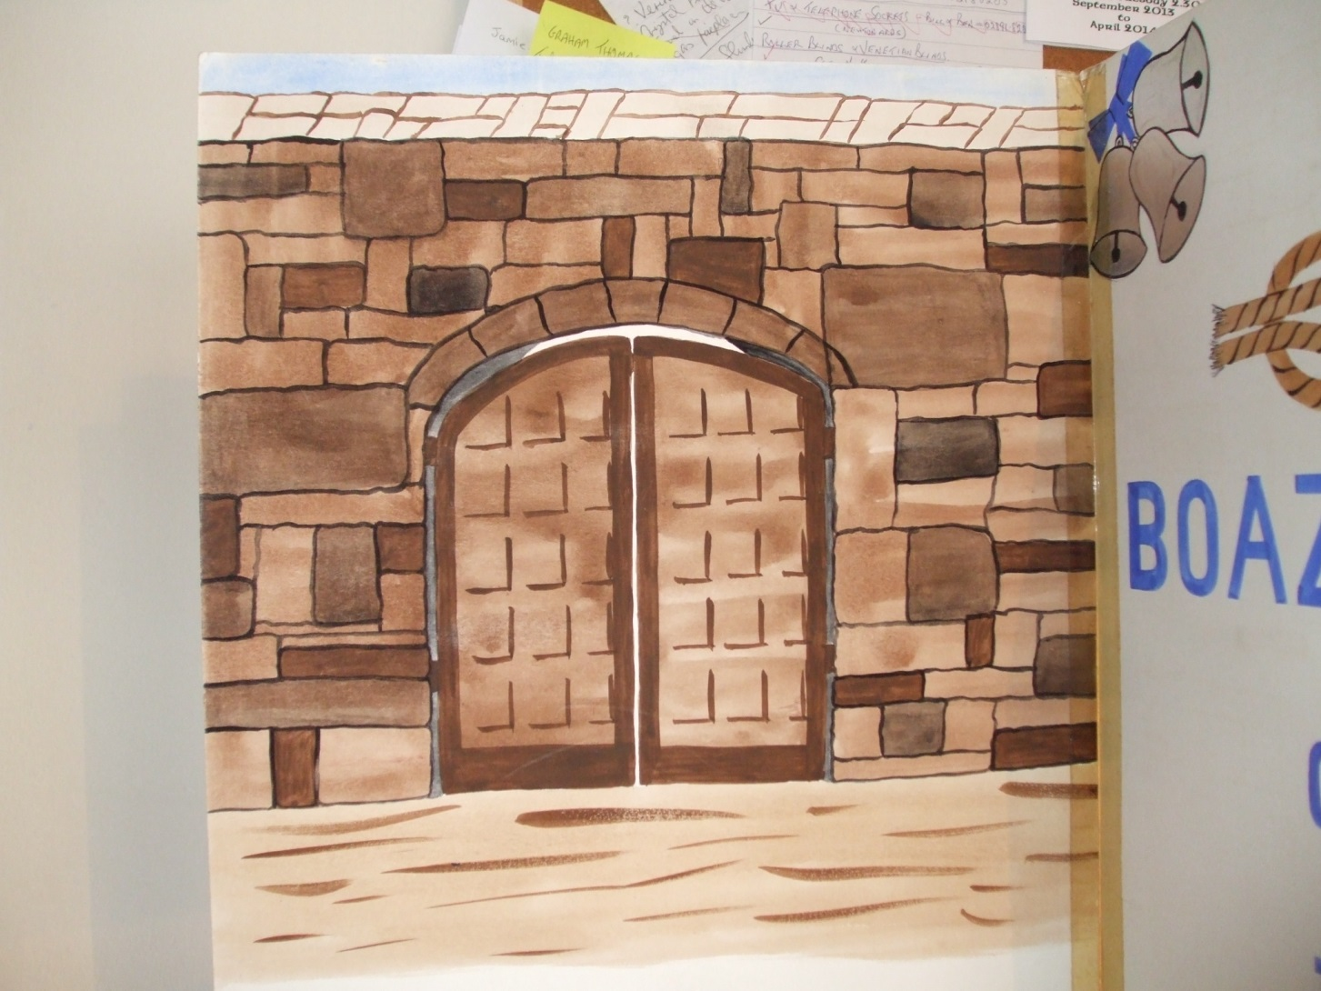
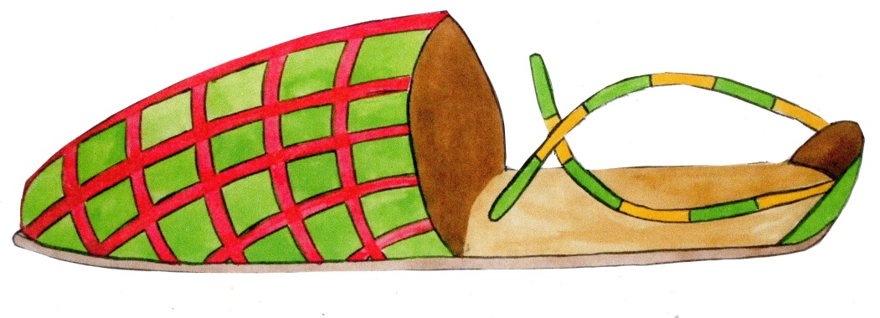
The City gate
Boaz discusses with a nearer relative about redeeming the land once owned by Elimelech
The nearer relative is willing to redeem. Boaz reminds him that he would also have to marry Ruth (Deuteronomy 25
v. 8-10)
The nearer relative is unwilling to spoil his own inheritance
He shows his unwillingness to redeem by removing his sandal and giving it to Boaz
Chapter 4
vs. 1-10
5
Notes:
Boaz comes to the city gate to discuss with a nearer relative the buying back (redeeming) of Naomi’s land
The nearer relative is willing to do this but Boaz points out that he would also have to marry Ruth in accordance with the Law of God (Deuteronomy)
The nearer relative is unwilling to spoil his own inheritance
He shows his unwillingness to redeem by removing his sandal and giving it to Boaz

Slide 6
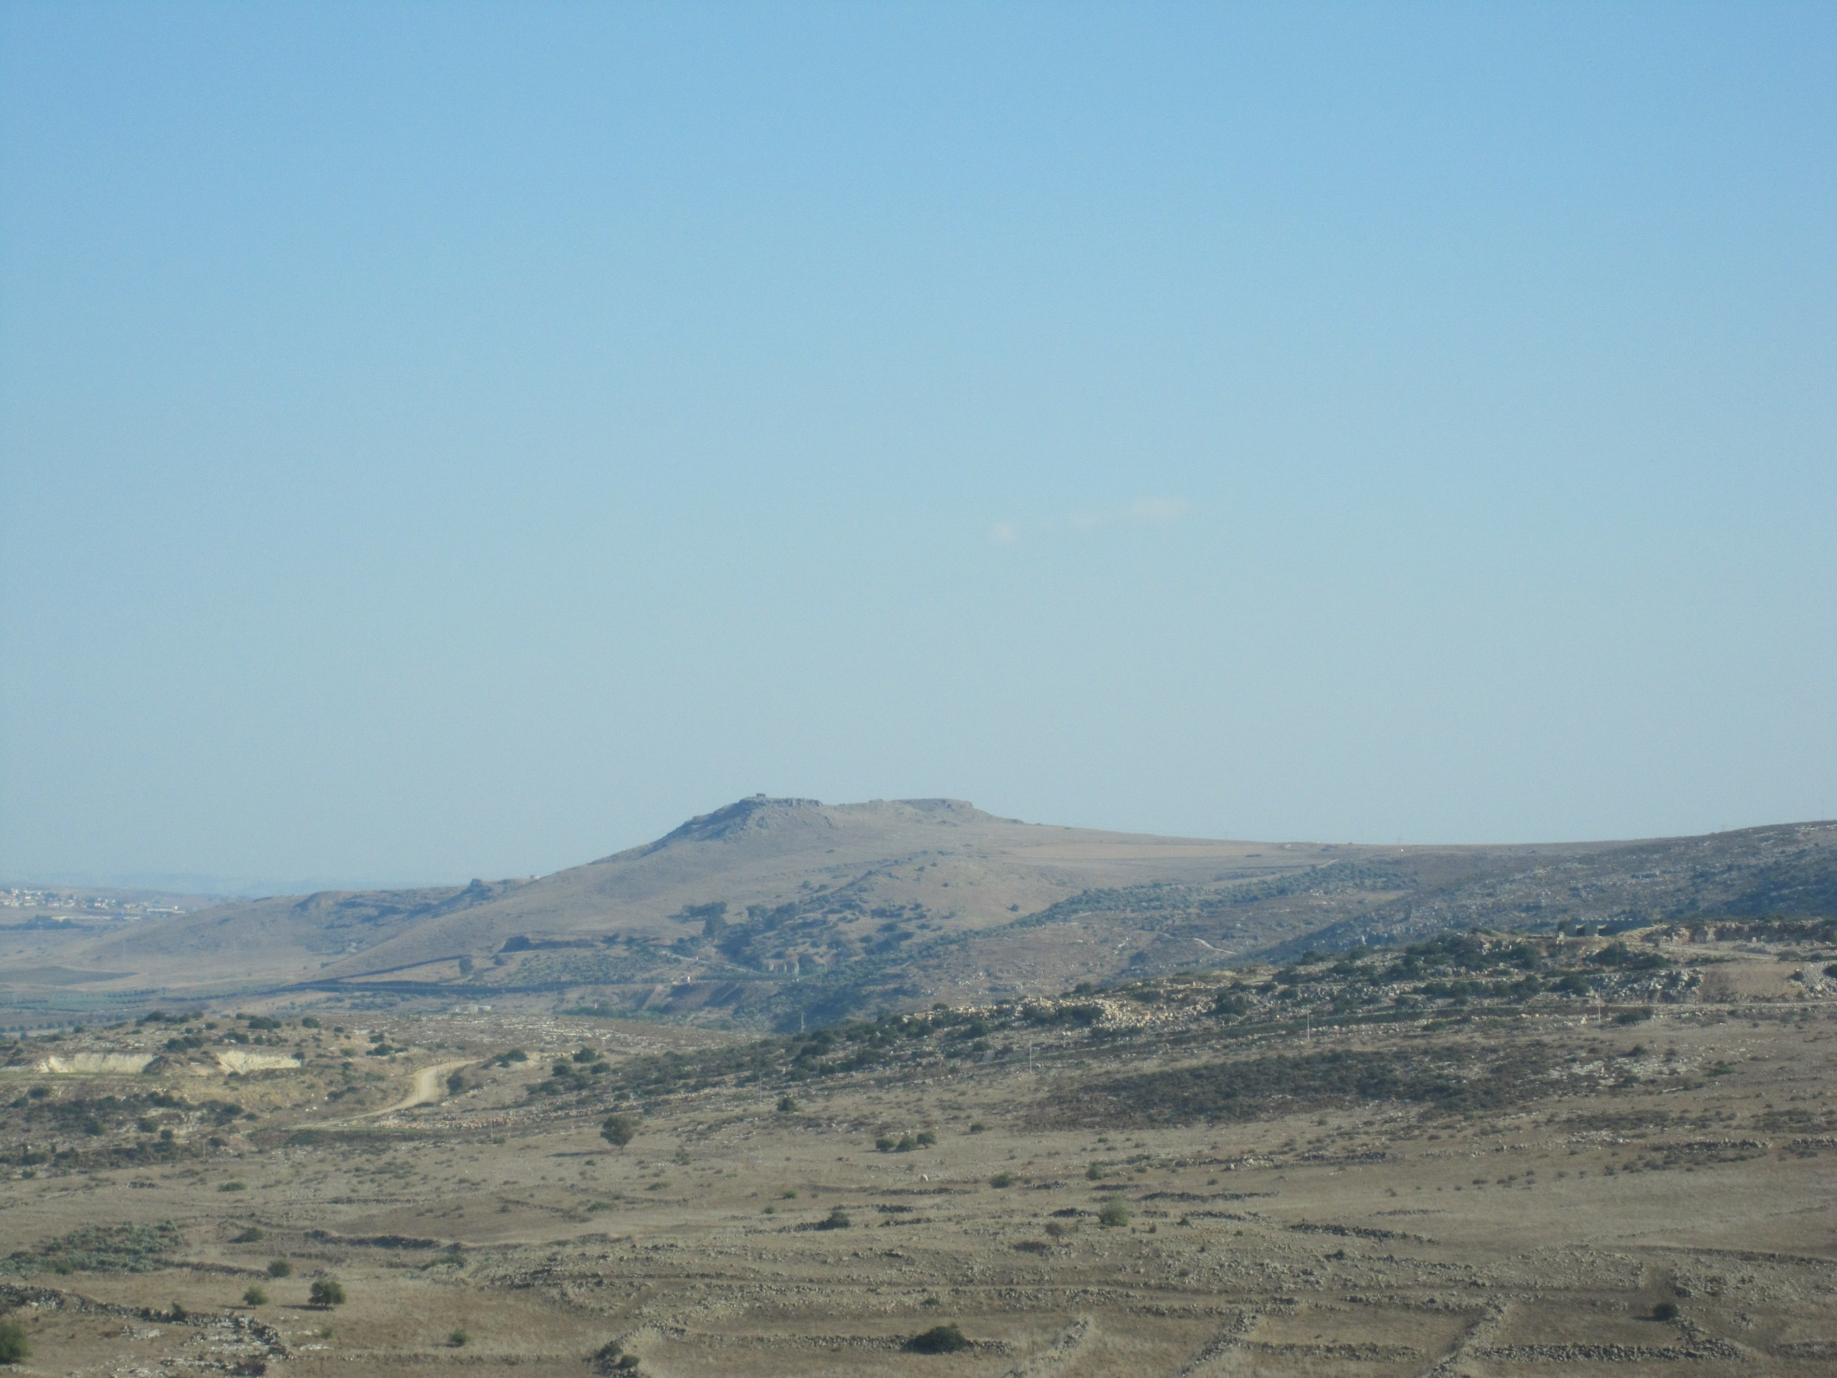
Boaz was able to act as Redeemer because –
He was QUALIFIED by relationship
He was ABLE by his riches
He was WILLING in his person
Ruth was wholly dependent on the
grace of Boaz who chose to redeem her
6

Slide 7
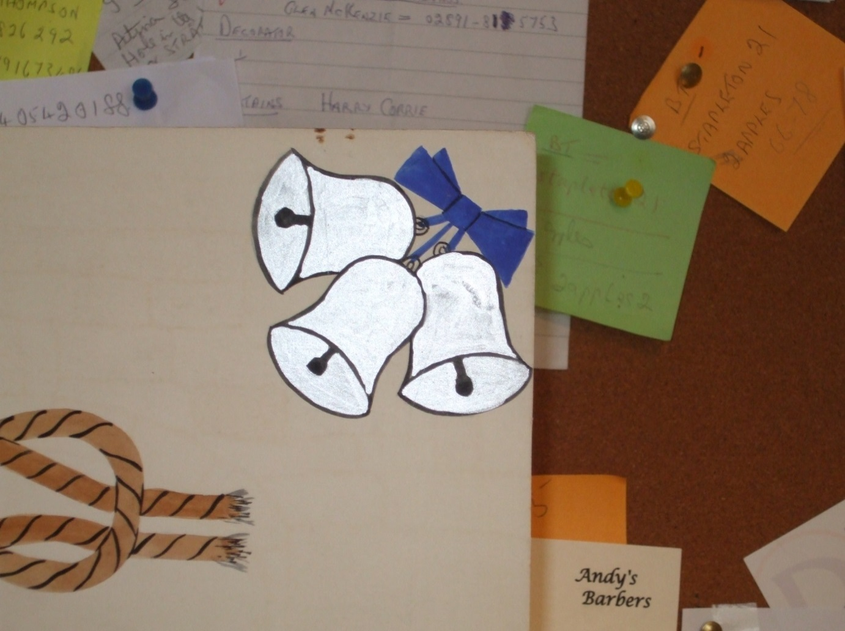
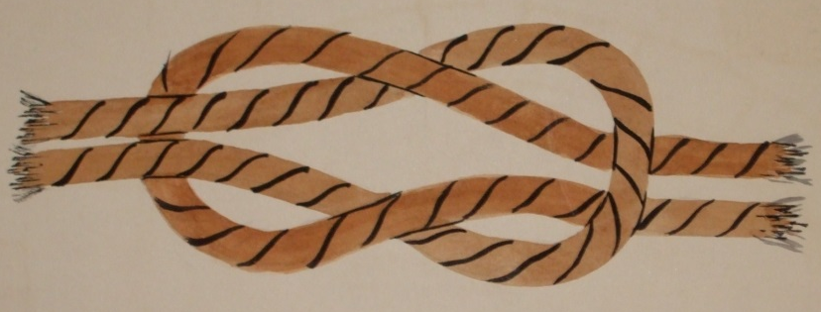
Ruth = Boaz
Obed
Jesse
DAVID
†
7

Slide 8
†
ABLE
WILLING
Job 19 vs.25-26
Titus 2 vs.13-14
QUALIFIED
8

