Slide 1
The following Biblical presentation is based on
notes and illustrations by the Rev L G Stapleton
compiled by
Mark Stapleton
© Mark Stapleton 2016
1

Slide 2
JUDGES
GOD
or
gods
2

Slide 3
1
Israel serves God
6
Israel is delivered
2
Israel falls into sin and idolatry
The ups and downs of the Book of Judges
5
God raises up a Judge
3
Israel is enslaved
4
Israel cries out to God
3

Slide 4
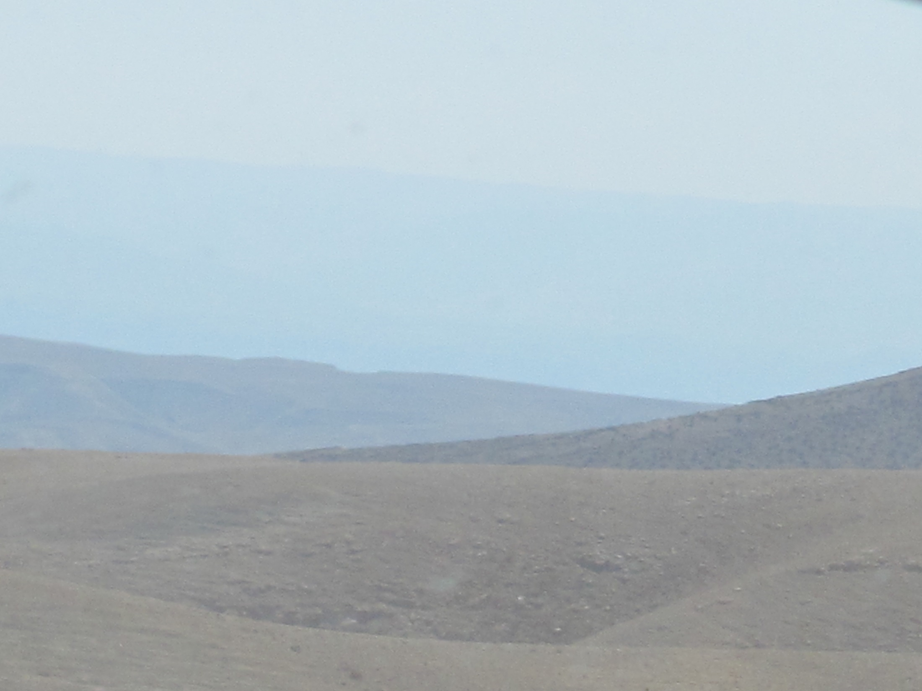
God raised up Judges
They were:
Leaders in battle
Rulers in peace
The Book of Judges covers about 300 years.
4

Slide 5
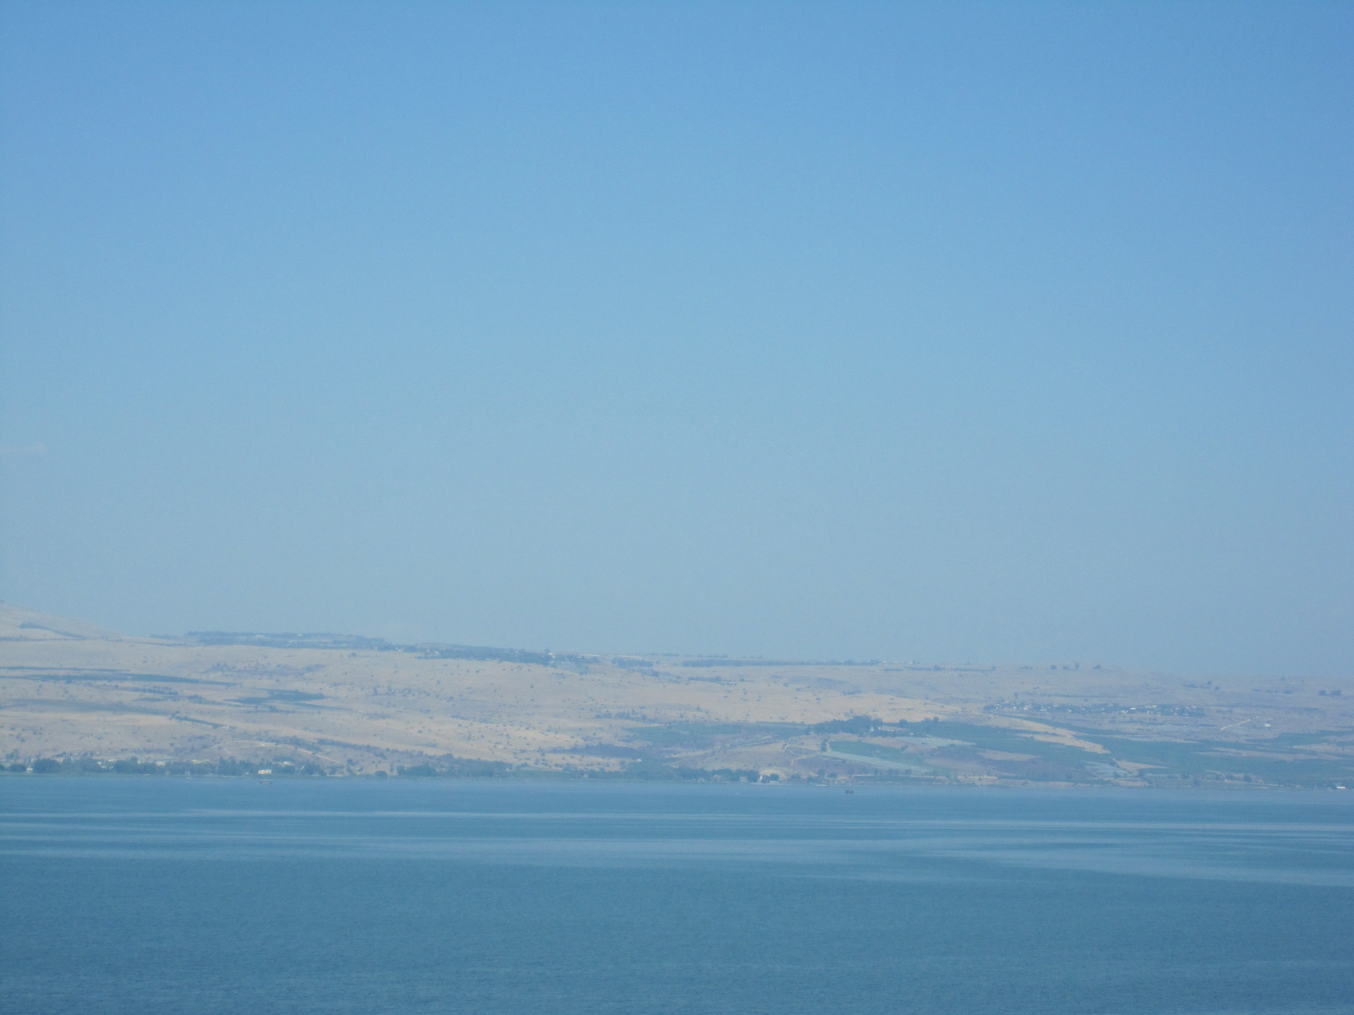
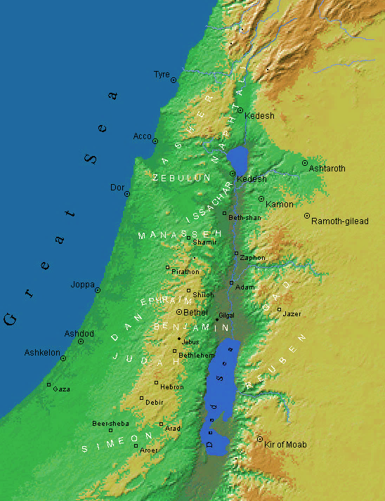
WHERE THE JUDGES LED AND RULED
Tola
Ch.10 v.1
Othniel
Ch.3 v.9
Elon
Ch.12 v.2
Jepthah
Ch.11 v.1
Deborah
Ch.4 v.4
Gideon
Ch.6 v.11
Jair
Ch.10 v.3
Ibzan
Ch.12 v.8
Abdon
Ch.12 v.13
Shamgar
Ch.3 v.31
Ehud
Ch.3 v.15
Samson
Chs.13-16
CARM MAPS
5

Slide 6


JUDGE DEBORAH
God gives victory to Israel;
the land has rest for 40 years
Chapter 4 v. 4 – chapter 5 v. 35
6

Slide 7
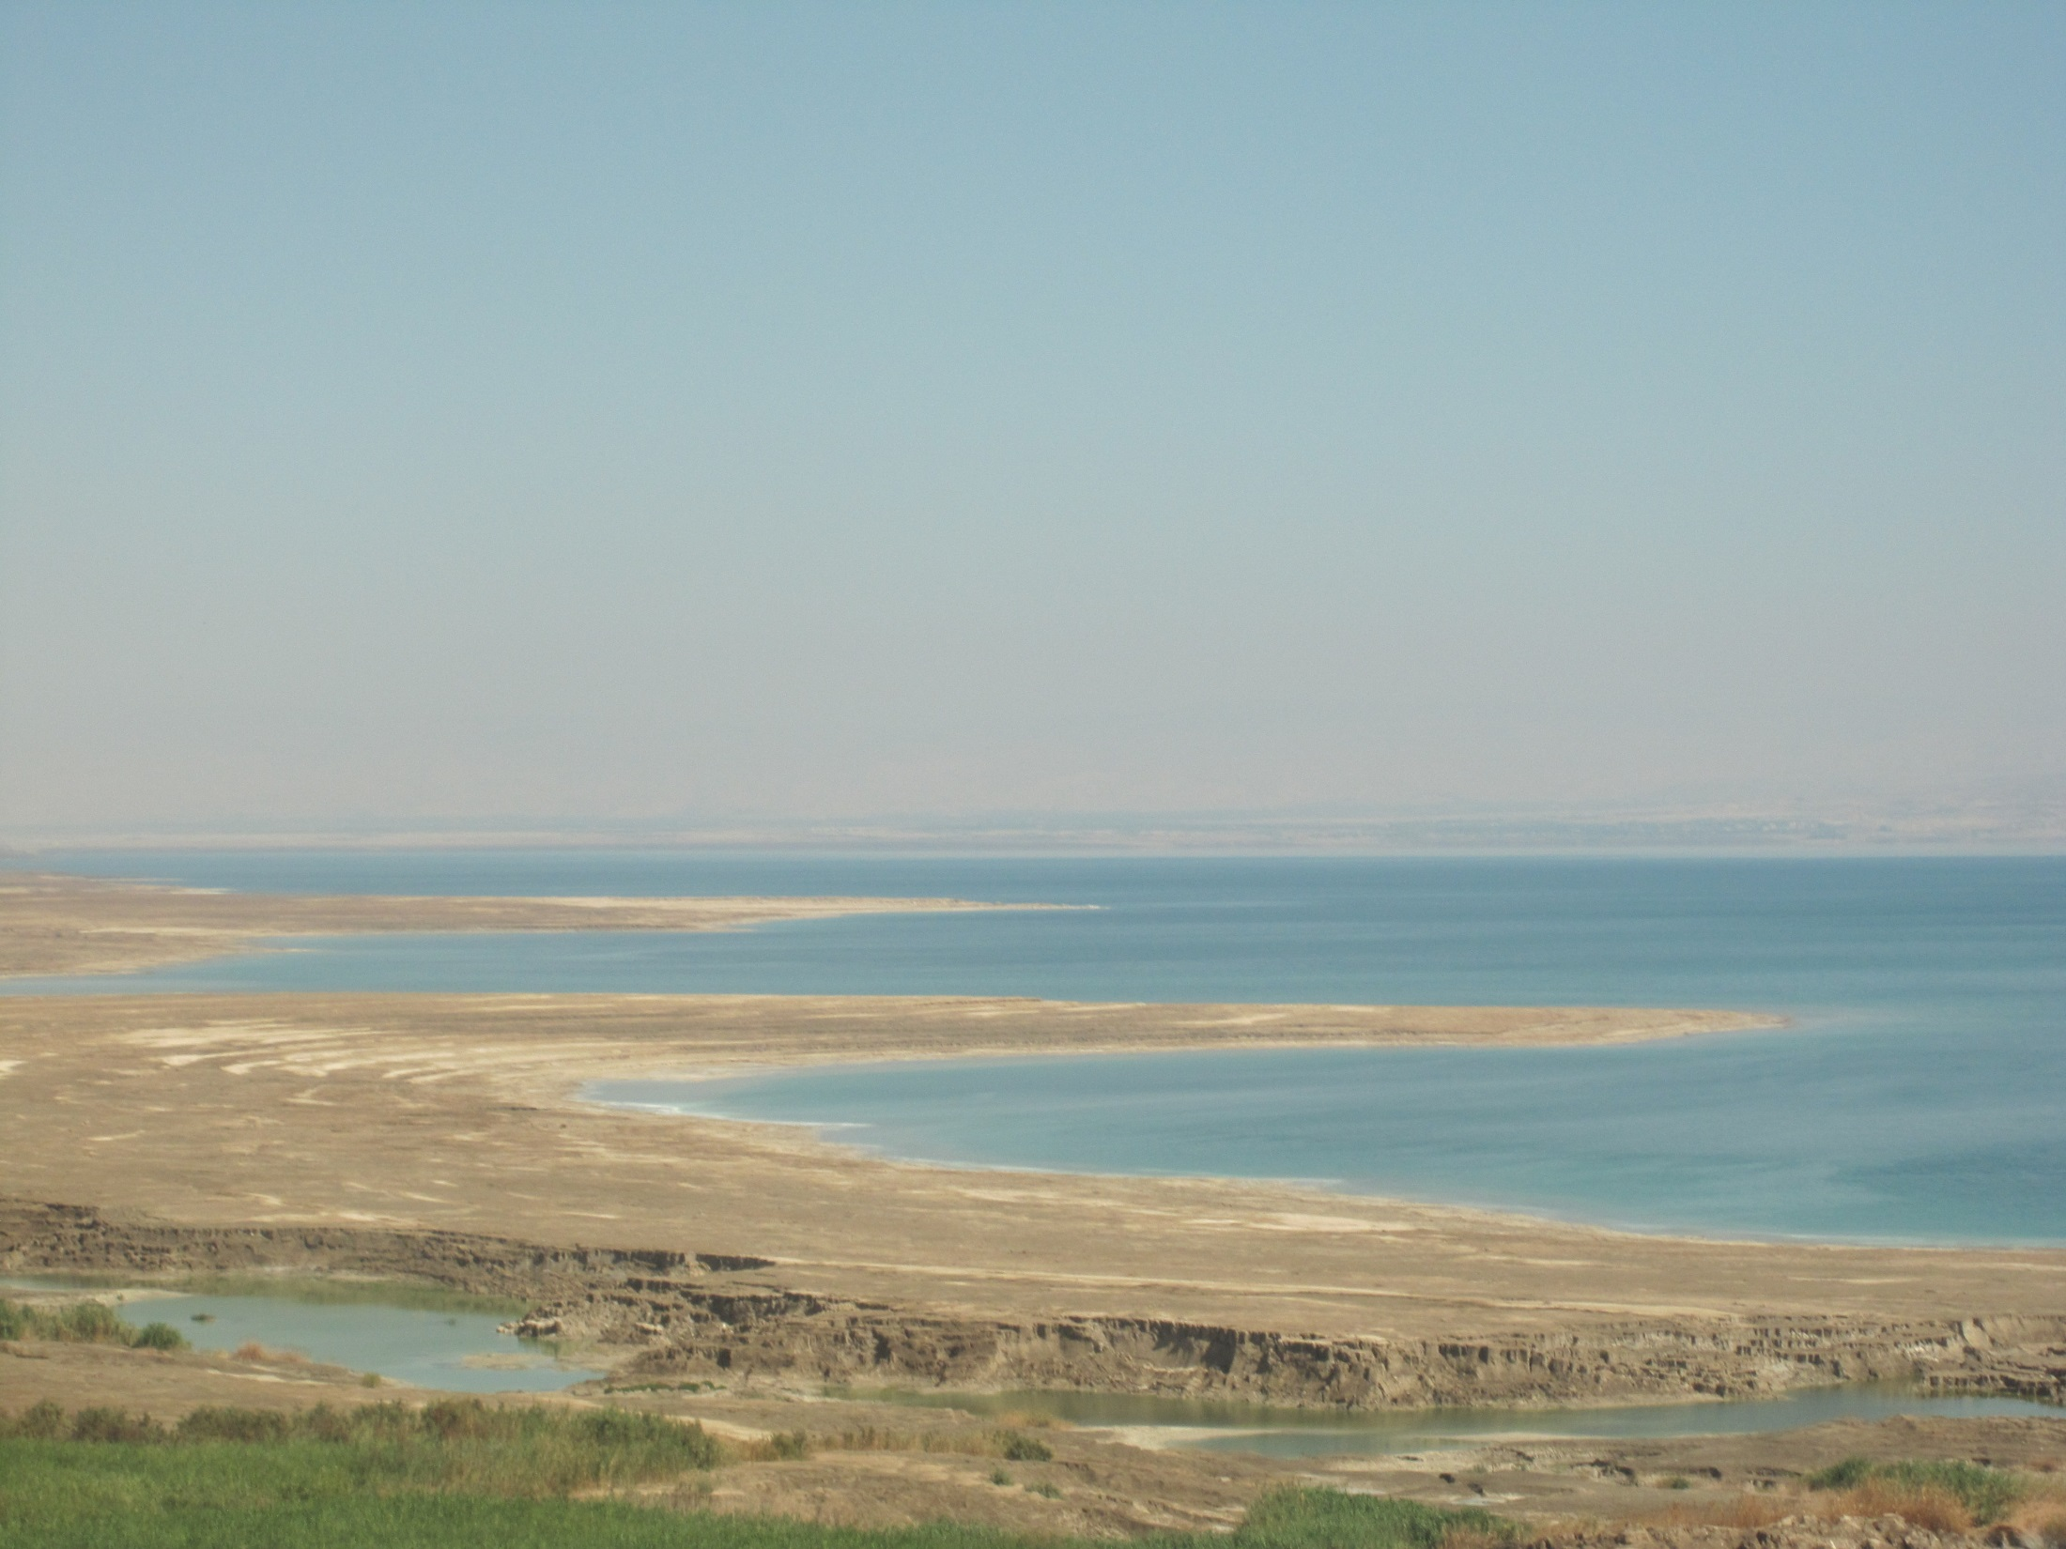

JUDGE GIDEON
GOD’S CHOSEN MAN
Chapter 7
GOD’S CHOSEN MEN
THE MIDIANITES
ISRAEL
32,000
TOO MANY!
ISRAEL 10000
MIDIANITES
MILLIONS
Afraid?
22,000 sent home
Tested at the water
9,700 sent home
7

Slide 8

JUDGE GIDEON
GOD’S CHOSEN MAN
Chapter 7
GOD’S CHOSEN MEN
THE MIDIANITES
MIDIANITES
MILLIONS
ISRAEL
300
God’s
Chosen
men
8

Slide 9
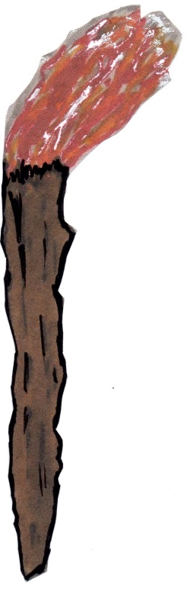
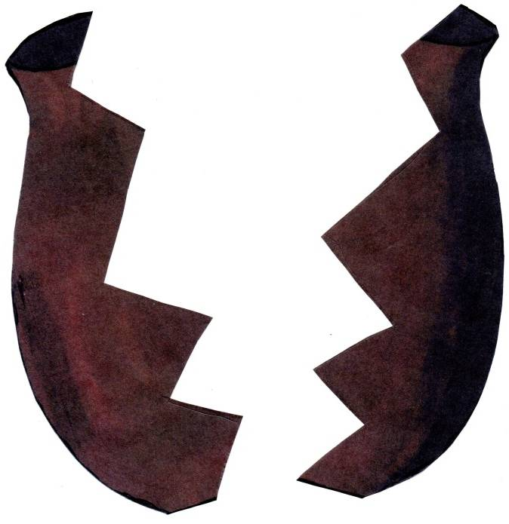

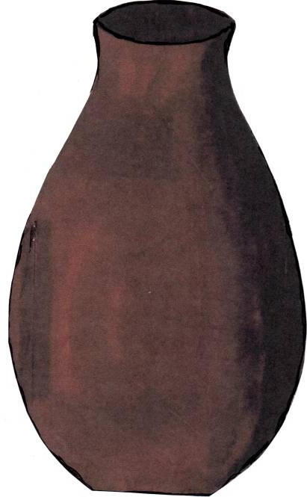
GOD’S
300 CHOSEN MEN
Gideon’s instructions:
Watch me
Copy me
9

Slide 10
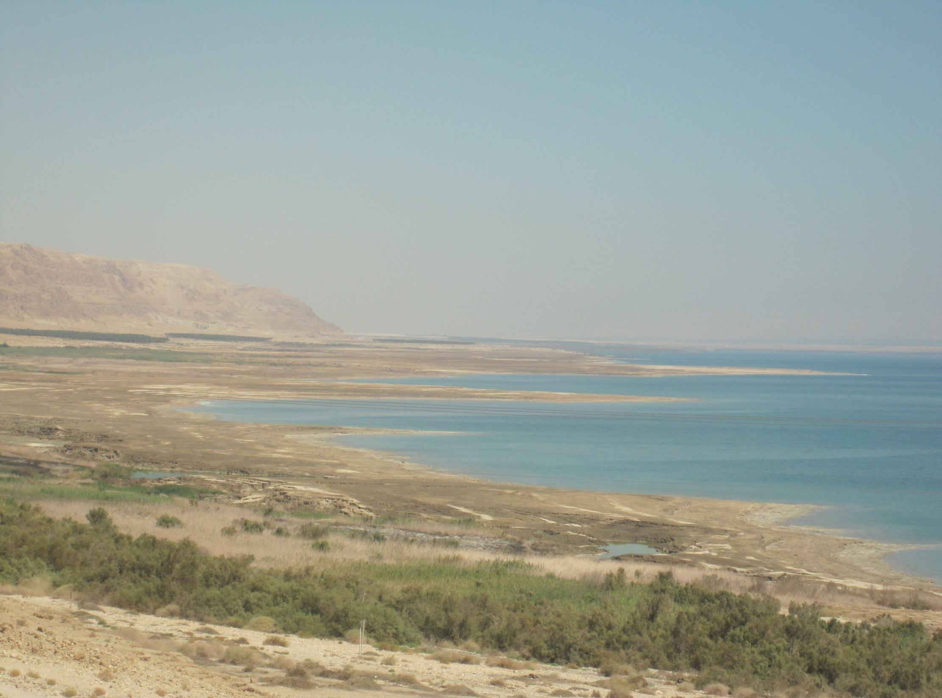
JUDGE SAMSON chapters 13 - 16
A NAZARITE FROM BIRTH
Chapter 13 v. 5
THE VOW
No wine
No unclean thing to be eaten
No hair to be cut
(see Numbers chapter 6)
10

Slide 11
11
JUDGE SAMSON
chapters 13 - 16
He became strong
His hair began to grow again

Slide 12
The book of ups and downs
JUDGEs
No continual leadership
No continual peace
No continual victory
…everyone did what was right in his own eyes
Judges 21 vs. 25
12

Slide 13
The Lord Jesus Christ has made peace for us for eternity through His death on the cross.
Romans 5 vs.1
†
The Christian life is to be ruled by Christ
“Right in his own eyes” is no motto for the Christian
13

