Slide 1
The following PowerPoint presentation has been assembled from notes and illustrations by the Rev L G Stapleton
compiled by The following Biblical presentation is based on notes and illustrations by the Rev L G Stapleton
compiled by
Mark Stapleton
© Mark Stapleton 2016
Mark Stapleton
© Mark Stapleton 2014
1

Slide 2
JOSHUA
A NEW LEADER
Deuteronomy 31 vs.23
A NEW LAND
(Canaan)
Joshua 1 vs. 1-4
2

Slide 3
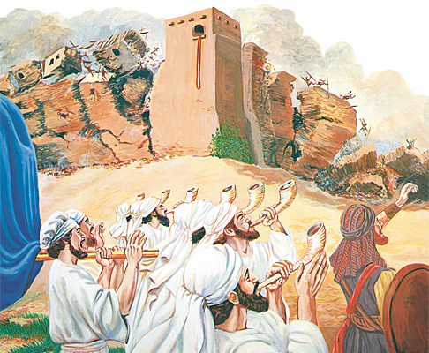
VICTORY THROUGH OBEDIENCE
AT
JERICHO
Joshua chapter 6
3

Slide 4
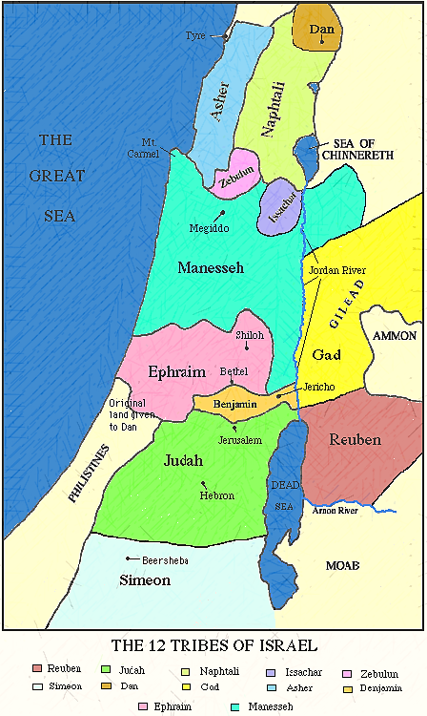
DEFEAT THROUGH DISOBEDIENCE
at
Ai
Manasseh
Manasseh
•Ai
Achan (Trouble) and his sin
Joshua chapter 7
4

Slide 5
The New Land divided among the 12 tribes of Israel
Chapters 13 - 19
Kedesh
9 ½ tribes on the West of the Jordan River
Golan
2 ½ tribes on the East of the Jordan River
6 Cities of refuge -
Chapter 21
Ramoth
Manasseh
Shechem
Bezer
Hebron
5

Slide 6
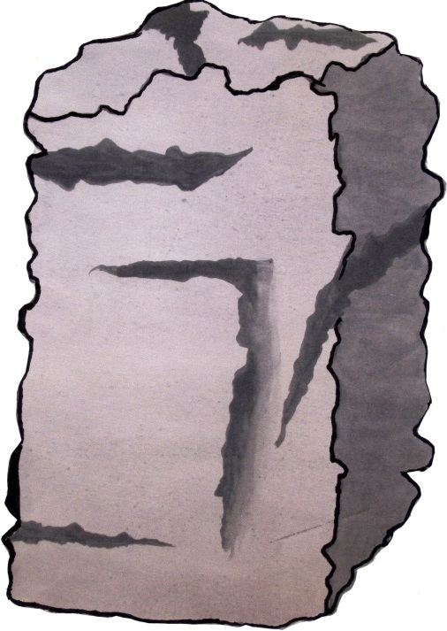
The Stone of Witness.
What God said to His people, through Joshua.
Chapter 24 vs. 2 - 16
“ …choose for yourselves this day whom you will serve…” (v. 15)
The people’s response -
“No, but we will serve the LORD!”.
Verse 21.
The people’s response -
“The LORD our God we will serve, and His voice we will obey!”
Verse 24.
6

Slide 7
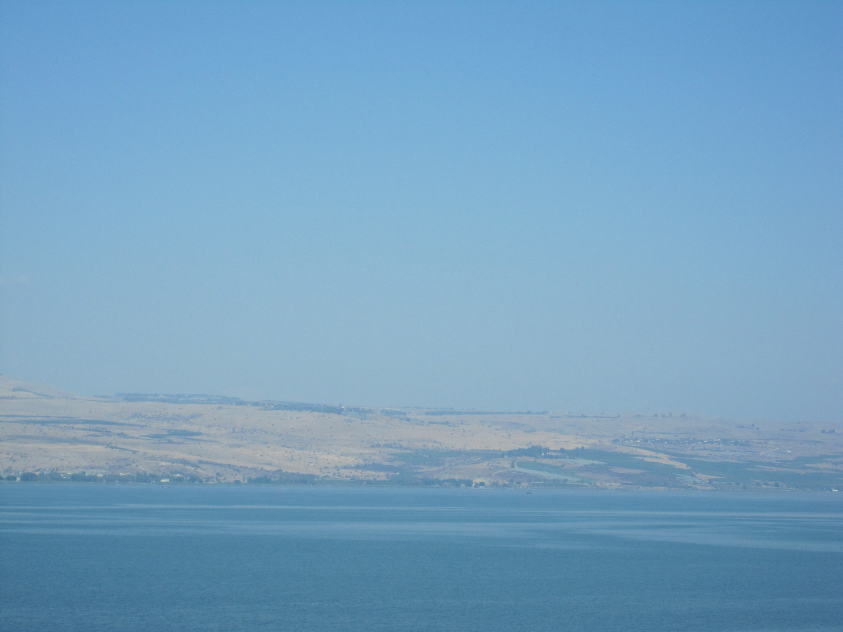
Joshua’s testimony to –
in crossing the Jordan
Ch. 3 v.10
in supplying the manna Ch. 5 v.12
in ALL that He said He would do Ch. 20
v.14
God’s
faithfulness
in establishing refuge cities
Ch. 20 v.7-8
in giving victory over enemies Ch. 5
v.13-15
7

Slide 8
The name JOSHUA in the Old Testament means Salvation. (Hebrews 4 vs.8)
†
Joshua’s testimony to God’s faithfulness is guaranteed in the cross - 2 Corinthians 1 v.20
This is the same name as JESUS in the New Testament, which means – Saviour
(Matthew 1 vs. 21)
God’s promise of His continual presence.
Our Lord’s promise of Matthew 28 v.20
8

