Slide 1
The following Biblical presentation is based on notes and illustrations by the Rev L G Stapleton
compiled by
Mark Stapleton
© Mark Stapleton 2016
1

Slide 2
The last of five books of the Law known as the PENTATEUCH
The 2nd reading of the Law by Moses
The generation who were present at the first reading of the Law were now dead
(except Joshua and Caleb)
DEUTERONOMY
2

Slide 3
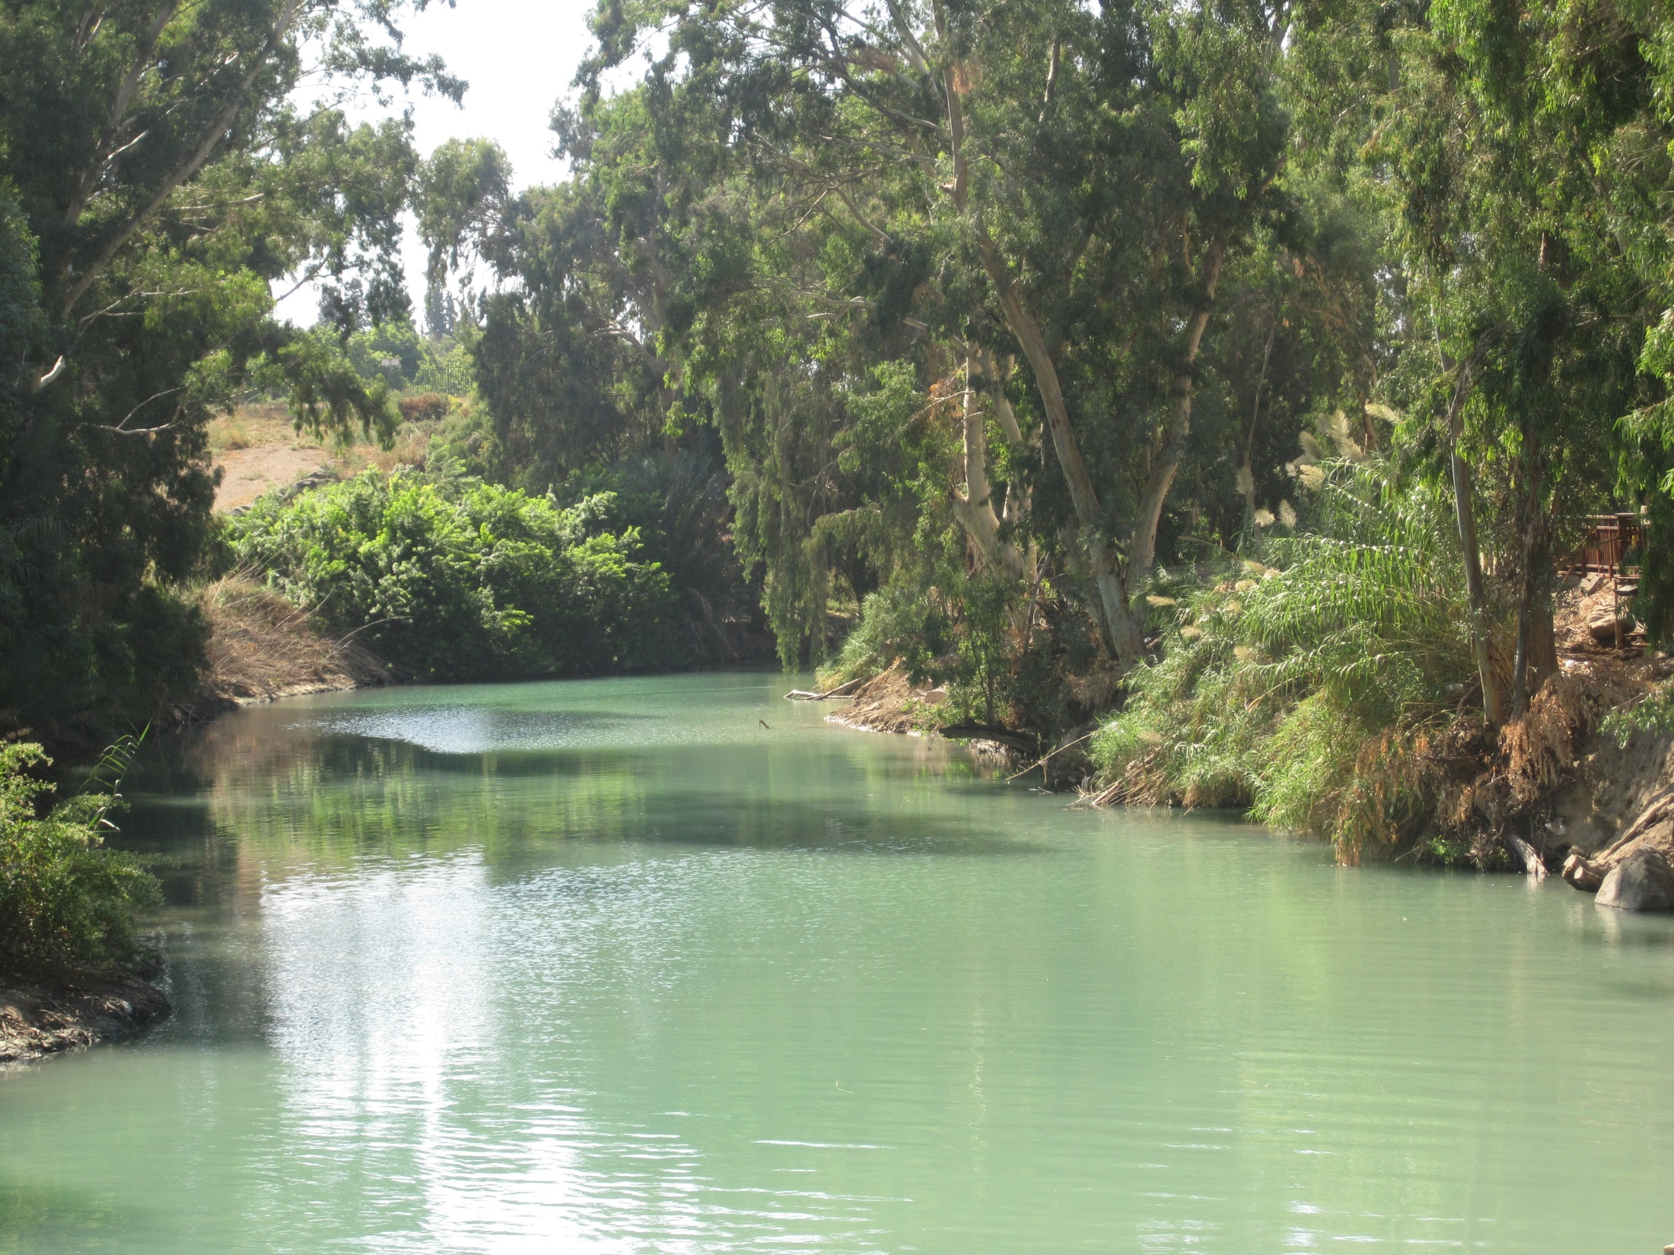

The River Jordon was an important place in the history of Israel
It represented the change from Egypt to Canaan
(Chapters 1, 4, 6, 31)
EGYPT
CANAAN
3

Slide 4

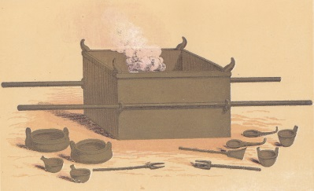


Deuteronomy sums up the three previous books:
Exodus – THE WAY OUT – of Egypt (Deut. 6 v.12)
Leviticus – THE WAY IN – to God’s presence, worship and how we can be right with God (Deut. 12)
Numbers – THE WAY THROUGH – the wilderness (Deut. 8 v.2)
4

Slide 5
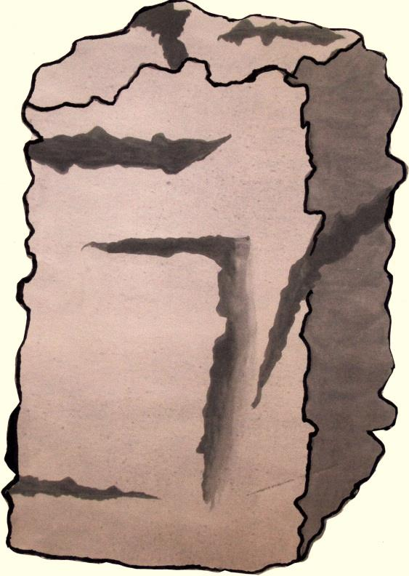
Remember
Obey
Deuteronomy
Chapter 6
Deuteronomy
Chapter 5
The SHEMA – the great Commandment - learnt by Jewish children from earliest years. Looking back to bondage and redemption
The TEN COMMANDMENTS – rules for knowing God’s blessing and protection.
Obedience rests on love to God.
Originally given in Exodus ch. 20
5

Slide 6
Fruitfulness
Ch. 11 vs. 13-25
The coming Messiah
Ch. 18 v. 15
Security
Ch. 33 v. 12
GREAT PROMISES
Daily strength
Ch. 33 v. 23
God’s continual care
Ch. 33 v. 27
God’s protection and power
Ch. 33 v. 27
6

Slide 7
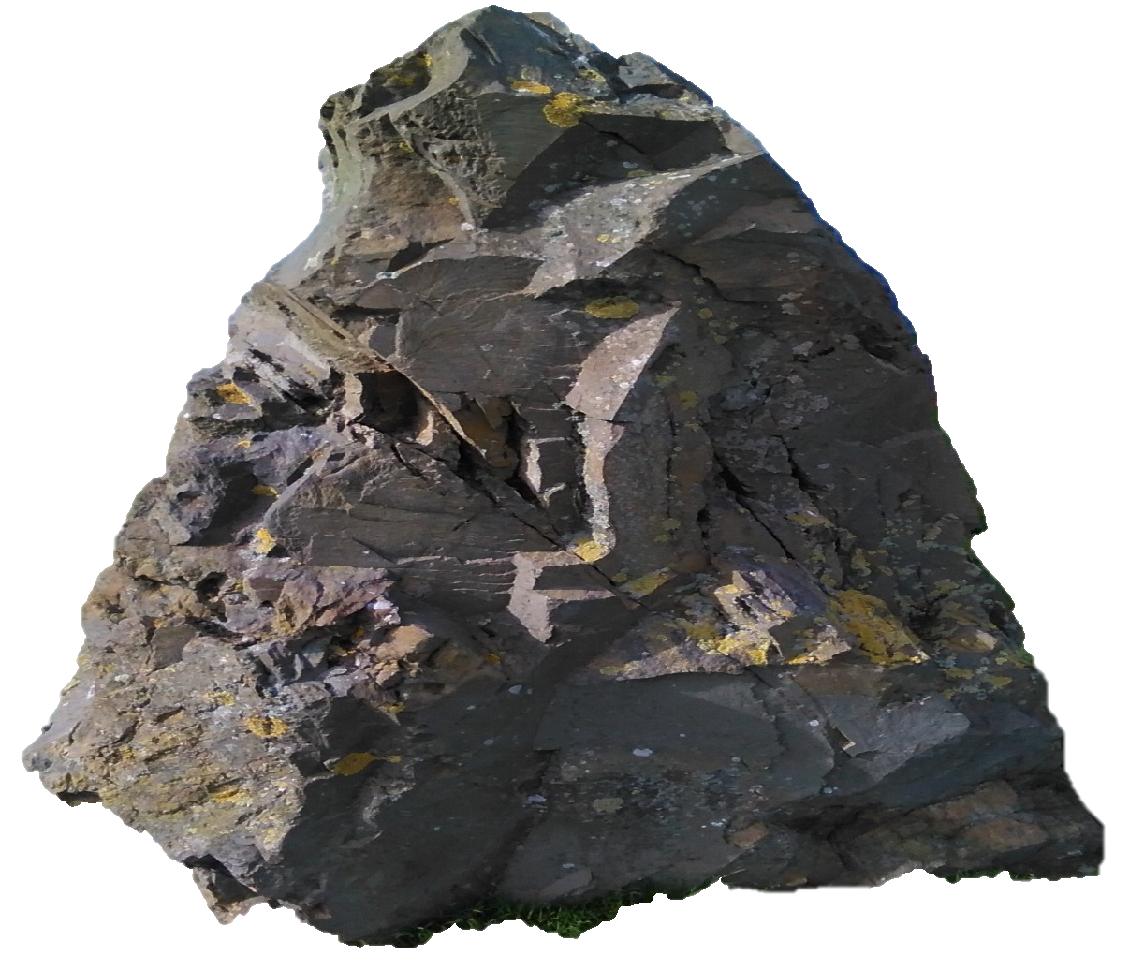
†
God is referred to as
THE ROCK
Deuteronomy 32 vs. 4, 15 and 18
In the New Testament
THE ROCK is spoken of as being the LORD JESUS CHRIST
1 Corinthians 10 vs.4
7

