Slide 1
The following Biblical presentation based on notes and illustrations by the Rev L G Stapleton
compiled by
Mark Stapleton
© Mark Stapleton 2016
1

Slide 2
NUMBERS
5
Priests
5830
Carters
5
Packers
2750
Carriers
12
Princes
603550
Soldiers
12
Captains
70
Elders
The Hebrew name for the book means:
“In the wilderness”
2

Slide 3


God is orderly
The people of Israel were to move in an orderly and disciplined way.
The signals to move were -
The cloud – moved by God
(Numbers 9 vs.15-16, 21-23)
The Silver Trumpets – blown by the priests (Numbers 10 vs. 1-4)
3

Slide 4
God is orderly
The order of the camp
Chapter 2
NORTH
MANASSEH EPHRAIM BENJAMIN
ISSACHAR JUDAH ZEBULUN
ASHER DAN NAPHTALI
MOSES AARON PRIESTS
GERSHONITES
MERARITES
WEST
TABERNACLE
EAST
KOHATHITES
SIMEON REUBEN GAD
SOUTH
4

Slide 5
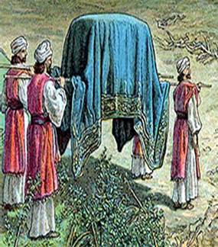
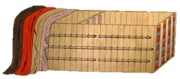
God is orderly
The order of the march
Chapter 10
Dan
Asher
Naphtali
Ephraim
Manasseh
Benjamin
The Holy furniture
carried by
Kohathites
Reuben
Simeon
Gad
Tabernacle
on carts -
Gershonites
Merarites
Issachar
Judah
Zebulun
❻
❺
❹
❸
❷
❶
5

Slide 6
THE SPIES
One from each of the 12 tribes
⬇
Caleb and Joshua gave a good report
⬇
Ten spies gave a bad report
⬇
Israel’s unbelief and disobedience brought 40 years of wandering
in the wilderness
(1 year for each of the 40 days the spies visited Canaan)
Numbers chapters 13-14
6
Notes:
40 years – 1 year for each of the 40 days of spying

Slide 7
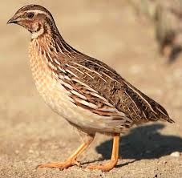
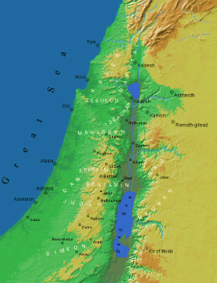

God Provides
Quails and Manna provided
(Numbers 11)
Promised Land provided
(Numbers 14 vs.26 - 31)
A leader provided
(Numbers 27 vs.15-23)
Water provided
(Numbers 20 vs.11)
Joshua
7

Slide 8
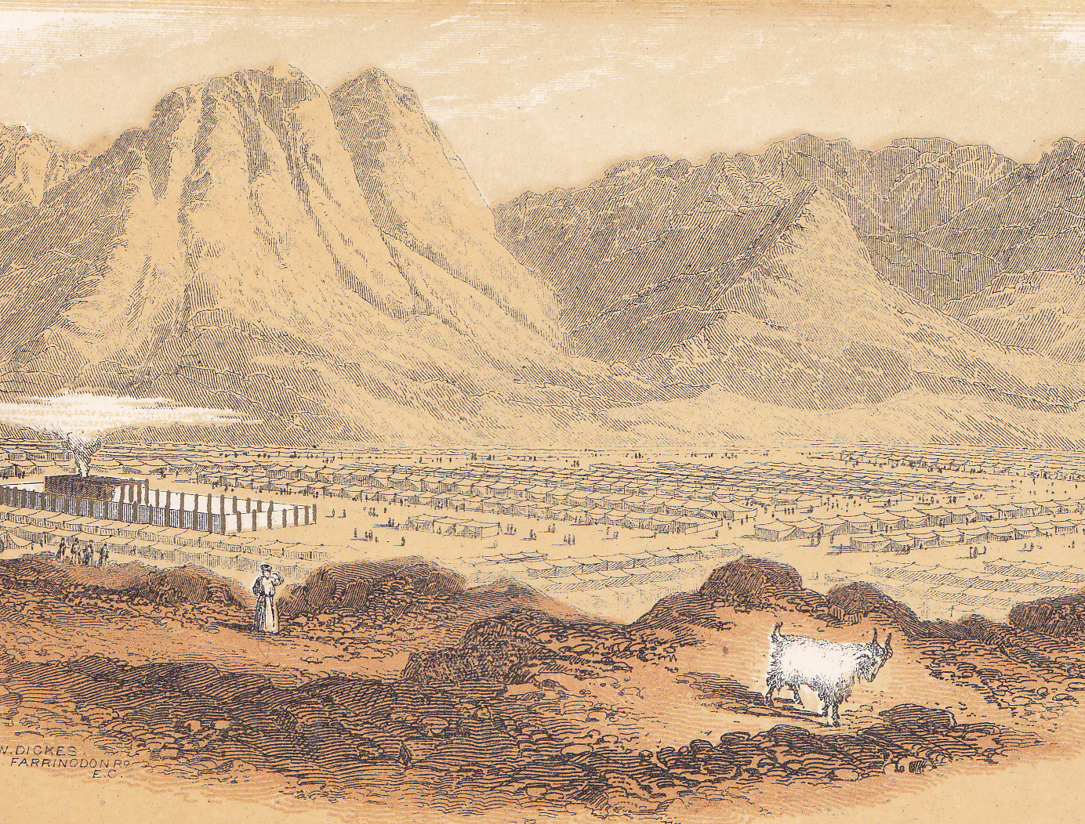
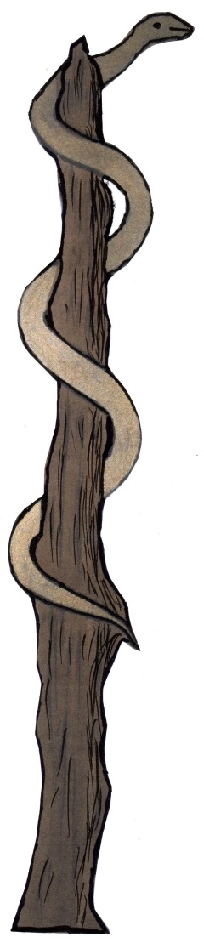
God delivers
Numbers 21 vs.7-9 + John 3 vs.14
8

Slide 9

Numbers 24 vs.17
†
God’s Delivers us
The promise of the Messiah
John 3 vs. 16
9

