Slide 1
The following Bible presentation is based on notes and illustrations by the
Rev L G Stapleton
The picture of the Tabernacle is taken from the CANDLE BOOKS – ‘Essential Bible Reference Series’ – ‘The Tabernacle’ by Tim Dowley,- permission applied for.
Compiled by
Mark Stapleton
©Mark Stapleton 2016
1

Slide 2
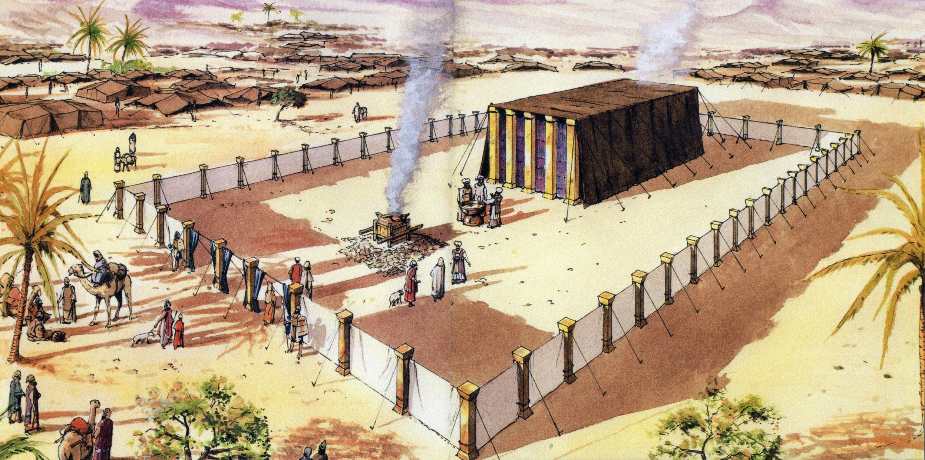
LEVITICUS
2

Slide 3
LEVITICUS
3
The 12 sons of Israel
The Tribe of Levi = the Priestly Tribe, looked after the Tabernacle (later the Temple)
The family of Aaron was set aside
to be Priests
Aaron, the brother of Moses, was set aside as the first High Priest
The High Priest was allowed to enter the most Holy Place in the Tabernacle, and this only once a year

Slide 4
THE MESSAGE
Man is sinful
God is Holy
How can man be “at one” with God ?
Man can be in fellowship with God
4

Slide 5
THE CONTENT
5
The Offerings,
consecration of the Priests
Chapters 1 – 8
Priestly ministry begins
Chapters 9 - 10
Forbidden contacts and forbidden foods
Chapters 11 - 15
Day of Atonement
Chapters 16 - 17
Moral and ceremonial law, qualifications and conduct of Priests
Chapters 18 - 22
The feasts, and care of the Tabernacle
Chapters 23 - 24
7th year, year of jubilee, slavery, redemption of property, lending
Chapter 25
Promise of blessing and retribution
Chapter 26
Further laws about redemption and property
Chapter 27
6

Slide 6
God’s Holiness
Man fails to reach God’s standard.
Any approach to God means we must -
6

Slide 7
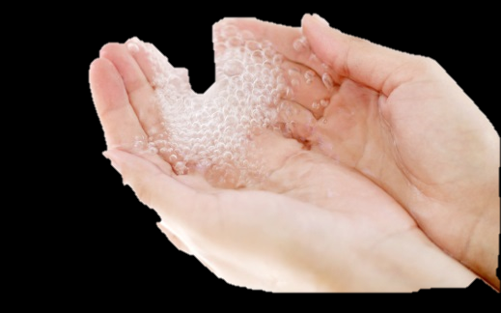
Three things (among others) that stop us coming into God’s Holy presence -
1
Unclean hands – Psalm 24 vs.4.
What we do.
7

Slide 8
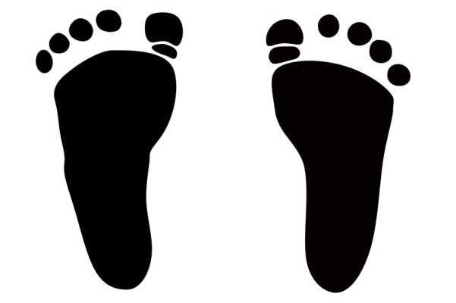
Three things (among others) that stop us coming into God’s Holy presence -
2
Straying feet – Isaiah 53 vs.6,
Proverbs 1 vs. 10, 16.
Where we go.
8

Slide 9
Three things (among others) that stop us coming into God’s Holy presence -
3
Unclean heart –
Psalm 24 vs.4, Jeremiah 17 vs.9.
What we are.
9

Slide 10
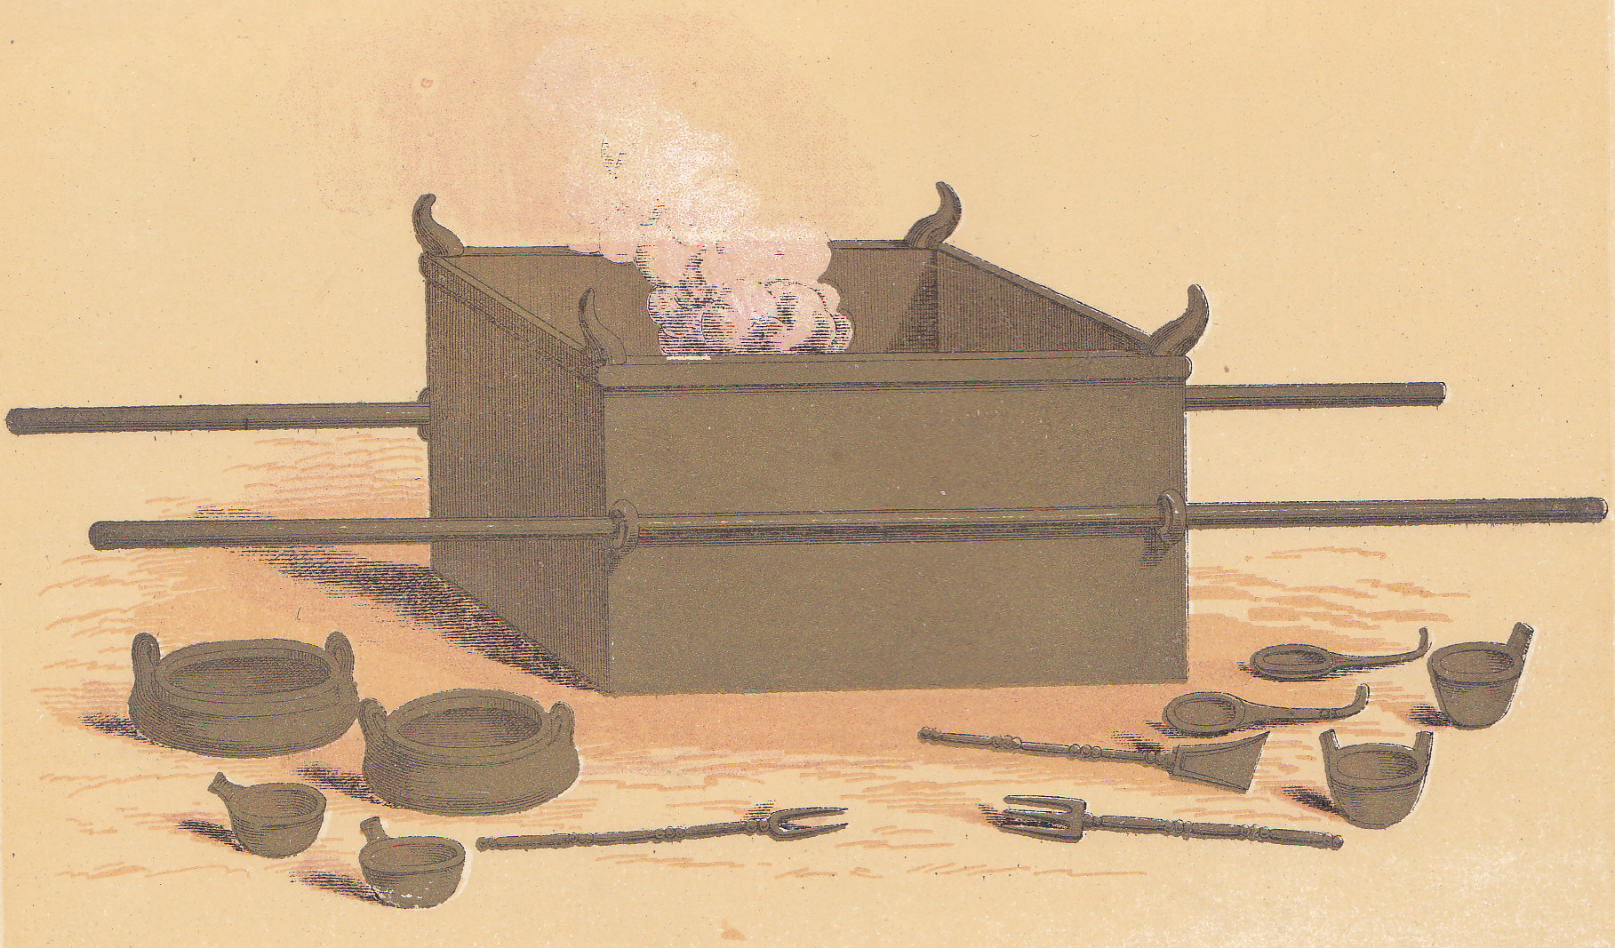
God’s provision for His people
SACRIFICES OFFERED AT THE BRONZE ALTAR
BULLOCK
Ch. 4 v. 3,14
SHEEP
Ch. 5 v. 6
TWO PIGEONS
Ch. 5 v.7
…without shedding of blood
there is no remission.
Hebrews 9 vs.22
10

Slide 11
No longer an altar
no MORE animal sacrifices
†
UNCLEAN HANDS
ALL SIN
THE ATONEMENT
“Behold! The Lamb of God who takes away the sin of the world!”
John 1 vs.29
STRAYING FEET
UNCLEAN HEARTS
…the blood of Jesus Christ His (God’s) Son cleanses us from all sin
1 John 1 vs. 7
11

