Slide 1
bb
The following Bible presentation is based on notes and illustrations by the
Rev L G Stapleton
The picture of the Tabernacle is taken from the CANDLE BOOKS – ‘Essential Bible Reference Series’ – ‘The Tabernacle’ by Tim Dowley - permission applied for.
Compiled by
Mark Stapleton
©Mark Stapleton 2016
1

Slide 2
EXODUS
THE BOOK OF
THE WAY OUT
OF EGYPT
2

Slide 3
The main events of the book:
The slavery of the people of Israel in Egypt.
(Chapter 1)
God appoints Moses as leader of the people (Chapter 3)
The ten plagues against Pharaoh (Chapters 7 – 11)
The Passover meal (Chapter 12) and the Exodus from Egypt (Chapters 13-14)
God gives the Ten Commandments to Moses.
(Chapter 20)
Records most of the life of Moses (120 yrs.) – the God-given leader for the
GOING OUT
The record of the plans and building of the Tabernacle
(Chapters 25 – 40)
3

Slide 4
The words of Moses could be written over the whole book:
“He brought us out … that He might bring us in.”
Deuteronomy 6 vs.23
4

Slide 5
The way out of:-
A foreign country
A condition of slavery
A place of death
5

Slide 6
The way into:-
The new land of Canaan
God’s purpose for Israel was to bring them into a fruitful place. It was to be their own possession.
Colossians 1 vs.13
6

Slide 7
The way into:-
Liberty
God’s purpose for Israel was that they should have liberty. They were to be a free people, a nation in their own right.
John 8 vs.36
7

Slide 8
The way into:-
A new life
God’s purpose for Israel was that they should come into a new life.
Hebrews 2 vs.14-15
8

Slide 9
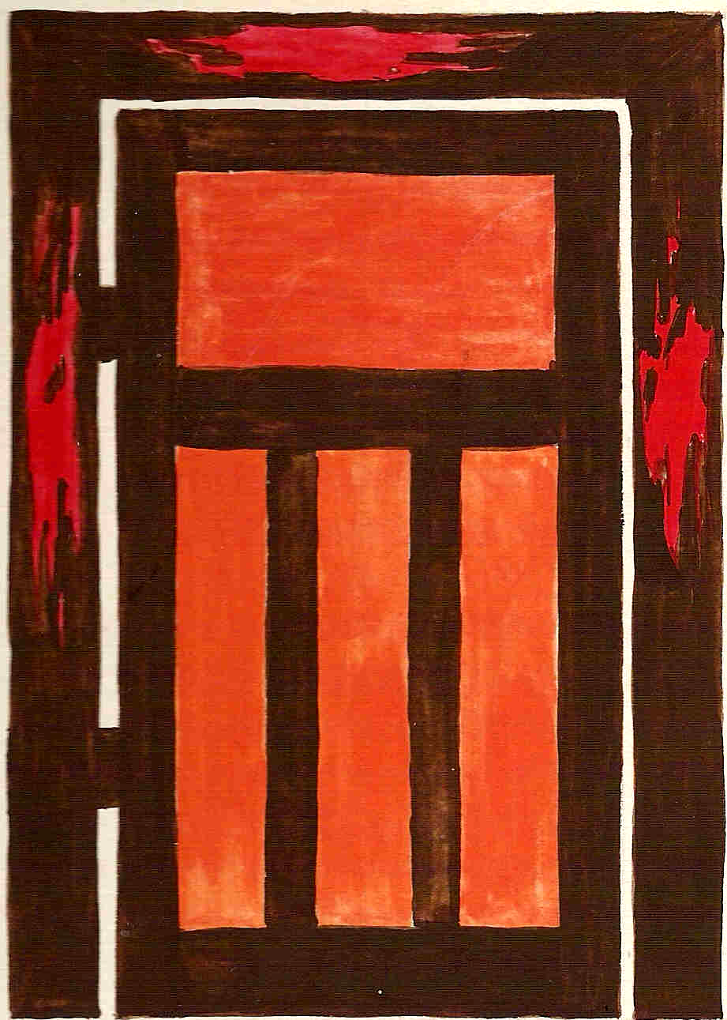
The way through
  The Passover - Exodus 12
Everyone who left Egypt had to pass
through the blood.
1 Corinthians 5 vs.7
9

Slide 10
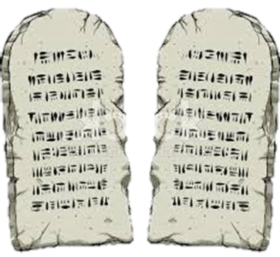
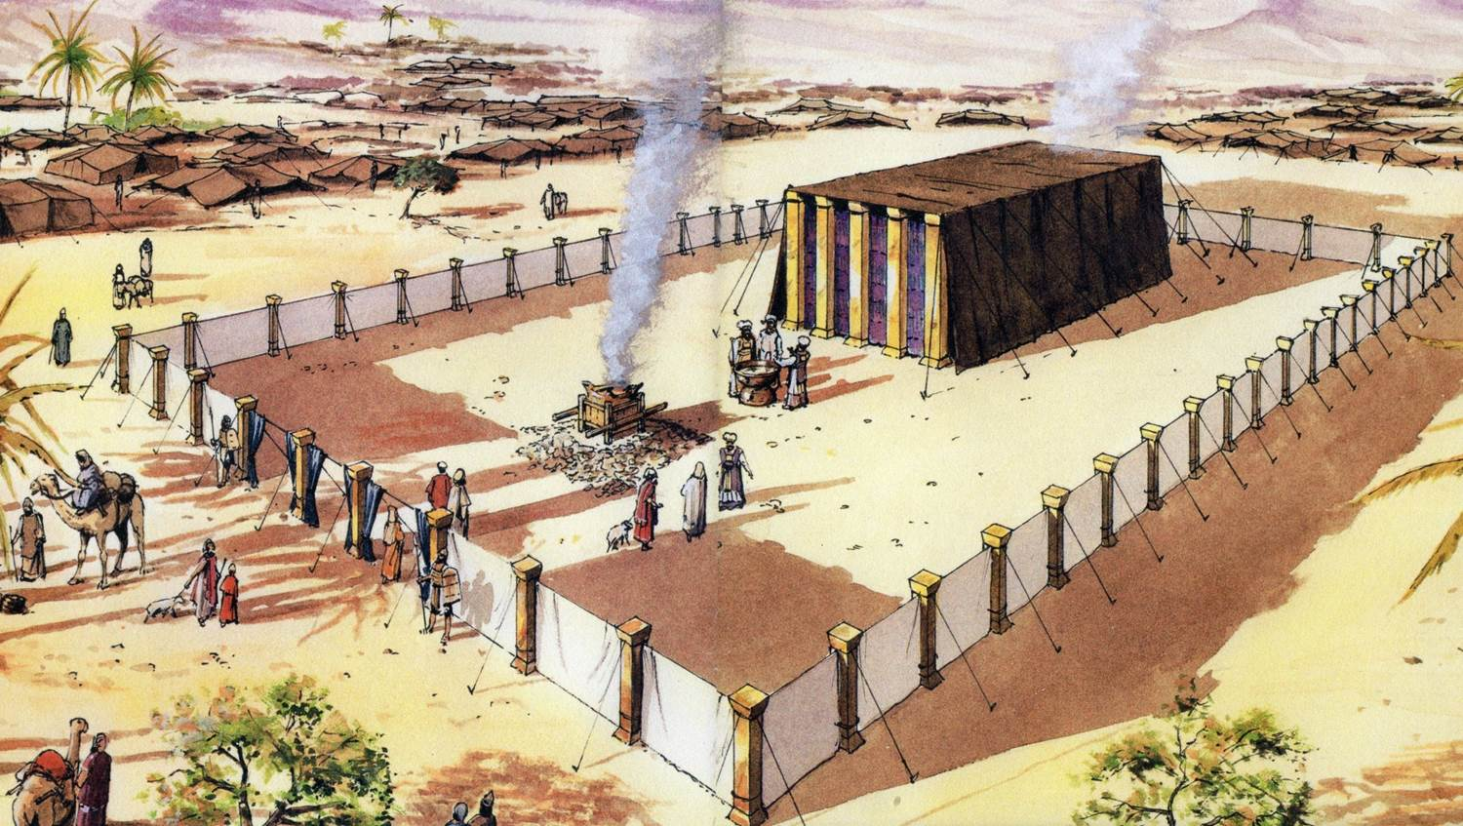
The way through
God gave them the
Ten Commandments
to obey
In their new life, the people of Israel were to experience fellowship with God at the Tabernacle
10

Slide 11
The way through
†
John 11 vs.15
11
Notes:
The Cross is our door. We come out of spiritual Egypt (old life) and into our spiritual Canaan, through the Cross alone.
Nobody can come any other way. We must now observe John 14 vs.15.

