Slide 1
The following Biblical presentation is based on notes and illustrations by the Rev L G Stapleton compiled by
Mark Stapleton
© Mark Stapleton 2016
1

Slide 2
GENESIS
God is at the heart of all things
Genesis 1 v. 1
A book of revelation
2 Peter 1 v. 21
God is the
self- existent one
No-one can finally explain God
God is the only Creator
2

Slide 3

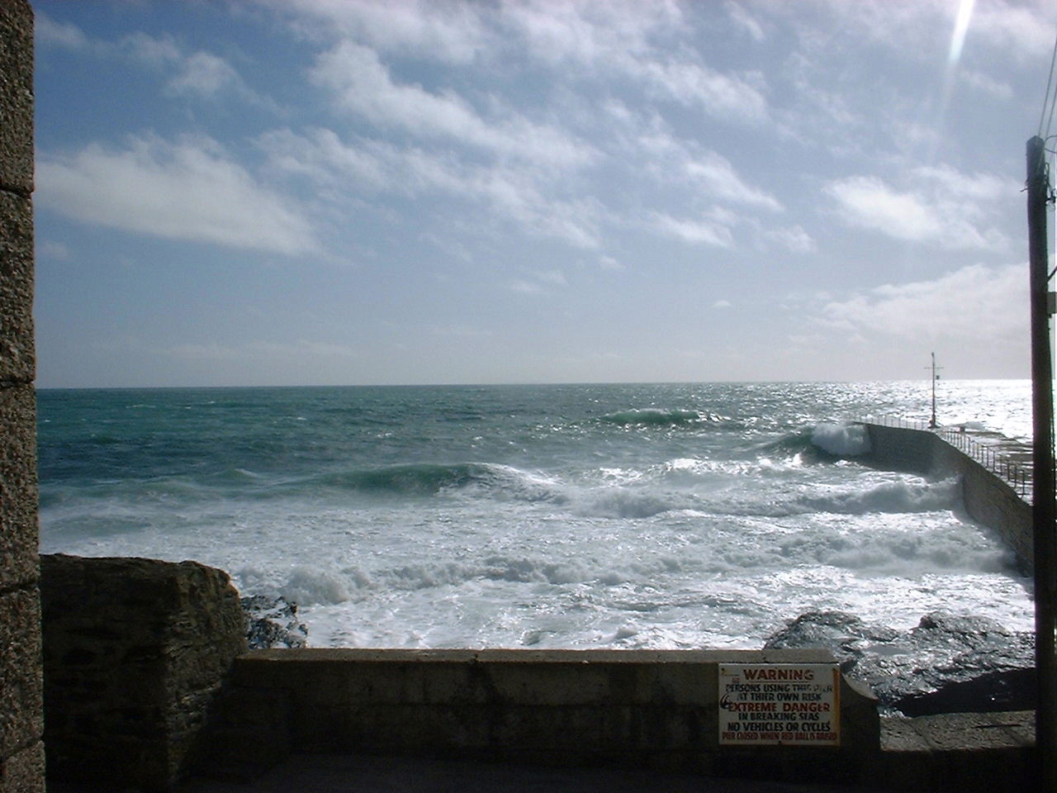



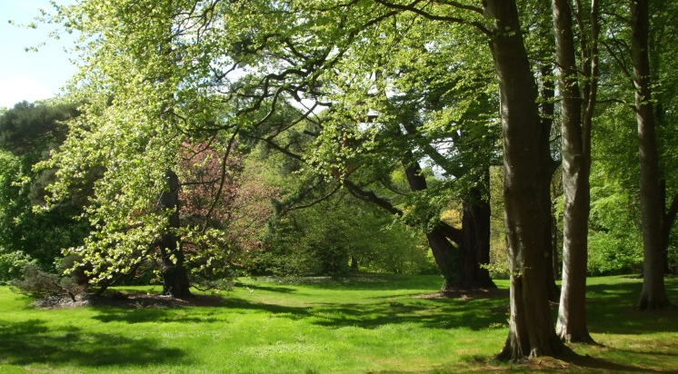
MAN
3
⑥
⑤
④
①
②
③

Slide 4
DAY

Then God blessed the seventh day and sanctified it, because in it He rested from all His work which God had created and made. Ch. 2 v. 3
See also – Exodus 20 v. 8,
Isaiah 58 v. 13
4

Slide 5
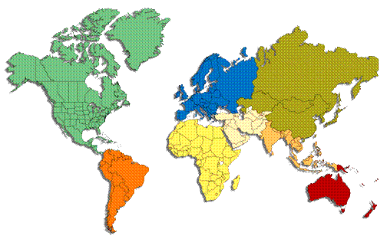
WORLD
GOD’s
5

Slide 6
GENESIS
The seed book of the Bible –
a book of beginnings
Death
Music
Man
Creation
Life
Sabbath Day
Sacrifice
Redemption
Sin
Marriage
Cities
Languages
6

Slide 7
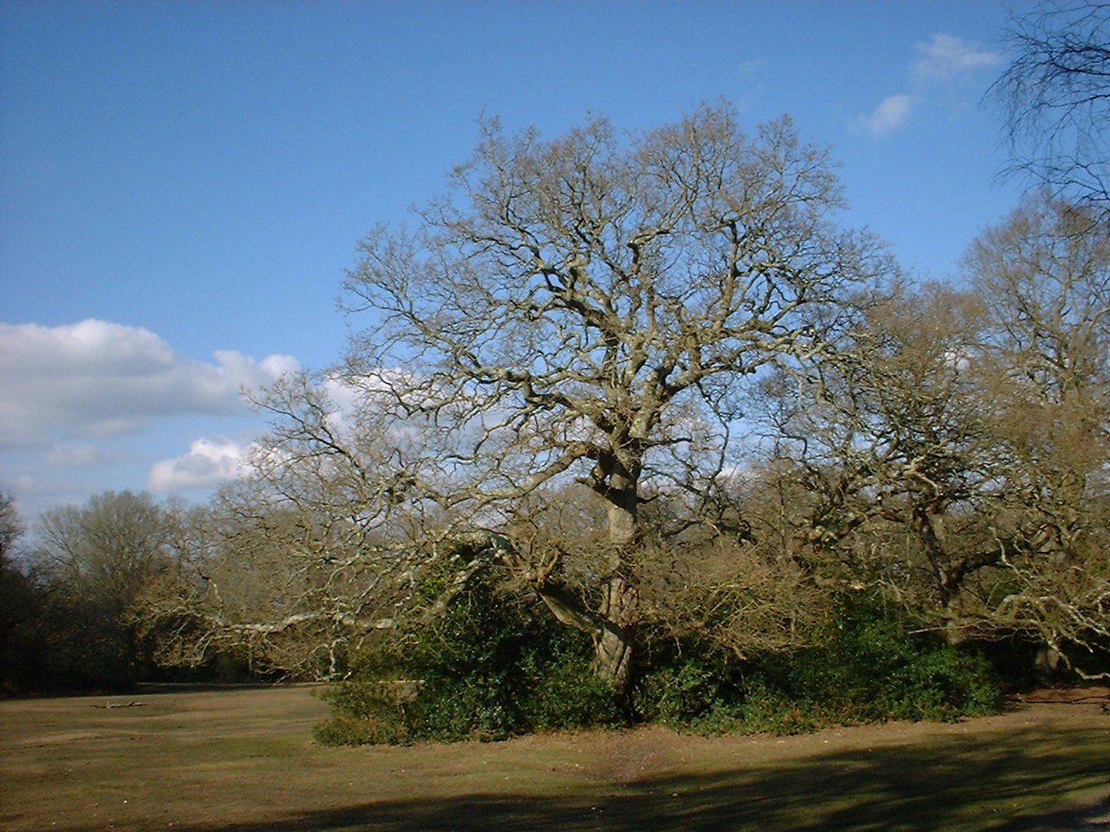
JEW
(Chapter 12)
GENTILE
(Chapter 12)
BABEL
(Chapter 11)
SODOM
(Chapter 19)
GARDEN
(Chapter 3)
FLOOD
(Chapter 7)
MAN – planted by God
7

Slide 8
JEALOUSY
(Chapter 37)
ENVY
(Chapter 37)
GODLESSNESS
(Chapter 19)
DECEIT
(Chapter 27)
MURDER
(Chapter 4)
PRIDE
(Chapter 11)
HATRED
(Chapter 4)
DISOBEDIENCE
(Chapter 3)
LIES
(Chapter 3)
SIN – planted by Satan
8

Slide 9
9
JOSEPH
(Chapter 45)
ISAAC
(Chapter 22)
ARK
(Chapter 7)
EDEN
(Chapter 3)
ABEL
(Chapter 4)
REDEMPTION – planted by God

Slide 10

†
MAN
Redemption planned
in Eternity
Revelation 13 v.8
Redemption’s seed developed into the work of Christ on the Cross
Galatians 3 v.13
10

