Slide 1
The following Biblical presentation is based on notes by the Rev L G Stapleton compiled by Mark Stapleton
© Mark Stapleton 2016
1

Slide 2
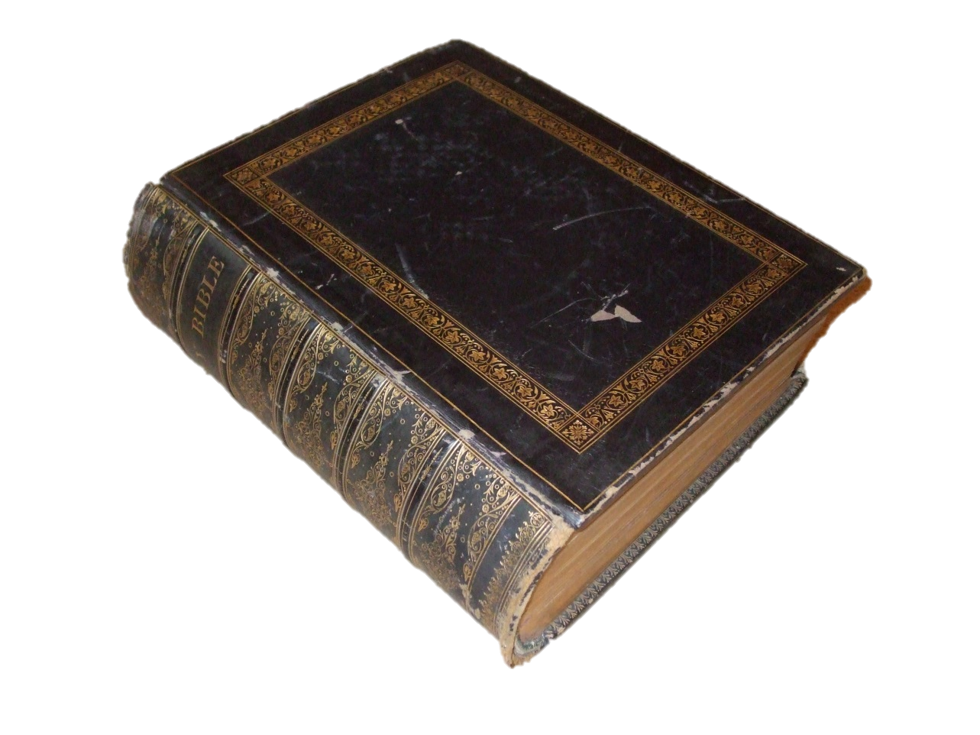
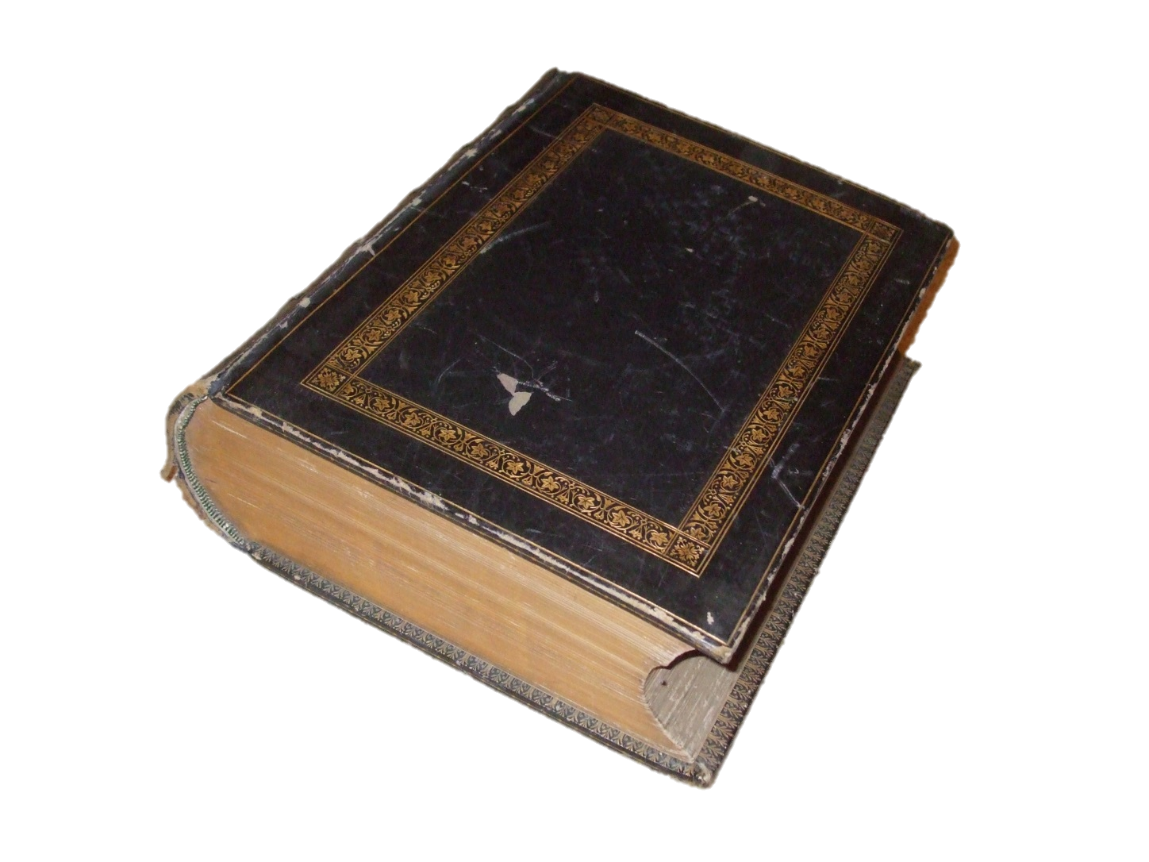
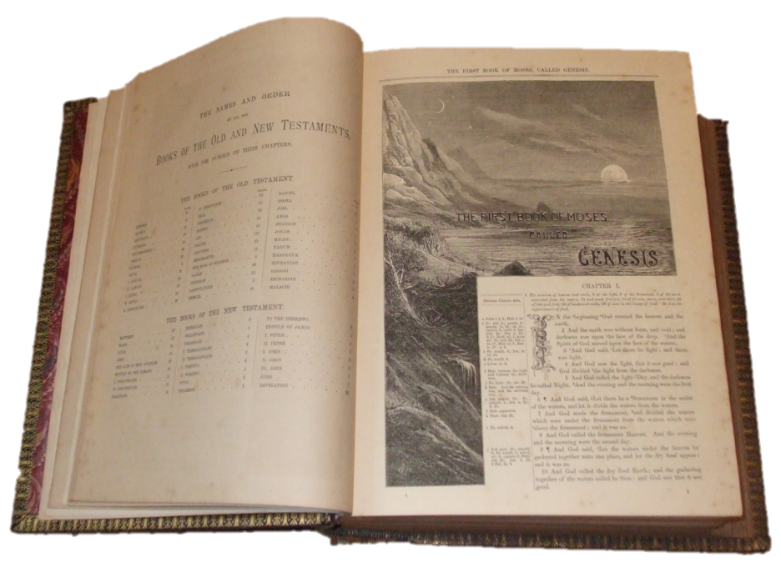
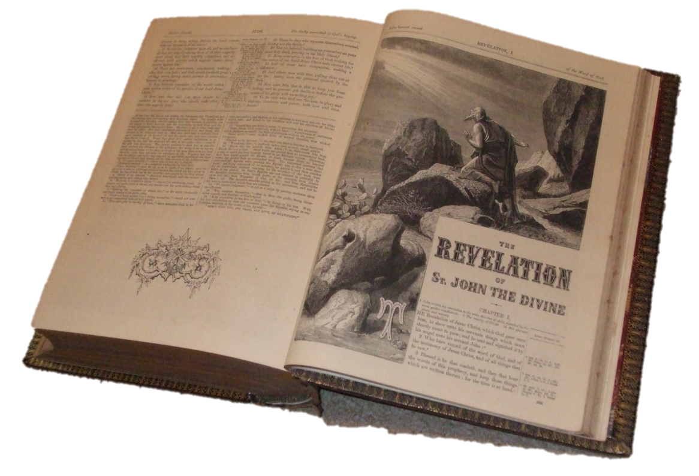
The Bible -
the word of God
Closed?
Open?
2

Slide 3

The Bible
An appalling lack of knowledge of the Word of God, both by the
non-Christian and the Christian, makes the work of those spreading heresy and error so much easier
3

Slide 4
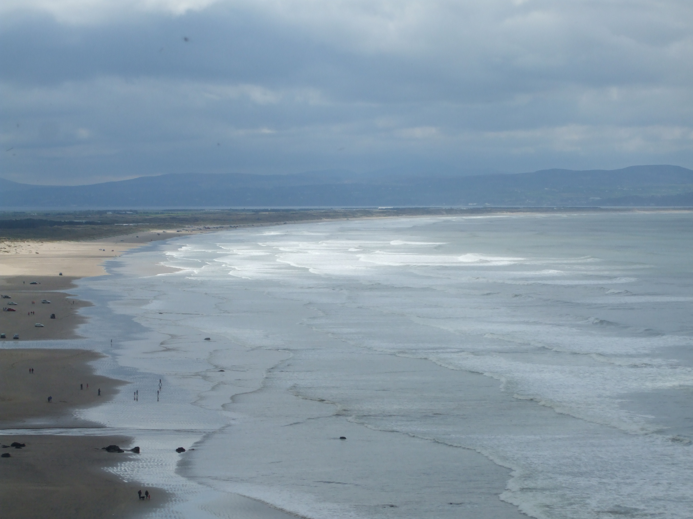
The Bible
is of infinite value
Bible believing Christians assert their belief in its -
Inspiration
Authority
Reliability
4

Slide 5

The Bible
… is a textbook for the Christian
… gives life
1 Peter 1 v.23
… maintains a living faith
… nourishes the Christian life
… is proved as we accept and test it in experience
5

Slide 6
The Bible
…is only rightly understood as it is interpreted by the Holy Spirit
2 Peter 1 v.21
2 Timothy 3 v.15-17
Reverence, and an expectant heart, is needed when studying the Bible, as we look to God to speak to us from it
6

Slide 7

The Bible
is one book
This unity is clearly seen in that -
This fact will -
It bears the marks of ONE
DIVINE
AUTHOR
It consists of 66 individual books
(Old Testament = 39 New Testament = 27)
has many writers - about 40 - and covers many centuries
It has consistent lines of teaching regarding God and His dealings with men
1. Save us many difficulties and doubts
2. Increase our wonder, reverence and love for it
3. Make us all the better able to use it
(Ephesians 6 v.17)
7

Slide 8

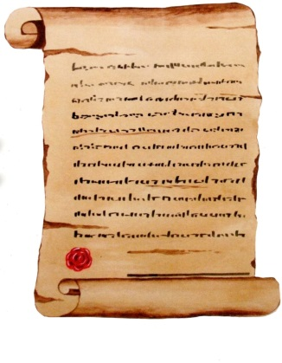
The Bible is the story of two covenants
The Old Testament
God’s dealings with man on the basis of LAW
†
The Life, Death and Resurrection of the Lord Jesus Christ
The New Testament
God’s dealings with man on the basis of GRACE
8

Slide 9

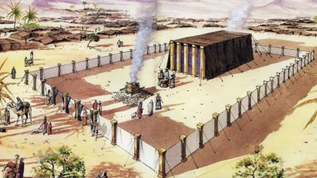
The Bible is the story of two covenants
The Old Testament
To understand the Old Testament you need the Key of the New Testament – Christ Himself
†
The Life, Death and Resurrection of the Lord Jesus Christ
The New Testament
To appreciate the New Testament you need the illustrative background of the Old Testament
9

Slide 10
The Bible is the story of two covenants
The Old Testament
†
The Life, Death and Resurrection of the Lord Jesus Christ
Christ on the Throne
The New Testament
10

Slide 11

The Bible can be divided into 7 groups of books
OLD TESTAMENT (39 books)
THE
PENTATEUCH
Genesis
Exodus
Leviticus
Numbers
Deuteronomy
(5)
POETRY/WISDOM
Job
Psalms
Proverbs
Ecclesiastes
Song of Solomon
(5)
PROPHETS
HISTORY
Isaiah
Jeremiah
Lamentations
Ezekiel
Daniel
Hosea
Joel
Amos
Obadiah
Jonah
Micah
Nahum
Habbakuk
Zephaniah
Haggai
Zechariah
Malachi
(17)
Joshua
Judges
Ruth
1 & 2 Samuel
1 & 2 Kings
1 & 2 Chronicles
Ezra
Nehemiah
Esther
(12)
11
Notes:
Some commentators put some of the writings into the Prophets and vice-versa

Slide 12
The Bible can be divided into 7 groups of books
NEW TESTAMENT (27 books)
THE GOSPELS
and ACTS
Matthew
Mark
Luke
John
Acts
(5)
EPISTLES (LETTERS)
REVELATION
Revelation
(1)
Romans
1 & 2 Corinthians
Galatians
Ephesians
Philippians
Colossians
1 & 2 Thessalonians
1 & 2 Timothy
(21)
Titus
Philemon
Hebrews
James
1 & 2 Peter
1, 2 & 3 John
Jude
12
Notes:
Some commentators put some of the writings into the Prophets and vice-versa

Slide 13

The Bible reveals
The Lord Jesus Christ
He affirms that each division of the Old Testament testifies concerning HIM.
Luke 24 verses 27, 44 are the Key.
This is our authority for viewing the Old Testament as well as the New Testament as the revelation of Christ
The Old Testament pointed forward to Christ because it was inadequate on its own. (Hebrews 10 vs.4)
The Old Testament was fulfilled in every way in Christ Himself
13

Slide 14

The Old Testament
The New Testament is LATENT in the Old Testament; the
Old Testament is PATENT (made obvious) in the
New Testament
The God of the Old Testament is the same God as in
the New Testament
Malachi 3 v.6, Hebrews 13 v.8
It is OLD but not OBSOLETE
(i.e. worn out, discarded)
It is part of the whole Bible:
the Revelation of God to man
14

Slide 15

The Old Testament
A Record of Historical facts -
Concerned with how God dealt with His chosen people (other nations come into the history in so far as they affect Israel’s history)
Much O.T. history has now been crosschecked by archaelogical evidence
Time is often passed over when God’s people are in subjection e.g. –Judges 3 vs.8, 13; 6 v.1
15

Slide 16

The Old Testament
Prophetic utterances fulfilled
For example:
70 years captivity – Jeremiah 29: 10; 32: 11
Birth of Christ – Isaiah 7 v.14; 9 v. 6
Place of Christ’s birth – Micah 5 v. 2
The suffering Messiah – Isaiah 53
16

Slide 17

The Old Testament
Spiritual illustrations
(God’s unchanging principles)
The Flood = Judgement on a godless world
Tower of Babel = Man’s efforts
without God
Brazen Serpent = Life offered from God
Red Sea Crossing = Redemption
by power
Hosea = God’s undying love for His own
Passover Lamb = Redemption by blood
The Captivity = Judgement on a
disobedient people
Isaiah = God’s unapproachable Holiness
17

Slide 18

The Old Testament
Its Divine Authority
The dominant note of the prophets was – “Thus saith the LORD” (Jeremiah 37: 7). Note the tragic sense of bewilderment when it was not heard (Jeremiah 37: 17, Amos 5: 11-12)
Earlier, the Lawgivers’s demands had been summed up in the Ten Commandments (Exodus chapter 20).
The O.T was the reference book of the Lord Jesus Christ, of Peter, of Paul etc.
(Luke 4: 7-9, 24: 44; Acts 2: 16, 2: 34-35;
Galatians 3: 16; Hebrews 1: 5; Isaiah 61: 1-2).
18

Slide 19
God’s
Wonderful
Word
19

